Slide 1


Expert-System
Bar Recommender
Isti
Tomi
Gábor
Kristóf

Slide 2

Bars & questions
    Existing bars
    Straight forward questions
    Only for REAL MAN

Slide 3

Plans
    Working code
    Working github
    Equal teamwork
    Make it simple

Slide 4
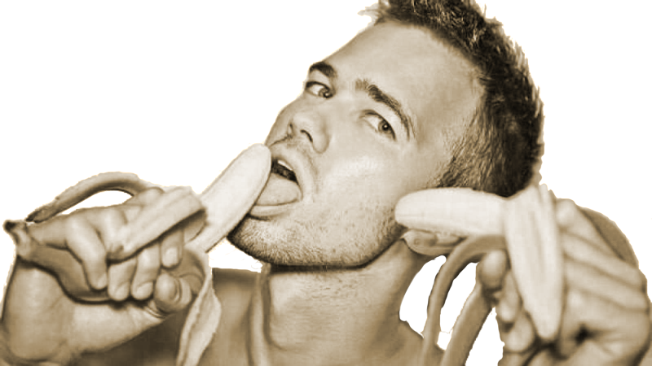
Struggles
    .idea/workspace.xml
    Understand the UML Diagram
    Understanding the descrtiption

Slide 5

Results
    Our program fulfills the demand for the special bar database
    Clear output
    Lightning fast processing
    Reading Data from XML file dynamically

