Slide 1







Schedule Master 20001
By: mingyacomming
Dominik
Norbi
Gabi
Kristóf

Slide 2

Planning
Loads of good material
  Finish previous tasks
  New Task Logging
  Guest Links
  Admin panel

Slide 3


Workflow
- Dynamic Proactive Squad
- Daily Stand Downs
- Dominik’s Code review
- Such effective, So qualified, Very extreme, So experienced

Slide 4
What we achieved
  FX level JavaScript
  Working editing
  Guest links
  Refactor
  Different permissions
  Logger (on 5lvl)

Slide 5
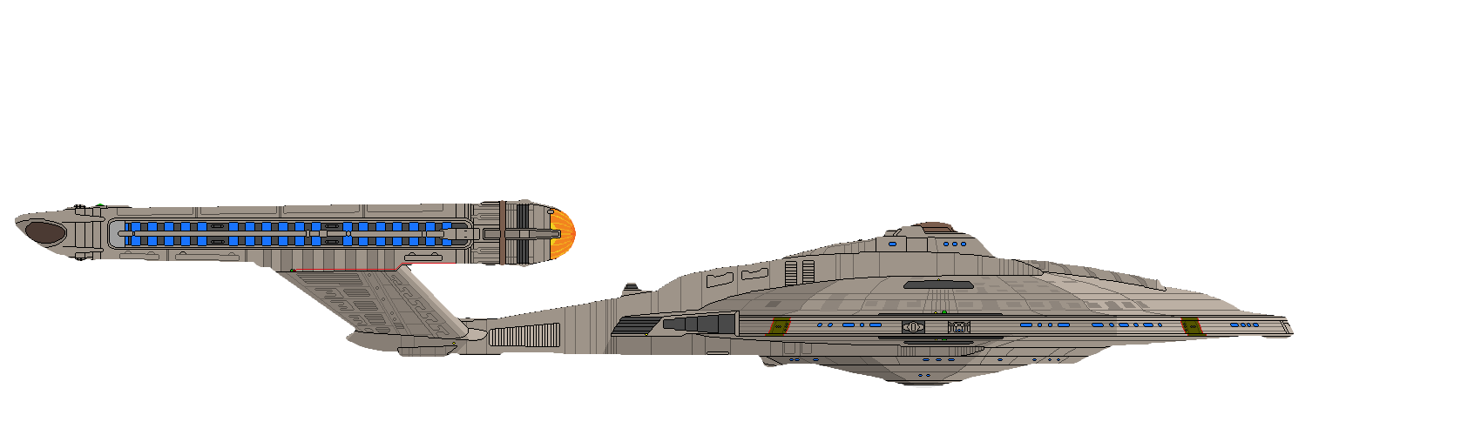
Future Plans
UI Optimization
Implement the rewarding system
Don’t fail the PA

