Slide 1




Schedule Master 20000
By: mingyacomming
Dominik
Norbi
Gabi
Kristauf

Slide 2

Planning
Loads of good material
  Szuri
  Zombies
  Space ship
  Last but least Schedule System

Slide 3
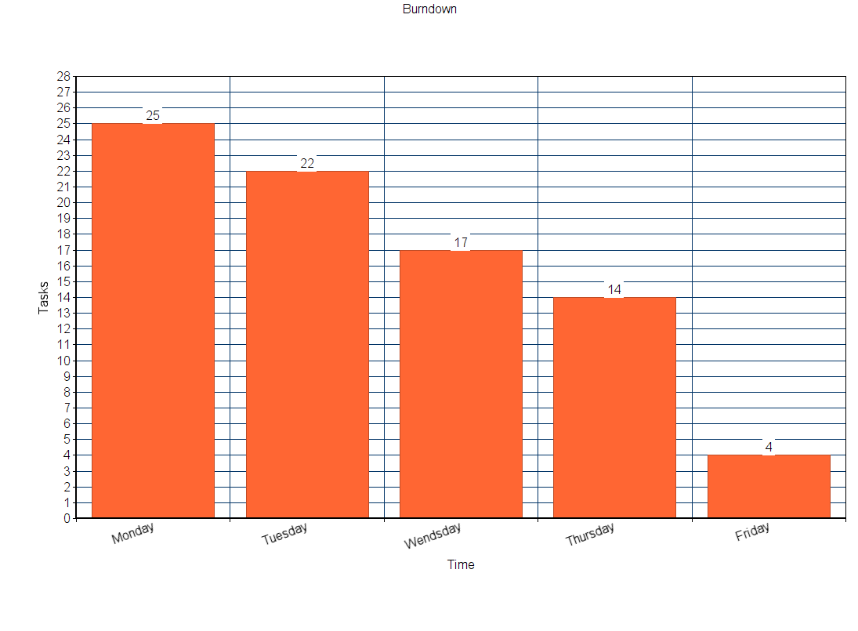

Slide 4


Workflow
- Dynamic resource management
- Single/Pair/Quad programming
- Daily Sit Downs (Norbi állt)
- Dominik’s Code review
- Such JavaScript, So JSON, Very Java, So SQL

Slide 5

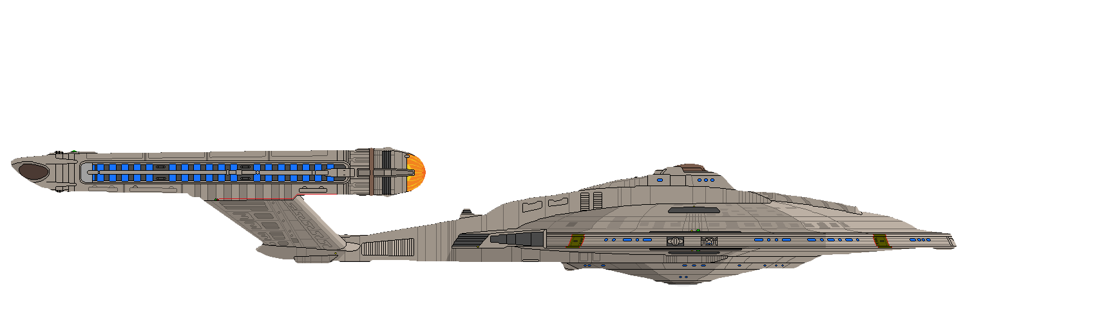
Future Plans
Finish the Tasks
Implement the rewarding system
Learn more – Inifinite knownledge

