Slide 1

Data-Driven Relative Value Intelligence for MCX Gold Futures
COMMODITY DERIVATIVES INTELLIGENCE
Problem Statement –PS-03: Commodity Derivatives
Focus – MCX Gold Futures Cross-Contract Relative Value Analysis
Theme – Quantitative Finance / Data Analytics / FinTech
Category –Data Product / Software
Team –
Team Name – [YOUR TEAM NAME]

Slide 2
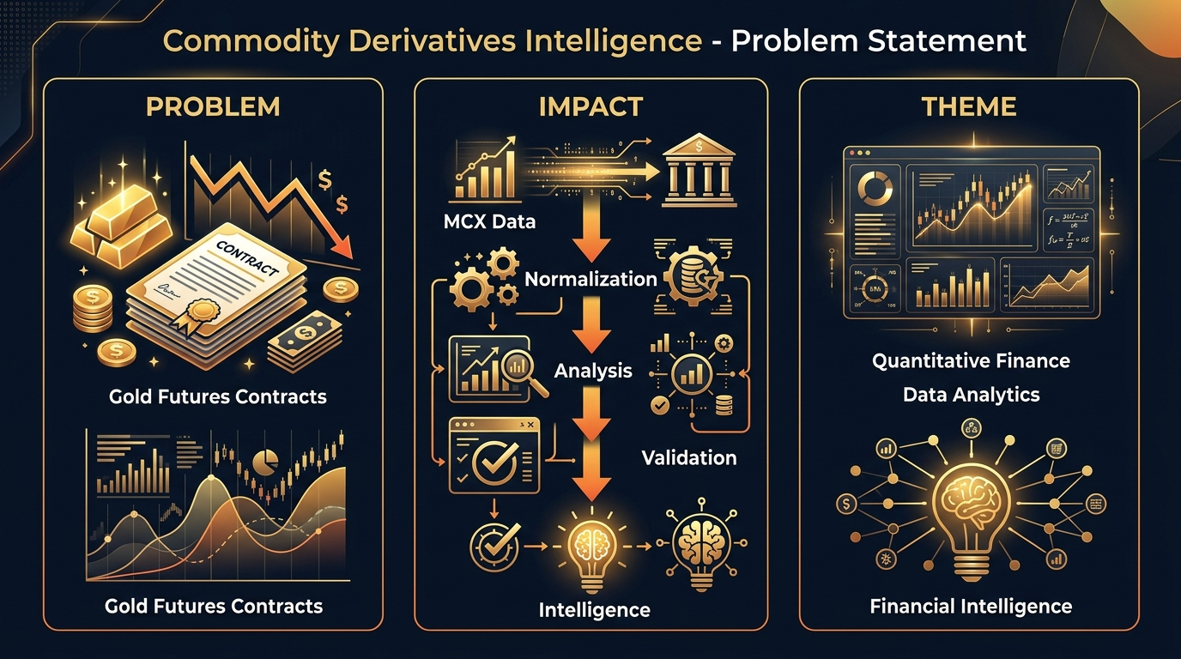
PROBLEM STATEMENT
[YOUR TEAM NAME]
PROBLEM
MCX offers multiple gold futures contracts:
GOLDM • GOLDTEN • GOLDGUINEA • GOLDPETAL
Prices cannot be directly compared due to:
Contract size, quotation basis, gold purity
Expiry and liquidity differences
IMPACT
Raw prices create misleading comparisons
MCX Data → Normalization → Relative Analysis → Validation → Market Intelligence
THEME ALIGNMENT
Quantitative Finance + Data Analytics + Financial Intelligence
Normalized analytics • Relative-value analysis • Statistical signals • Backtested insights

Slide 3
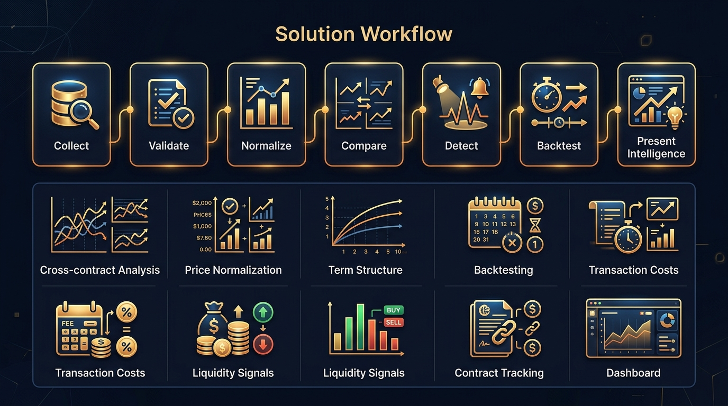
SOLUTION
[YOUR TEAM NAME]
SOLUTION OVERVIEW
A contract-aware quantitative intelligence platform that transforms MCX gold futures data into:
Normalized cross-contract analytics
Relative-value signals
Validated market insights
CORE WORKFLOW
1. Collect MCX data
2. Validate and clean
3. Normalize contracts
4. Compare relative prices
5. Detect unusual deviations
6. Backtest historically
7. Present actionable intelligence
UNIQUE VALUE: Tests whether relative-price relationships remain meaningful after costs, liquidity, expiry and historical behavior.

Slide 4
ARCHITECTURE
[YOUR TEAM NAME]
DATA PIPELINE
MCX Daily Bhavcopy
↓
Data Ingestion
↓
Validation & Cleaning
↓
Contract Identification
↓
Price Normalization
↓
Relative Value Engine
↓
Walk-Forward Backtesting
↓
Web Dashboard
FRONTEND
React • TypeScript • Recharts/ECharts
ANALYTICS
Pandas • NumPy • SciPy
BACKEND
Python • FastAPI
STORAGE
PostgreSQL / SQLite
⚠ IMPORTANT: Track contracts by expiry date, not continuous near-month series. Avoids artificial price jumps from rollover.
DATA SOURCE
MCX Daily Bhavcopy — Publicly available, no API key required

Slide 5
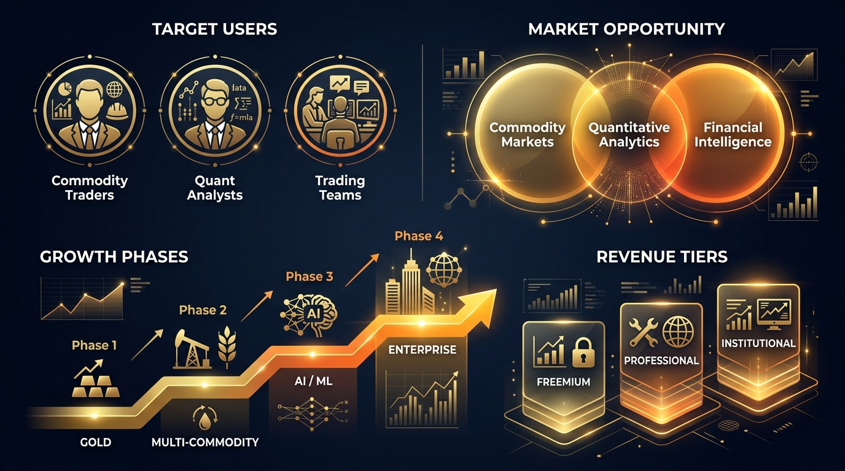
MARKET RESEARCH
[YOUR TEAM NAME]
TARGET USERS
Primary: Commodity traders, quantitative analysts, proprietary trading teams
Secondary: Financial institutions, FinTech companies, market-data platforms
MARKET OPPORTUNITY
Commodity Markets + Quantitative Analytics + Financial Intelligence
Initial focus: MCX Gold → Silver → Base Metals → Energy → Multi-Commodity
REVENUE MODEL
Freemium — Basic analytics, limited history
Professional — Advanced analytics, backtesting, alerts
Institutional — APIs, custom analytics, enterprise dashboards

Slide 6
FUTURE SCOPE
[YOUR TEAM NAME]
1. MOBILE / REAL-TIME DEPLOYMENT
Mobile dashboard
Real-time monitoring
Push alerts
Mobile-friendly analytics
2. AI / ML MODEL IMPROVEMENT
Regime detection
Adaptive thresholds
Anomaly detection
Explainable predictive analytics
3. ENTERPRISE INTEGRATIONS
REST APIs
Institutional dashboards
Data exports
Broker/platform integrations
4. SCALING TO GLOBAL USERS
Additional commodities
Other commodity exchanges
International market analytics
Multi-market intelligence

Slide 7
WHY OUR ANALYSIS IS DEFENSIBLE
[YOUR TEAM NAME]
CONTRACT-AWARE
Track each contract using its actual expiry
NORMALIZED
Account for contract size, quotation basis and purity
NO LOOK-AHEAD BIAS
Historical testing uses only info available at that time
COST-AWARE
Consider transaction costs and execution limitations
LIQUIDITY-AWARE
Volume is not automatically treated as market depth
SIGNAL DISCIPLINE
Deviations are not automatically trading opportunities
VALIDATION FIRST
Use unseen data and walk-forward testing
NEGATIVE RESULTS ARE VALID
If an edge disappears after costs, report that result
Normalized Price → Spread → Statistical Deviation → Backtest → Validation

Slide 8
[YOUR TEAM NAME]
THANK YOU
COMMODITY DERIVATIVES INTELLIGENCE
From Exchange Data to Defensible Market Intelligence
Team: [YOUR TEAM NAME]
[DEMO URL] • [EMAIL] • [GITHUB]

