Slide 1

PHILLY 311 DASHBOARD
By Hackadashery

Slide 2

THE HACKADASHERY TEAM
Akim Akimov – Data Science
Kurt Esposito - UX
Julie Lazarus – UX + Design
Iain McCallum – Front End
Adrienne McDonnell – Front End + GIS
Angela Minster – Data Science

Slide 3
PHILLY 311 DASHBOARD
Primary Goal:
Connect residents with 311 data
Secondary goal:
Provide a place to explore 311 data and understand its benefits to the community
Notes:
Give verbal examples of each

Slide 4
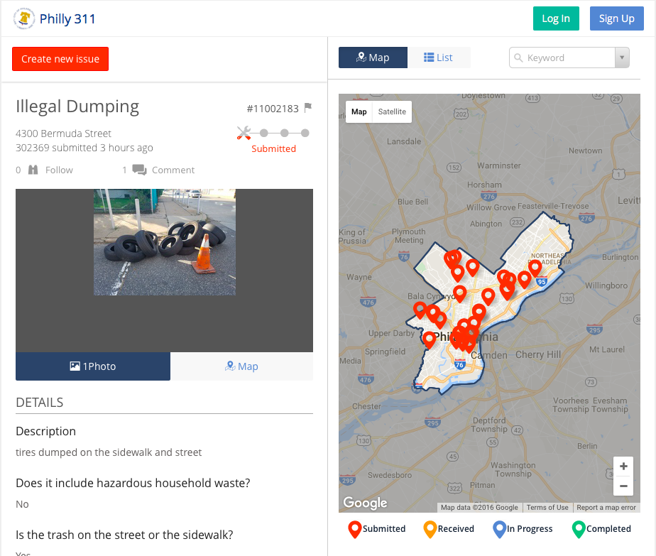
Notes:
This is the current 311 resources page. Discuss Pros an Cons and what we want to change with our page.

Slide 5
OUR PROCESS TO A SOLUTION
Hackathon weekend: laying the groundwork
Meeting with stakeholders
Weekly Hackadashery meetings

Slide 6
Our solution (so far)…
https://hackadashery.github.io/

Slide 7
STEPS TO FINISH
Phase 1:
About section
Connecting to pre-analyzed data with regular updates
User testing
Phase 2:
Alerts & Important Trends
Building out the explore and about sections

