Slide 1

Cyberbullying Detection
Using RNN and hybrid LSTM

Slide 2
Introduction
Cyberbullying is a serious issue that can have devastating effects on victims. Traditional methods of detection often fall short, especially when dealing with subtle forms of cyberbullying. Deep learning techniques, such as Recurrent Neural Networks (RNNs) and hybrid models combining RNNs and Convolutional Neural Networks (CNNs), offer a promising solution. These models can analyze text data, identify patterns, and accurately classify content as cyberbullying or non-cyberbullying. By leveraging the power of deep learning, we can create safer online environments and protect individuals from the harmful effects of cyberbullying.

Slide 3
Milestone 1
Data Collection: web scraping
Social media platforms used : Youtube
Link - https://youtu.be/YgQy70_LPS4?si=aR3qko1M_niA8VAN
Data Preprocessing
Class labelling
Text Cleaning - normalized text(convert to lower case, stemming)
Removing contractions and punctuations
Tokenization – Breaking text into tokens
Stop words Removal(e.g: is,the,and,of etc.)
Data Splitting(Divide the dataset into training, validation, and testing sets.)
By leveraging web scraping and advanced text preprocessing techniques, we can effectively collect and prepare a robust dataset for training our cyberbullying detection model.

Slide 4
Milestone 2
Implementing Traditional ML models:
Logistic Regression
Text preprocessing-Convert text data into numerical features (e.g., TF-IDF, bag-of-words).
Model Training-Train a logistic regression model to classify text as cyberbullying or non-cyberbullying.
Random Forest Classifier
Text preprocessing- similar to Logistic regression
Model Training- Train a random forest classifier to classify text.
Performance
Evaluate model performance using metrics like accuracy, precision, recall, and F1-score.
Use confusion matrices to visualize classification results.

Slide 5
Milestone 3
In this milestone, we explored advanced models beyond traditional machine-learning approaches. Specifically, we implemented Recurrent Neural Networks (RNN) and Long Short-Term Memory Networks (LSTM) to achieve more accurate results in our classification task.
The implementation of the RNN model yielded the highest accuracy of 83%, showcasing its effectiveness in capturing sequential patterns. Similarly, the LSTM model, known for its ability to handle long-term dependencies in data, also achieved a peak accuracy of 83%.
Additionally, we successfully integrated the trained model with a user-friendly front-end interface using Flask, enabling seamless interaction and real-time predictions. This milestone marks significant progress toward building a robust and accessible classification solution.

Slide 6
WEB SCRAPING
Web scraping is the process of using automated tools or scripts to extract specific data from websites. It involves sending requests to web servers, receiving HTML responses, parsing the content, and extracting information based on HTML tags or patterns. This data is stored in a structured format for easy analysis. Web scraping is widely used in fields like market research, price monitoring, news aggregation, and social media tracking.
Sending a Request: The scraper first sends a request to the website's server for a specific webpage (usually an HTTP GET request).
Retrieving the HTML: If the request is successful, the server responds with the HTML content of the webpage.
Parsing the HTML: The scraper then processes the HTML to locate and extract specific information. It involves identifying particular HTML tags, classes, IDs, or other elements that contain the desired data.
Extracting and Storing Data: Once the information is identified, it’s extracted, transformed as needed, and stored in a structured format like CSV, Excel, or a database for easy access and analysis.
Pre-processing:
Pre-processing cleans and structures raw data for analysis by removing irrelevant symbols, correcting errors, and handling missing values. It ensures consistency and reduces noise, which is essential for accurate results. Missing data can be imputed, flagged, or removed depending on its relevance. Pre-processing transforms messy data into a reliable, usable format, improving the quality and performance of machine learning models or analytical tools.
Text Normalization:
Text normalization standardizes text data for analysis in natural language processing. It includes converting text to lowercase, removing stop words (like "the" or "is") that add little value, stripping punctuation, and applying lemmatization to reduce words to their root forms. This process ensures consistency, reduces redundancy, and focuses on the most meaningful parts of the text, enabling more accurate analysis and machine learning results.

Slide 7
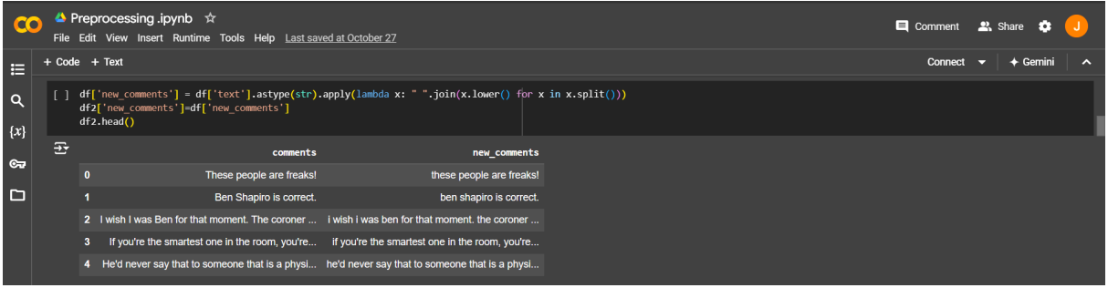
Tokenization and Text Conversion
Tokenization converts text into smaller units, typically words or sub-words, to help the model understand the input text. This is necessary for processing text data in machine learning models.
Why Tokenization? Cyberbullying detection requires analyzing the semantics and context of sentences. Breaking down text into tokens allows the model to handle each word as a meaningful unit.
Converts text to lowercase, making it easier to work with consistently.
Tokenization happens here indirectly: the text is split by whitespace (via split()) and joined back together, giving us lowercase tokens without changing word order.

Slide 8
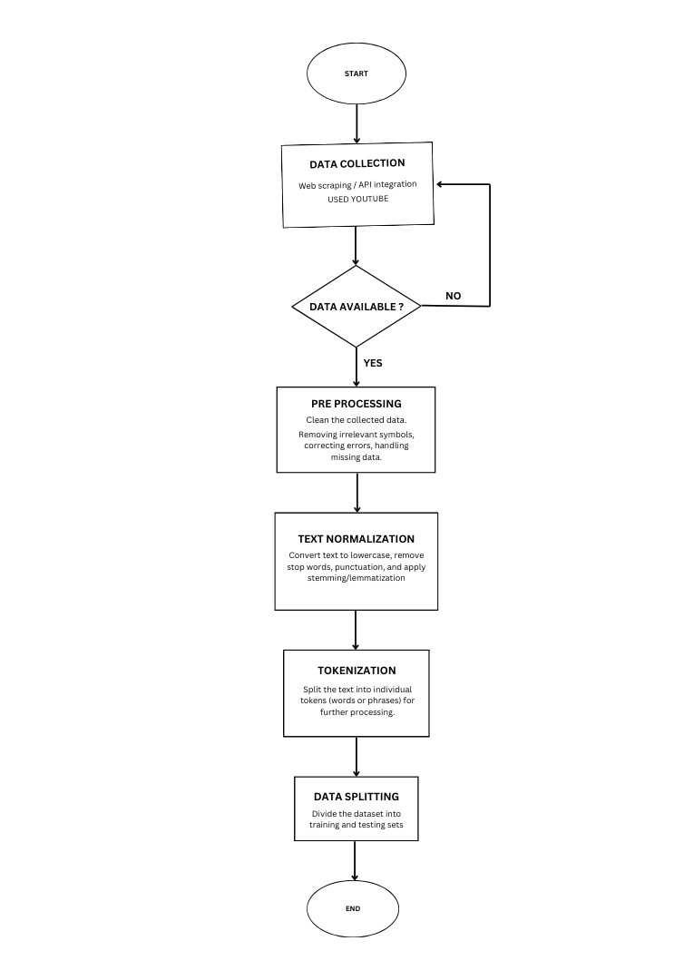
Flow chart

Slide 9
ACCURACY RATE
LOGISTIC REGRESSION:
For test size 0.2 : 70.70 %
For test size 0.25 : 70.45 %
For test size 0.3 : 69.36 %
For test size 0.33 : 68.50
RANDOM FOREST REGRESSION
For test size 0.2 : 68.68 %
For test size 0.25 : 68.01 %
For test size 0.3 : 70.03 %
For test size 0.33 : 71.25 %
NAÏVE BAYERS CLASSIFIER:
For test size 0.2 : 62.94 %
For test size 0.25 : 63.82 %
For test size 0.3 : 64.74 %
For test size 0.33 : 65.74%

Slide 10
ACCURACY RATE
DECISION TREE CLASSIFIER:
For test size 0.2 : 61.92 %
For test size 0.25 : 60.56 %
For test size 0.3 : 61.35 %
For test size 0.33 : 62.96%
SUPPORT VECTOR MACHINE
For test size 0.2 : 61.92 %
For test size 0.25 : 60.56%
For test size 0.3 : 61.35 %
For test size 0.33 : 62.96 %
K-NEAREST NEIGHBOUR(KNN):
For test size 0.2 : 65.98 %
For test size 0.25 : 67.07 %
For test size 0.3 : 67.11 %
For test size 0.33 : 69.44%

Slide 11
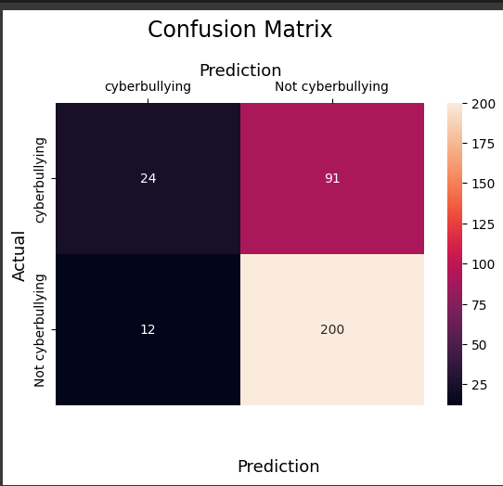
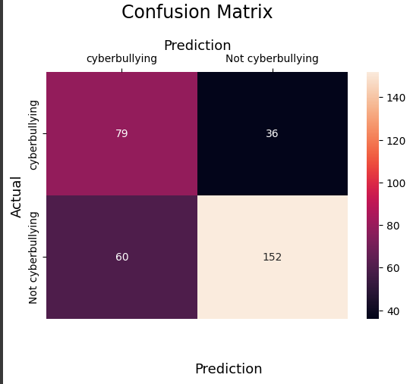
Confusion Matrix
Logistic Regression Radom forest classifier

Slide 12
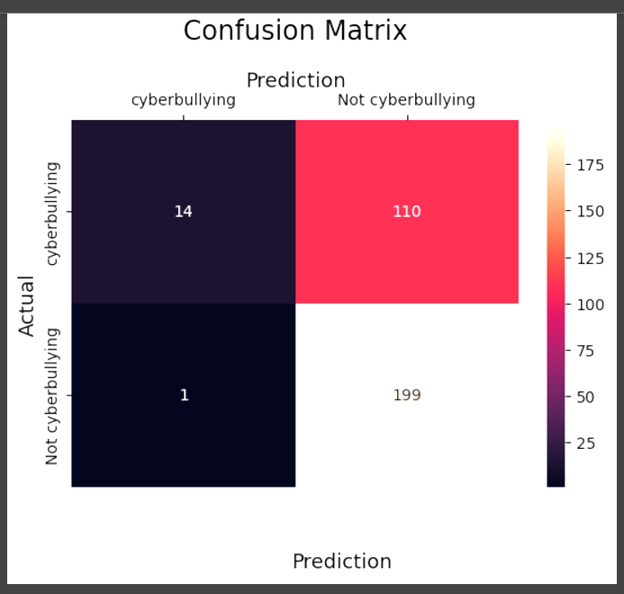
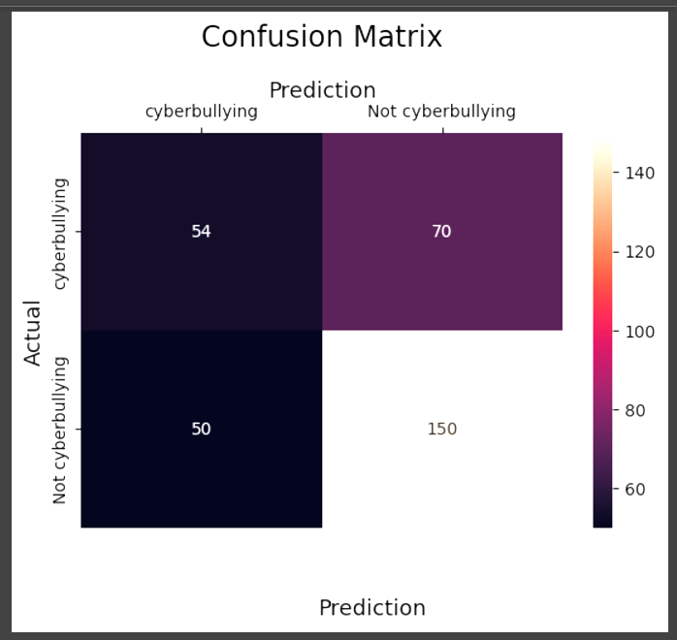
Confusion Matrix
NAÏVE BAYERS CLASSIFIER DECISION TREE CLASSIFIER:

Slide 13
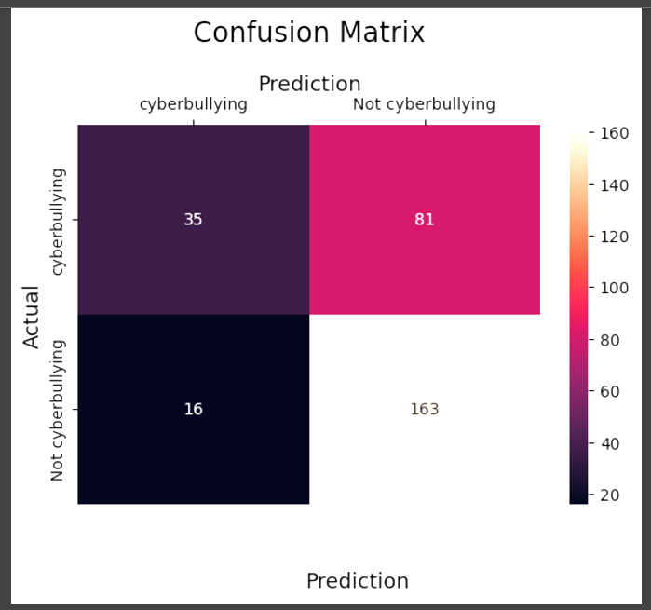
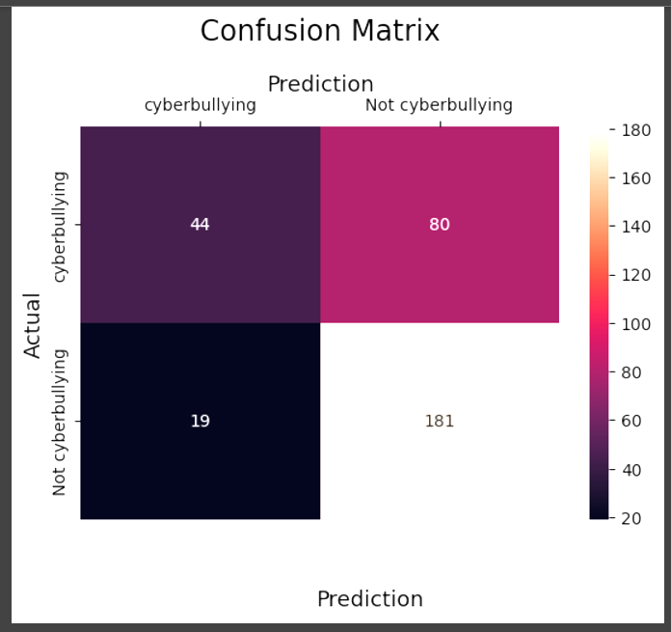
Confusion Matrix
Support Vector Machine K-Nearest Neighbour(KNN)

Slide 14
Recurrent Neural Network
A Recurrent Neural Network (RNN) is a type of artificial neural network designed for processing sequential data. Unlike traditional feedforward neural networks, RNNs have connections that form cycles, enabling them to maintain a "memory" of previous inputs and capture temporal dependencies. This makes them well-suited for tasks where the order or context of data matters.

Slide 15
Advantages Of RNN 1. Sequence Handling: RNNs are explicitly designed to handle sequential data, such as time-series data, speech, and text, making them well-suited for applications like language modeling and speech recognition. 2. Contextual Memory: RNNs maintain a hidden state that carries information from previous steps in the sequence, enabling them to remember and process contextual information over time.

Slide 16
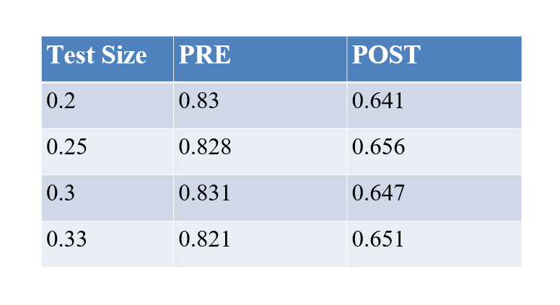
Accuracy For RNN

Slide 17
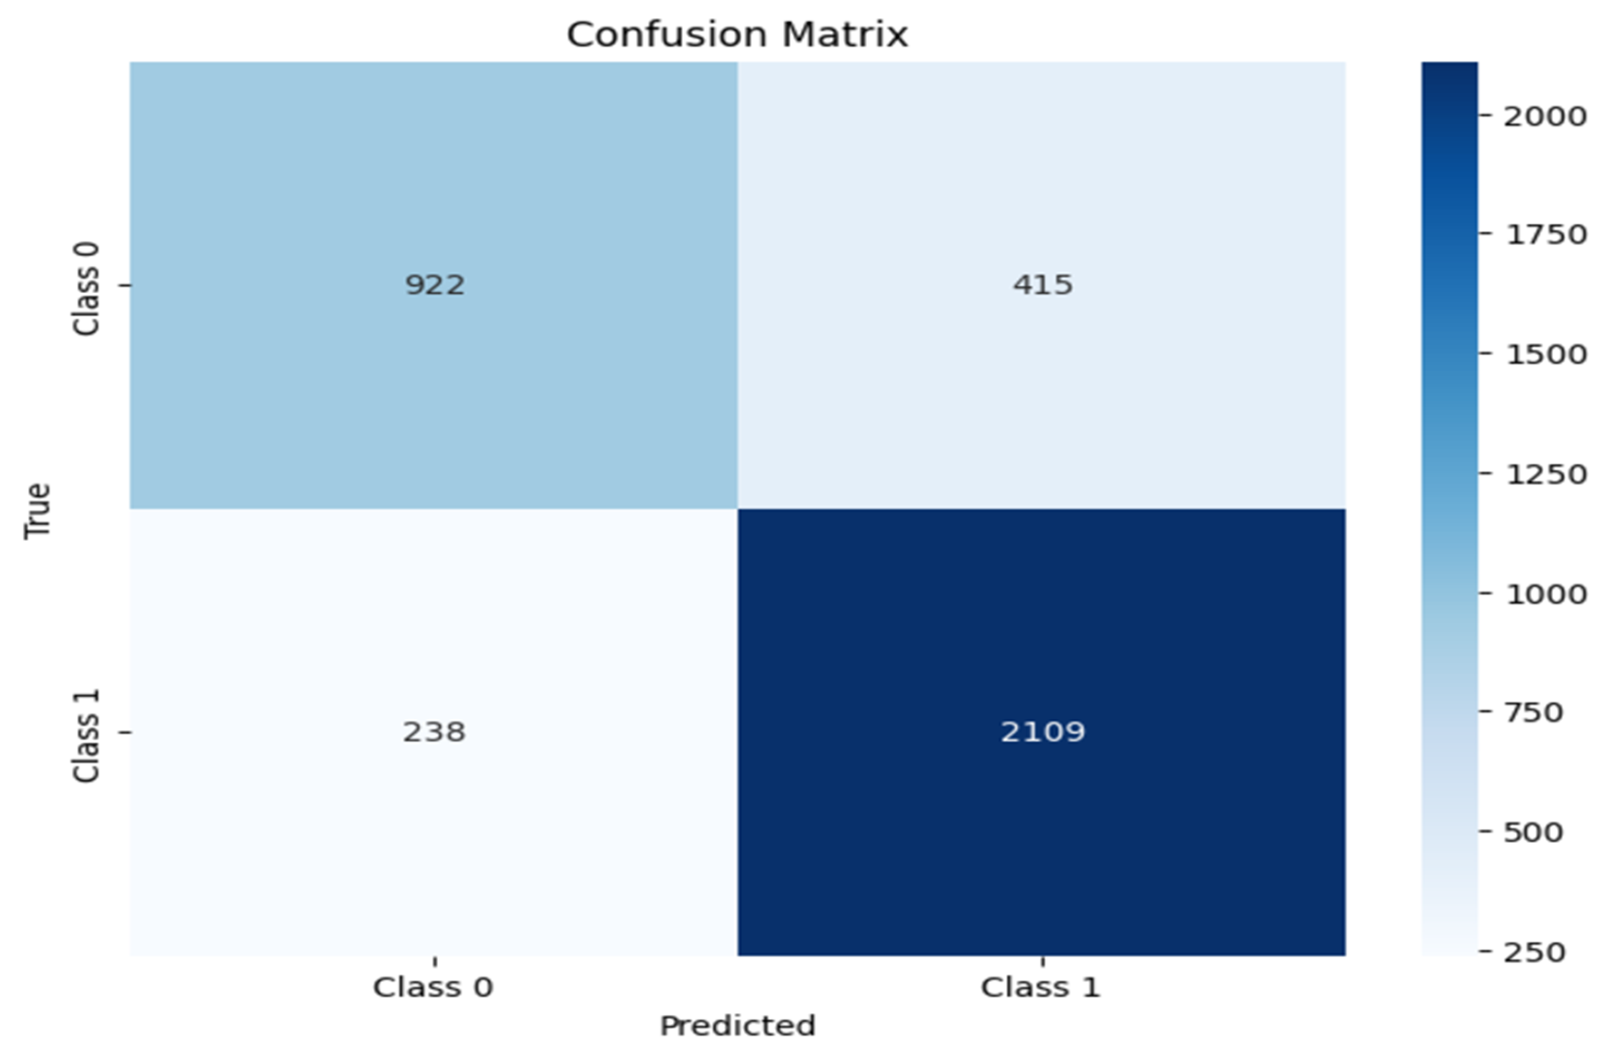
Confusion Matrix for
Recurrent Neural Network

Slide 18
Long Short-Term Memory (LSTM)
Long Short-Term Memory (LSTM) is a specialized Recurrent Neural Network (RNN) designed to handle the vanishing gradient problem, allowing it to learn and retain long-term dependencies in sequential data. It achieves this through a more sophisticated structure that includes memory cells and gates, which control the flow of information.

Slide 19
Advantages Of LSTM 1. Effective Long-Term Dependency Learning LSTMs can capture long-term dependencies in sequential data due to their gated structure, which helps retain important information over extended sequences while forgetting irrelevant data. 2. Prevention of Vanishing/Exploding Gradients The gating mechanisms in LSTMs mitigate the problem of vanishing or exploding gradients during backpropagation, enabling the network to learn from longer sequences effectively.

Slide 20
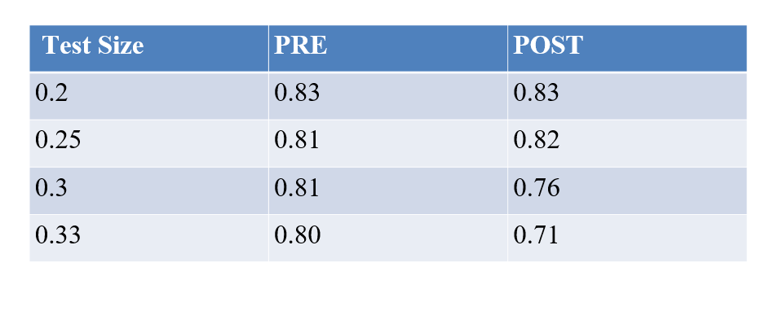
Accuracy For LSTM

Slide 21
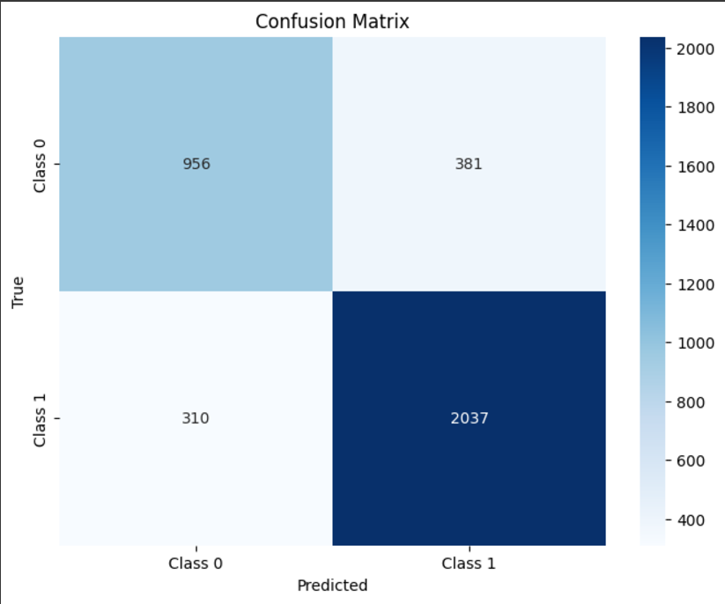
Confusion Matrix for LSTM

Slide 22
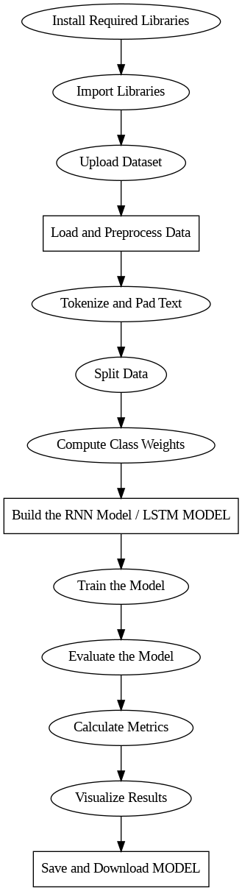
FLOWCHART

Slide 23
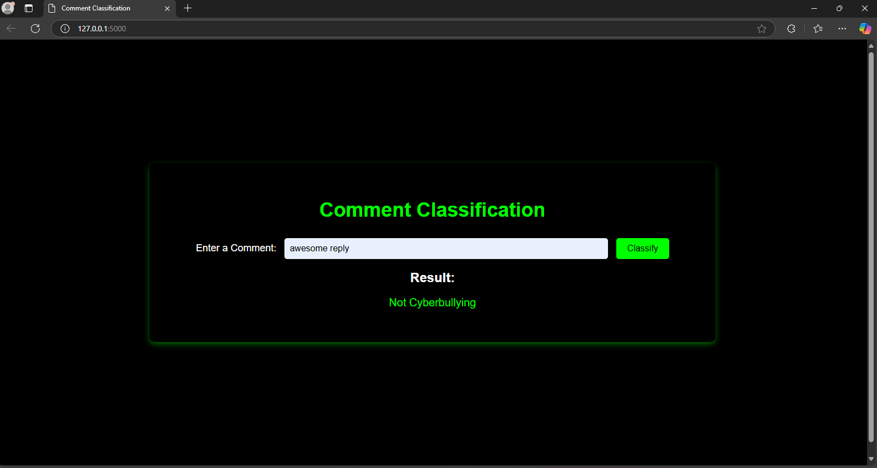
Frontend
Model Predicting as Not CyberBullying

Slide 24
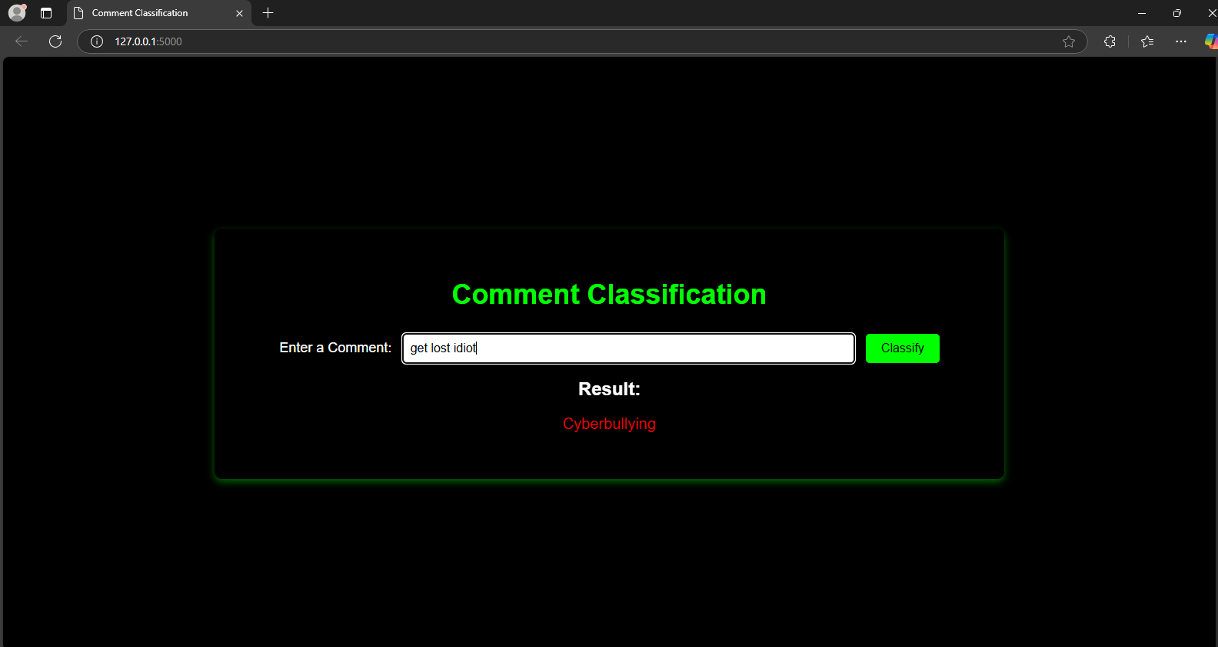
Frontend
Model Predicting as CyberBullying

Slide 25
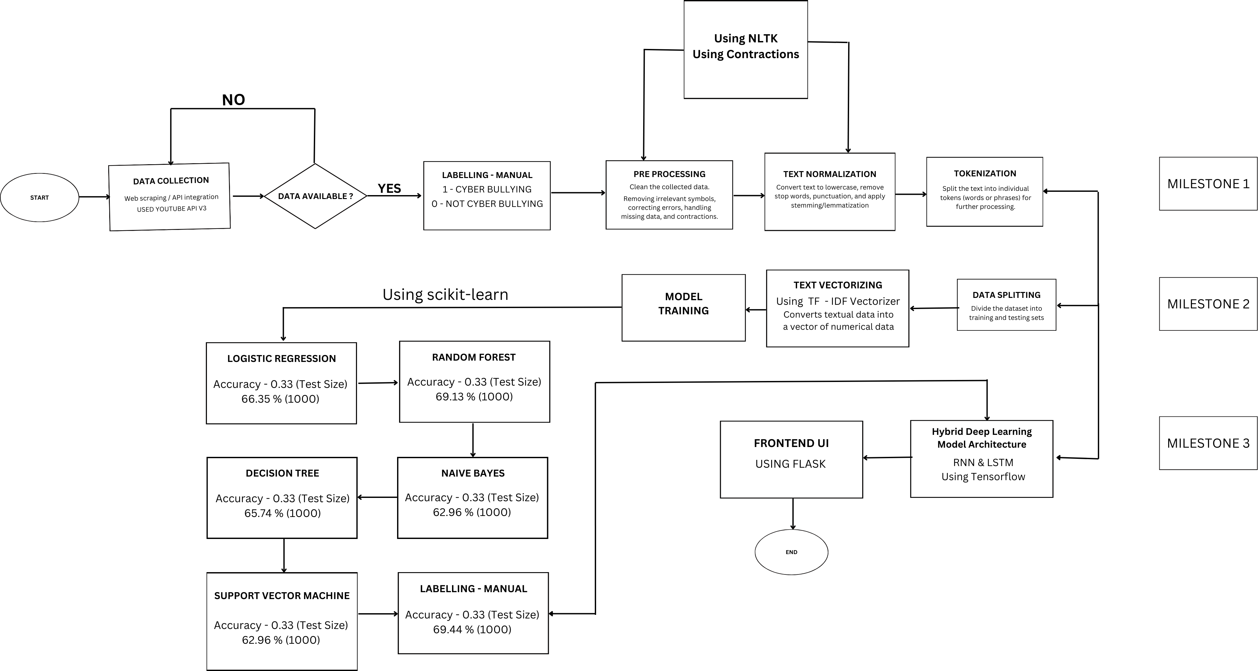
Flow Chart

Slide 26
Conclusion
Cyberbullying, a pervasive issue in the digital age, poses significant threats to individuals, especially adolescents. Traditional methods often struggle to detect subtle forms of cyberbullying.
Deep learning, particularly Recurrent Neural Networks (RNNs) and hybrid models combining RNNs and Convolutional Neural Networks (CNNs), offer a promising solution. RNNs effectively capture long-term dependencies within text, while CNNs extract local features. These hybrid models can accurately identify cyberbullying patterns, even in complex and evolving online interactions.
By training these models on large datasets and fine-tuning their hyperparameters, we can achieve state-of-the-art performance in cyberbullying detection. This enables us to create safer online environments and protect individuals from the harmful effects of cyberbullying.

Slide 27
Team Members
Janvi Singh
Praneetha Sai
Dona Krishna sai
Ayush Srivastava
Kalpesh Mahajan

