Slide 1
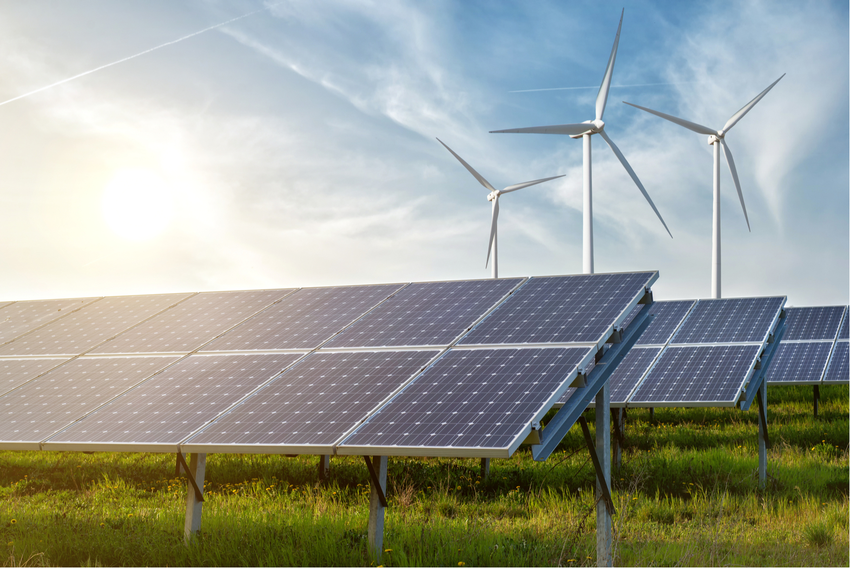
Where are ideal locations for Green-Energy?

Slide 2
Where are ideal locations for Green-Energy?
Analyse wind and solar data
Look at legal requirements as well as meterological data (wind speeds, sunlight hours, etc.) and consisting infrastructure (high voltage lines)
Show these locations a map (Highlight the best locations with a colour-ranking)
Optional: Calculate the amout energy that can be produced at a specific location
Optional: Calculate the break even-point
→ Goal: Recommend ideal locations for solar or wind parks

