Slide 1

SMS SPAM CLASSIFIER
Group no. 33
Priyanka(B21212) Prajwal Erappa (B21258)
Kumar Love (B21301) Vasu Jain (B21233)
Neha N (B21109) Srijan (B21227)

Slide 2

PROBLEM STATEMENT
We are required to predict whether the input SMS is spam or not.
The given dataset has two attributes and approximately 5600 records.
The two attributes are a message and an associated label (spam or ham).
Then, using classification techniques, prediction of the SMS as spam is done.

Slide 3
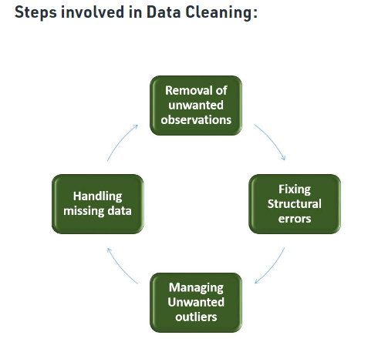
DATA CLEANING
Data cleaning is the process of fixing or removing incorrect, corrupted, incorrectly formatted, duplicate, or incomplete data within a dataset. When combining multiple data sources, there are many opportunities for data to be duplicated or mislabeled. It plays a significant part in building a model.

Slide 4

EXPLORATORY DATA ANALYSIS
Data analysis involving visual methods is called exploratory data analysis (EDA). With the use of statistical overviews and graphical representations, it is used to identify trends, patterns, or to verify assumptions.

Slide 5
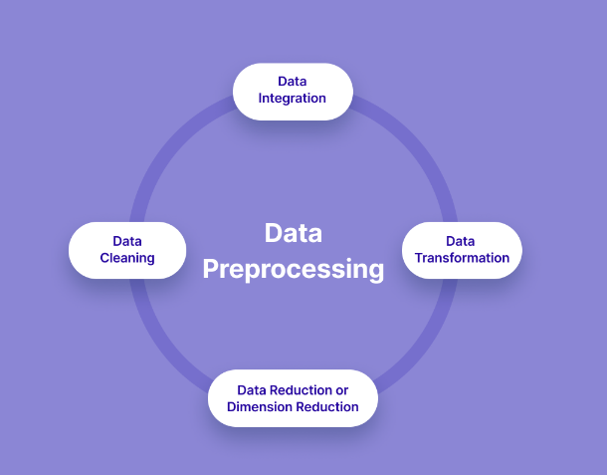
DATA PREPROCESSING
Data preprocessing is a data mining technique which is used to transform the raw data in a useful and efficient format. It has traditionally been an important preliminary step for the data mining process. More recently, data preprocessing techniques have been adapted for training machine learning models and AI models and for running inferences against them.

Slide 6

LEMMATIZATION
Lemmatization is a text normalization technique used in Natural Language Processing (NLP), that switches any kind of a word to its base root mode.
Lemmatization uses the context in which the word is being used.
For example:
Caring -> Care
Better -> Good

Slide 7
MODEL BUILDING
The data is trained using Support Vector Classifier, KNN Classifier, Random Forest Classifier, Extra Tree Classifier, Naïve bayes, XGB classifier
The model having highest accuracy is considered for prediction

Slide 8
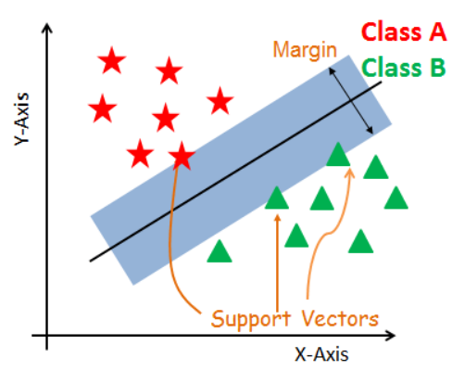
SVC
SVC or Support Vector Classifier, is a supervised machine learning algorithm typically used for classification tasks. SVC works by mapping data points to a high-dimensional space and then finding the optimal hyperplane that divides the data into two classes.

Slide 9
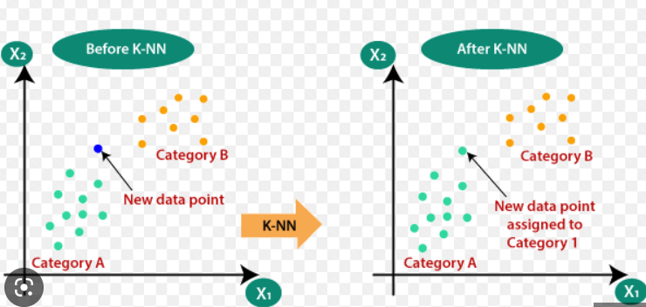
KNN CLASSIFICATION
In KNN, K is the number of nearest neighbors. The number of neighbors is the core deciding factor. K is generally an odd number if the number of classes is 2. When K=1, then the algorithm is known as the nearest neighbor algorithm. This is the simplest case. Suppose P1 is the point, for which label needs to predict. First, you find the one closest point to P1 and then the label of the nearest point assigned to P1.

Slide 10
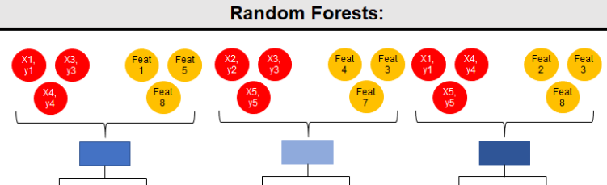
RANDOM FOREST CLASSIFIER
Random forests is a supervised learning algorithm. It can be used both for classification and regression. It is also the most flexible and easy to use algorithm. A forest is comprised of trees. It is said that the more trees it has, the more robust a forest is. Random forests creates decision trees on randomly selected data samples, gets prediction from each tree and selects the best solution by means of voting. It also provides a pretty good indicator of the feature importance.

Slide 11
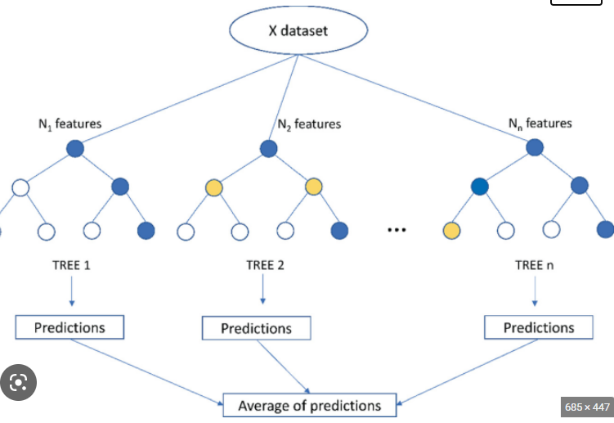
EXTRA TREE CLASSIFIER
Extra Trees is like Random Forest, in that it builds multiple trees and splits nodes using random subsets of features, but with two key differences: it does not bootstrap observations (meaning it samples without replacement), and nodes are split on random splits, not best splits.

Slide 12
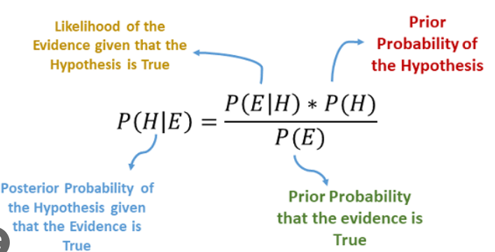
NAÏVE BAYES
Naïve bayes classifiers are a family of probabilistic classifiers based on applying bayes’ theorem with strong independence assumptions between the features.

Slide 13
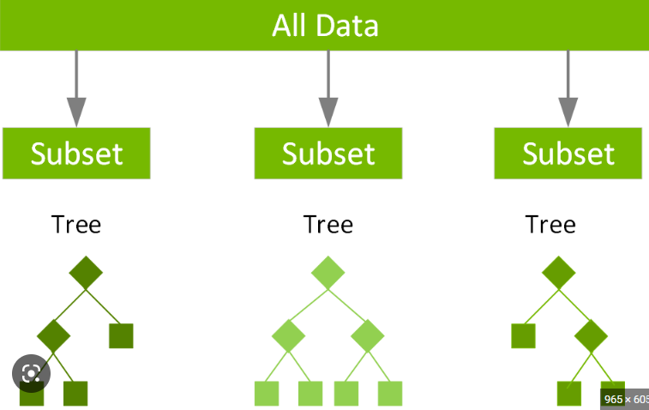
XGB CLASSIFIER
XGBoost, which stands for Extreme Gradient Boosting, is a distributed gradient decision tree machine leaning library. It provides parallel tree boosting.

Slide 14
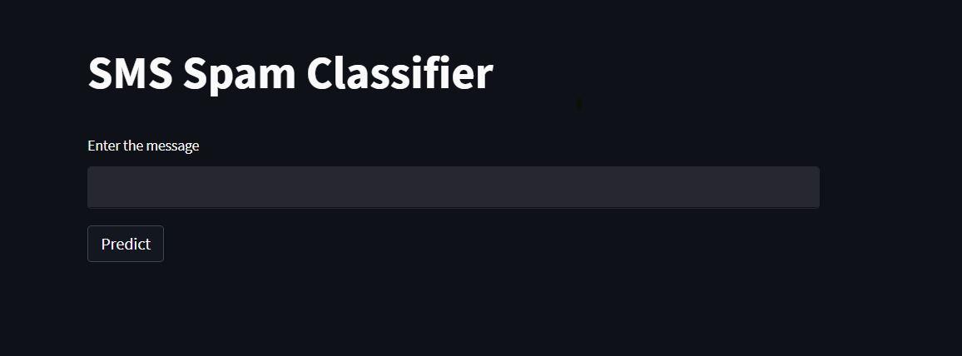
Website Designing
The Pickle library used to covert the vectorizer and the best models to files. The files are then imported on PyCharm to make the website. The Streamlit library is used for making the website.

Slide 15
FUTURE SCOPE
Review spam detection is critical because it can ensure justice for sellers while also maintaining buyer trust in online stores. So far, the algorithms developed have not been able to eliminate the need for manual review. As a result, complete automation of spam detection systems with maximum efficiency is possible. As the popularity of online stores grows, so does the competition. Spammers are becoming smarter by the day, and spam reviews are becoming untraceable. To develop counter-algorithms, it is necessary to first identify spamming techniques.

Slide 16

CONCLUSION
The existing spam detection techniques, their current applications, and their limitations are highlighted in this paper. It has been realized that even existing techniques have imperfections, and none of the methods are completely effective on their own. Review spam detection is a difficult task, but it necessitates ongoing research and development in this field.

Slide 17
THANK YOU

