Slide 1

CAPSTONE PROJECT
Library AI Agent
Presented By:
KAVEANANTH V
Sathyabama Institute of Science and Technology,Chennai
B.E CSE

Slide 2
OUTLINE
Problem Statement
Proposed System/Solution
System Development Approach
Algorithm & Deployment
Result (Output Image)
Conclusion
Future Scope
References

Slide 3
Problem Statement
A Library AI Agent is an intelligent system designed to assist students in finding the right learning materials based on their academic needs. It can autonomously analyze user profiles, study topics, and course syllabi to suggest relevant books and resources. Using natural language processing, it understands student queries and matches them with the most suitable books in the library database. The agent can check real-time book availability, prioritize high-demand titles, and assist with reservation or waitlist actions. It saves time by streamlining the search process and offering personalized recommendations aligned with current academic work. Library AI Agents enhance access, engagement, and resource utilization in educational environments.

Slide 4
The Library AI Agent intelligently:
Understands student queries via Natural Language Processing (NLP).
Analyzes course syllabi and user profiles.
Suggests personalized resources.
Checks book availability in real-time.
Prioritizes high-demand titles.
Supports reservations and waitlists.
This results in efficient and tailored access to relevant academic materials.
Proposed Solution

Slide 5
System Approach
Platform & Tools Used:
IBM Cloud Lite
IBM Watsonx AI Services
Watson Studio / Agent Lab
Jupyter Notebook (Python 3.11)
Libraries:
ibm_watsonx_ai – For deploying and testing AI service
JSON – To structure input/output
Python NLP libraries (optionally used in service layer)

Slide 6
Algorithm & Deployment
AI Agent Workflow:
Input: Natural language query from student.
Prompt Processing: AI agent interprets the query using prompt lab.
Matching Logic: Cross-references with syllabi/book database (mock or live).
Output: Personalized book recommendations and availability.
Deployment:
Packaged as an AI Service on IBM Cloud.
Deployed using IBM Watsonx Agent Lab and tested through the notebook.

Slide 7
Result
Student Query: "I need books for machine learning in Python for my 5th semester."
AI Agent Output:
“Python Machine Learning” by Sebastian Raschka (Available)
“Hands-On ML with Scikit-Learn & TensorFlow” (Waitlisted)

Slide 8
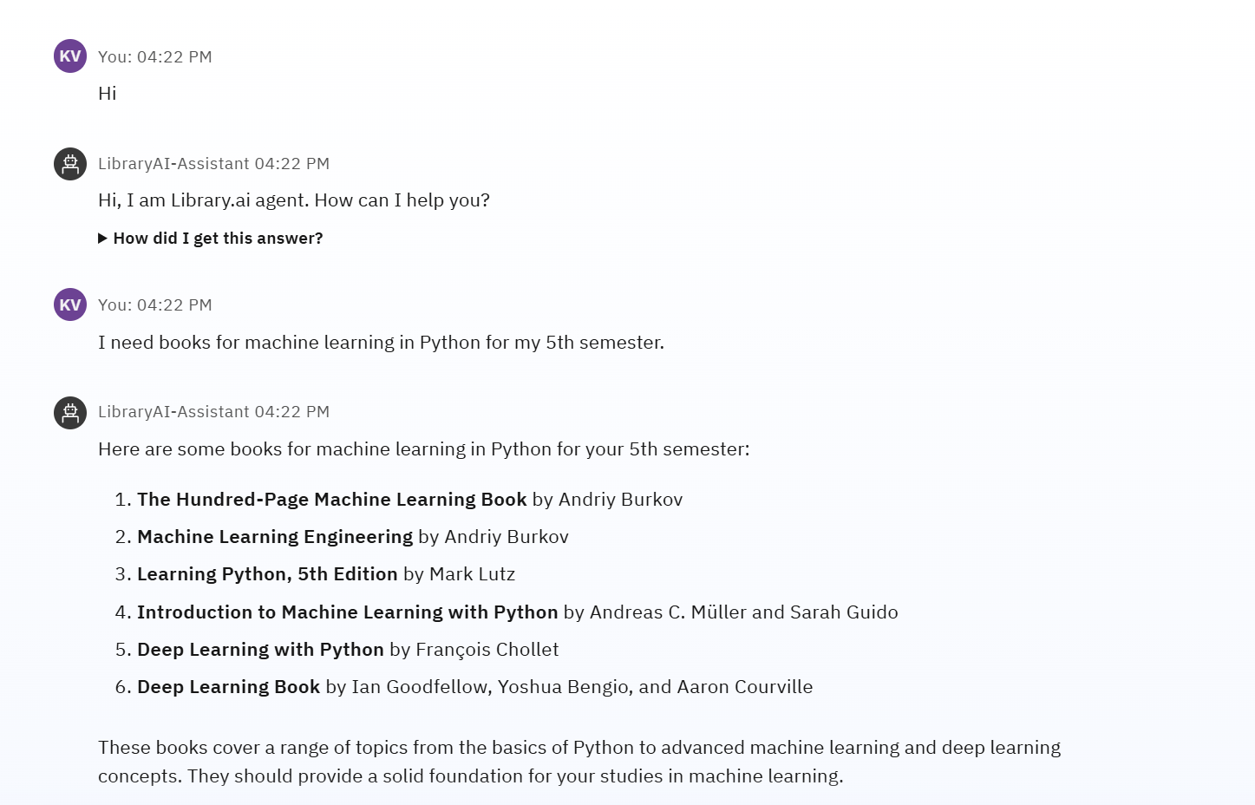
OUTPUT

Slide 9
Conclusion
The AI Agent effectively assists in personalizing book recommendations.
Reduces student search time.
Enhances engagement with library resources.
Provides dynamic responses using real-time data and NLP understanding.

Slide 10
Future scope
Integrate real library APIs for dynamic catalog updates.
Support voice queries.
Add multi-language support for international users.
Analyze user behavior for improved recommendations.

Slide 11
References
IBM Watsonx AI Documentation
IBM Cloud API Reference
NLP Techniques for Recommendation Systems
Project GitHub - link

Slide 12
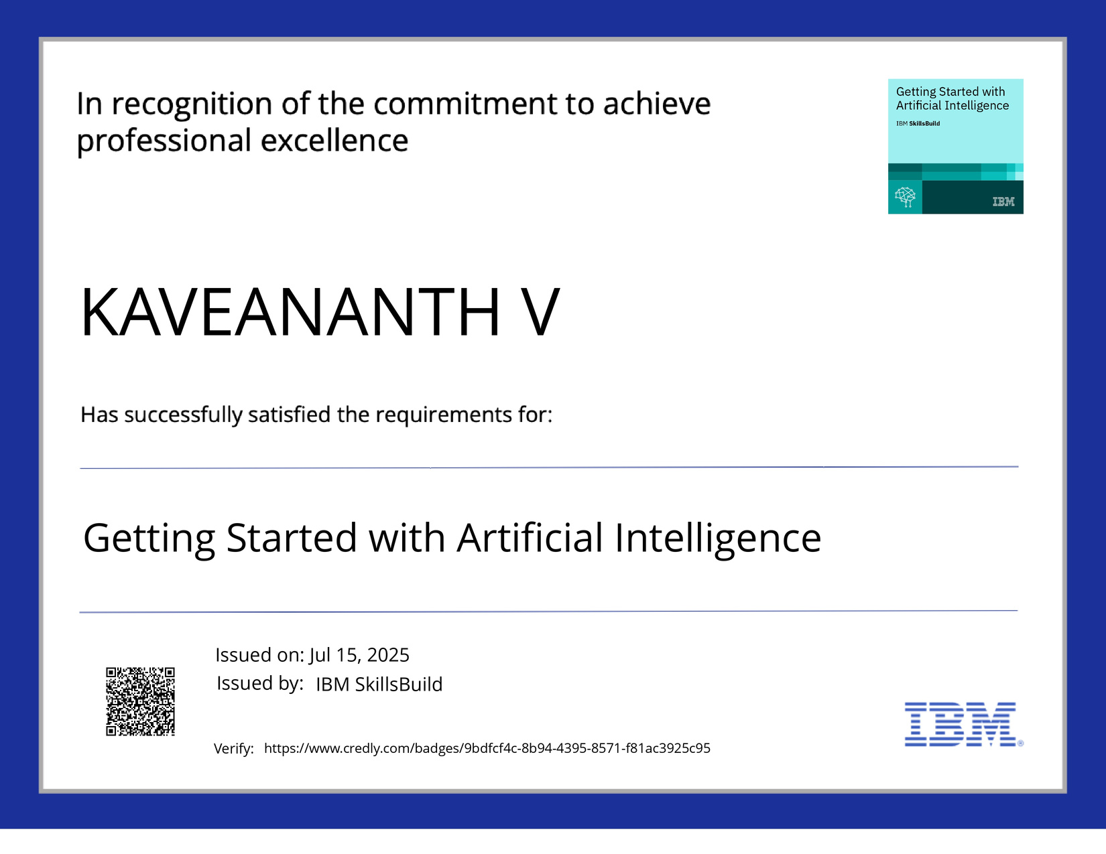
IBM Certifications

Slide 13
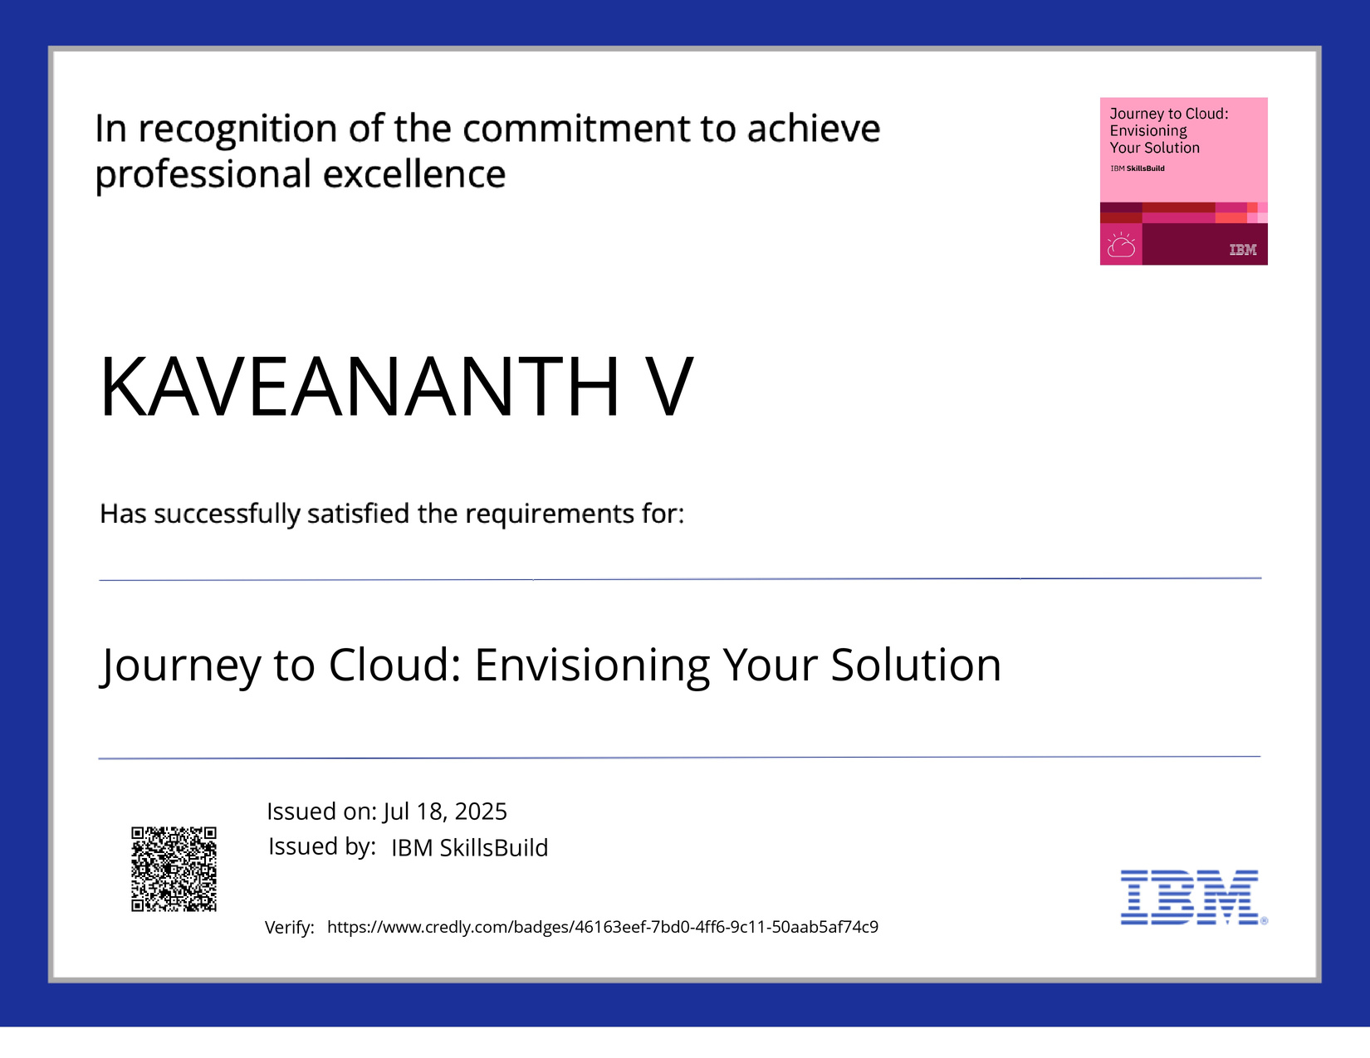
IBM Certifications

Slide 14
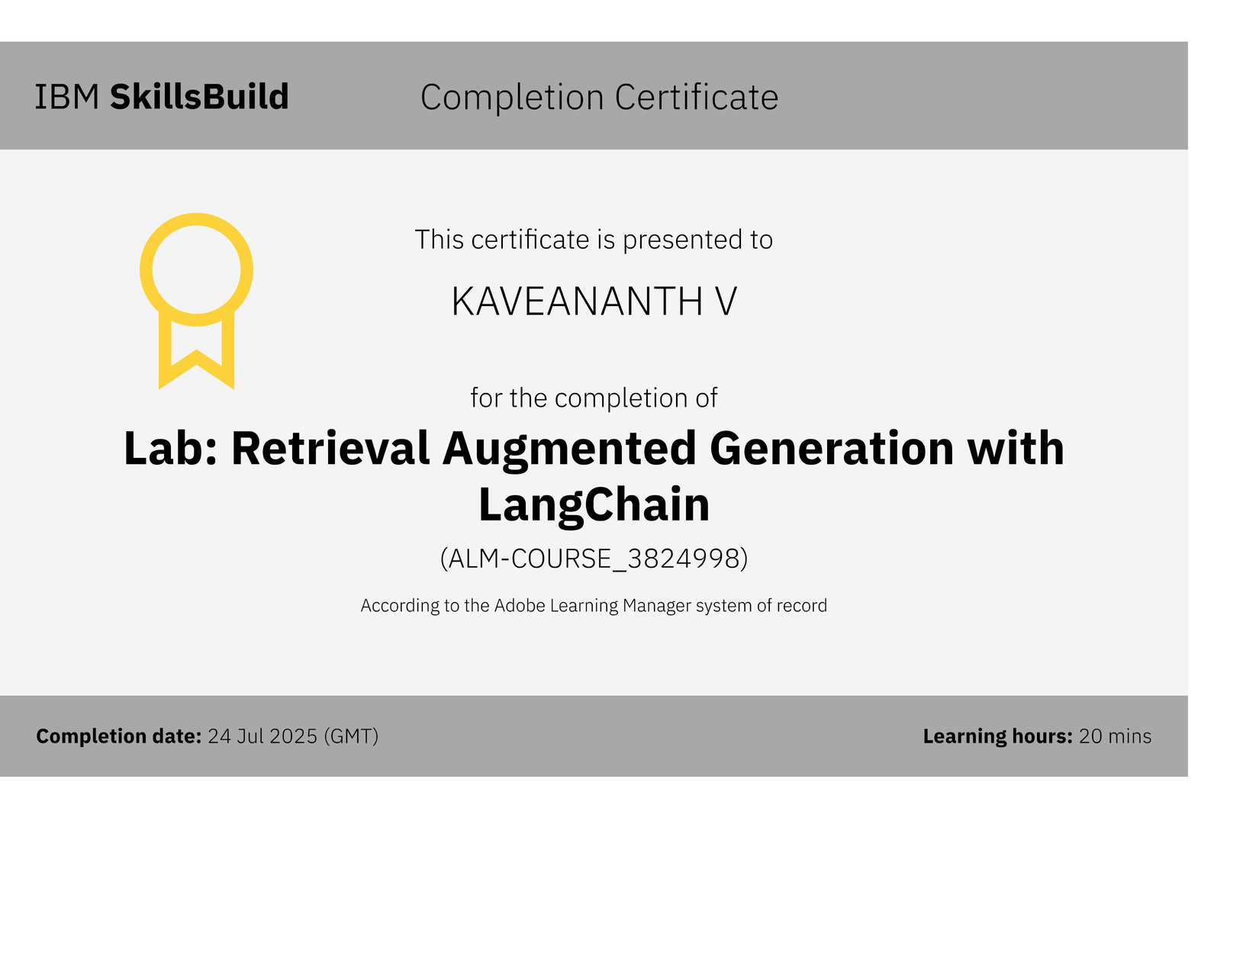
IBM Certifications

Slide 15
THANK YOU

