Slide 1



Smart Shop:
Self Service Price Checker/ Product
Locator with Barcode Scanner
Members:
Abellanosa, Leo Mark S.
Capili, Reneir Gake C.
Mandamiento, Javenn L.
Nabong, Jericho C.
Tion, Jhyvriel Ian C.
NAME OF PRESENTER
Designation

Slide 2

INTRODUCTION
Simplified Shopping with Technology
Navigating a store can be challenging, especially when no clerks are available, or we’re not in the mood for social interactions. This can lead to frustration and wasted time. For small business owners, limited staff makes it hard to assist every customer.
With barcode scanning and a self-service price checker and product locator, these issues can be solved. Customers can quickly access product details, prices, and locations without asking for help. This saves time, conserves energy, and enhances the shopping experience. Businesses can also improve efficiency, offering a seamless and user-friendly solution for all.

Slide 3
Objectives
Key Objectives:
Enhance Customer Convenience: Allow independent checking of product prices and locations.
Improve Retail Efficiency: Real-time integration of barcode scanning, product locator, and database.
Support Small Businesses: Minimize reliance on staff while ensuring smooth inventory management.

Slide 4
Objectives
Additional Objectives:
Promote Accessibility & Inclusivity: User-friendly interface for diverse needs, including those with tech challenges.
Modernize Shopping: Align in-store experience with tech-savvy expectations.
Ensure Accuracy: Centralized database for reliable product details and inventory tracking.
Provide Secure Tools: Flexible, secure management for adding, updating, and removing product data.
Enable Scalability: Expandable database for future growth and system upgrades.

Slide 5
Scope and Delimitation
Core Features and Capabilities:
Price Checking: Provides accurate and updated product prices through a centralized database.
Product Locator: Displays real-time product location details, including aisles and shelves.
User Interface Design: Intuitive interface ensuring smooth navigation for all tech proficiency levels.

Slide 6
Scope and Delimitation
Self-Service Focus: Empowers customers to access product details independently, without staff assistance.
Database Management: Maintains a secure, robust database for seamless updates and administration.
Data Accuracy: Ensures consistency and error-free information for all users.
Quick Product Inquiry: Utilize a barcode scanner to fetch product information instantly from the database, ensuring accuracy and speed.

Slide 7
Scope and Delimitation
Current Limitations and Challenges:
Adding Barcodes via Scanning: Difficulty incorporating barcode scanning into product addition workflows.
Search Errors and Bugs: Issues with querying product names with multiple iterations or types, causing system errors and bugs.

Slide 8
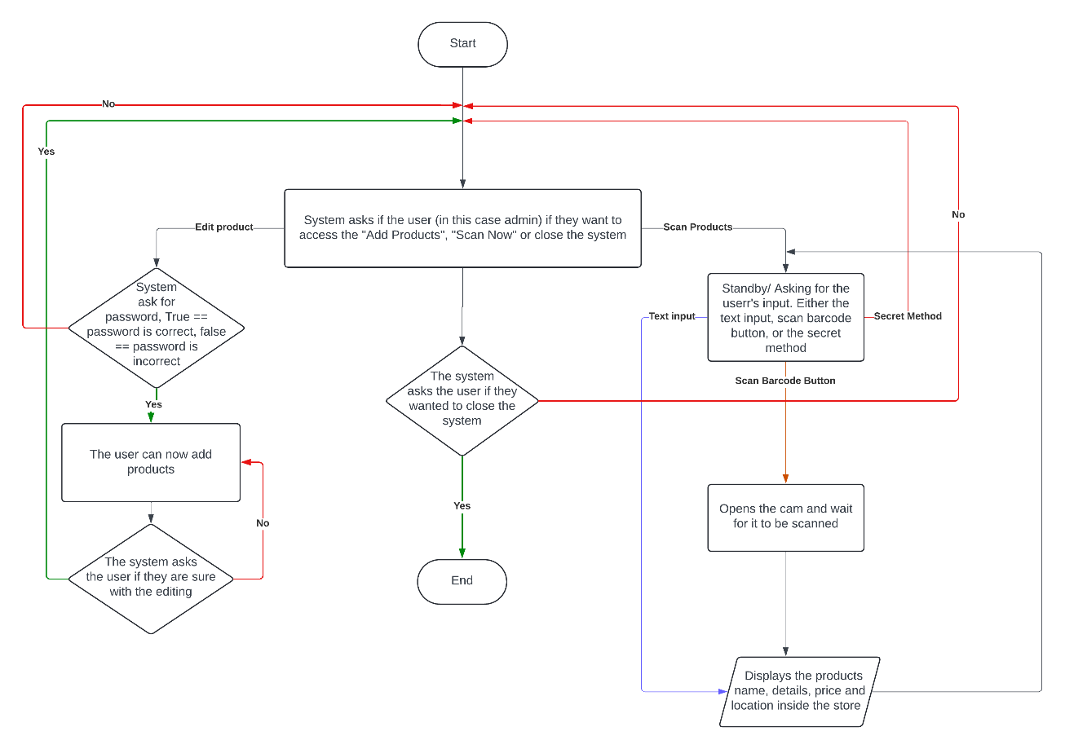
FLOWCHART
Smart Shop overall flowchart

Slide 9
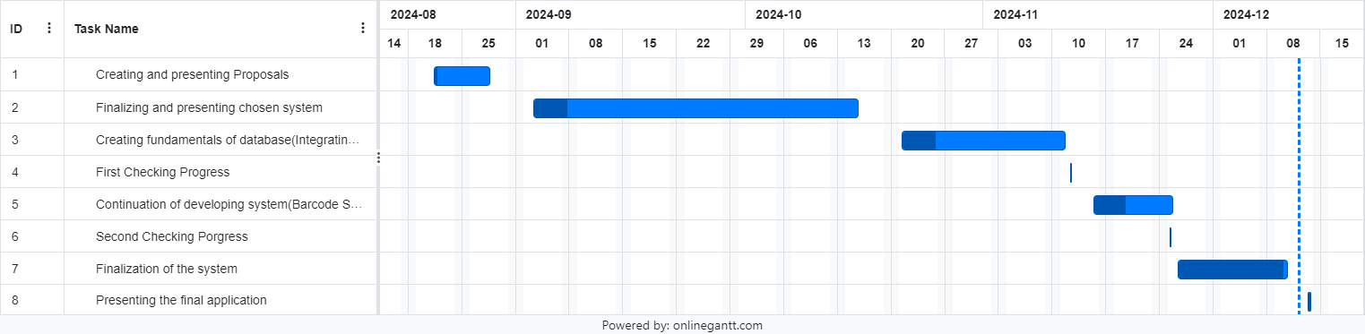
GANTT CHART

Slide 10
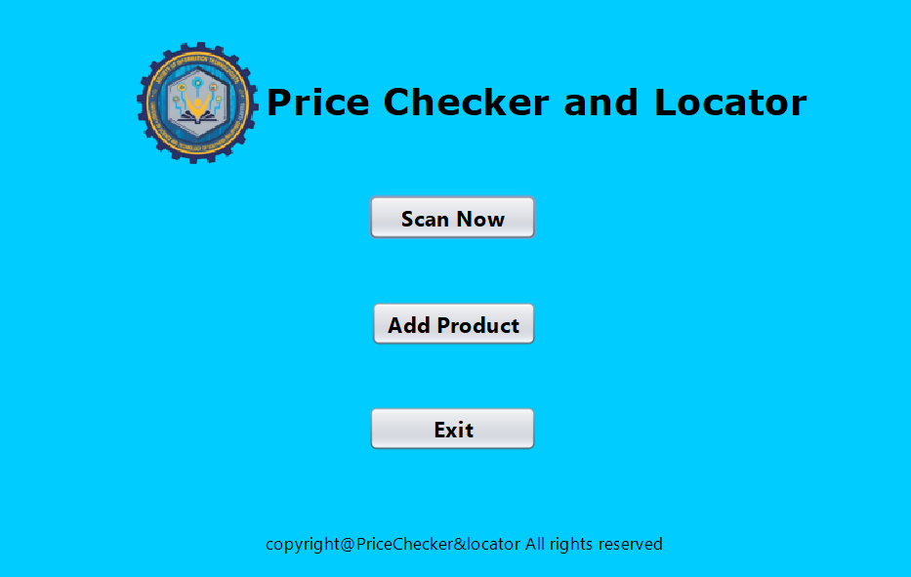
SYSTEM DESIGN
This is the “Main Interface”, this is the first window you will se in opening the code

Slide 11
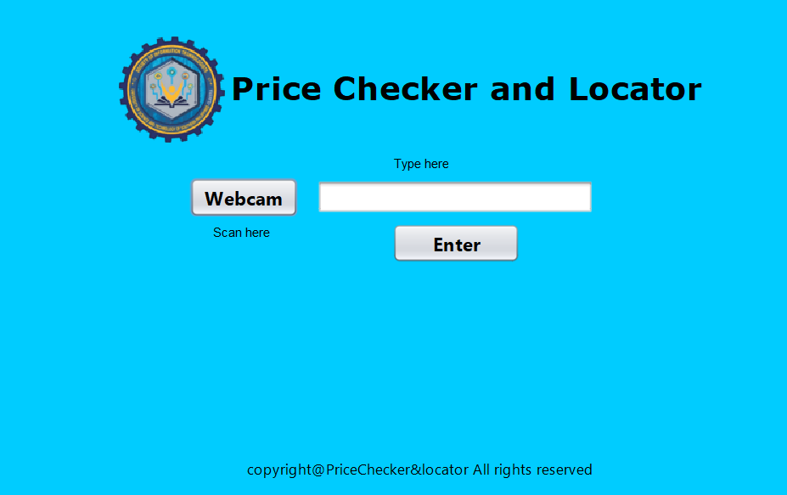
SYSTEM DESIGN
Scan Now button path:
When the "Scan Now" button is "default" view when the system is in the storefront. Clicking the BSIT icon ten (10) times will return clicked, this GUI will be displayed. This interface is also what customers should see and serves as to the “Main Interface”, this is the “Secret Method.

Slide 12
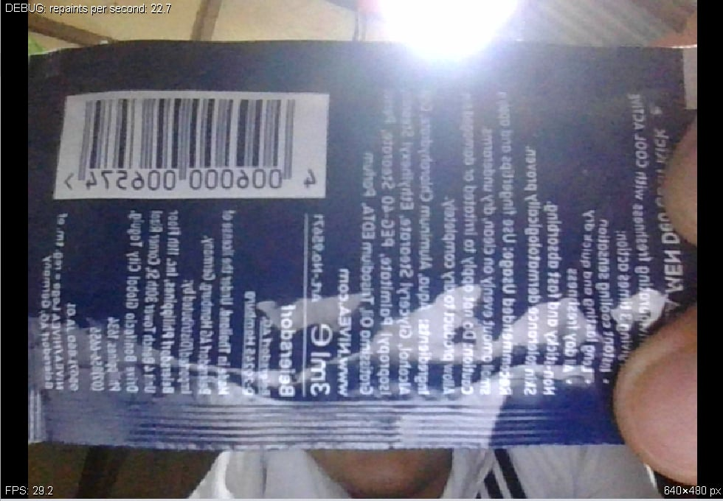
SYSTEM DESIGN
Upon clicking the “Webcam” button, this should be the GUI that appears.

Slide 13
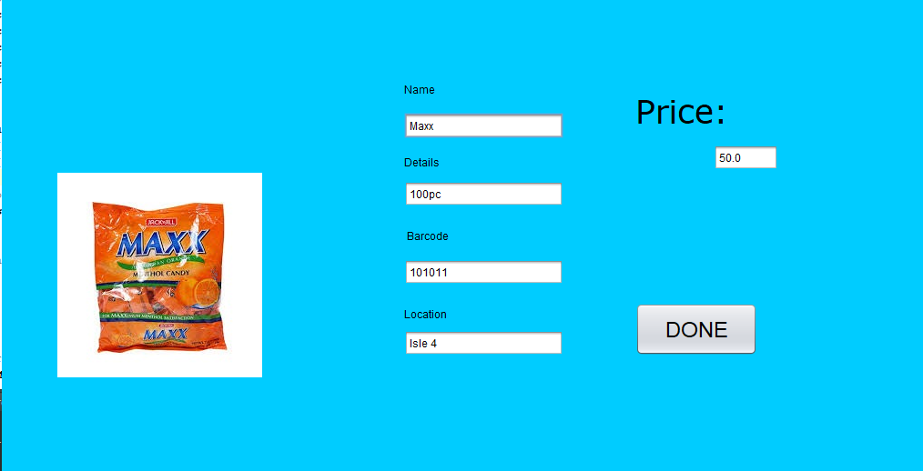
SYSTEM DESIGN
When the barcode or the product name is entered, the product with the same barcode or product name is showed in this manner:

Slide 14
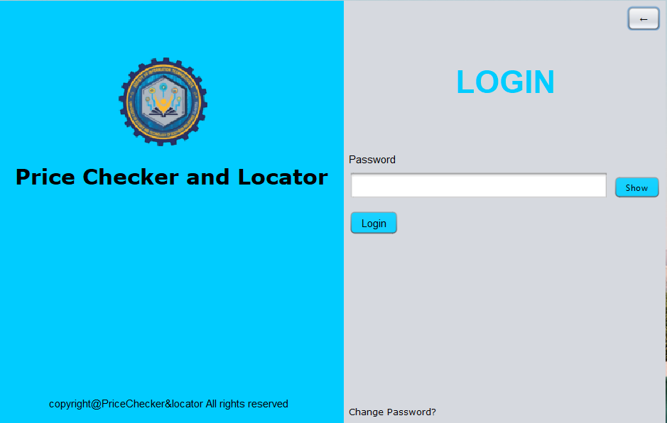
SYSTEM DESIGN
Add Product button path:
When “Add Product” button is clicked, the user can’t proceed to the access of the editing of the products. The user must enter first the password.

Slide 15
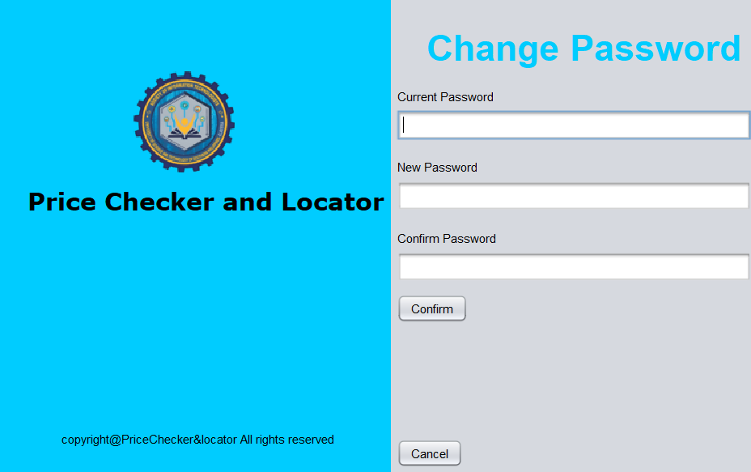
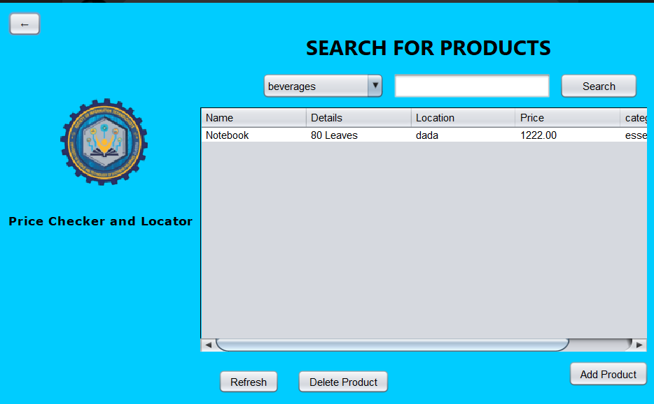
SYSTEM DESIGN
When the user wants to change the password, he can do so.
When the correct password is entered, the user can now see the products in this GUI.
You can also edit and read the products by its
categories and by searching it.

Slide 16
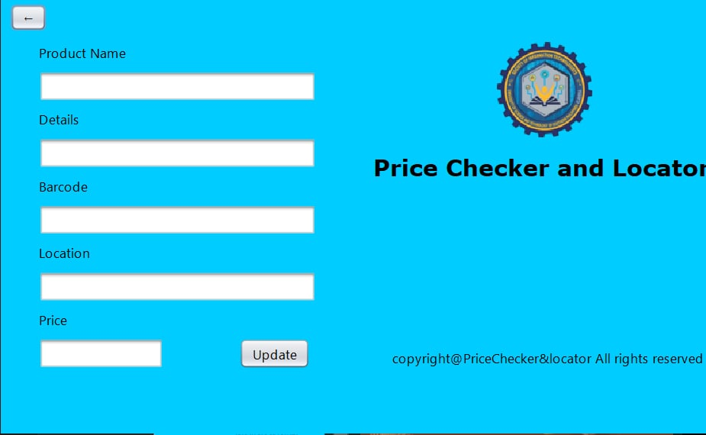
SYSTEM DESIGN
By clicking “Edit Product” you can edit products via this UI:

Slide 17
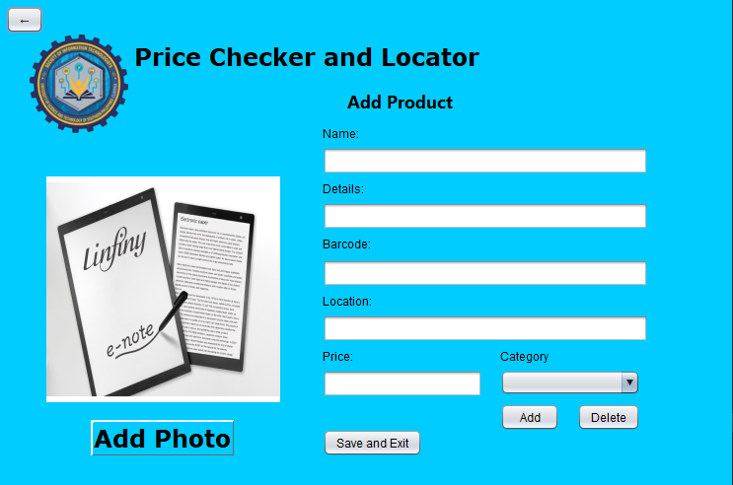
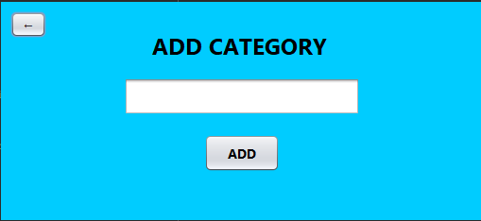
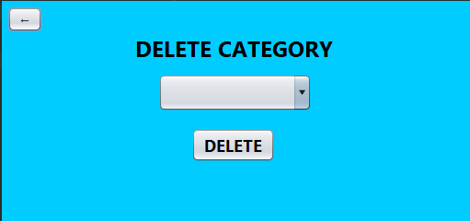
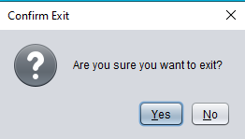
SYSTEM DESIGN
By clicking “Add Product” you can add
products via this UI:
User can also add or delete product by these manner:
And lastly, when the user wats to exit the application, the system asks if the user is sure.

Slide 18
CONCLUSION
The Smart Shop system enhances the shopping experience by providing a self-service tool that integrates barcode scanning and a centralized database for real-time product information. It reduces dependency on staff, benefits small businesses, and offers a user-friendly, inclusive interface while supporting scalability for future growth.

Slide 19
RECOMMENDATION
More functionality of barcode:
a. Scan-to-Add: Allows scanning a barcode to add it to the database instead of manually encoding it.
b. Faster scanning: The current scanning feature is slow and clunky. Optimizing it will make the process faster and more efficient.

Slide 20
RECOMMENDATION
Improving the customization of the database:
a. Improving Update: Improving this functionality will make the update process more straightforward and the database more customizable.
b. Optimizing database: As for now, the database is messy.
Finding a way to organize this database will make customization efficient.
Improving search: When entering products with similar name, both products should appear. (e.g. Nescafe 3g and 25g)

