Slide 1

Image and video compression LAB Optimization
Xiajun Zhou
Zeen Song
Technische Universität München
Fakultät für Elektro -und Informationstechnik
Lehrstuhl für Medientechnik
München, 30.7.2019

Slide 2
Attempts:
▪ Another colour Space(PCA)
▪ DWT
▪ Adaptive quantization table
0,01PSNR improvement average ☹
Bad result without toolbox ☹
Even worse than before ☹
Final Decision:
▪ Deep Learning with CNN ☺

Slide 3
PCA Color Space
Reference:
▪ Li, Ming, et al. "A Better Colour Space Conversion Based on Learned Variances For Image Compression.“ CVPR workshops 2019.[link]

Slide 4
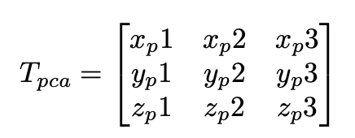
Approach:
Main idea: Principle component analyses(PCA)
1. Mean Subtract(little trick): Instead of subtracting whole images average. Whole Image will be divided into 16*16 blocks, each sample minus the average within the same grid.
2. Covariance Matrix: Define the sample as S, and ST × S is the covariance matrix COV of size 3×3.
3. Eigenvalue Decomposition: Perform EVD for the covariance matrix COV.

Slide 5
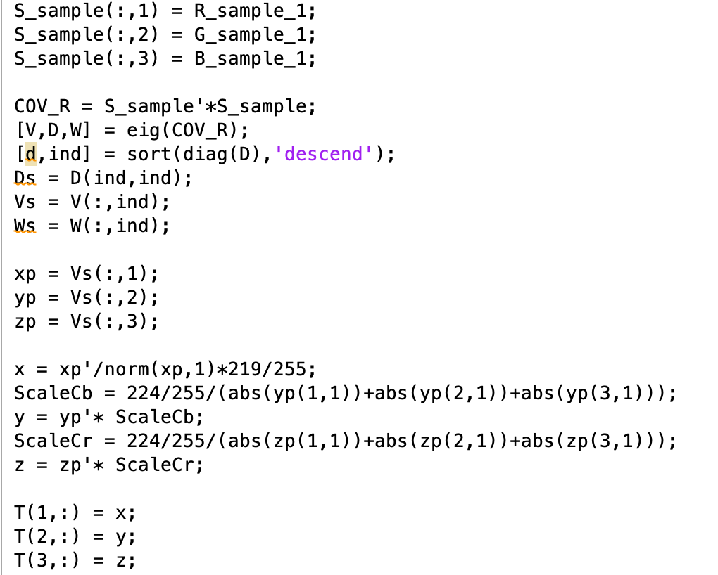
Code

Slide 6
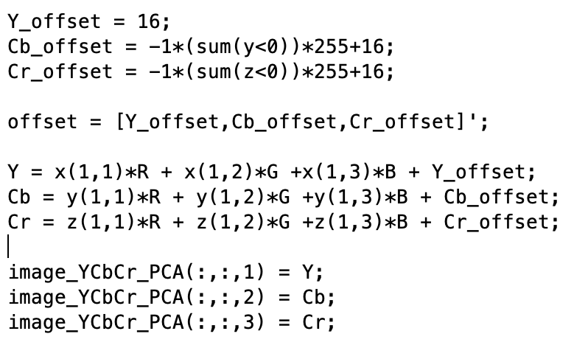
Code

Slide 7
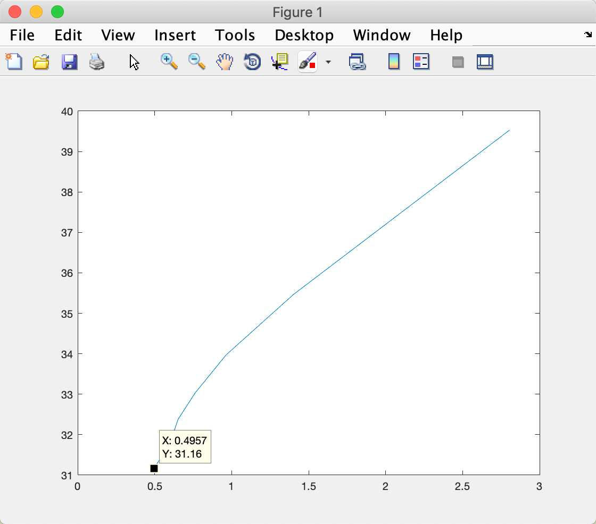
Bad Result:
Reasons:
Color Space domain not fit.
More Bitstream: less zero than before(solved by training with Lena)
Have to send a matrix for T and offset, because every picture has a unique one.

Slide 8
Deep Learning Method
Reference:
▪ Chao Dong, et al. “Compression Artifacts Reduction by a Deep Convolutional Network.” ICCV 2015 [link]
▪ Pavel Svoboda, et al. “Compression Artifacts Removal Using Convolutional Neural Networks.” ICCV 2017 [link]

Slide 9
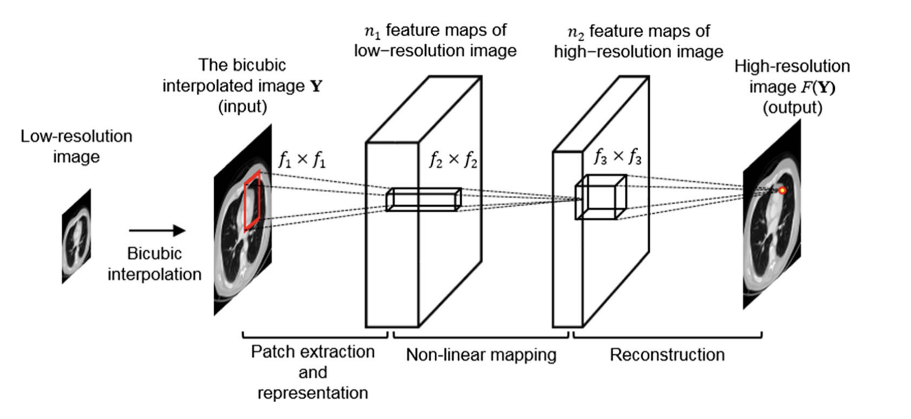
Approach
Old Type SRCNN
Idea source of ARCNN: SRCNN

Slide 10
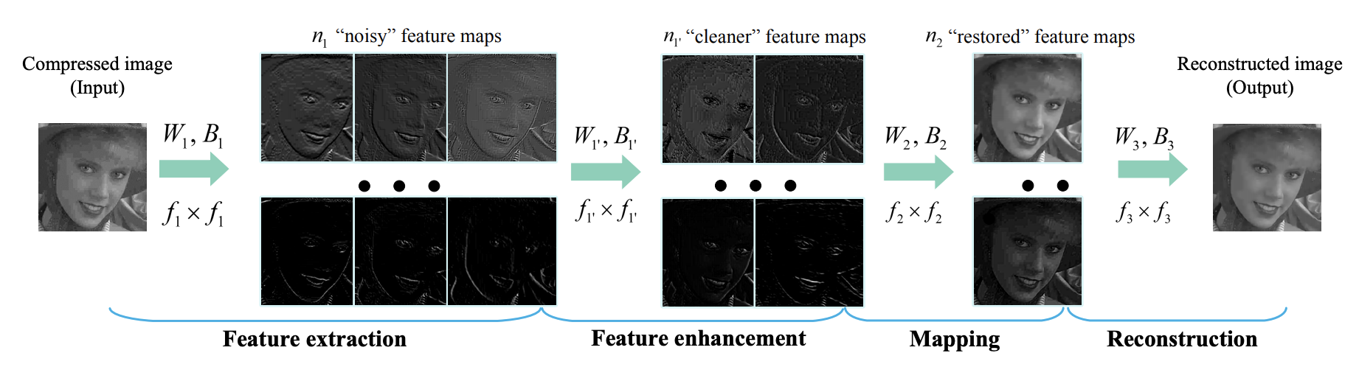
Approach

Slide 11
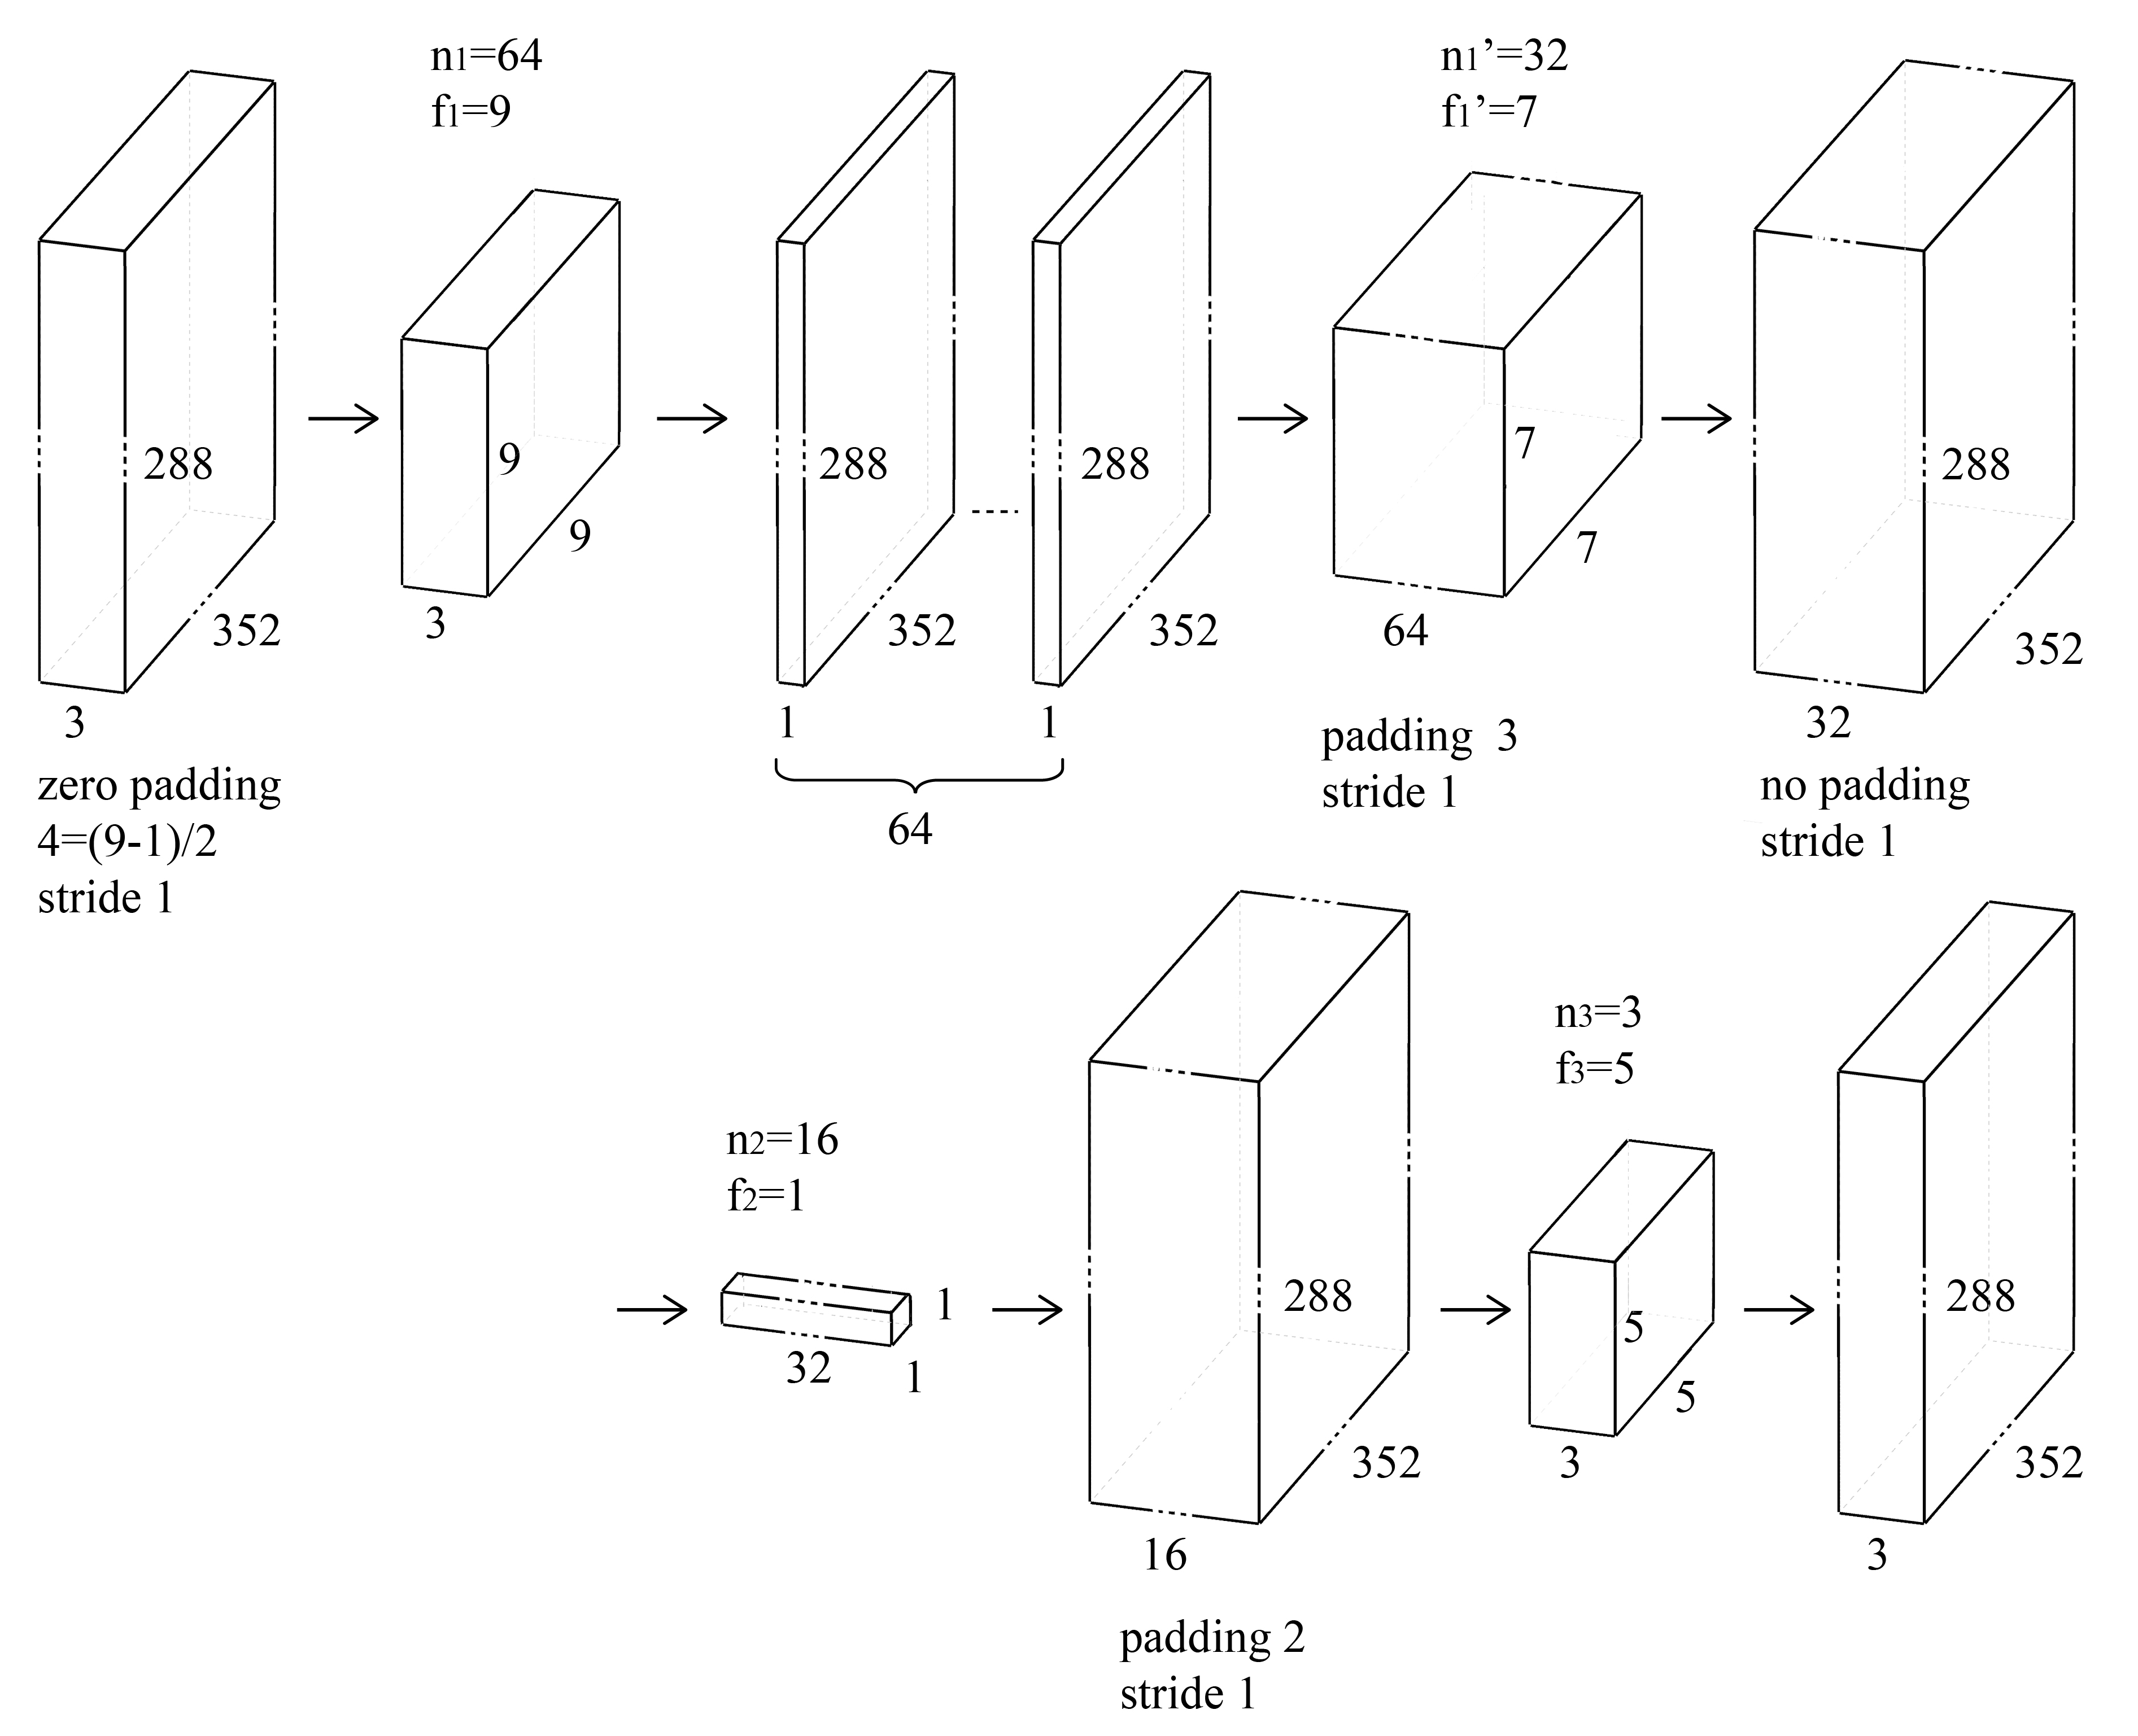
Our CNN Network Structure
Improvement!

Slide 12
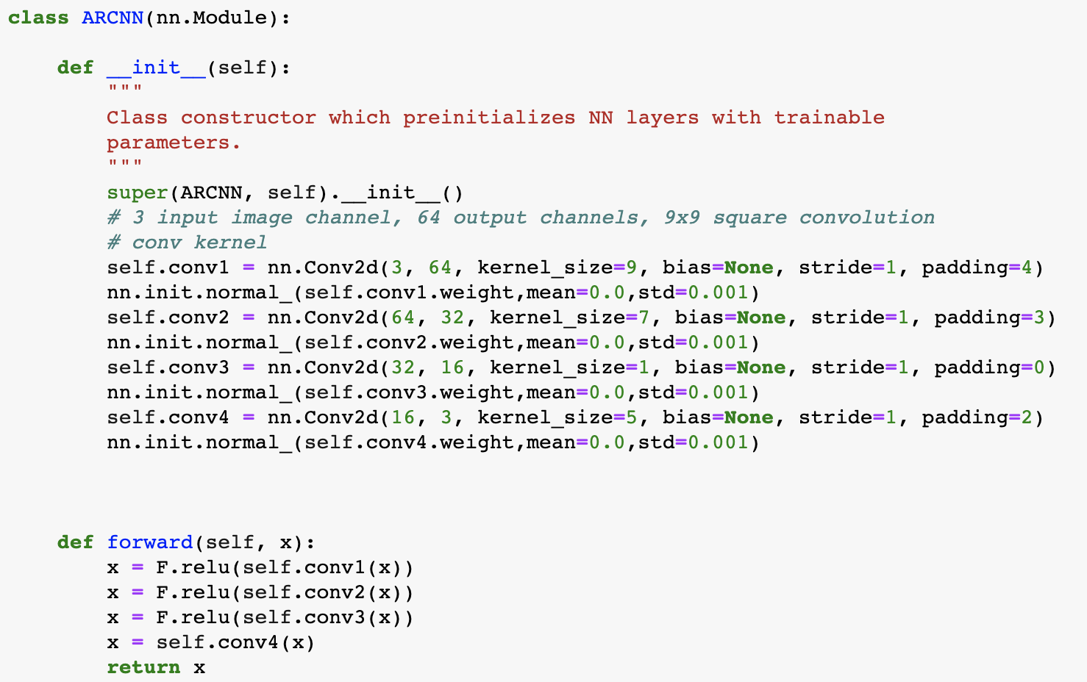
Model Code

Slide 13
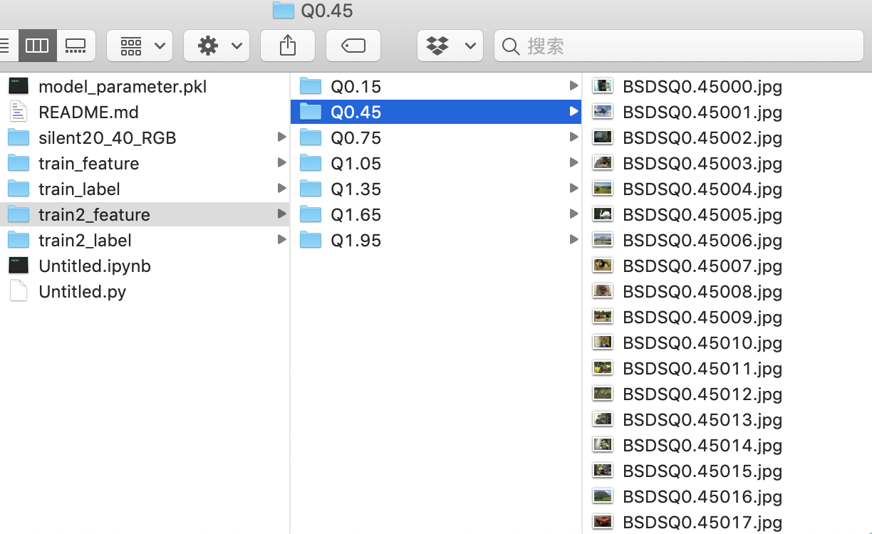
Preparation
Label data (Ground Truth):
1. Video Sequence: from LAB except foreman0020-0040 (e.g. silent0020-0040)
2. Still images: 200 images BSDS500
Training data(feature):
Put Ground Truth above into our Matlab codec program in Lab session 5 and take qScale = 0.15:0.3:1.95. For each qScale there will be feature pictures corresponding to ground truth.

Slide 14
Data processing
From pictures to tensors, to make the data suitable for GPU
Normalize the data, to make it range from [-1,1]
Use dataloader from pytorch to train the data in batch

Slide 15
Training
First approach: use only provided sequences as training set, and train the training data with all quantization scale together.
Result: the output images have PSNR worth than the input images
Improvement: trained the data with specific order, trained the images with low quality first and gradually raise the quality.
Result: the output images have PSNR 0.1~0.4dB higher than input images
Further improvement: increasing dataset and use BSDS500 as training set.
Result: the output images have PSNR 1.3~2dB higher than the input images

Slide 16
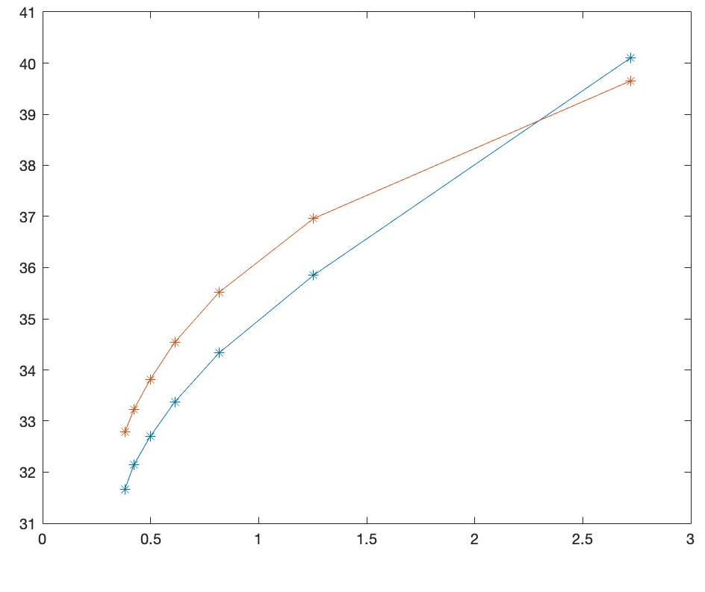
Test and Result Compare
Blue: BASELINE
Orange: ARCNN

Slide 17
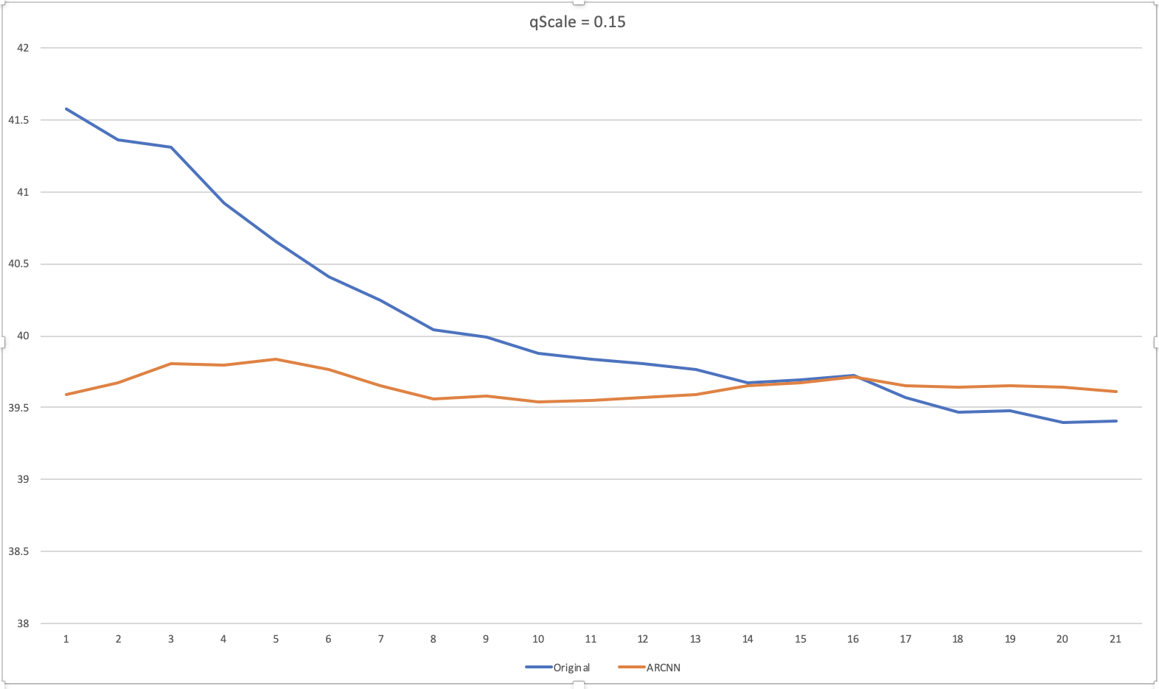
Analyses about qScale = 0.15
Max-Min: 2.1757
Max-Min: 0.2903

Slide 18
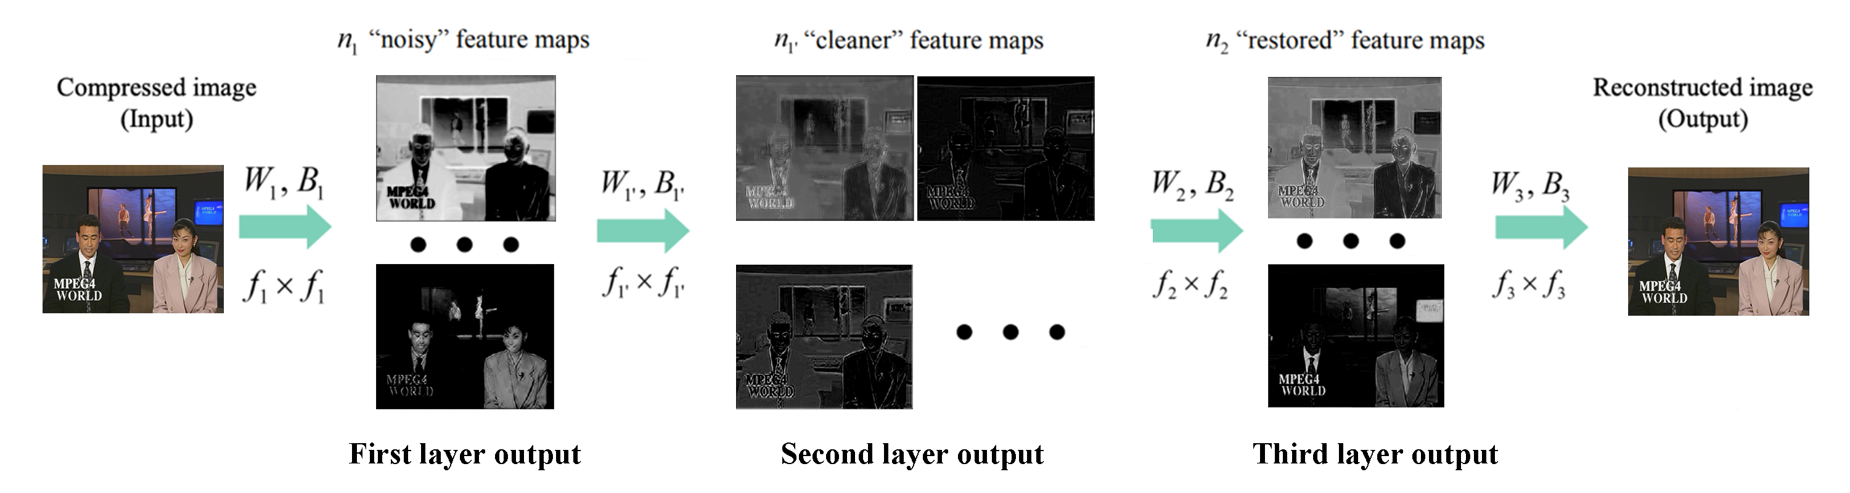
Discussion
some confusion from our side:
the BSDS500 dataset are already with jpeg compressed images, which might be the reason of bad performance in high quality compression.
Function of second layer with f2 = 1.
The codec of still image is not exactly the same as the codec of video sequences.

Slide 19
Thanks for your attention
Xiajun Zhou
Zeen Song
München, 30. 07 2019

