Slide 1

Could you pick up milk if you are at Safeway, please?

Slide 2
Problem
Trips to the store for just a few items is painful

Slide 3
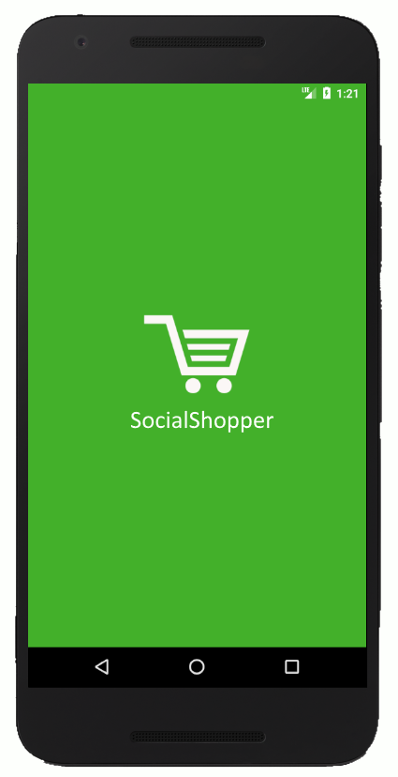

Slide 4
Design Thoughts
Login
Facebook for Trust
1
User Experience
Fun
Fast
Intuitive
2
Context
Location awareness
3
Messaging
Reaching People
4

Slide 5
video

Slide 6
Future Plans
Payments
Peer-to-peer
1
Smarter Messaging
Target people most likely to help
2
Users
Not limited to friends
3

Slide 7
SocialShopper
Greeshma Umapathi Santosh
Sriram Santosh Aripirala
Rahul Deshpande

