Slide 1

Could you pick up milk if you are at Safeway, please?

Slide 2
Problem
Trips to the store for just a few items is painful

Slide 3
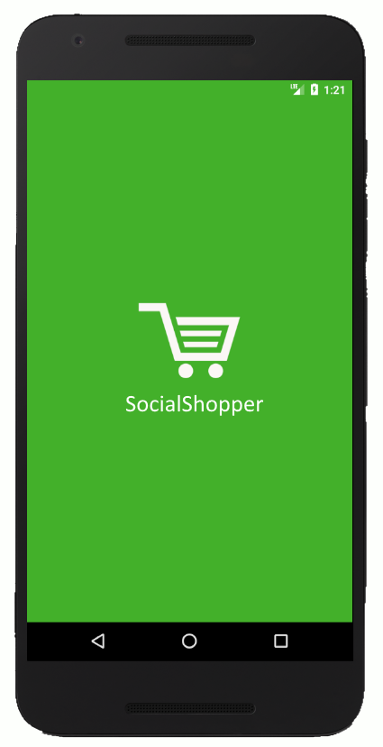
SocialShopper
Incredibly easy to use
Inherently trustworthy
Extremely non-intrusive

Slide 4
Why Mobile?
Context
Location awareness
1
Availability
Most used form factor
2
Reach
Reach people when needed
3
Sharing
Camera
Maps
4

Slide 5
Design Thoughts
Login
Facebook for Trust
1
UI
Fun and intuitive
2
Flow
Minimum clicks from launch to publish
3
Discovery
Intelligent messaging
4

Slide 6
video

Slide 7
Building Blocks
Android
Location Services
Camera
1
Firebase
Realtime Database
Functions
Cloud Messaging
2
Third Party Libraries
Animation
Gestures
3
Anything else?
4

Slide 8
Future Plans
Payments
Peer-to-peer
1
Smarter Messaging
Target people most likely to help
2
More Interaction
In-app calling
In-app chat
3
Users
Not limited to friends
4

Slide 9
SocialShopper
Greeshma Umapathi Santosh
Sriram Santosh Aripirala
Rahul Deshpande

