Slide 1
SQL

Slide 2
Creating and Manipulating Tables
CREATE TABLE Products ( prod_id CHAR(10) NOT NULL, vend_id CHAR(10) NOT NULL, prod_name CHAR(254) NOT NULL, prod_price DECIMAL(8,2) NOT NULL, prod_desc VARCHAR(1000) );
CREATE TABLE Orders ( order_num INTEGER NOT NULL, order_date DATETIME NOT NULL, cust_id CHAR(10) NOT NULL );
CREATE TABLE Vendors ( vend_id CHAR(10) NOT NULL, vend_name CHAR(50) NOT NULL, vend_address CHAR(50) , vend_city CHAR(50) , vend_state CHAR(5) , vend_zip CHAR(10) , vend_country CHAR(50) );
CREATE TABLE OrderItems ( order_num INTEGER NOT NULL, order_item INTEGER NOT NULL, prod_id CHAR(10) NOT NULL, quantity INTEGER NOT NULL DEFAULT 1, item_price DECIMAL(8,2) NOT NULL );

Slide 3
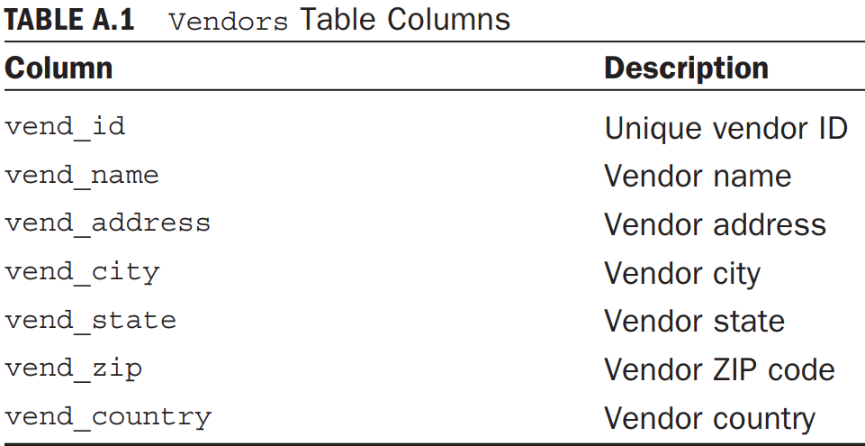
Vendors Table
The Vendors table stores the vendors whose products are sold. Every vendor has a record in this table, and that vendor ID (the vend_id, primary key) column is used to match products with vendors.

Slide 4
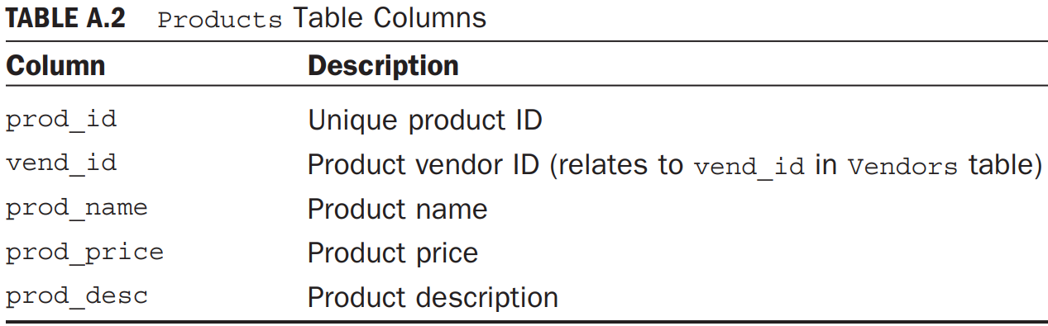
Products Table
The Products table contains the product catalog, one product per row. Each product has a unique ID (the prod_id column) and is related to its vendor by vend_id (the vendor’s unique ID).

Slide 5
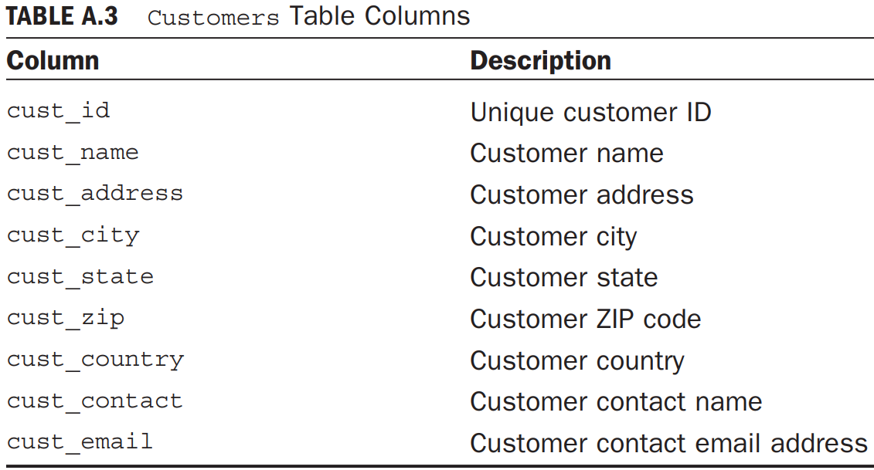
Customers Table
The Customers table stores all customer information. Each customer has a unique ID (the cust_id column).

Slide 6
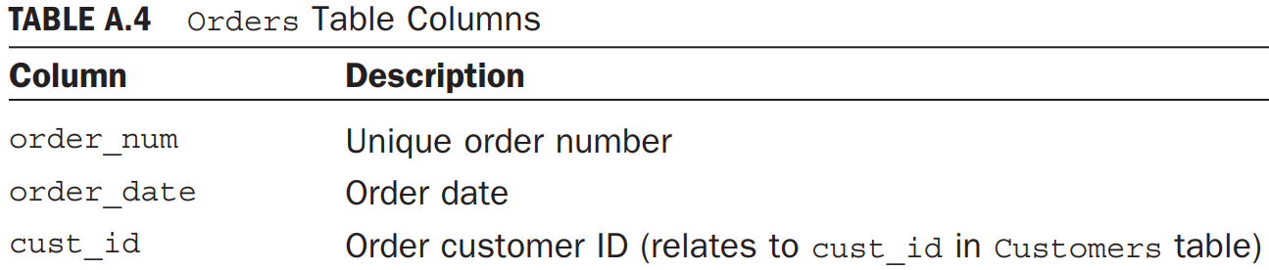
Orders Table
Orders table stores customer orders (but not order details). Each order is uniquely numbered (the order_num column). Orders are associated with the appropriate customers by the cust_id column (which relates to the customer’s unique ID in the Customers table).

Slide 7
OrderItems Table
The OrderItems table stores the actual items in each order, one row per item per order.
For every row in Orders there are one or more rows in OrderItems
Each order item is uniquely identified by the order number plus the order item (first item in order, second item in order, and so on).
Order items are associated with their appropriate order by the order_num column (which relates to the order’s unique ID in Orders).
In addition, each order item contains the product ID of the item orders.
This table should use order_num and order_item as its primary keys.

Slide 8
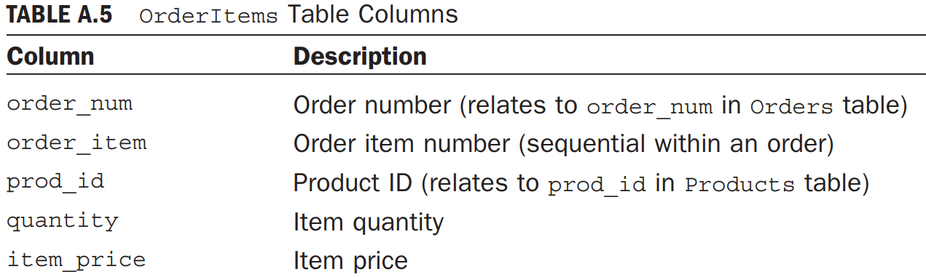

Slide 9
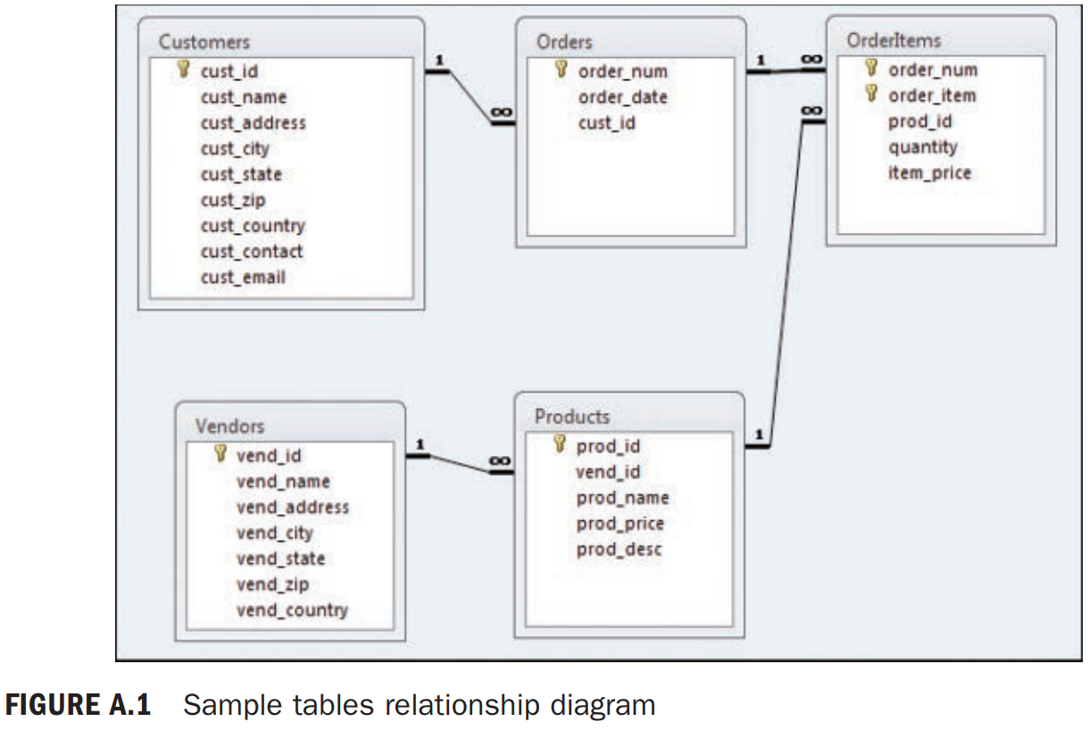
Relationship among tables

Slide 10
ALTER table structure
ALTER TABLE Vendors ADD vend_phone CHAR(20);
ALTER TABLE Vendors DROP COLUMN vend_phone;
Deleting a table
DROP TABLE CustCopy;
Renaming a table
RENAME TABLE ORDERS TO ACTIVE_ORDERS;
ALTER TABLE table_name RENAME TO new_table_name;

Slide 11
Inserting data
INSERT INTO Customers VALUES(1000000006, 'Toy Land', '123 Any Street', 'New York', 'NY', '11111', 'USA', NULL, NULL); -- Filling all column values.
INSERT INTO Customers(cust_id, cust_name, cust_address, cust_city, cust_state, cust_zip, cust_country) VALUES(1000000006, 'Toy Land', '123 Any Street', 'New York', 'NY', '11111', 'USA’); -- Filling specific columns.

Slide 12
INSERT INTO Customers(cust_id, cust_contact, cust_email, cust_name, cust_address, cust_city, cust_state, cust_zip, cust_country) SELECT cust_id, cust_contact, cust_email, cust_name, cust_address, cust_city, cust_state, cust_zip, cust_country FROM CustNew;
CREATE TABLE CustCopy AS SELECT * FROM Customers;

Slide 13
Updating and Deleting Data
UPDATE Customers SET cust_email = 'kim@thetoystore.com' WHERE cust_id = 1000000005;
UPDATE Customers SET cust_contact = 'Sam Roberts', cust_email = 'sam@toyland.com' WHERE cust_id = 1000000006;
UPDATE Customers SET cust_email = NULL WHERE cust_id = 1000000005;
DELETE FROM Customers WHERE cust_id = 1000000006;

Slide 14
Retrieving Data
Individual Column:
SELECT prod_name FROM Products;
Multiple Columns:
SELECT prod_id, prod_name, prod_price FROM Products;
All Columns:
SELECT * FROM Products;
Distinct Rows: SELECT returns all matched rows. But what if you do not want every occurrence of every value?
SELECT DISTINCT vend_id FROM Products;

Slide 15
Limiting Results
SELECT prod_name FROM Products WHERE ROWNUM <=5;
Sorting Data
SELECT prod_name FROM Products ORDER BY prod_name;
Sorting by Multiple Columns
SELECT prod_id, prod_price, prod_name FROM Products ORDER BY prod_price, prod_name;
Sorting by Column Position
SELECT prod_id, prod_price, prod_name FROM Products ORDER BY 2, 3;

Slide 16
Sort Direction
SELECT prod_id, prod_price, prod_name FROM Products ORDER BY prod_price DESC;
SELECT prod_id, prod_price, prod_name FROM Products ORDER BY prod_price DESC, prod_name;
Filtering Data (where clause)
SELECT prod_name, prod_price FROM Products WHERE prod_price = 3.49;
SELECT prod_name, prod_price FROM Products WHERE prod_price < 10;
SELECT vend_id, prod_name FROM Products WHERE vend_id <> 'DLL01';

Slide 17
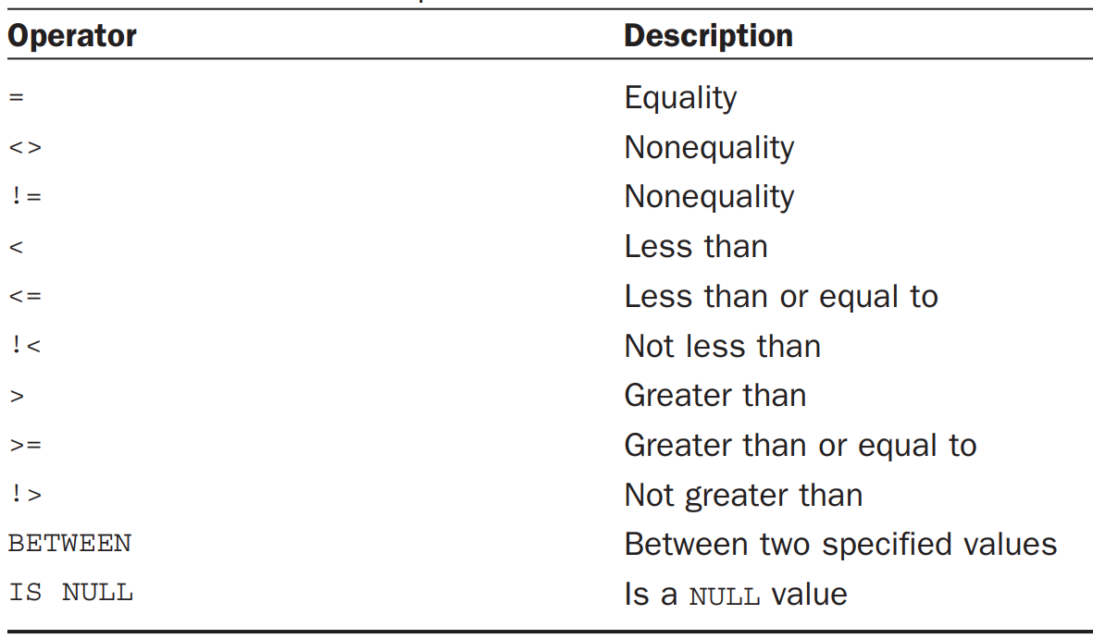
where clause operators

Slide 18
SELECT prod_name, prod_price FROM Products WHERE prod_price BETWEEN 5 AND 10;
SELECT prod_name FROM Products WHERE prod_price IS NULL;
Combining where clauses
SELECT prod_id, prod_price, prod_name FROM Products WHERE vend_id = 'DLL01' AND prod_price <= 4;
SELECT prod_id, prod_price, prod_name FROM Products WHERE vend_id = 'DLL01' OR vend_id = 'BRS01’;
SELECT prod_name, prod_price FROM Products WHERE vend_id = 'DLL01' OR vend_id = 'BRS01' AND prod_price >= 10; --AND evaluates first then result doing OR operation.

Slide 19
SELECT prod_name, prod_price FROM Products WHERE (vend_id = 'DLL01' OR vend_id = 'BRS01') AND prod_price >= 10;
SELECT prod_name, prod_price FROM Products WHERE vend_id IN ('DLL01','BRS01') ORDER BY prod_name;
SELECT prod_name, prod_price FROM Products WHERE vend_id = 'DLL01' OR vend_id = 'BRS01' ORDER BY prod_name;
SELECT prod_name FROM Products WHERE NOT vend_id = 'DLL01' ORDER BY prod_name;
SELECT prod_name FROM Products WHERE vend_id <> 'DLL01' ORDER BY prod_name;

Slide 20
Wild Card filtering:
SELECT prod_id, prod_name FROM Products WHERE prod_name LIKE 'Fish%’;
% matches any number of occurrences of any character.
SELECT prod_id, prod_name FROM Products WHERE prod_name LIKE '%bean bag%’;
SELECT prod_name FROM Products WHERE prod_name LIKE 'F%y’;
The underscore(_) is used just like %, but instead of matching multiple characters, the underscore matches just a single character.

Slide 21
SELECT prod_id, prod_name FROM Products WHERE prod_name LIKE '__ inch teddy bear’;
SELECT prod_id, prod_name FROM Products WHERE prod_name LIKE '% inch teddy bear’;
Concatenating Fields:
SELECT vend_name || '(' || vend_country || ')' FROM Vendors ORDER BY vend_name;
SELECT RTRIM(vend_name) || ' (' || RTRIM(vend_country) || ')' FROM Vendors ORDER BY vend_name;

Slide 22
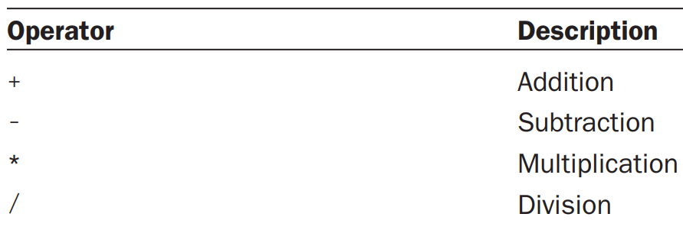
Aliases:
SELECT RTRIM(vend_name) || ' (' || RTRIM(vend_country) || ')' AS vend_title FROM Vendors ORDER BY vend_name;
Mathematical calculations:
SELECT prod_id, quantity, item_price, quantity*item_price AS expanded_price FROM OrderItems WHERE order_num = 20008;

Slide 23
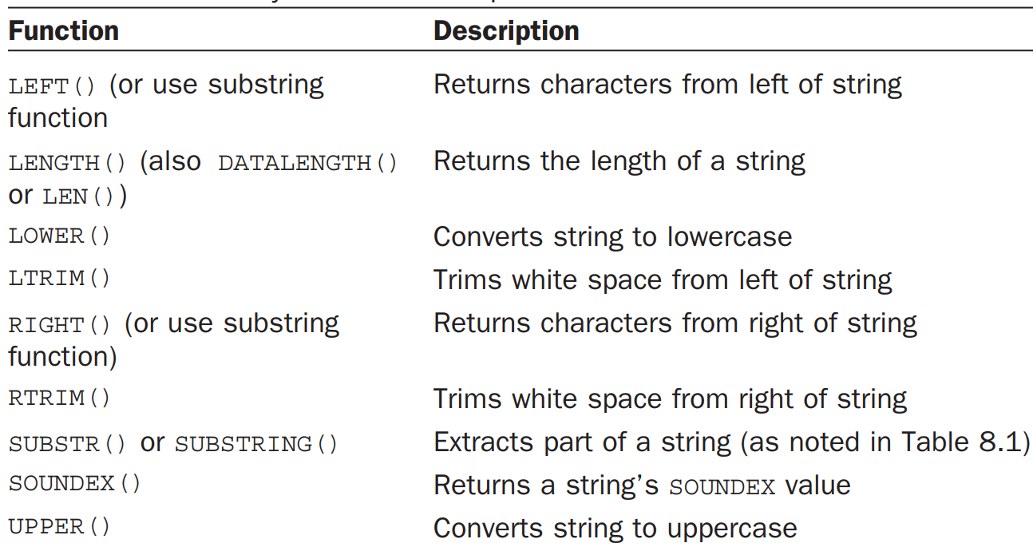
Using Functions(Text/Numeric/Date and time/formatting/System)
SELECT vend_name, UPPER(vend_name) AS vend_name_upcase FROM Vendors ORDER BY vend_name;

Slide 24
SELECT cust_name, cust_contact FROM Customers WHERE SOUNDEX(cust_contact) = SOUNDEX('Michael Green’);
Date:
SELECT order_num FROM Orders WHERE EXTRACT(year FROM order_date) = 2020;
SELECT order_num FROM Orders WHERE order_date BETWEEN to_date('2020-01-01', 'yyyy-mm-dd') AND to_date('2020-12-31', 'yyyy-mm-dd');

Slide 25
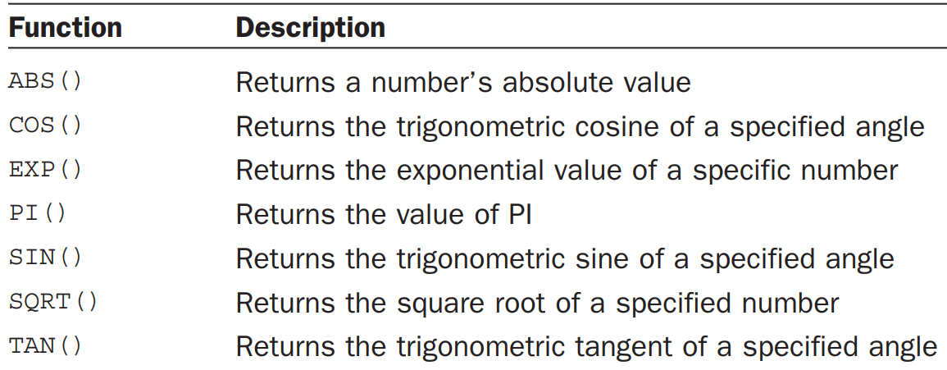
Numeric Manipulation:

Slide 26
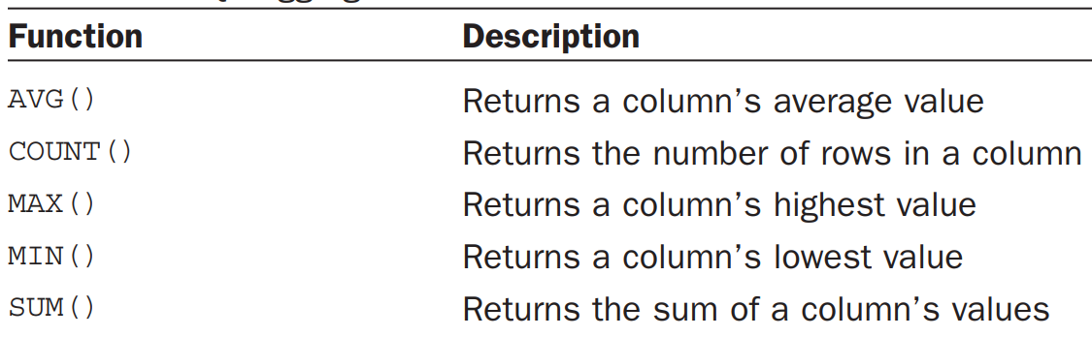
Summarizing Data
Using aggregate functions

Slide 27
SELECT AVG(prod_price) AS avg_price FROM Products;
SELECT AVG(prod_price) AS avg_price FROM Products WHERE vend_id = 'DLL01’;
SELECT COUNT(*) AS num_cust FROM Customers;
SELECT COUNT(cust_email) AS num_cust FROM Customers;
SELECT MAX(prod_price) AS max_price FROM Products;
SELECT MIN(prod_price) AS min_price FROM Products;
SELECT SUM(quantity) AS items_ordered FROM OrderItems WHERE order_num = 20005;
SELECT SUM(item_price*quantity) AS total_price FROM OrderItems WHERE order_num = 20005;

Slide 28
Aggregates on Distinct Values
SELECT AVG(DISTINCT prod_price) AS avg_price FROM Products WHERE vend_id = 'DLL01’;
Combining Aggregate Functions:
SELECT COUNT(*) AS num_items, MIN(prod_price) AS price_min, MAX(prod_price) AS price_max, AVG(prod_price) AS price_avg FROM Products;

Slide 29
Grouping Data
But what if you wanted to return the number of products offered by each vendor? Or products offered by vendors who offer a single product, or only those who offer more than 10 products?
This is where groups come into play. Grouping lets you divide data into logical sets so that you can perform aggregate calculations on each group

Slide 30
Creating Groups – GROUP BY clause
SELECT vend_id, COUNT(*) AS num_prods FROM Products GROUP BY vend_id;
Filtering Groups - allows you to filter which groups to include and which to exclude.
For example, you might want a list of all customers who have made at least two orders. To obtain this data, you must filter based on the complete group, not on individual rows.
SELECT cust_id, COUNT(*) AS orders FROM Orders GROUP BY cust_id HAVING COUNT(*) >= 2;
SELECT vend_id, COUNT(*) AS num_prods FROM Products WHERE prod_price >= 4 GROUP BY vend_id HAVING COUNT(*) >= 2;

Slide 31
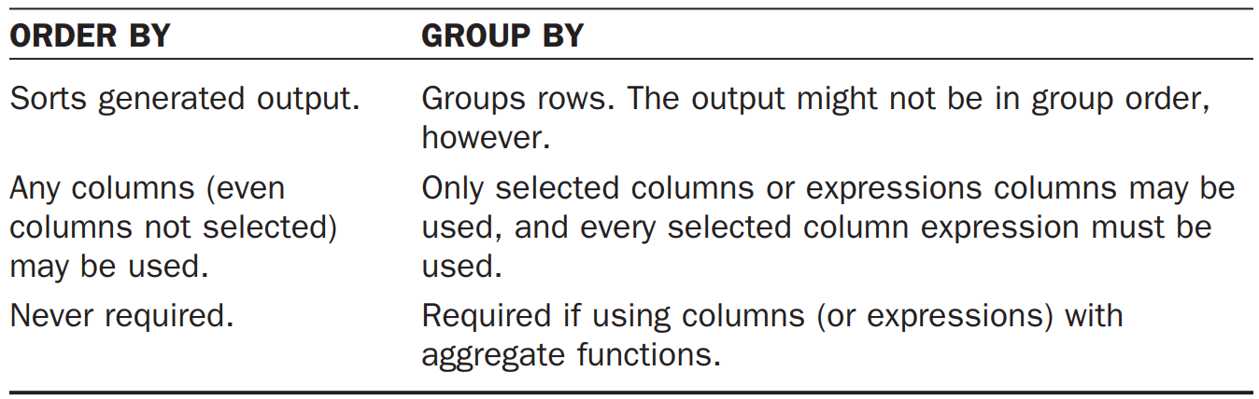
Grouping and Sorting
SELECT order_num, COUNT(*) AS items FROM OrderItems GROUP BY order_num HAVING COUNT(*) >= 3;
SELECT order_num, COUNT(*) AS items FROM OrderItems GROUP BY order_num HAVING COUNT(*) >= 3 ORDER BY items, order_num;

Slide 32
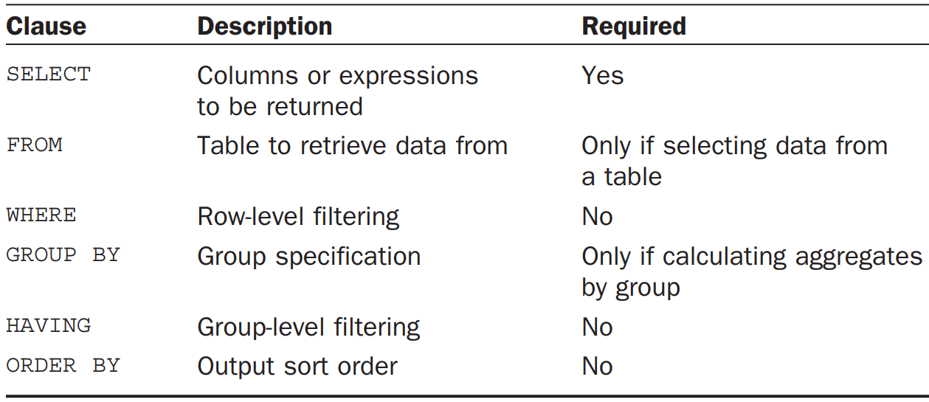
SELECT clause and Their Sequence

Slide 33
Working with Subqueries
Queries that are embedded into other queries.
Why would you want to do this?
Ex: Orders are stored in two tables.
The Orders table stores a single row for each order containing order number, customer ID, and order date.
The individual order items are stored in the related OrderItems table.
The Orders table does not store customer information. It only stores a customer ID.
The actual customer information is stored in the Customers table.

Slide 34
Now suppose you wanted a list of all the customers who ordered item RGAN01.
What would you have to do to retrieve this information?
Here are the steps:
1. Retrieve the order numbers of all orders containing item RGAN01.
2. Retrieve the customer ID of all the customers who have orders listed in the order numbers returned in the previous step.
3. Retrieve the customer information for all the customer IDs returned in the previous step.

Slide 35
1. SELECT order_num FROM OrderItems WHERE prod_id = 'RGAN01’;
2. SELECT cust_id FROM Orders WHERE order_num IN (20007,20008);
3. SELECT cust_name, cust_contact FROM Customers WHERE cust_id IN (1000000004,1000000005);
1 & 2: SELECT cust_id FROM Orders WHERE order_num IN (SELECT order_num FROM OrderItems WHERE prod_id = 'RGAN01’);
1 & 2 & 3: SELECT cust_name, cust_contact FROM Customers WHERE cust_id IN (SELECT cust_id FROM Orders WHERE order_num IN (SELECT order_num FROM OrderItems WHERE prod_id = 'RGAN01'));

Slide 36
Using Subqueries as Calculated Fields
Suppose you wanted to display the total number of orders placed by every customer in your Customers table.
Orders are stored in the Orders table along with the appropriate customer ID.
To perform this operation, follow these steps:
1. Retrieve the list of customers from the Customers table.
2. For each customer retrieved, count the number of associated orders in the Orders table.

Slide 37
SELECT COUNT(*) AS orders FROM Orders WHERE cust_id = 1000000001;
SELECT cust_name, cust_state,
(SELECT COUNT(*) FROM Orders WHERE Orders.cust_id = Customers.cust_id) AS orders
FROM Customers ORDER BY cust_name;

Slide 38
Joining Tables
Breaking data into multiple tables enables more efficient storage, easier manipulation, and greater scalability.
If data is stored in multiple tables, how can you retrieve that data with a single SELECT statement?
The answer is to use a join.
Simply put, a join is a mechanism used to associate, or join, tables within a SELECT statement (and thus the name join).
By using a special syntax, you can join multiple tables so that a single set of output is returned, and the join associates the correct rows in each table on the fly

Slide 39
Creating a Join
You must specify all the tables to be included and how they are related to each other.
SELECT vend_name, prod_name, prod_price FROM Vendors, Products WHERE Vendors.vend_id = Products.vend_id; --equijoin or inner join.
Here WHERE clause to set the join relationship.
When tables are joined in a SELECT statement, that relationship is constructed on the fly.
There is nothing in the database table definitions that can instruct the DBMS how to join the tables. You have to do that yourself.

Slide 40
When you join two tables, what you are actually doing is pairing every row in the first table with every row in the second table.
The WHERE clause acts as a filter to only include rows that match the specified filter condition—the join condition, in this case.
Without the WHERE clause, every row in the first table will be paired with every row in the second table, regardless of whether they logically go together or not.
SELECT vend_name, prod_name, prod_price FROM Vendors, Products;

Slide 41
In some DBs, inner join represented as:
SELECT vend_name, prod_name, prod_price FROM Vendors INNER JOIN Products ON Vendors.vend_id = Products.vend_id;
Joining Multiple Tables
SELECT prod_name, vend_name, prod_price, quantity FROM OrderItems, Products, Vendors WHERE Products.vend_id = Vendors.vend_id AND OrderItems.prod_id = Products.prod_id AND order_num = 20007;
SELECT cust_name, cust_contact FROM Customers, Orders, OrderItems WHERE Customers.cust_id = Orders.cust_id AND OrderItems.order_num = Orders.order_num AND prod_id = 'RGAN01';

Slide 42
SQL also enables you to alias table names. There are two primary reasons to do this:
To shorten the SQL syntax .
To enable multiple uses of the same table within a single SELECT statement.
Ex:
SELECT cust_name, cust_contact FROM Customers C, Orders O, OrderItems OI WHERE C.cust_id = O.cust_id AND OI.order_num = O.order_num AND prod_id = 'RGAN01’;
Self join:
Suppose you wanted to send a mailing to all the customer contacts who work for the same company for which Jim Jones works. This query requires that you first find out which company Jim Jones works for and next which customers work for that company.

Slide 43
Using subqueries:
SELECT cust_id, cust_name, cust_contact FROM Customers WHERE cust_name in (SELECT cust_name FROM Customers WHERE cust_contact = 'Jim Jones’);
Using self join:
SELECT c1.cust_id, c1.cust_name, c1.cust_contact FROM Customers c1, Customers c2 WHERE c1.cust_name = c2.cust_name AND c2.cust_contact = 'Jim Jones’;
Natural Joins
Whenever tables are joined, at least one column will appear in more than one table (the columns being used to create the join)
Standard joins (the inner joins) return all data, even multiple occurrences of the same column.
A natural join simply eliminates those multiple occurrences so that only one of each column is returned.

Slide 44
A natural join is a join in which you select only columns that are unique.
This is typically done using a wildcard (SELECT *) for one table and explicit subsets of the columns for all other tables. The following is an example:
SELECT C.*, O.order_num, O.order_date, OI.prod_id, OI.quantity, OI.item_price FROM Customers C, Orders O, OrderItems OI WHERE C.cust_id = O.cust_id AND OI.order_num = O.order_num AND prod_id = 'RGAN01';

Slide 45
Outer Joins:
Most joins relate rows in one table with rows in another.
But occasionally, you want to include rows that have no related rows.
For example, you might use joins to accomplish the following tasks:
Count how many orders were placed by each customer, including customers that have yet to place an order.
List all products with order quantities, including products not ordered by anyone.
Calculate average sale sizes, taking into account customers that have not yet placed an order.
In each of these examples, the join includes table rows that have no associated rows in the related table.
This type of join is called an outer join

Slide 46
Inner Join:
SELECT Customers.cust_id, Orders.order_num FROM Customers INNER JOIN Orders ON Customers.cust_id = Orders.cust_id;
Outer Join:
SELECT Customers.cust_id, Orders.order_num FROM Customers LEFT OUTER JOIN Orders ON Customers.cust_id = Orders.cust_id;
SELECT Customers.cust_id, Orders.order_num FROM Customers RIGHT OUTER JOIN Orders ON Customers.cust_id = Orders.cust_id;
SELECT Customers.cust_id, Orders.order_num FROM Customers FULL OUTER JOIN Orders ON Customers.cust_id = Orders.cust_id;

Slide 47
Joins with Aggregate Functions
You want to retrieve a list of all customers and the number of orders that each has placed. The following code uses the COUNT() function to achieve this:
SELECT Customers.cust_id, COUNT(Orders.order_num) AS num_ord FROM Customers INNER JOIN Orders ON Customers.cust_id = Orders.cust_id GROUP BY Customers.cust_id;

