Slide 1

Bank Analysis

Slide 2
Bank Analysis
by Faisal Khan

Slide 3
Project Bootcamp Program
Bank Loan of Customers
Year Wise Loan Amount Stats
Grade and Sub-Grade Wise Revol_bal
State Wise Loan Status
Home ownership vs Last Payment Date Status
about
Month Wise Loan Status
about
about
Total Payment for Verified and Non-Verified
about
about
about
Group-1

Slide 4
Grade and Sub-Grade Wise Revol_bal
Year Wise Loan Amount Stats
State Wise Loan Status
Home ownership vs Last Payment Date Status
about
Month Wise Loan Status
about
about
about
Total Payment for Verified and Non-Verified
about
about
Observation
Observation
The lending activity of the company increased significantly between 2007 and 2011 with a focus on both Fully Paid and Charged Off loans.
Suggestion
Need to focus on attracting more borrowers who are able to repay their loans in full by improving marketing and advertising efforts, or offering more competitive loan terms and interest rates.

Slide 5
Grade and Sub-Grade Wise Revol_bal
Year Wise Loan Amount Stats
State Wise Loan Status
Home ownership vs Last Payment Date Status
about
Month Wise Loan Status
about
about
Total Payment for Verified and Non-Verified
about
about
about
Observation
Observation
The majority of people in this dataset are either renting or have a mortgage. Mortgages people has steadily increased and more people taking out mortgages to buy homes.
Suggestion
Need to conduct survey increasing trend of mortgages. This could involve factor like housing affordability, interest rates, and economic conditions. Also, provides affordable housing programs, financial education and counseling.

Slide 6
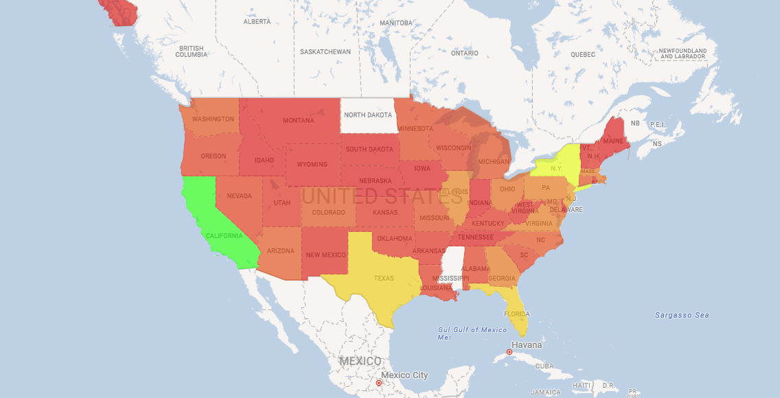
Grade and Sub-Grade Wise Revol_bal
Year Wise Loan Amount Stats
about
Home ownership vs Last Payment Date Status
Month Wise Loan Status
State Wise Loan Status
about
Total Payment for Verified and Non-Verified
about
about
about
about
Observation
Observation
California has the highest total loan amount. There are some states with relatively low loan amounts, such as Iowa, Vermont, and South Dakota
Suggestion
By increasing marketing efforts and expanding loan programs in states with lower loan amounts.

Slide 7
Grade and Sub-Grade Wise Revol_bal
Year Wise Loan Amount Stats
about
Home ownership vs Last Payment Date Status
Month Wise Loan Status
State Wise Loan Status
about
about
about
Total Payment for Verified and Non-Verified
about
about
Observation
Observation
Verified loans are more profitable as total payment significantly higher than that of not verified. The bank has a higher volume of verified loans.
Suggestion
Increase efforts to verify loan applicants to increase profitability for the bank. Offering gift vouchers or promotions to encourage customers to apply for verified loans.

Slide 8
Grade and Sub-Grade Wise Revol_bal
Year Wise Loan Amount Stats
Home ownership vs Last Payment Date Status
about
Month Wise Loan Status
State Wise Loan Status
about
about
about
Total Payment for Verified and Non-Verified
about
about
Observation
Observation
Potential issue with loan approval or collection processes as charged off loans increases. At the end of the year loan amount in increases in number.
Suggestion
Implementing a customer loyalty program or other incentives to encourage timely loan payments.

Slide 9
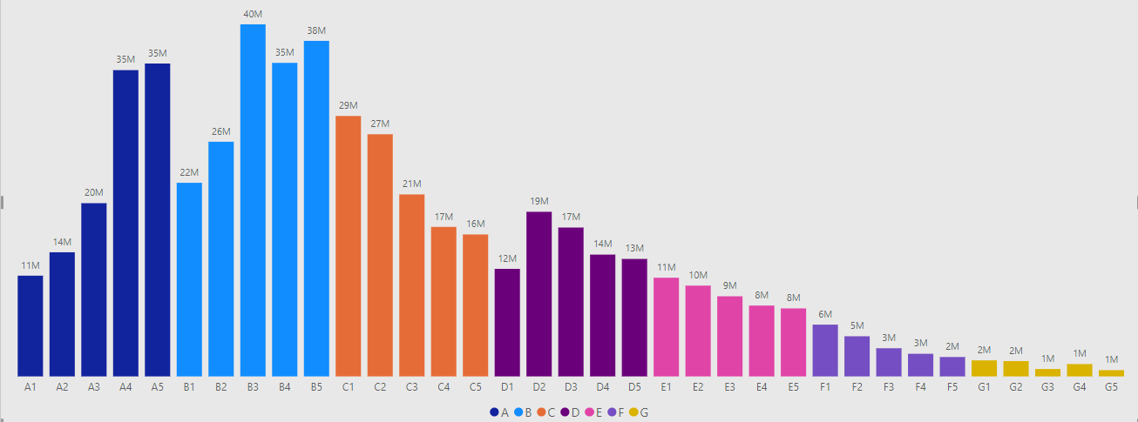
Year Wise Loan Amount Stats
Home ownership vs Last Payment Date Status
Month Wise Loan Status
State Wise Loan Status
about
about
about
Total Payment for Verified and Non-Verified
Grade and Sub-Grade Wise Revol_bal
about
about
about
Observation
Observation
Category B have the highest credit utilization. as the highest sum of revol_bal.
Suggestion
Providing credit counseling manage their credit utilization and rewards to customers.

Slide 10
Thank You

