Slide 1

Internship Training Project Presentation on
STUDENT MANAGEMENT SYSTEM IN C
Submitted To:
Submitted By:
Mr. Gaurav Gulati
Rohan (Roll No: XXXXXX)
Assistant Professor
Harsh (Roll No: XXXXXX)
Department of Computer Science & Engineering
Karan (Roll No: XXXXXX)
Department of Computer Science & Engineering
Panipat Institute of Engineering & Technology (PIET)

Slide 2

2. INTRODUCTION
What is this project?
The Student Management System is a console-based application developed entirely in the C programming language.
It is designed to replace physical registers with a digital, automated system. It provides an easy interface to store, organize, and manage academic data efficiently.
A Simple, Fast & Effective Solution for Academic Record Keeping.
The system uses basic file handling concepts to ensure that data is saved permanently and is not lost when the program is closed.

Slide 3
3. PROJECT OBJECTIVES
Digitize Manual Records
To eliminate paper-based record keeping and transition to a fully digital environment for managing student details.
Implement CRUD Logic
To practically apply the core concepts of software engineering: Create, Read, Update, and Delete operations.
Learn File Handling in C
To understand how temporary and permanent data storage works using text files (CSV format) in C programming.
Data Security (Authentication)
To implement a basic login mechanism so that only authorized admins can access or modify the student database.

Slide 4






4. SYSTEM FEATURES (CRUD)
Create (Add)
Read (View & Search)
Add new students to the system by entering their Roll Number, Name, Branch, and CGPA. Data is appended to a CSV file.
Display all students in a neatly formatted table. Also, search for a specific student instantly using their unique Roll Number.
Update (Modify)
Delete (Remove)
Search a student by Roll No and overwrite their old data with new information (e.g., correcting a name or updating CGPA).
Permanently remove a student's record from the database. Uses a secure method of transferring data to a temporary file.

Slide 5
5. TECHNOLOGY & CONCEPTS USED
Core Language
Key C Concepts
Component | Details
Language | C Programming
Compiler | GCC (GNU Compiler Collection)
Storage | Local Flat Files (.csv format)
Structures (struct)Used to group mixed data types (int, char, float) into a single entity called 'Student'.
File HandlingUsing fopen(), fprintf(), and fscanf() to read and write data to the hard drive.
Control FlowUsing infinite while(1) loops for the menu and switch cases for user choices.

Slide 6

6. SYSTEM FLOW DIAGRAM
Start
Menu
Input
Process
Loop
Admin Login Password Verification
Main Menu Display Choices (1-6)
Select Action Switch Case execution
Execute CRUD File Read/Write Ops
Return / Exit Back to menu or Stop

Slide 7
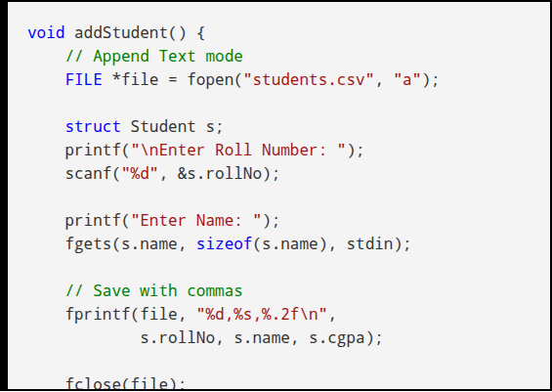
7. ALGORITHM & SOURCE CODE CLIP
Update/Delete Algorithm Logic:
Open Files: Open main file in 'Read' mode and a temp file in 'Write' mode.
Search & Match: Read data line-by-line. Compare entered Roll No with saved data.
Modify: If matched, write new data (for update) or skip it (for delete) into the temp file.
Save: Write all other unmatched data as-is to the temp file.
Replace: Delete original file and rename temp file to main file.

Slide 8
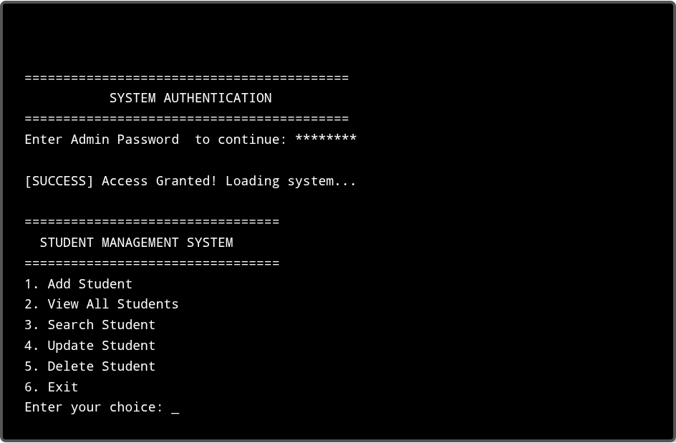
8. TERMINAL OUTPUT CLIP
Command Prompt - C:\Projects\StudentSystem.exe

Slide 9



9. ADVANTAGES & LIMITATIONS
Advantages
Limitations
Lightweight: Uses very minimal RAM and processing power.
Security: Data is saved in a plain text CSV file, which anyone can open and read easily.
No External Setup: Does not require installing heavy software like MySQL or Oracle.
Single User: It does not support multiple admins modifying data at the exact same time.
Fast Execution: Text file operations in C are incredibly fast for small to medium datasets.
No UI: Console-based interface is not very visually appealing to modern end-users.

Slide 10

10. FUTURE SCOPE & CONCLUSION
Future Scope
Conclusion
The current system is a foundational prototype. In the future, we can upgrade it by:
This project successfully demonstrates the practical implementation of CRUD operations using the C programming language.
Database Integration: Moving from flat files to a proper SQL database for better data management.
It proves that complex data management tasks can be solved using fundamental programming concepts like Structs, Pointers, and File Handling.
Graphical User Interface: Building a GUI using C++ (Qt) or Java instead of a black console window.
Data Encryption: Encrypting the password and student details before saving to the file.

Slide 11
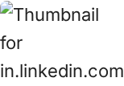
IMAGE SOURCES
https://media.licdn.com/dms/image/v2/C4E0BAQG1mF3j8c1n9g/company-logo_200_200/company-logo_200_200/0/1630600028489/panipat_institute_of_engineering__technology_logo?e=2147483647&v=beta&t=7U1H6Lw9fG99Y4_Kk2pZ5c1W7mO42_R8u9Q3G5q9Z8g
Source: in.linkedin.com

Slide 12
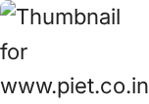
IMAGE SOURCES
https://api.piet.co.in/uploads/1773136760698-piet%20white%20logo%20(1).png
Source: www.piet.co.in

