Slide 1
Home Reader App
By Nicole hulett

Slide 2
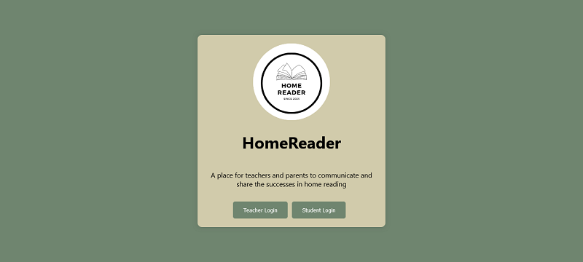
This app was made for teachers and parents to communicate a student’s home reading.

Slide 3
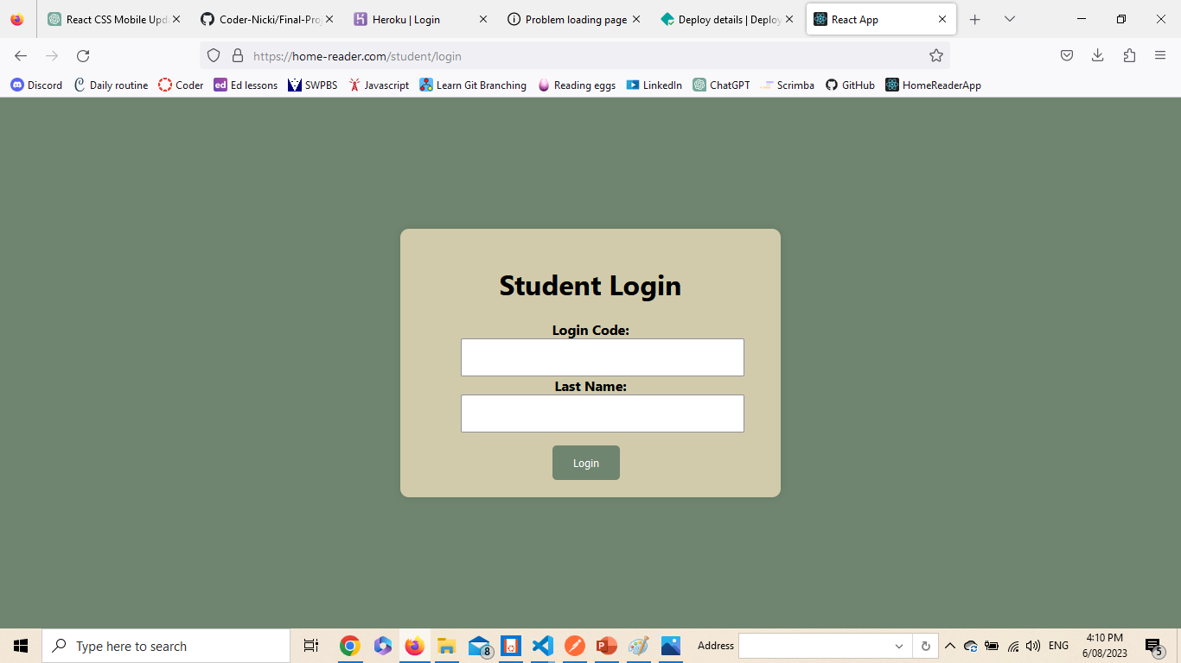
Clear simple designs – desktop version

Slide 4
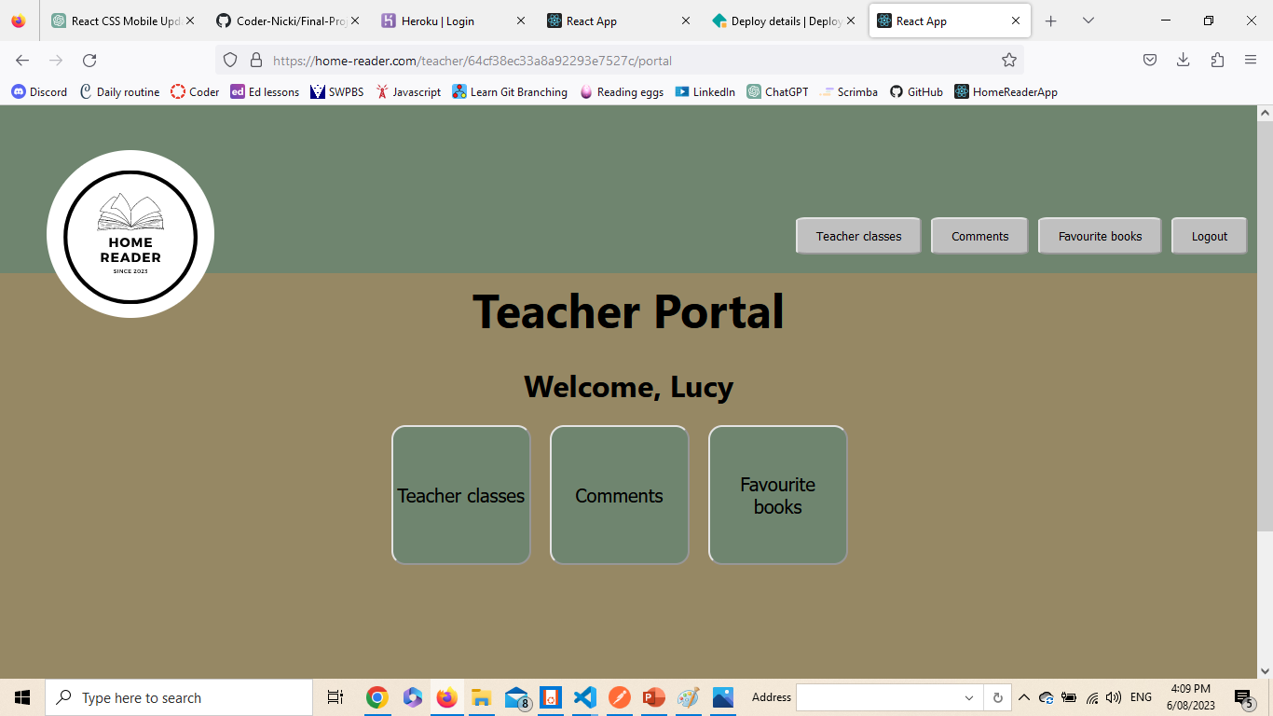
The main homescreen for teachers. Here they can access all the information they need

Slide 5
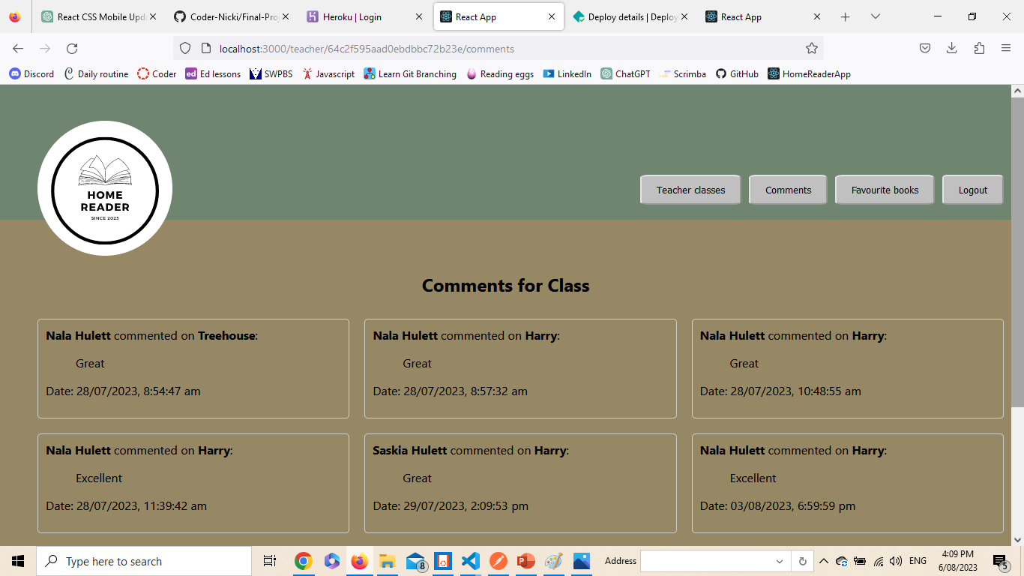
The logo was designed in canva and is a link back to the teacher portal

Slide 6
difficulties
CSS styling of the header and logo that was responsive and sat half on half off the header
Creating appropriate tests
Completing the project in the time frame
React, this was one of my weaknesses. Unfortunately, I did not use context providers or global reducers.

Slide 7
Future improvements
Add more responsive styling
Many more unit tests in both front end and back end
A teacher password reset feature
A picture header to create a more professional and sleek feel for the app

