Slide 1

Seasonal Agriculture Performance Analysis
Presented By –
Priyanka Dutta
University of Kalyani
AICTE STU ID : STU687dd63dd4c1e1753077309

Slide 2


PROBLEM STATEMENT
The Reality
Agricultural performance shifts heavily from season to season due to changing weather and resource availability.
The Gap
Without analyzing historical data, it is difficult to spot the exact trends or predict how the seasonal changes impact total yield.
The Objective
To analyze the dataset, uncover hidden seasonal patterns, and provide data-driven insights for better agricultural planning.

Slide 3
Project Description
Focus Area
Analyzing an agricultural dataset to evaluate how farming performance changes across seasons.
The Challenge
Weather, resource shifts, and changing farming practices make seasonal production highly unpredictable.
Methodology
Exploring the data using statistical analysis and visualization to find hidden trends and relationships.
Ultimate Goal
Turn raw data into practical, evidence-based insights to improve future agricultural planning.

Slide 4

TARGET END USERS
Farmers & Growers
Optimize planting schedules.
Maximize seasonal crop yields.
Reduce resource waste.
Agricultural Advisors
Provide data-backed recommendations.
Improve resource allocation.
Guide local farming practices.
Supply Chain Managers
Plan logistics & transport early.
Estimate required storage space.
Prevent post-harvest losses.
Financial Analysts
Forecast market prices.
Budget for seasonal dips.
Manage investment risks.
eco
forum
local_shipping
trending_up

Slide 5

Technology Used
Pandas
Data loading, cleaning, transformation and aggregation
NumPy
Numerical calculations and data processing
Python
Data analysis and overall project implementation
Seaborn
Statistical plots and relationship visualization
SciPy
Statistical analysis and hypothesis testing
Matplotlib
Creating analytical visualizations
Jupyter Notebook
Development, analysis and documentation

Slide 6
RESULTS & PIPELINE
A systematic data-driven workflow for seasonal agricultural performance analysis
01
02
03
04
05
06
07
database
cleaning_services
build
bar_chart
science
wb_sunny
lightbulb
Agricultural Dataset
Initial raw farm-level records
Data Cleaning
Handling missing values & noise
Feature Engineering
Deriving seasonal indicators
EDA & Visuals
Exploratory plots & trends
Statistical Analysis
Hypothesis testing & modeling
Seasonal Compare
Kharif, Rabi, & Zaid cross-study
Insights & Action
Data-backed advisory output

Slide 7
RESULTS
Data Preparation, Cleaning Pipeline & Key Methodology Code
alt_routeData Preparation Workflow
methodology_pipeline.py
1. Raw Dataset
Initial agricultural performance dataset
# 1. Load Dataset
DATA_PATH = "seasonal_agriculture_performance_dataset.csv"
df = pd.read_csv(DATA_PATH)
# 2. Create Profit Margin Metric
clean_df["Profit_Margin_pct"] = np.where(
clean_df["Revenue_INR"] != 0,
(clean_df["Profit_INR"] / clean_df["Revenue_INR"]) * 100,
np.nan
)
# 3. Create Cost per Tonne Metric
clean_df["Cost_per_Tonne_INR"] = np.where(
clean_df["Production_Tonnes"] != 0,
clean_df["Total_Cost_INR"] / clean_df["Production_Tonnes"],
np.nan
)
database
travel_explore
2. Data Understanding
Schema analysis and distribution profiling
running_with_errors
3. Missing Value Check
Identifying null values and sparse features
content_copy
4. Duplicate & Invalid Check
Detecting redundancy and constraint violations
cleaning_services
5. Data Cleaning
Type casting and outlier handling
construction
6. Feature Engineering
Deriving seasonal performance KPIs
Analysis: ANOVA + Kruskal-Wallis + IQR Outlier Analysis

Slide 8
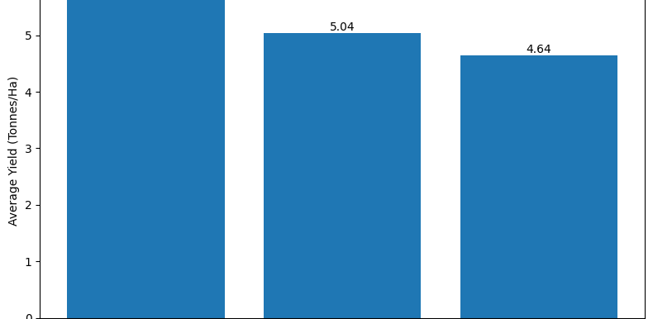
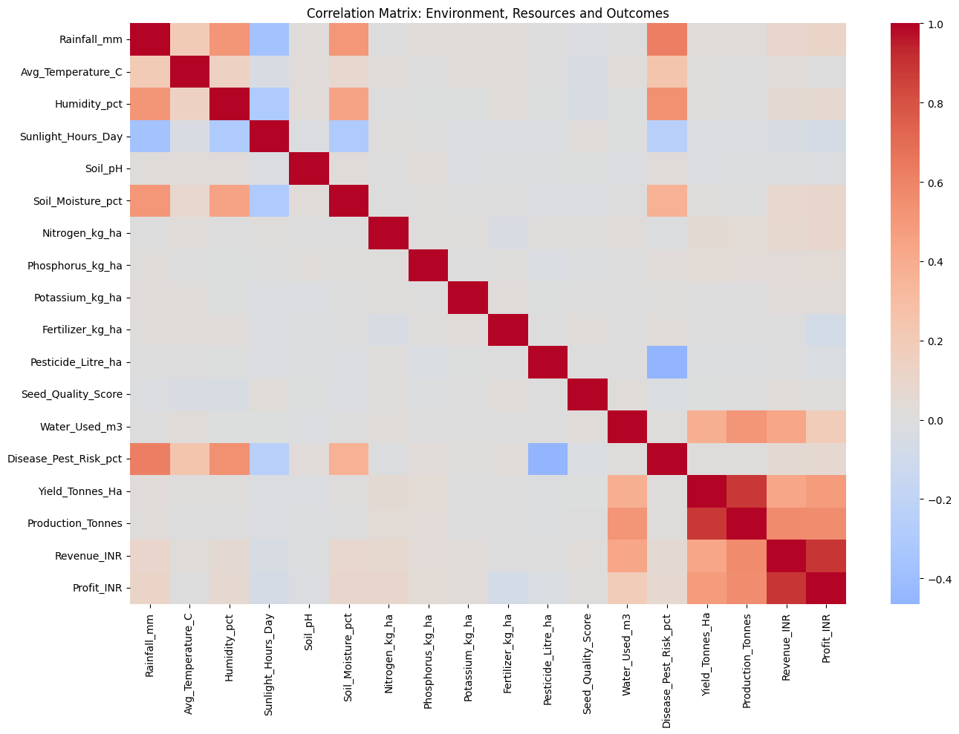
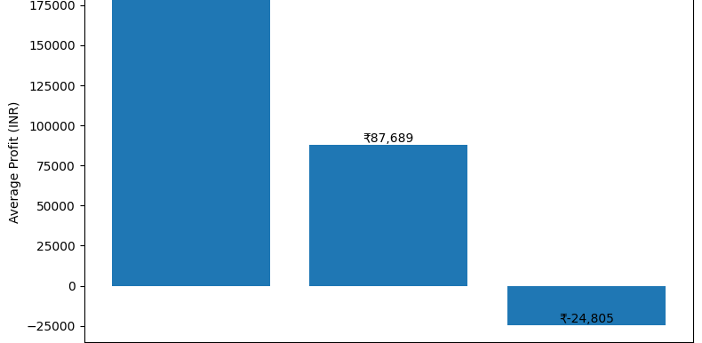
RESULTS
Exploratory analysis of seasonal yields, profitability, and resource correlations
bar_chartSeasonal Yield & Profitability Metrics
grid_onResource & Environmental Correlations

Slide 9
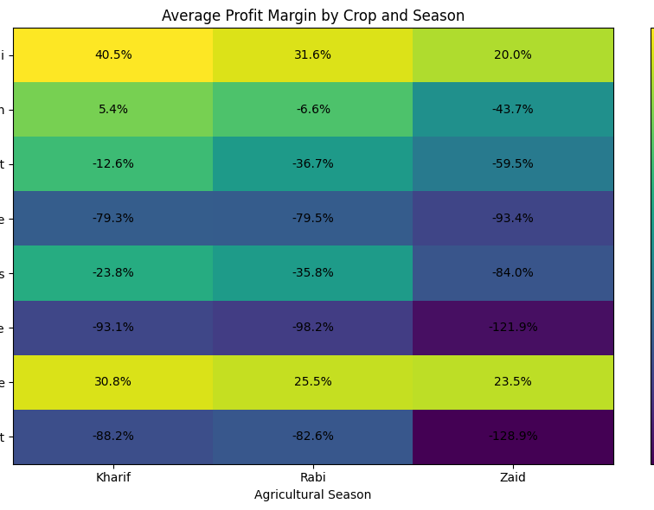
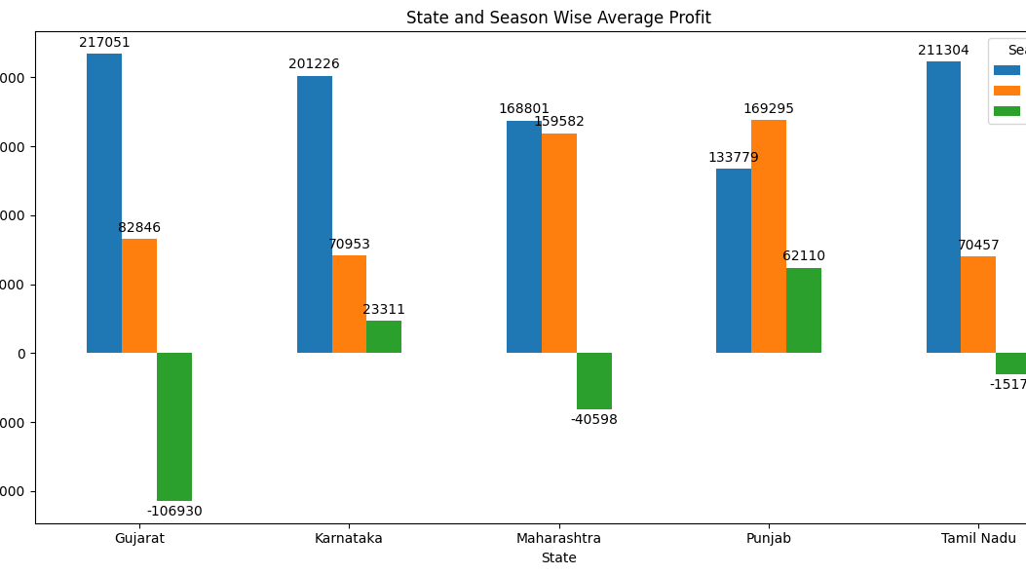
RESULTS
Comparative analysis of crop profit margins and state-level seasonal profitability
table_chartAverage Profit Margin by Crop and Season
bar_chartState & Season Wise Average Profit

Slide 10
RESULTS
Seasonal Performance Evaluation & Statistical Significance Testing
starKey Metrics (Kharif Dominance)
Across all parameters analyzed, the Kharif season demonstrated the highest performance averages compared to other crop seasons.
trending_up
Highest Average Yield
Kharif (5.63 t/ha)
payments
Highest Average Profit
Kharif (INR 178,915)
opacity
Highest Water Efficiency
Kharif (5.89 t/1,000 m³)
bug_report
Disease & Pest Risk
Kharif (54.47%)
analyticsStatistical Testing
ANOVA Hypothesis Tests
Yield: F = 1.5439, p = 0.2137 (Not Sig.)
Profit: F = 34.2918, p = 1.71e-15 ***
Kruskal-Wallis Rank Tests
Yield: H-Stat = 68.71, p = 1.20e-15 ***
Profit: H-Stat = 101.93, p = 7.36e-23 ***
gavelDecision Rule
A p-value < 0.05 indicates robust empirical evidence of statistically significant variation among seasonal periods.

Slide 11
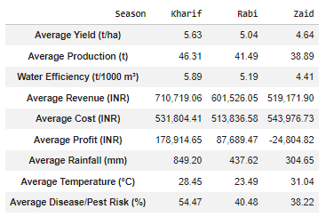
RESULTS
Comprehensive Seasonal Agriculture Performance Summary Table
table_chartSeasonal Performance Metrics
lightbulbKey Observations
Kharif DominanceAcross almost all evaluated parameters, the Kharif season records the highest overall performance.
Yield & Efficiency CorrelationStrong water efficiency (5.89 t/1000 m³) correlates directly with the highest average crop yields (5.63 t/ha).
Zaid Season ViabilityZaid exhibits the lowest average profit (INR -24,804.82), indicating potential areas for resource reallocation.
Pest & Disease RisksHigher moisture and average temperatures (31.04°C) during Zaid run parallel to varied seasonal crop risks.

Slide 12
Future scope
psychology
Machine Learning Prediction
Develop ML models to predict crop yield and agricultural performance.
dashboard
Interactive Dashboard
Develop a Power BI/web dashboard for real-time monitoring and decision-making.
sensors
Real-Time Data Integration
Incorporate live weather, rainfall, soil and market-price data.
public
Regional-Level Analysis
Expand the analysis to more states, districts and geographical regions.
trending_up
Resource Optimization
Use analytics to optimize water, fertilizer, pesticide and other resource usage.

Slide 13
GitHub Repository
Access the complete project codebase and analysis resources
code
VOIS Major Project
Seasonal Agriculture Performance Analysis
Clone or browse the repository on GitHub:
linkhttps://github.com/Coder-Pinku/VOIS_Major_Project_Seasonal_Agriculture_Performance_Analysis

Slide 14
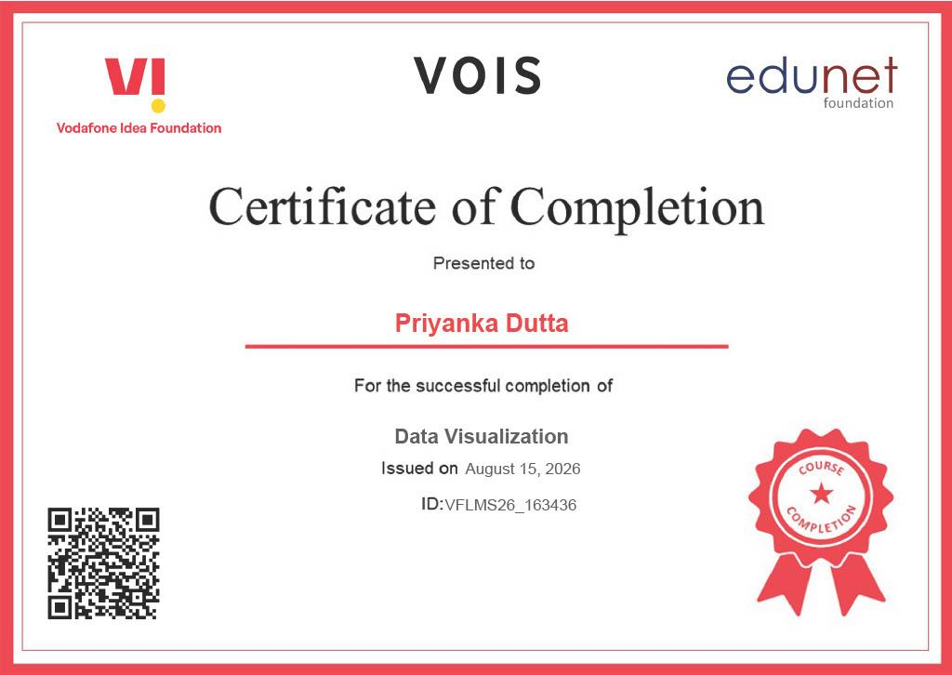
VOIS Course completion certificate - Data Visualization

Slide 15
Thank you
.

