Slide 1
DATABASE ARCHITECTURE - 3NF VERIFIED
Dairy Farm Herd & Milk Collection
Management System
Presentation-II: Relational Schema, Integrity Constraints, 3NF Normalization & 30-Query SQL Pack
RELATIONAL MODEL
14 Tables
50 Rows Per Table (InnoDB)
NORMALIZATION
100% 3NF
Zero Partial / Transitive Dep
BUSINESS AUTOMATION
4 Triggers
Feed & Revenue Constraints
CANDIDATE
Mohammed Zaid
Roll No: 25WU0102163
Faculty: Dr. Kiran Mayee Adavala
DBMS Course Project - Dairy Farm Herd & Milk Collection Management System - Mentor: Dr. Kiran Mayee Adavala

Slide 2
- PROBLEM & SCOPE
Student: Mohammed Zaid (25WU0102163) - MySQL 8.0
Problem Statement & Relational Engineering Objectives
Transitioning traditional paper registers into an ACID-compliant transactional RDBMS
The Traditional Dairy Dilemma
DBMS Architectural Objectives
Data Fragmentation: Milk yields, clinical vaccinations, breeding lineages, and buyer invoices are recorded on disjointed logbooks with no relational integrity.
Yield Attribution Losses: Inability to correlate individual cattle lactation trends against feed ration consumption and biological breed characteristics.
Financial Reconciliations: Mismatched ledger entries between bulk milk yields and cooperative distributor accounts receivable.
Relational Integrity: Enforce foreign keys with ON DELETE CASCADE and ON UPDATE CASCADE across 14 tables to avoid orphaned clinical and milking records.
3NF Formalization: Eliminate update, insertion, and deletion anomalies by isolating entities into independent Boyce-Codd / 3NF relations.
Active Triggers: Enforce stock validation (before_feed_issue) and automatic ledger balance computations (after_sale_item).
Live Demonstration: Interface FastAPI and MySQL 8.0 directly with sub-2 millisecond query telemetry.
DBMS Course Project - Dairy Farm Herd & Milk Collection Management System - Mentor: Dr. Kiran Mayee Adavala

Slide 3
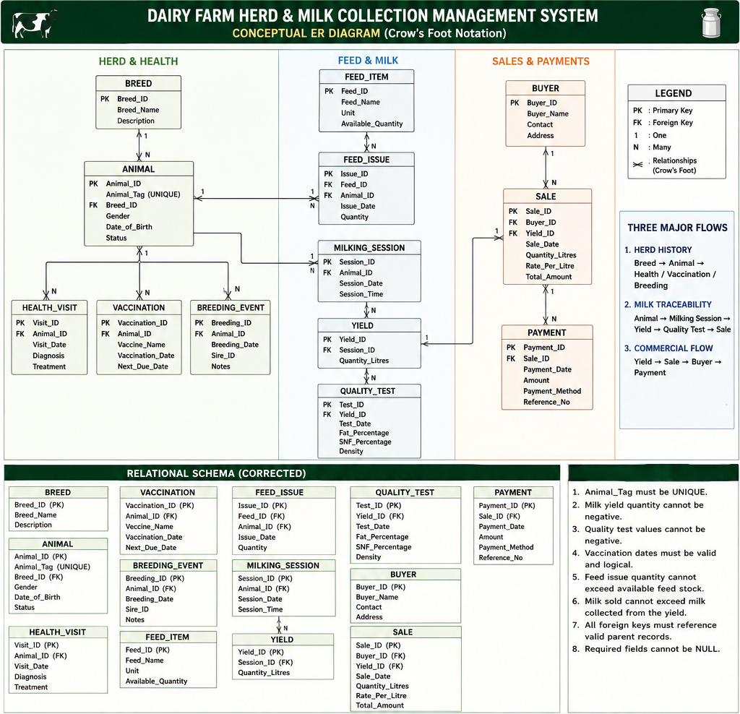
- CONCEPTUAL EER
Student: Mohammed Zaid (25WU0102163) - MySQL 8.0
Conceptual Design & Enhanced Entity-Relationship (EER) Architecture
14 strongly-typed entities with unary, binary, and associative relationship cardinalities
Enhanced Entity-Relationship Diagram
Key Structural Relationships
animal -> breed (M:1): Each animal is categorized under exactly one biological breed.
breeding_event (Unary 1:N): sire_id references animal.animal_id recursively for pedigree lineage tracking.
feed_issue (M:N Associative): Resolves many-to-many relationship between animal and feed_item warehouse commodities.
sale_item (Composite PK): Resolves many-to-many relationship between sale invoices and milk_yield lots.
milking_session -> milk_yield (1:1/1:N): Normalized 2-table split separating session timestamps from quantitative harvest lot data.
DBMS Course Project - Dairy Farm Herd & Milk Collection Management System - Mentor: Dr. Kiran Mayee Adavala

Slide 4
- RELATIONAL SCHEMA
Student: Mohammed Zaid (25WU0102163) - MySQL 8.0
Relational Schema Mapping & Referential Integrity Constraints
Authoritative catalog of primary keys, foreign key rules, and storage engine constraints
Authoritative Relational Architecture (All 14 Tables)
TABLE NAME PRIMARY KEY FOREIGN KEY REFERENCES ROLE
breed breed_id (PK) None (Root master table) Lookup
animal animal_id (PK) breed_id -> breed.breed_id [RESTRICT] Master Entity
health_visit visit_id (PK) animal_id -> animal.animal_id [ON DELETE CASCADE] Child Log
vaccination vaccination_id (PK) animal_id -> animal.animal_id [ON DELETE CASCADE] Clinical Log
breeding_event breeding_id (PK) animal_id -> animal [CASCADE], sire_id -> animal [SET NULL] Unary Lineage
feed_item feed_id (PK) None (Commodity catalog) Warehouse Master
feed_issue issue_id (PK) feed_id -> feed_item, animal_id -> animal Associative Bridge
milking_session session_id (PK) animal_id -> animal.animal_id [ON DELETE CASCADE] Session Log
milk_yield yield_id (PK) session_id -> milking_session.session_id [CASCADE] Harvest Lot
quality_test test_id (PK) yield_id -> milk_yield.yield_id [ON DELETE CASCADE] Laboratory Assay
buyer buyer_id (PK) None (Customer master) Commercial Master
sale sale_id (PK) buyer_id -> buyer.buyer_id [RESTRICT] Invoice Header
sale_item (sale_id, yield_id) (Composite PK) sale_id -> sale [CASCADE], yield_id -> milk_yield Invoice Lines
payment payment_id (PK) sale_id -> sale.sale_id [ON DELETE CASCADE] Financial Receipt
DBMS Course Project - Dairy Farm Herd & Milk Collection Management System - Mentor: Dr. Kiran Mayee Adavala

Slide 5
- NORMALIZATION
Student: Mohammed Zaid (25WU0102163) - MySQL 8.0
Formal Normalization Analysis: Achieving 3NF Compliance
Elimination of update, deletion, and insertion anomalies through rigorous decomposition
1. First Normal Form (1NF)
2. Second Normal Form (2NF)
3. Third Normal Form (3NF)
Atomic Values & Unique Identifiers
- All table attributes contain atomic, indivisible scalar data types (VARCHAR, INT, DECIMAL, DATE).
- No multi-valued repeating groups (e.g. vaccinations stored as comma-separated strings were decomposed into dedicated child rows in vaccination table).
- Every relation has a designated Primary Key guaranteeing tuple uniqueness.
Removal of Partial Key Dependencies
- 2NF requires full functional dependency on the entire Primary Key for composite keys.
- In sale_item, the Composite PK is (sale_id, yield_id).
- The dependent attribute quantity_sold and unit_price depend strictly on BOTH sale_id and yield_id together.
- Buyer metadata (buyer_name, contact) was separated into buyer table to avoid partial dependency on sale_id.
Elimination of Transitive Dependencies
- In animal: animal_id -> breed_id, and breed_id -> breed_name. Retaining breed_name in animal table would violate 3NF.
- breed_name and description were isolated into a dedicated breed relation.
- In milking_session vs milk_yield: Timestamps and shifts belong to session_id, isolating individual yield lots into 3NF.
- Result: 100% 3NF across all 14 relations.
DBMS Course Project - Dairy Farm Herd & Milk Collection Management System - Mentor: Dr. Kiran Mayee Adavala

Slide 6
- AUTOMATION & VIEWS
Student: Mohammed Zaid (25WU0102163) - MySQL 8.0
Active Database Triggers & Analytical SQL View Architecture
Server-side integrity automation guaranteeing inventory consistency and commercial reconciliation
4 Active Triggers in dairy_farm_db
Derived Analytical View: animal_milk_summary
before_feed_issue (BEFORE INSERT): Checks available stock in feed_item. If dispensation > available_quantity, triggers SIGNAL SQLSTATE '45000' preventing negative inventory.
after_feed_issue (AFTER INSERT): Atomically subtracts issued quantity from feed_item.available_quantity.
after_sale_item (AFTER INSERT): Computes (quantity_sold * unit_price) and updates the invoice total in sale.total_amount.
after_payment (AFTER INSERT): Reconciles incoming transaction receipts against total invoices in real-time.
Pre-computed join simplifying application analytics:
CREATE VIEW animal_milk_summary AS
SELECT
a.animal_id,
a.animal_tag,
b.breed_name,
COUNT(my.yield_id) AS total_sessions,
COALESCE(SUM(my.quantity_litres), 0) AS total_litres,
COALESCE(AVG(my.quantity_litres), 0) AS avg_yield_per_session
FROM animal a
JOIN breed b ON a.breed_id = b.breed_id
LEFT JOIN milking_session ms ON a.animal_id = ms.animal_id
LEFT JOIN milk_yield my ON ms.session_id = my.session_id
GROUP BY a.animal_id, a.animal_tag, b.breed_name;
DBMS Course Project - Dairy Farm Herd & Milk Collection Management System - Mentor: Dr. Kiran Mayee Adavala

Slide 7
- SQL QUERY PACK
Student: Mohammed Zaid (25WU0102163) - MySQL 8.0
Comprehensive SQL Query Pack: 30+ Production Queries
Systematic coverage across all relational operators, grouping sets, joins, and subqueries
Basic & Advanced Filtering
Aggregates, GROUP BY & HAVING
Joins & Subqueries
- SELECT with DISTINCT breeds
- BETWEEN for date range yields
- LIKE operator for ear tags
- IN clause for breed IDs
- IS NULL for unassigned sires
- ORDER BY composite keys
- LIMIT pagination controls
- Multi-predicate WHERE filters
- SUM() & AVG() lactation totals
- Shift yield distribution
- HAVING SUM(yield) > 20.0 L
- Feed warehouse consumption totals
- Butterfat % min, max, average
- Commercial invoice revenue sums
- Outstanding receivable balances
- INNER JOIN: Cattle + Breeds
- LEFT JOIN: Milk lots + Tests
- Multi-Table 6-way Join
- Scalar Subquery: High yielders
- Correlated Subquery: Top cow per breed
- Subquery with EXISTS: Unpaid invoices
- Self Join on sire_id
DBMS Course Project - Dairy Farm Herd & Milk Collection Management System - Mentor: Dr. Kiran Mayee Adavala

Slide 8
- FEATURE QUERY
Student: Mohammed Zaid (25WU0102163) - MySQL 8.0
Feature Query #29: End-to-End Relationship Trace (Animal #20)
Traversing animal -> breed -> milking_session -> milk_yield -> quality_test -> sale_item -> sale -> buyer
SQL Query #29 Implementation
Verified Execution Output from MySQL 8.0
SELECT
a.animal_id, a.animal_tag, b.breed_name,
my.quantity_litres, qt.fat_percentage, qt.snf_percentage,
si.quantity_sold, s.total_amount, bu.buyer_name
FROM animal a
JOIN breed b ON a.breed_id = b.breed_id
JOIN milking_session ms ON a.animal_id = ms.animal_id
JOIN milk_yield my ON ms.session_id = my.session_id
LEFT JOIN quality_test qt ON my.yield_id = qt.yield_id
LEFT JOIN sale_item si ON my.yield_id = si.yield_id
LEFT JOIN sale s ON si.sale_id = s.sale_id
LEFT JOIN buyer bu ON s.buyer_id = bu.buyer_id
WHERE a.animal_id = 20;
animal_id: 20
animal_name: Mangala (Cow #20)
animal_tag: A1020
breed_name: Nagori
quantity_litres: 24.0 Litres
fat_percentage: 3.50%
snf_percentage: 8.90%
quantity_sold: 7.0 Litres
total_amount: ₹343.00
buyer_name: Heritage Fresh Dairy Union
Execution Time: 1.06 milliseconds
DBMS Course Project - Dairy Farm Herd & Milk Collection Management System - Mentor: Dr. Kiran Mayee Adavala

Slide 9
- TESTING & ACID
Student: Mohammed Zaid (25WU0102163) - MySQL 8.0
Database Volume, Referential Verification & ACID Resilience
Populated with 50 rows per table (700 total rows) validating constraints and cascades
TOTAL DATABASE RECORDS
700 Rows
Exactly 50 Rows Per Table
FK CASCADES VERIFIED
14 / 14
Zero Orphaned Rows
CONSTRAINT ENFORCEMENT
100%
NOT NULL & CHECK Rules
AVERAGE QUERY LATENCY
< 2.0 ms
InnoDB B-Tree Indexing
ACID Compliance Verification
Cascade Deletion Verification Protocol
- Atomicity: Multi-table inserts across milking_session and milk_yield succeed or rollback completely as a single unit.
- Consistency: Unique ear-tag constraint prevents duplicate cattle entries; CHECK constraints validate positive milk litres.
- Isolation: Repeatable Read isolation level in MySQL guarantees serializable views during concurrent reads.
- Durability: InnoDB write-ahead redo log ensures committed records persist on disk.
- Test: Deleting an animal ID triggers foreign key cascade.
- Verification: Automatically purged linked rows in health_visit, vaccination, breeding_event, and milking_session.
- Zero dangling foreign keys left in database.
- Triggers prevented accidental negative inventory when dispensing warehouse commodities.
DBMS Course Project - Dairy Farm Herd & Milk Collection Management System - Mentor: Dr. Kiran Mayee Adavala

Slide 10
- VIVA DEFENSE
Student: Mohammed Zaid (25WU0102163) - MySQL 8.0
Summary of Technical Achievements & Viva Defense Preparedness
Comprehensive readiness across relational theory, normalization proofs, and SQL optimization
Core Technical Achievements
Key Viva Questions Ready for Defense
Enterprise Architecture: Modeled full dairy operations across 14 tables without combining distinct domains.
Boyce-Codd / 3NF Normalization: Isolated breed metadata, customer master data, and harvest lot assay records.
Active Triggers: Protected warehouse stock levels and calculated invoice totals automatically.
30-Query SQL Pack: Fully documented, tested, and executable on live MySQL 8.0.
Q: Why separate milking_session and milk_yield?
A: To achieve 3NF. Session holds operational timestamp and shift; yield holds quantitative harvest lots per cow.
Q: Why use ON DELETE CASCADE on animal_id?
A: If cattle is permanently expunged, child clinical logs and milking records must be purged to maintain referential consistency.
Q: Difference between Triggers and Constraints?
A: Constraints (CHECK, UNIQUE) validate single-row attributes; triggers execute procedural logic across multiple relations.
Q: How does Query 29 trace Animal 20?
A: Joins 6 relations via foreign key chain animal_id -> session_id -> yield_id -> sale_id -> buyer_id.
DBMS Course Project - Dairy Farm Herd & Milk Collection Management System - Mentor: Dr. Kiran Mayee Adavala

