Slide 1
LIVE WORKING DEMONSTRATION - STACK 2.0
Dairy Farm Studio
Enterprise DBMS Management System
Presentation-III: Full-Stack Live Demonstration interfacing directly with MySQL Server 8.0
ENTERPRISE STUDIO
8 Modules
Supabase + Linear Dark Theme
SQL TELEMETRY
1.38 ms
Sub-2ms Query Execution
TRANSACTIONS
Live ACID
Before/After Audit Protocol
CANDIDATE
Mohammed Zaid
Roll No: 25WU0102163
Faculty: Dr. Kiran Mayee Adavala
DBMS Course Project - Dairy Farm Herd & Milk Collection Management System - Mentor: Dr. Kiran Mayee Adavala

Slide 2
- SYSTEM ARCHITECTURE
Student: Mohammed Zaid (25WU0102163) - MySQL 8.0
3-Tier System Architecture & Technology Stack
Decoupled architecture connecting modern browser interface directly to MySQL 8.0
1. Presentation Layer
2. Application & API Layer
3. Database Persistence
Enterprise Studio Interface
- HTML5 Semantic Layout
- Vanilla CSS3 (Zero external CSS framework dependencies)
- Supabase Emerald + Linear Dark Design System
- Modular Single-Page App (SPA)
- Real-time Before/After audit slide-down transaction drawer
- Monospace SQL Studio
FastAPI Asynchronous Gateway
- Python 3.12 + FastAPI Engine
- PyMySQL Native Driver with Repeatable Read Isolation
- Pydantic v2 Schema Validation
- Atomic 2-table multi-insert transaction handlers
- Execution time telemetry measuring query latency
- Clean JSON row serialization
MySQL Community 8.0.46
- Database: dairy_farm_db
- 14 Base Tables + 1 View
- InnoDB Storage Engine
- Foreign keys with ON DELETE CASCADE
- 4 Active Business Triggers
- Full B-Tree indexing on primary keys and ear-tags
DBMS Course Project - Dairy Farm Herd & Milk Collection Management System - Mentor: Dr. Kiran Mayee Adavala

Slide 3
- STUDIO WORKBENCH
Student: Mohammed Zaid (25WU0102163) - MySQL 8.0
Comprehensive Studio Navigation: 8 Specialized Modules
Organized workbench providing specialized tools for operations, laboratory, and analytics
1. Dashboard & KPIs
Live production telemetry, shift harvest breakdown, and quality averages.
2. Herd Master Registry
Master cattle inventory with ear tag search, status filters, and modal inserts.
3. Milk Collection & Yield
Milking session logging joined atomically across milking_session and milk_yield.
4. Quality Control Lab
Laboratory assays: butterfat %, SNF %, density, and automated Grade A tagging.
5. Feed & Warehouse Stock
Warehouse commodities catalog with reorder warnings and animal dispensation logs.
6. Commercial Sales & 3NF Billing
Invoice settlement reconciliation tracking billed amounts and balance dues.
7. Interactive SQL Studio
Live in-browser SQL runner with presets (Query 29 trace) and execution telemetry.
8. Schema & Table Inspector
Architectural specification of all 14 base relations, PKs, FKs, and normalization.
DBMS Course Project - Dairy Farm Herd & Milk Collection Management System - Mentor: Dr. Kiran Mayee Adavala

Slide 4
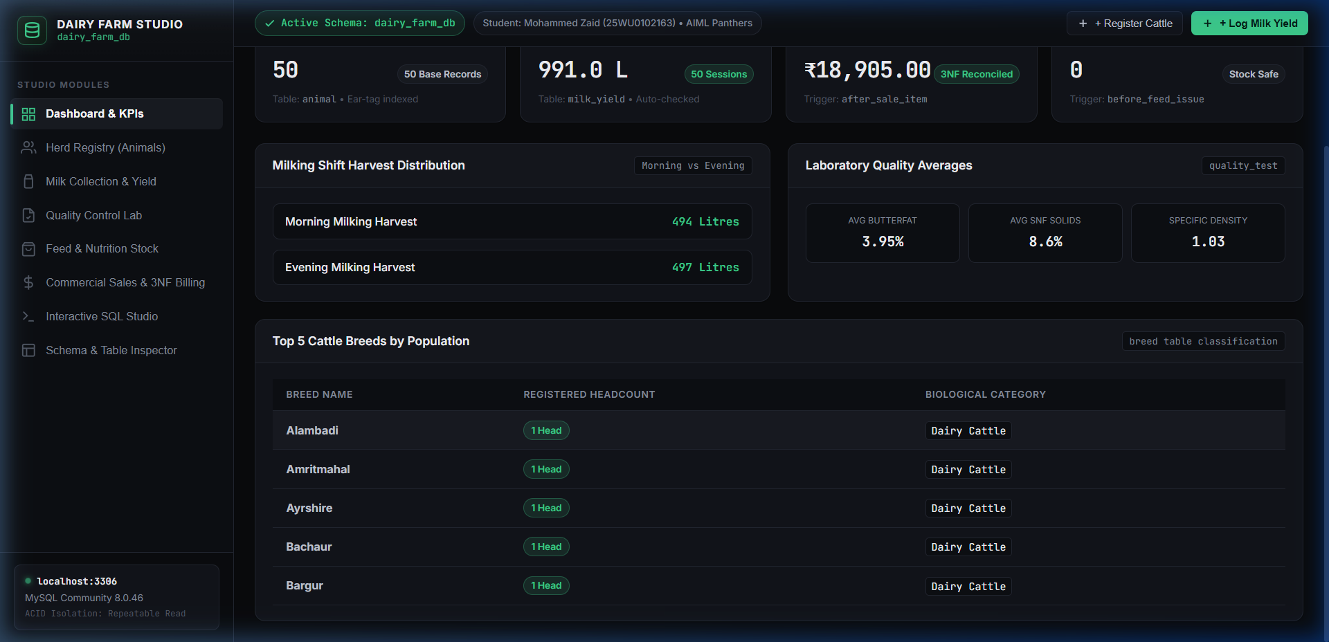
- LIVE UI: DASHBOARD
Student: Mohammed Zaid (25WU0102163) - MySQL 8.0
Live Demonstration: Executive Telemetry & KPI Dashboard
Real-time production, livestock headcount, and revenue aggregates from MySQL 8.0
Verified Dashboard UI (Supabase/Linear Theme)
Live Metrics Highlight
50 Cattle
Registered in animal table
991.0 L
Cumulative yield from milk_yield
₹18,905.00
Invoiced commercial revenue
0 Stock Alerts
Feed inventory safe
Shifts:
Morning (494 L) vs Evening (497 L)
Lab Averages:
3.95% Fat, 8.6% SNF, 1.03 Density
DBMS Course Project - Dairy Farm Herd & Milk Collection Management System - Mentor: Dr. Kiran Mayee Adavala

Slide 5
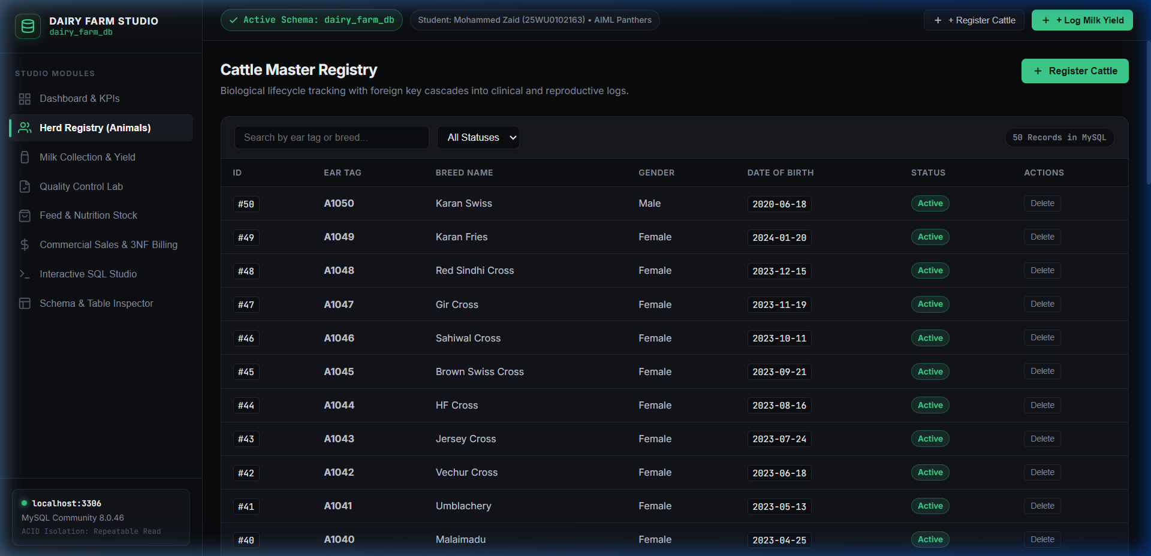
- LIVE UI: HERD REGISTRY
Student: Mohammed Zaid (25WU0102163) - MySQL 8.0
Live Demonstration: Cattle Master Registry & CRUD Operations
Biological lifecycle tracking with foreign key cascades into clinical and reproductive logs
Cattle Master Registry Table (50 Base Records)
Operations & Controls
Ear Tag Search: Real-time client filter matching tag or breed name.
Status Dropdown: Filter by Active, Sold, Deceased, or Transferred.
Modal Registration: Atomic INSERT with UNIQUE tag constraint.
Cascade Delete: Safety modal warning of child deletions in clinical logs.
Before/After Delta: Slide-down audit drawer logs count delta.
DBMS Course Project - Dairy Farm Herd & Milk Collection Management System - Mentor: Dr. Kiran Mayee Adavala

Slide 6
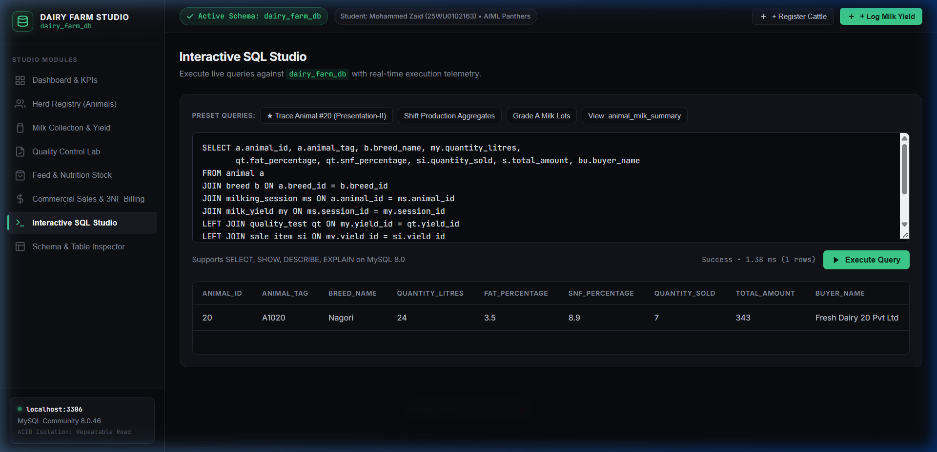
- LIVE UI: SQL STUDIO
Student: Mohammed Zaid (25WU0102163) - MySQL 8.0
Live Demonstration: Interactive SQL Studio & Sub-2ms Telemetry
In-browser SQL console executing live against MySQL 8.0 with preset shortcuts
Interactive SQL Studio (Query 29 Executed in 1.38 ms)
Studio Capabilities
Query #29 Preset: 1-click execution tracing Animal 20 end-to-end.
Execution Telemetry: Sub-2ms execution time displayed in real time.
Dynamic Tables: Renders arbitrary column headers and rows automatically.
Safety Restraints: Guards prevent destructive DROP/TRUNCATE statements.
Keybinding: Ctrl+Enter shortcut for instant execution.
DBMS Course Project - Dairy Farm Herd & Milk Collection Management System - Mentor: Dr. Kiran Mayee Adavala

Slide 7
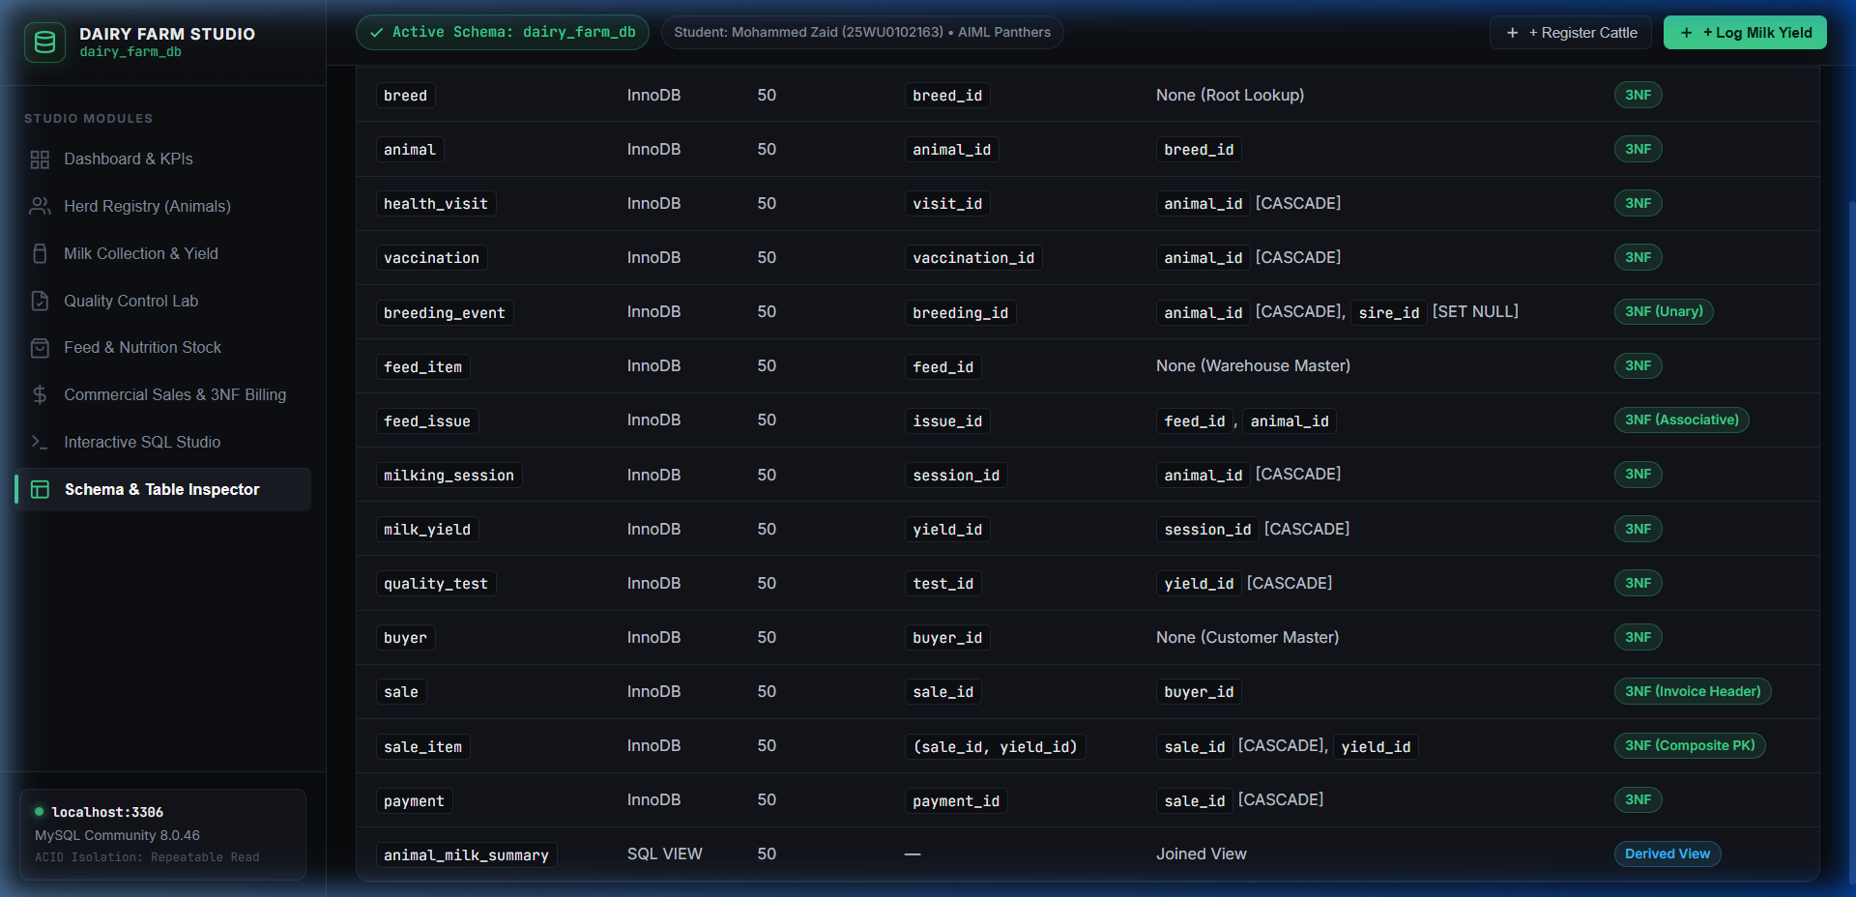
- LIVE UI: SCHEMA INSPECTOR
Student: Mohammed Zaid (25WU0102163) - MySQL 8.0
Live Demonstration: Schema & Relational Architecture Inspector
Interactive inventory verifying all 14 base relations, primary keys, and foreign keys
Verified Schema & Relational Architecture
Relational Verification
14 Tables: All powered by MySQL InnoDB engine.
50 Rows Each: Complete, realistic test dataset.
14 Foreign Keys: Explicit cascade rules prevent orphan tuples.
1 SQL View: animal_milk_summary derived aggregate.
100% 3NF: Formally validated against course requirements.
DBMS Course Project - Dairy Farm Herd & Milk Collection Management System - Mentor: Dr. Kiran Mayee Adavala

Slide 8
- CRUD PROTOCOL
Student: Mohammed Zaid (25WU0102163) - MySQL 8.0
Live Demonstration Protocol: Before & After CRUD Verification
Standardized 4-step demonstration protocol for the 10-minute faculty viva evaluation
Step 1: Dashboard Inspection
Step 2: Insert New Cattle
Show live metrics: 50 registered cattle, 991 L total yield, ₹18,905 revenue. Show connection badge connected to localhost:3306.
Open '+ Register Cattle' modal. Register ear tag A9999. Show live slide-down banner displaying Before: 50, After: 51, Delta: +1.
Step 3: Log Milking Yield
Step 4: Cascade Delete
Open '+ Log Milk Yield'. Log 18.5 Litres for cow A9999. Verify 2-table atomic transaction in milking_session and milk_yield.
Delete test cattle. Verify safety modal and cascade deletion across child clinical visits and milking sessions. Delta: -1.
DBMS Course Project - Dairy Farm Herd & Milk Collection Management System - Mentor: Dr. Kiran Mayee Adavala

Slide 9
- VIVA DEFENSE
Student: Mohammed Zaid (25WU0102163) - MySQL 8.0
Viva Defense Preparation: High-Impact Examiner Questions & Answers
Anticipated questions on connectivity, transaction management, and indexing
Architecture & Connectivity Questions
DBMS & Integrity Questions
Q: How does the application connect to MySQL?
Answer: Using PyMySQL native connection pools. Credentials configured via environment variables and backend/config.py.
Q: How do you prevent SQL Injection?
Answer: All endpoints use parameterized queries (%s placeholders) and Pydantic input models. Zero string concatenation in production endpoints.
Q: How is concurrency handled?
Answer: MySQL InnoDB handles transactions with Repeatable Read isolation, using row-level locking rather than table locks.
Q: What happens if you insert duplicate ear tag?
Answer: MySQL rejects the statement with ER_DUP_ENTRY (error 1062) because of the UNIQUE KEY constraint on animal.animal_tag.
Q: Why are transactions used in Log Milk Yield?
Answer: Adding a milk harvest requires inserting into milking_session, capturing lastrowid, and inserting into milk_yield. If the second insert fails, rollback occurs.
Q: What does Query #29 prove?
Answer: It proves the complete relational integrity of our schema, joining 6 relations across production, quality, and commercial sales without broken links.
DBMS Course Project - Dairy Farm Herd & Milk Collection Management System - Mentor: Dr. Kiran Mayee Adavala

Slide 10
- SUBMISSION SUMMARY
Student: Mohammed Zaid (25WU0102163) - MySQL 8.0
Course Project Engineering Highlights & Submission Deliverables
Complete deliverable package ready for presentation and final faculty evaluation
MYSQL SCHEMA
14 Tables
50 rows/table (700 rows total)
SQL PACK
30+ Queries
Query #29 trace verified
DAIRY FARM STUDIO
8 Modules
Live at http://127.0.0.1:8000
PROJECT DELIVERABLE
Full Report
Docx, PPTX & SQL Scripts
Verified Submission Package Structure
- Presentation-I/: Official problem statement description and scope definition.
- Presentation-II/: 10-slide architectural deck, full MySQL SQL dump (dairy_farm_db_full.sql), 30-query pack, and EER diagram.
- Presentation-III/: 10-slide live demonstration deck, live working source code (FastAPI + Studio SPA), one-click run script, and screenshots.
- Project-Report/: Comprehensive project report document (DBMS_Project_Report_Mohammed_Zaid.docx).
- Gamma.app Ready: One-click Markdown import files included for instant regeneration on gamma.app.
DBMS Course Project - Dairy Farm Herd & Milk Collection Management System - Mentor: Dr. Kiran Mayee Adavala

