Slide 1






URBAN SOLVE
Team Id : CC3H-223
Team Name : Code Crushers
Team Members
Nandini,Khushi
Team Leader
Nandni
Presented by Code Crushers

Slide 2
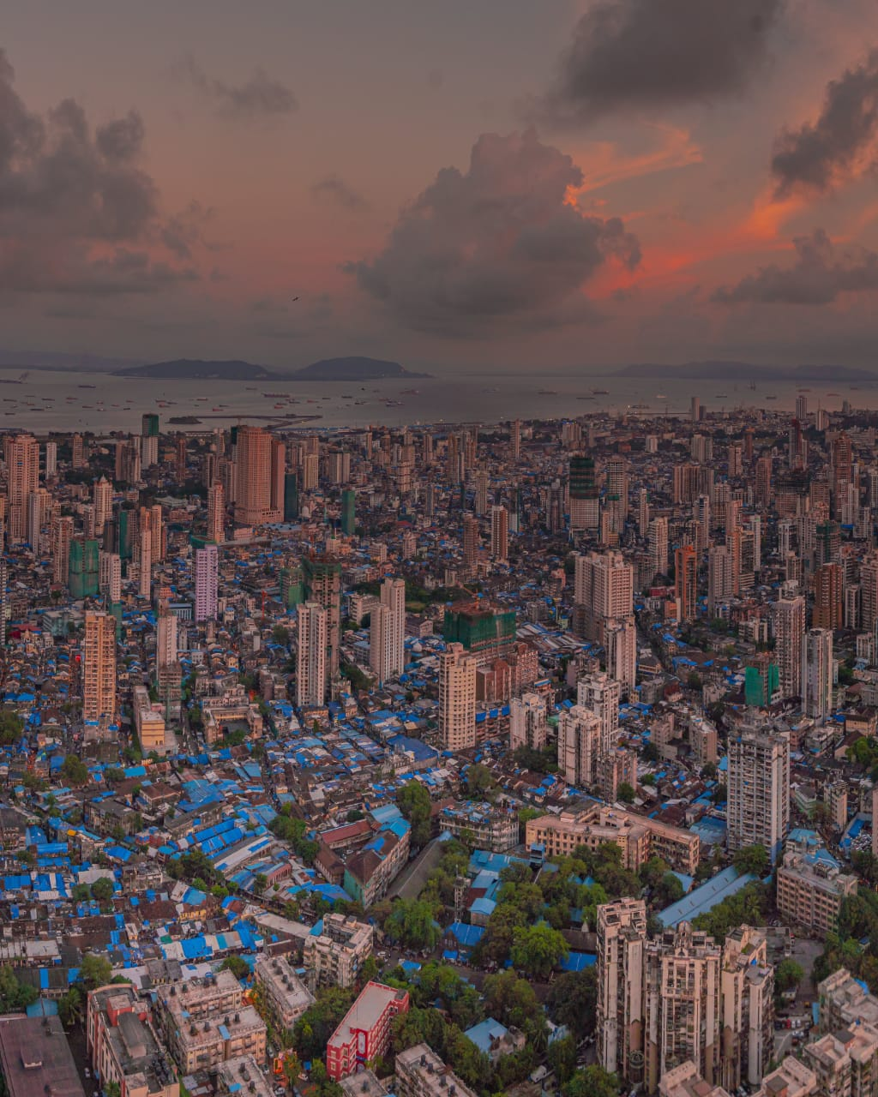


Introduction
UrbanSolve
City Problem Management System
Urbanization has led to increasing challenges like traffic, pollution, and waste management. Existing systems to handle these issues are often slow and inefficient.
The Urban Problem Management System is a digital platform that enables citizens to report problems easily and helps authorities resolve them quickly.

Slide 3
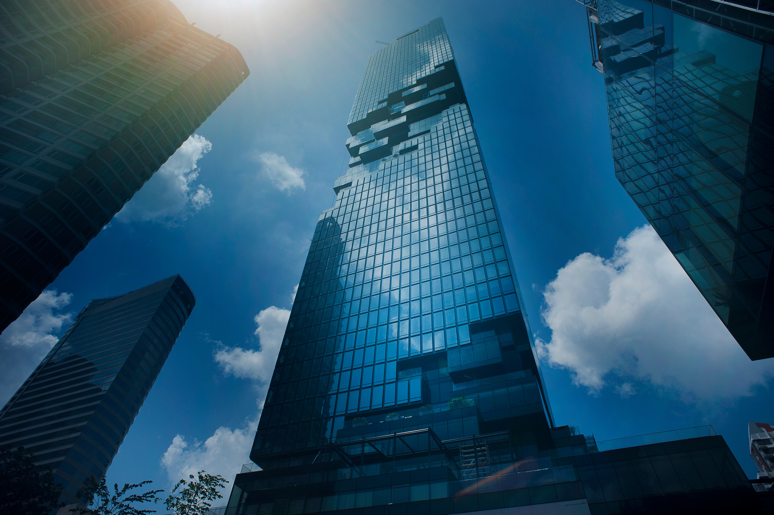
Problem Statement
Rapid urbanization has increased city-related issues
Citizens face difficulty in reporting problems efficiently
Lack of a centralized platform for complaint management
Delayed response from authorities
No proper tracking or transparency in issue resolution

Slide 4
Proposed Solution
A centralized digital platform for managing urban issues
Enables citizens to report problems easily
Provides real-time tracking of complaints
Connects users directly with authorities
Ensures faster and transparent resolution

Slide 5

System Overview
User-friendly web/mobile interface
Admin panel for authorities
Database to store complaints
Notification system for updates
Works as a bridge between citizens & government

Slide 6
Key Features
✅ User Friendly Interface
✅ Ticket Generatiion System
✅ Location Based Reporting
✅ Real Time Status Tracking
✅ Image Upload Support
✅ Priority system
✅ Notification & Tracking System
✅ Search & filter system
✅ Admin Dashboard

Slide 7
Working Process
User logs into the system
Submits complaint with details
Data stored in database
Admin reviews and assigns task
Issue gets resolved
User receives update

Slide 8
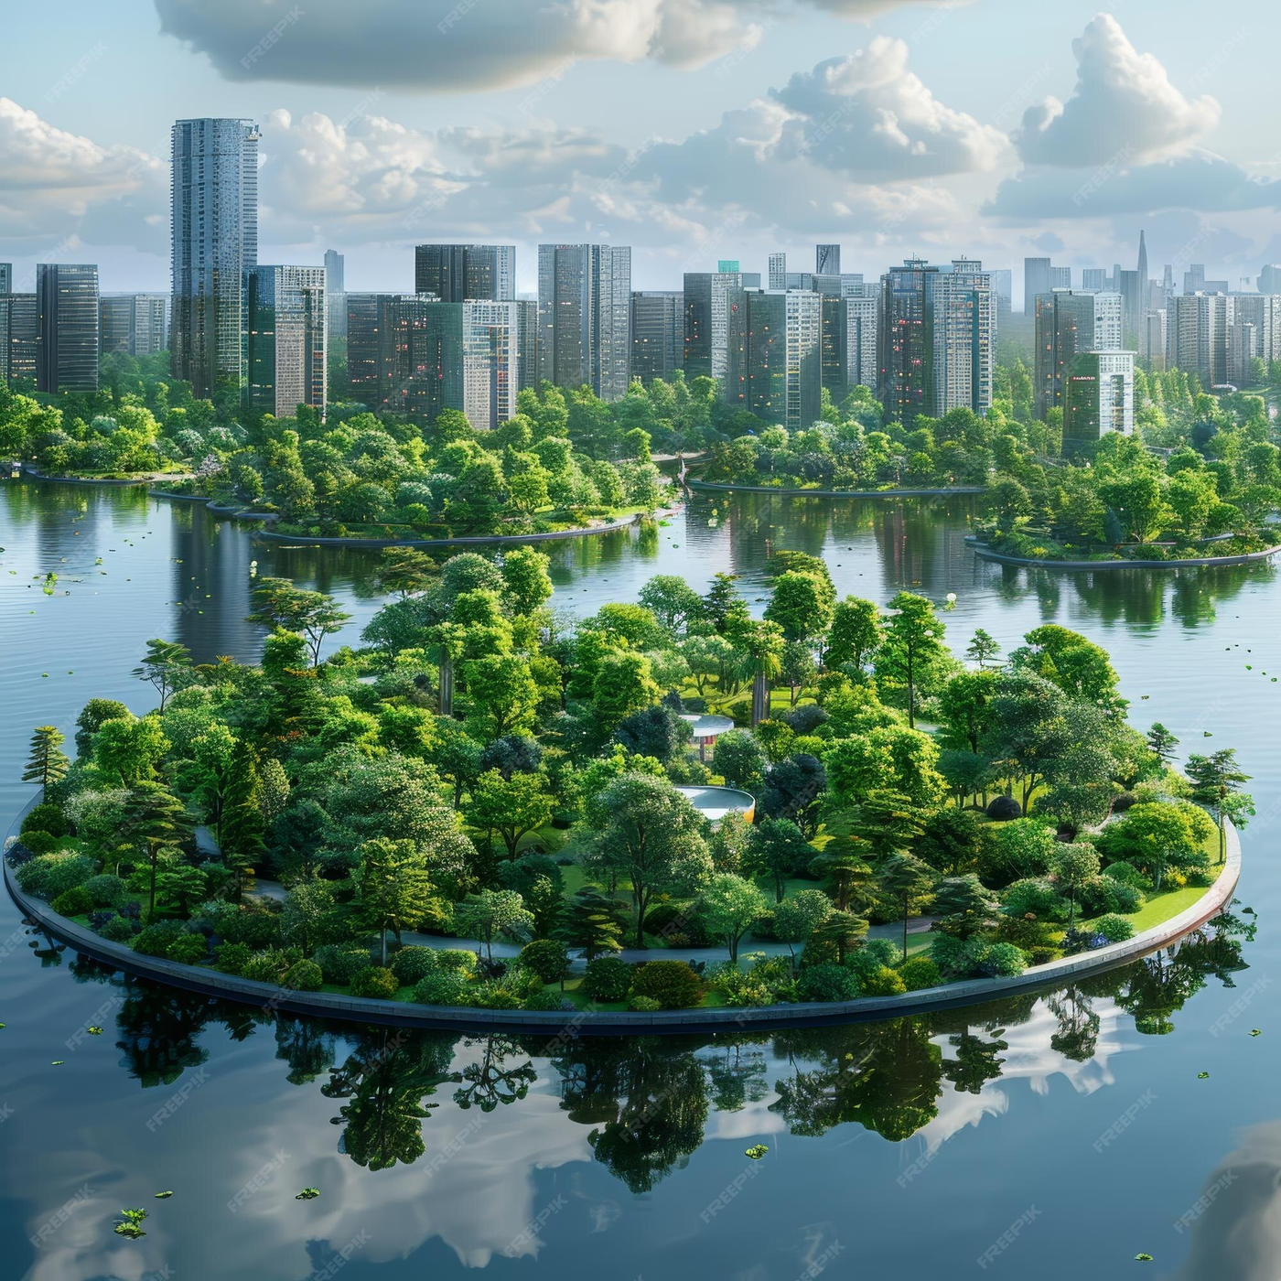
Future Scope
Mobile application development
AI-based issue detection
AI Priority Scoring
SLA Timer(Countdown system)
Offline Mode

Slide 9
Conclusion
Provides efficient urban problem management
Improves communication between citizens & authorities
Saves time and increases transparency
Step towards smart city development

Slide 10
Thank
You

