Slide 1
State Level Technical Festival, 2016
Designed and Hosted by ABES-EC (Nodal Center)

Slide 2
Summary of Events
Event Name | Concerned Branches | Students per team
Line follower and maze solving (Maze Solver) | Mechanical, Computer Science, Electronics and Electrical related branches | 3
Manual robotics (Road Rash) | Mechanical, Computer Science, Electronics and Electrical related branches | 3
Designing using AutoCAD (Mechanical Design) | Mechanical and Civil related branches | 2
Circuit Design (Logitronix) | Electronics and Electrical related branches | 3
Algorithm design and coding (Code Rush) | Computer Science, Electronics and Electrical related branches | 2

Slide 3
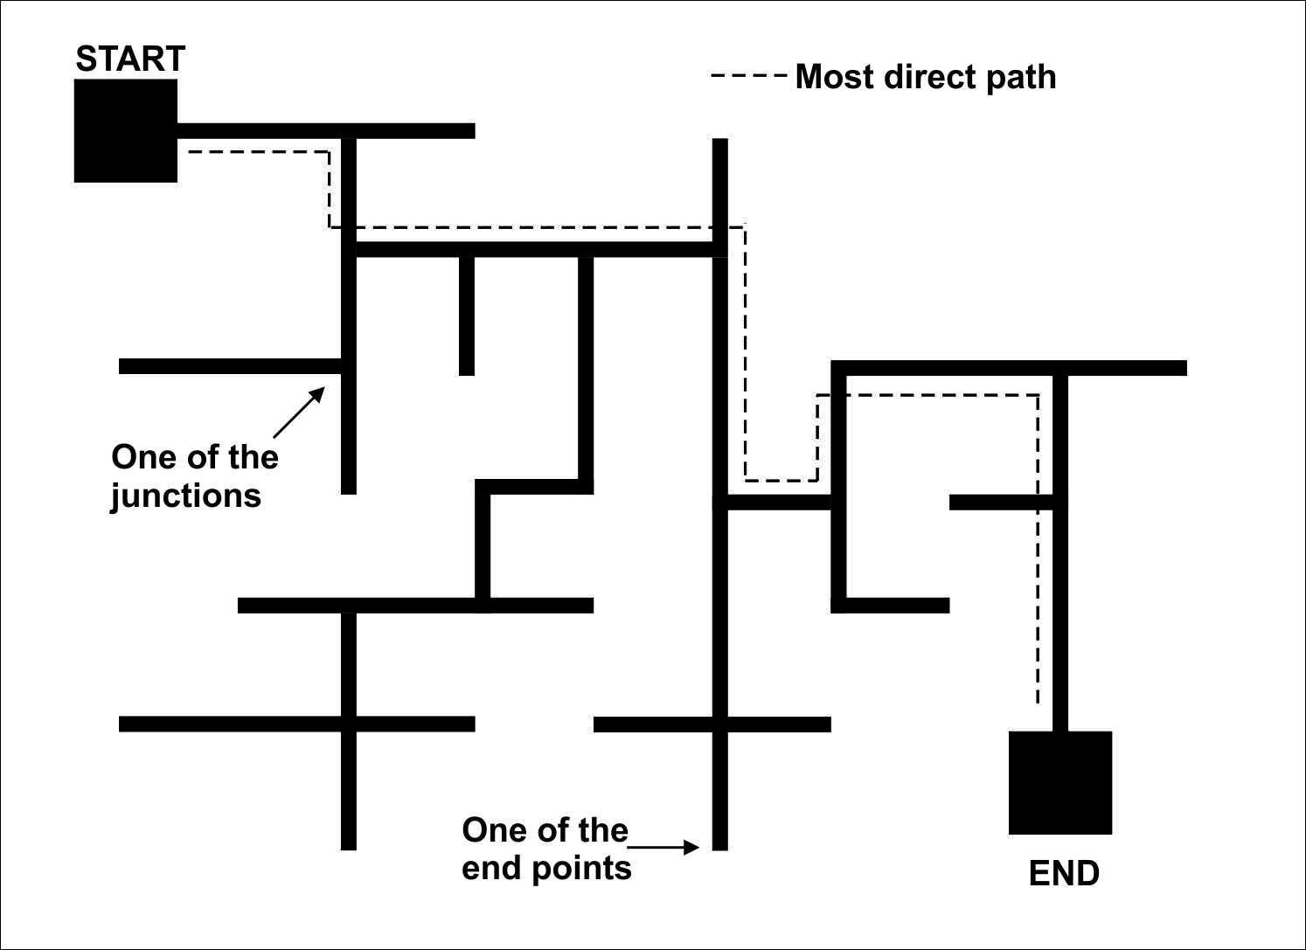
Maze Runner

Slide 4
Maze Runner (contd…)
Objective: Build a robot that should traverse a maze consisting of black lines printed on white flex sheet.
Game Play: Maze Mapping and Maze Traversal.
Marking scheme.
Actual arena to be disclosed on the day of the event. But it is guaranteed to be devoid of loops.

Slide 5
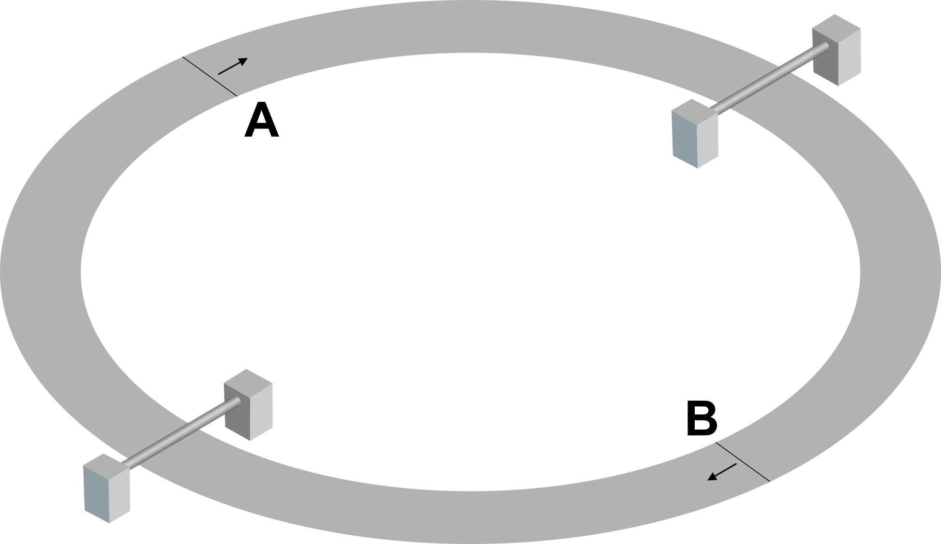
Road Raze

Slide 6
Road Raze (contd…)
Objective: Two manual robots will be racing against each other in a circular race track having some minor obstacles.
Game Play.
Marking Scheme.

Slide 7
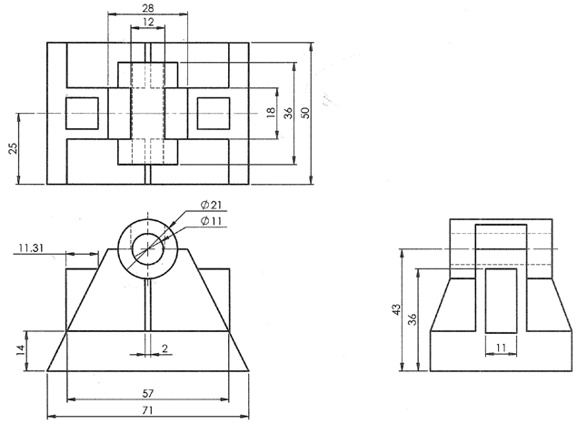

Designing using AutoCAD

Slide 8
Designing using AutoCAD (contd…)
Objective: Make 3D model of an object with the help of three standard views using AutoCAD.
Winning criteria: accuracy and least time.
Desktop computers with AutoCAD installed will be provided.
The actual problem will be disclosed at the time of the event.

Slide 9
Logitronix
Objective: Design and implement a 4 bit input 4 bit output digital logic circuit on breadboards.
Components allowed: 7400, 7402, 7404, 7421, 7432, BC547, BC557.
Winning criteria: Accuracy, minimal use of logic ICs and least time.
Truth table will be given on the spot.
Organizers will only provide working space and easy access to AC mains power socket.

Slide 10
Code Rush
Objective: Solve few real life coding problems by making use of computer programming (C/C++).
7 problems of varying difficulty level to be solved within 3 hours.
Problem design and administration and answer evaluation will be outsourced.

Slide 11
Queries!
Please consult the circulated document.

