Slide 1

INTERNSHIP PROJECT REPORT ON
ShieldJob AI: Multi-Modal Fake Job Detection System
An AI/ML-Powered Web Application & Chrome Extension for Job Scam Detection
Presented By:
Tanuku Ram Sai (PIN: 24A95A0503)
Department of Computer Science & Engineering
Aditya University, Surampalem

Slide 2
ABSTRACT
• Context: With hiring moving online (LinkedIn, Indeed, Naukri), fake job postings have risen rapidly, causing financial loss and identity theft for job seekers.
• The Challenge: Scammers create convincing job posts with fake company domains and unrealistic salary promises that manual checks easily miss.
• Proposed System: ShieldJob AI is a multi-modal verification platform that evaluates job posts through 4 safety layers: Machine Learning (Random Forest), Google Gemini AI, Website Verification, and Social Footprint analysis.
• Accessible Access: Delivered through a modern Flask web application and a 1-click Google Chrome Extension (Manifest V3) for instant in-browser checks.
• Key Result: Achieved 98.05% accuracy across 17,880 benchmark job postings, providing instant risk scores (0–100%) and clear safety badges.
ShieldJob AI: Multi-Modal Fake Job Detection System
2

Slide 3
INTRODUCTION
• Digital Hiring Era: Online job portals have made finding employment faster, but have also opened doors for recruitment scams and cyber fraud.
• Modern Scam Tactics: Fraudsters post fake openings, conduct sham interviews on Telegram/WhatsApp, and demand upfront fees for 'training' or 'equipment'.
• Why Simple Checks Fail: Traditional keyword filters miss sophisticated scam wording, while manual checks cannot easily verify domain age and official company records.
• The Solution: ShieldJob AI introduces an intelligent, automated safety check that cross-verifies job descriptions, company websites, and social presence in seconds.
• Goal: Empowering students and job seekers with a simple 1-click browser tool to verify job offers before sharing personal data or money.
ShieldJob AI: Multi-Modal Fake Job Detection System
3

Slide 4
PROBLEM STATEMENT
• Growing Scam Volume: Thousands of fresh graduates fall victim each year to fake job offers on popular portals like LinkedIn, Indeed, and Naukri.
• Upfront Fee Demands: Scammers extort money through fake registration charges, onboarding kit fees, or security deposits.
• Company Impersonation: Fraudulent actors copy reputable company names and build look-alike websites (typosquatting) to deceive applicants.
• Single-Layer Limitations: Checking text alone misses fake company websites; checking websites alone misses fraudulent job descriptions.
• Need for Real-Time Defense: Job seekers need an easy, instant in-browser tool that provides clear **Safe**, **Suspicious**, or **Fake** verdicts on the spot.
ShieldJob AI: Multi-Modal Fake Job Detection System
4

Slide 5
PROJECT OVERVIEW
• ShieldJob AI Platform: An end-to-end intelligent detection ecosystem designed to protect job seekers from recruitment scams in real time.
• The 4 Safety Layers: 1. Pattern Matcher (30%): ML model trained on 17,880 job records.
2. AI Content Inspector (30%): Google Gemini AI spotting tone & fee anomalies.
3. Website Authenticity (20%): Verifying company domain security & official existence.
4. Company Reputation (20%): Checking LinkedIn presence & public scam reports.
• Dual User Interfaces: A responsive Web Application for in-depth scans + a 1-Click Chrome Browser Extension for instant checks while browsing.
• Unified Safety Score: Combines all 4 layers into a single 0–100 score categorized as Legitimate (Safe), Suspicious, or Likely Fake.
• Explainable Feedback: Highlights exact red flags (e.g., suspicious payment demands, unverified domains, missing company history).
ShieldJob AI: Multi-Modal Fake Job Detection System
5

Slide 6
METHODOLOGY
• Step 1: Data Preparation: Processed 17,880 job postings from the benchmark EMSCAD dataset using TF-IDF NLP feature extraction.
• Step 2: ML Model Training: Trained a balanced Random Forest Classifier to statistically identify scam language and fraudulent requirements.
• Step 3: GenAI Content Audit: Engineered Google Gemini AI prompts to evaluate salary realism, recruiter professionalism, and hidden fee requests.
• Step 4: Live Web & Social Verification: Automated search queries via SerpAPI to cross-check company website credibility and LinkedIn presence.
• Step 5: Weighted Score Aggregation: Final Safety Score = (30% × ML) + (30% × Gemini AI) + (20% × Website) + (20% × Social).
ShieldJob AI: Multi-Modal Fake Job Detection System
6

Slide 7
SYSTEM ARCHITECTURE
USER INPUT: Job Posting & Description
(Job Title, Company Name, Requirements, Contact Details)
ML Model (30%)
• Random Forest Classifier
• TF-IDF text analysis
• Historical scam patterns
Gemini AI (30%)
• GenAI Content Auditor
• Scam tone detection
• Unrealistic salary checks
Website Check (20%)
• Domain credibility
• SSL & official site match
• Typosquatting detection
Social Check (20%)
• LinkedIn presence
• Public employee footprint
• Scam alert databases
Score Aggregation Engine: Weighted 4-Layer Risk Calculation (0–100%)
FINAL PREDICTION: ✅ Legitimate (Safe) | ⚠️ Suspicious | 🚨 Likely Fake
ShieldJob AI: Multi-Modal Fake Job Detection System
7

Slide 8
SYSTEM STRUCTURE & WORKFLOW
1. Browse Job Portal
• LinkedIn, Naukri, Indeed, or Unstop
• User views job offer
• Copies text or opens popup
2. Chrome Extension
• 1-Click ShieldJob AI popup
• Pastes description into popup
• Clicks 'Analyze Job'
3. Flask Cloud API
• Sends request to Render backend
• Secure payload processing
• Zero API keys on client
4. Multi-Layer Scan
• Runs ML + Gemini AI in parallel
• Checks domain & LinkedIn
• Computes risk score
5. Instant Verdict
• Color-coded safety badge
• Displays Risk Score %
• Lists detected red flags
ShieldJob AI: Multi-Modal Fake Job Detection System
8

Slide 9
IMPLEMENTATION & TECH STACK
• Backend Framework: Python 3.11 with Flask REST API, Gunicorn WSGI server, and CORS handling.
• Machine Learning: Scikit-learn, Random Forest Classifier, TF-IDF Vectorizer, and Joblib for model serialization.
• Generative AI: Google Gemini API (`google-generativeai` SDK) for qualitative content and scam indicator auditing.
• Live Web Search & Scraping: SerpAPI & Google Custom Search for verifying official company domains and social footprints.
• Frontend & Extension: Modern HTML5, Vanilla CSS3 (Custom Glassmorphism UI), JavaScript ES6, and Chrome Extension Manifest V3.
• Cloud Deployment: Hosted on Render with automated environment security and continuous deployment.
ShieldJob AI: Multi-Modal Fake Job Detection System
9

Slide 10
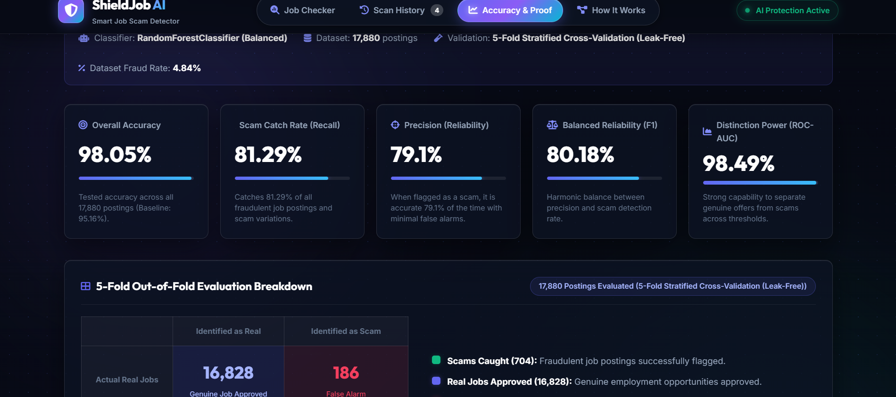
RESULTS: MODEL ACCURACY & PROOF
• Overall Accuracy (98.05%): Tested across all 17,880 benchmark job postings.
• Scam Catch Rate (81.29%): Successfully detects over 81% of fraudulent job postings.
• Precision (79.10%): High reliability when flagging scams with minimal false alarms.
• ROC-AUC Distinction (98.49%): Strong separation power between genuine offers and scams.
• 5-Fold Cross-Validation: Leak-free validation: 16,828 real jobs approved, 704 scams caught, only 186 false alarms.
ShieldJob AI: Multi-Modal Fake Job Detection System
10

Slide 11
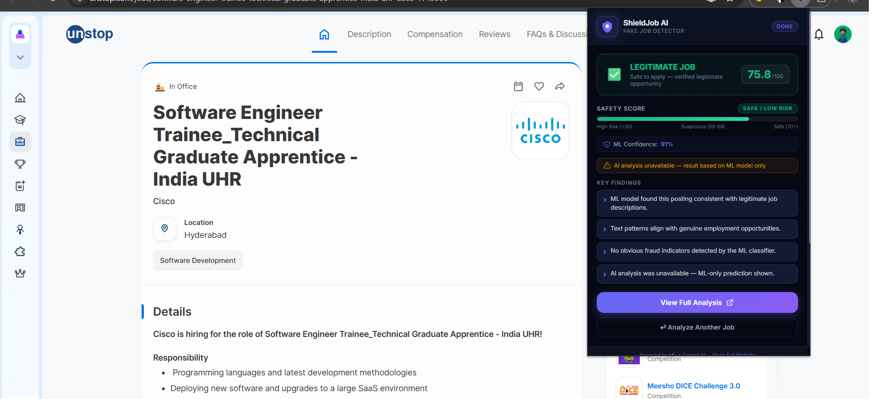
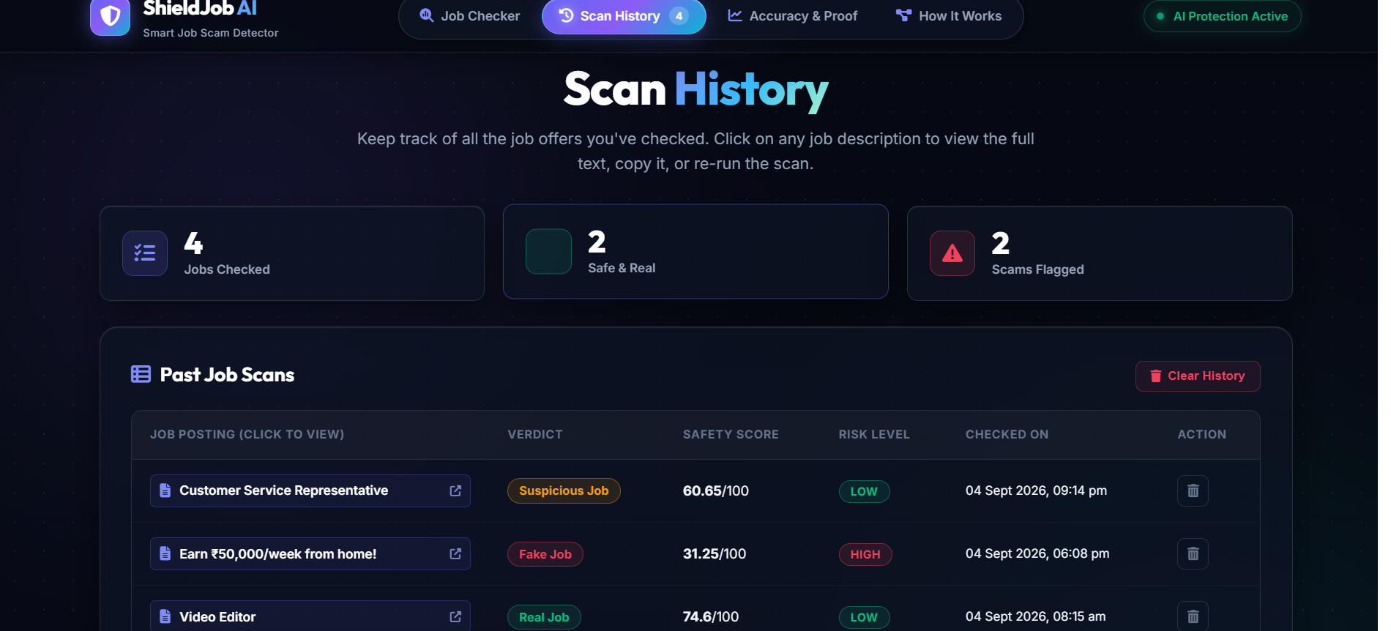
RESULTS: LIVE APP & EXTENSION IN ACTION
Chrome Extension Live Scan (Unstop Portal):
Verified Cisco job offer as LEGITIMATE (Score: 75.8/100, ML Confidence: 91%)
Scan History & Dashboard Tracking:
Real-time log of verified jobs with color-coded safety badges (Real / Suspicious / Fake)
ShieldJob AI: Multi-Modal Fake Job Detection System
11

Slide 12
CHALLENGES & LEARNING OUTCOMES
• Class Imbalance: Handled the low ratio of scam jobs (4.84%) using balanced class weights, stratified sampling, and ensemble techniques.
• Unstructured Text Formats: Standardized varied job postings and missing metadata fields using smart regex cleaning and NLP pipelines.
• Cloud Cold-Starts & Latency: Optimized parallel API calls and implemented fallback scoring to maintain smooth response times on Render.
• Key Learning Outcomes: Gained practical mastery in training & evaluating ML models, integrating Generative AI (LLMs), building Chrome Extensions (Manifest V3), and deploying full-stack web applications.
ShieldJob AI: Multi-Modal Fake Job Detection System
12

Slide 13
CONCLUSION & FUTURE SCOPE
• Project Summary: ShieldJob AI provides a fast, reliable, and multi-layered defense system that protects job seekers from online employment fraud.
• Usability & Impact: Combining a web dashboard with an in-browser Chrome Extension makes advanced AI protection accessible to any student with one click.
• Future Scope: Auto-Detection: Extracting job details directly from web pages (DOM scraping) for automatic safety badge overlays without copy-pasting.
• Future Scope: Multilingual Support: Extending NLP models to detect recruitment scams in regional and international languages.
• Future Scope: Interview Scam Defense: Adding AI analysis to verify video interview links and detect deepfake recruiter calls.
ShieldJob AI: Multi-Modal Fake Job Detection System
13

Slide 14
REFERENCES
• Scikit-learn Documentation: Pedregosa et al., 'Scikit-learn: Machine Learning in Python', Random Forest Classifier & TF-IDF Vectorization (scikit-learn.org).
• Google Generative AI: Google DeepMind, 'Gemini API & Generative AI Python SDK Documentation' (ai.google.dev).
• Chrome Extension Architecture: Google Chrome Developers, 'Manifest V3 Architecture & Extension Security' (developer.chrome.com).
• Recruitment Scam Research: Federal Trade Commission (FTC), 'Job Scams and Identity Theft Consumer Threat Reports'.
• Benchmark Dataset: Employment Scam Aegean Dataset (EMSCAD) / Kaggle Fake Job Postings Dataset Repository.
ShieldJob AI: Multi-Modal Fake Job Detection System
14

Slide 15
THANK YOU
Any Questions & Feedback?
Tanuku Ram Sai (PIN: 24A95A0503)
Department of Computer Science & Engineering
Aditya University, Surampalem
15

