Slide 1



TEAM
SKY_AVIATORS
TO THE MOON !!!
TEAM MEMBER 1:
TEAM MEMBER 2:
TUSHAR KAUSHIK
RACHIT RASTOGI

Slide 2

AHT and AST Analysis
Problem Statement
Identify key drivers of long Average Handle Time (AHT) and Average Speed to Answer (AST).
Optimize United Airlines' Call Center Performance
At United Airlines, our call center serves as the vital link between passengers and the assistance they require. However, as we strive for excellence, we encounter significant challenges that hinder our mission. Picture a passenger anxiously waiting on hold for help with a flight change. As the Average Speed to Answer (AST) drags on, their frustration mounts, eroding trust in our service.
When they finally connect with an agent, the Average Handle Time (AHT) continues to increase as complex issues are navigated, resulting in longer calls and decreased satisfaction. This scenario reflects a broader issue within our operations, where lengthy call durations impact both efficiency and the customer experience.
Compounding these challenges is the misallocation of resources. Many inquiries that could be resolved through self-service options escalate unnecessarily to agents, overwhelming our team during peak times. To elevate our call center operations and ensure every traveler feels valued, we must tackle these issues of long wait times, extended call durations, and ineffective routing of inquiries head-on.
Self-Service Optimization
Propose IVR improvements to reduce agent intervention for self-solvable issues.
Lack of accessible and reliable financial advisory services.
Call Reasons Categorization
Analyze call transcripts to uncover and categorize primary call reasons for operational efficiency.

Slide 3






Our Approach
Recommendations Based On Data Exploration
Here is the workflow diagram for our process we came up with:
DATA PREPROCESSING & CLEANING
EXPLORATORY DATA ANALYSIS
QUALITATIVE
ASSESSMENT
INTERPRETATION OF RESULTS

Slide 4


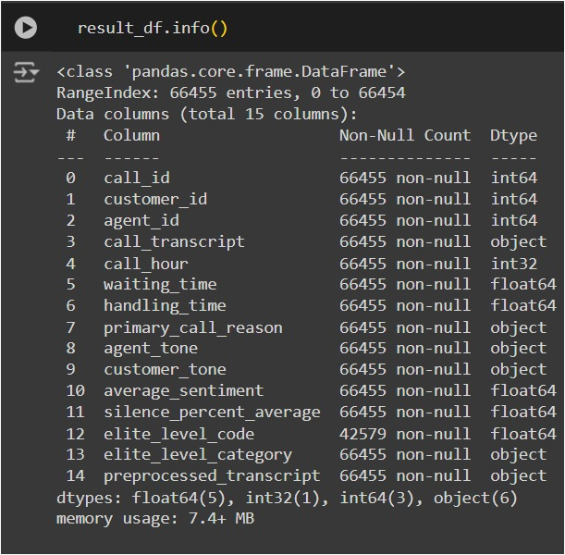
DATA PREPROCESSING & CLEANING
Cleaning, Preprocessing & Preparation
During data preprocessing and cleaning , we began by importing the pandas library and loading our dataset using pd.read_csv(). With the data in hand, we carefully examined its structure and types, utilizing df.info() to uncover insights about its contents and df.head() to grasp the context.
As we delved deeper, we addressed various data quality issues: handling missing values through thoughtful imputation or deletion, standardizing data formats for consistency, removing duplicate entries to maintain integrity, and identifying outliers that could skew our analysis. Recognizing the importance of a comprehensive dataset, we merged relevant datasets using pd.merge() based on common keys, ensuring that our combined data retained its integrity.
Finally, we conducted a thorough re-examination of our cleaned dataset, once more to confirm it was primed and ready for the next phase of our analysis.

Slide 5
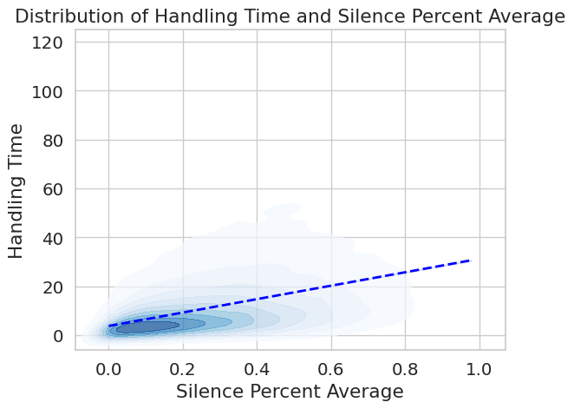
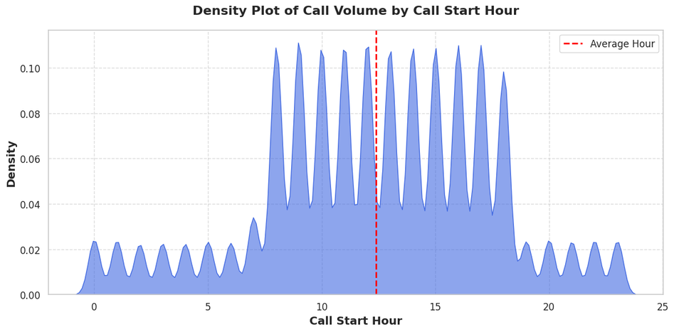
EXPLORATORY DATA ANALYSIS
Visualisating Key Parameters
We visualized key metrics to uncover insights for improving customer service. Starting with histograms of waiting and handling times, we identified patterns revealing process bottlenecks. Scatterplots examined relationships between handling time and silence percentage, showing how silence effects AHT. Density plots, pie charts, & heatmaps highlighted call duration volume, primary call reasons, & correlations .
We analyzed top call reasons by frequency and sentiment, with bar plots showing the impact of customer and agent tone on handling time. These visualizations provided a comprehensive understanding of our operations, enabling data-driven improvements.

Slide 6
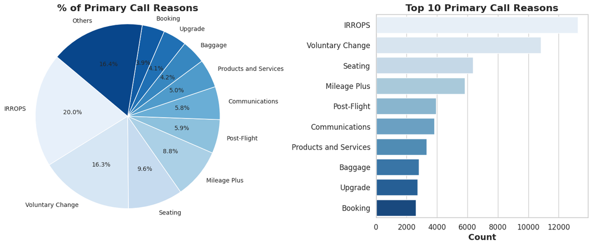
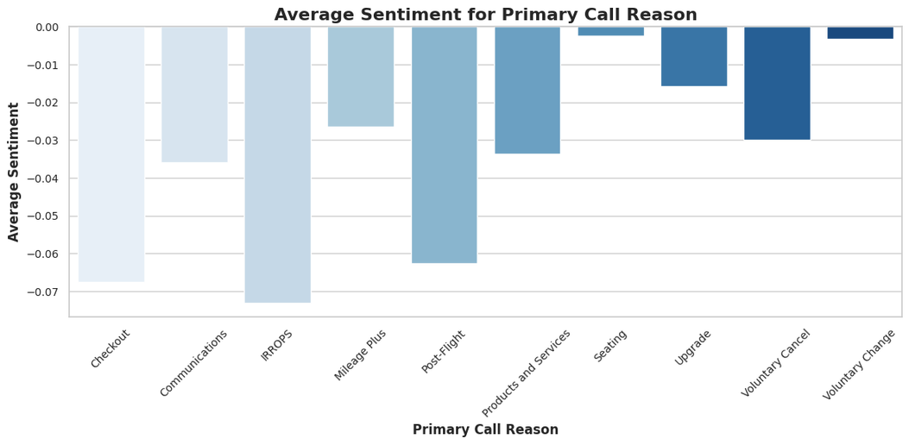
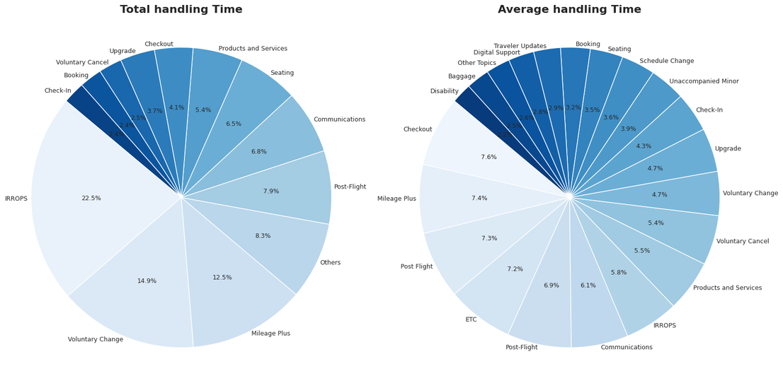
Primary Call Reasons Affecting Customers
Identifying Key Call Reasons which hinders our excellent Services provided to our customers.
Prioritizing & Resolving Primary call reasons will Enhance our services by Reducing Total Handling time.
Primary Call Reason directly affects Customer Tone & Sentiment. Tackling top Primary Call Reasons will improve Customer Satisfaction.

Slide 7

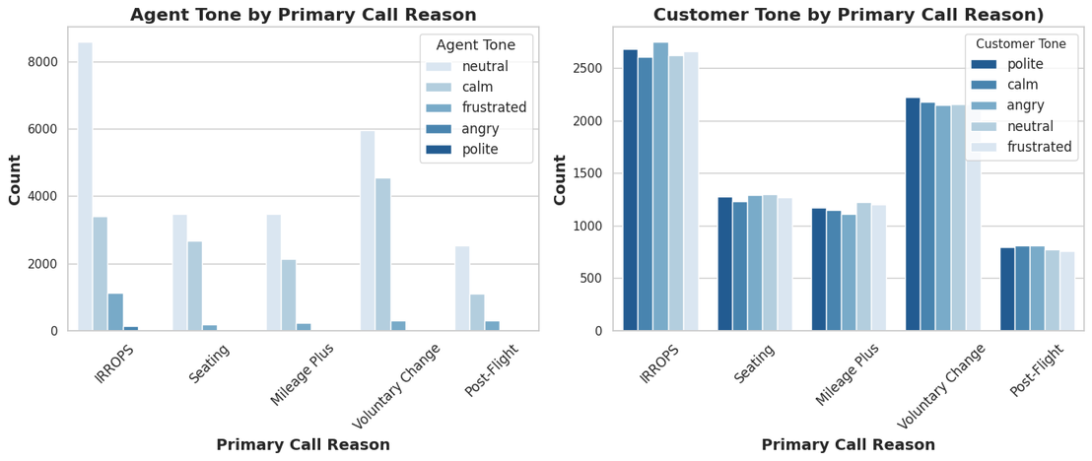
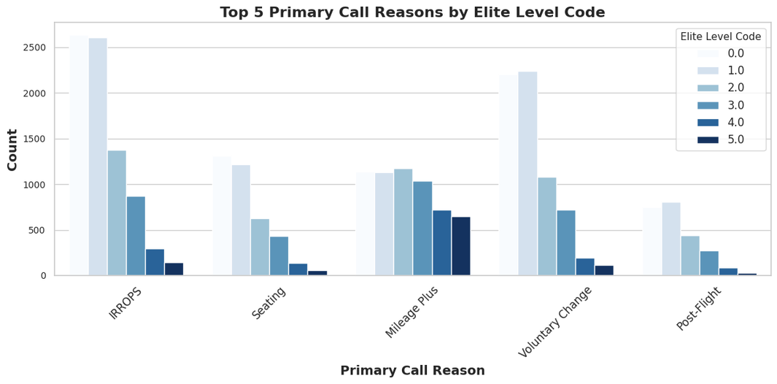
Understanding Primary Call Reasons
Analyzing the variations between Customer tones & Elite level Code for each Primary Call Reason
Our findings state, Different customers within respective Elite level code has different priorities.
IRROPS & Voluntary Change is a recurring issue within customers with low Elite level code. Whereas, Mileage Plus is disproportionately significant issue within high Elite level code.
Agent tone is mostly neutral while addressing Primary Call reason. IVR systems should incorporate Polite and Calm tone while handling customers.
The sentiment of the conversation is almost solely dependent on Agent tone. Let’s see how...

Slide 8
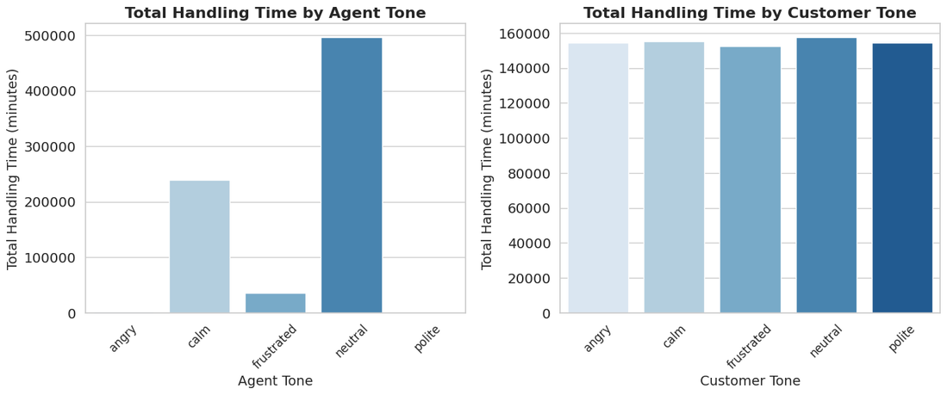
Understanding Factors affecting Sentiments
Realizing how Primary call reasons and sentiment are correlated
Agent Tone can be classified into - Calm, Frustrated & Neutral. Almost no polite tones, Increase in Polite & Calm tones, self-solvable issues can be greatly increases.
There is almost equal amounts of customers speaking in different tones.
Therefore, to enhance Sentiment for Primary call reason such as IRROPS, Checkout & Post-Flight issues, agent tone should be Polite & Calm.

Slide 9

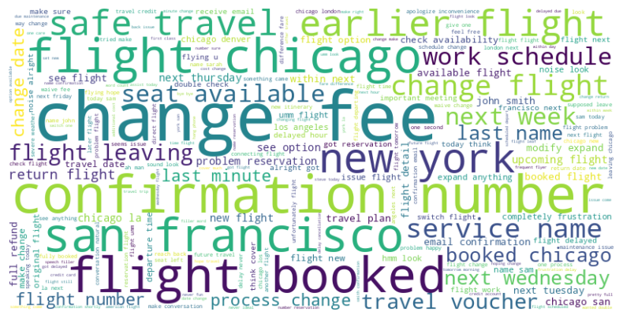
Qualitative Assessment
After a rigorous analysis of all call transcripts, there are some issues which are repeating. Focusing & choosing to solve these issues will be in direct accordance to enhanced Customer satisfaction, Operational efficiency & number of bookings!
This will automatically reduce agent intervention & dependency on IVR systems.
Interpretation of Result
After a rigorous analysis of all call transcripts, there are some issues which are repeating. Focusing & choosing to solve these issues will be in direct accordance to enhanced Customer satisfaction, Operational efficiency & number of bookings! This will automatically reduce agent intervention & dependency on IVR systems.

Slide 10
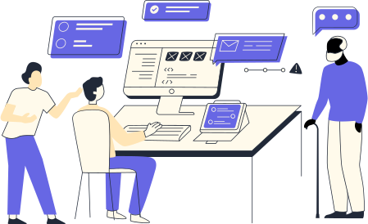
Thank You So Much !!

