Slide 1
AFRi Marigold Accessory
Initial Concepts - Stage One
Provisional concepts. AFRi reference material was not available, so colours, proportions and construction are studio assumptions.

Slide 2
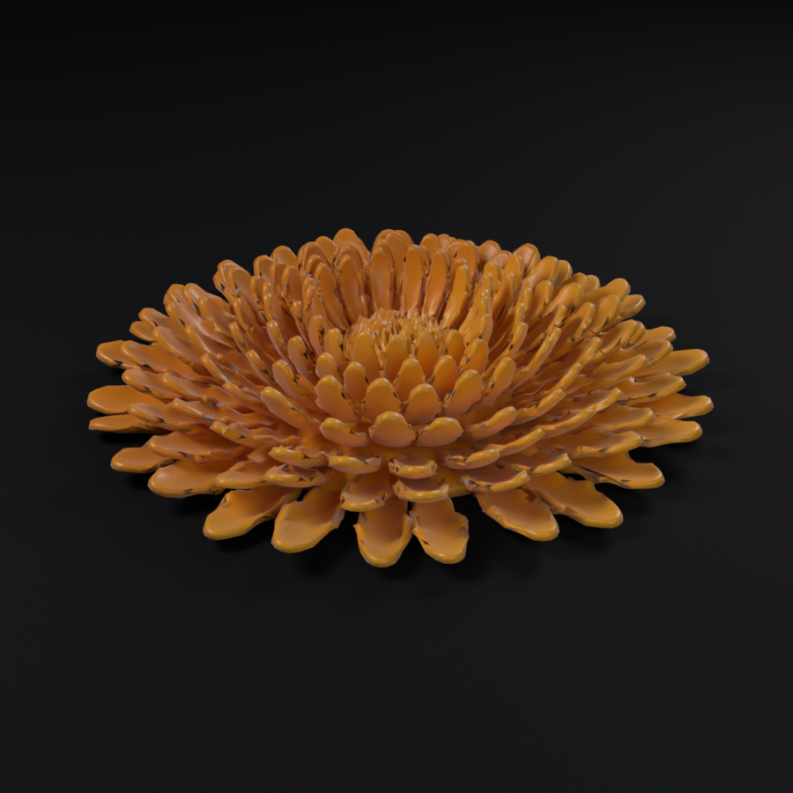
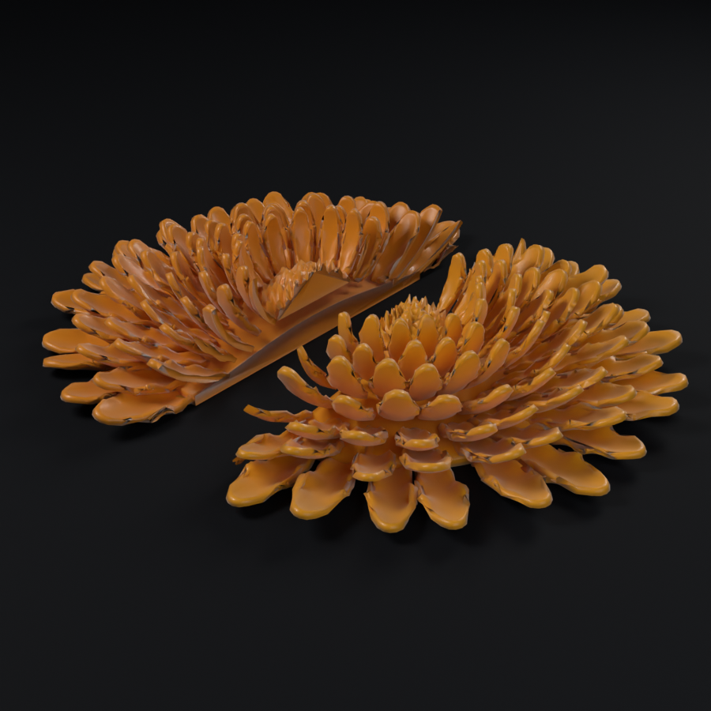
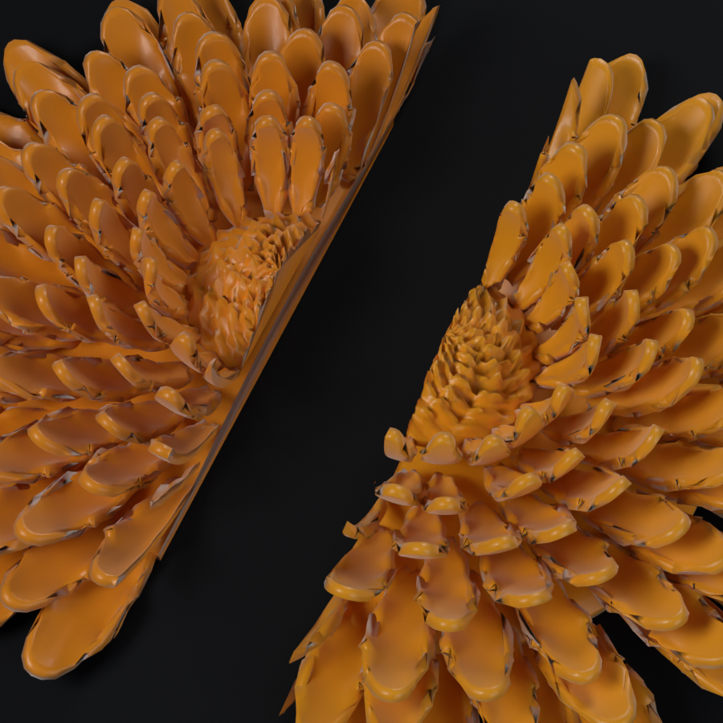
Concept A Balanced Split
A clear, near-symmetric division. The dividing line reads as a single confident stroke across the rosette.
Assembled flower
The two components, separated
Detail of the division

Slide 3
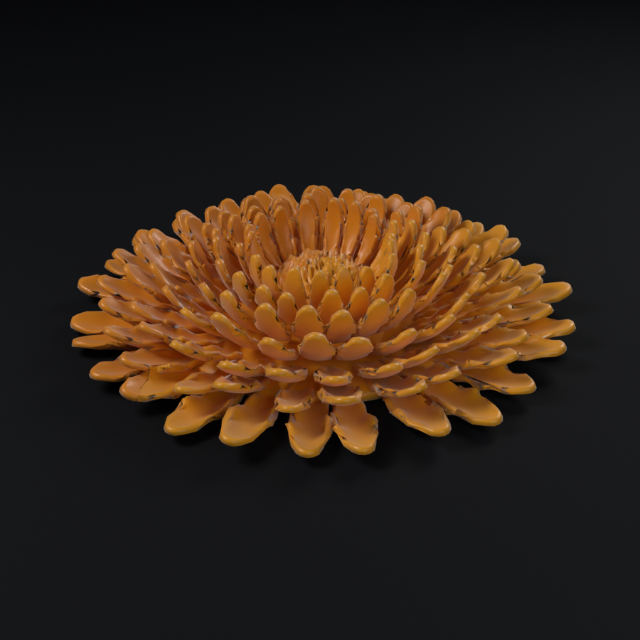
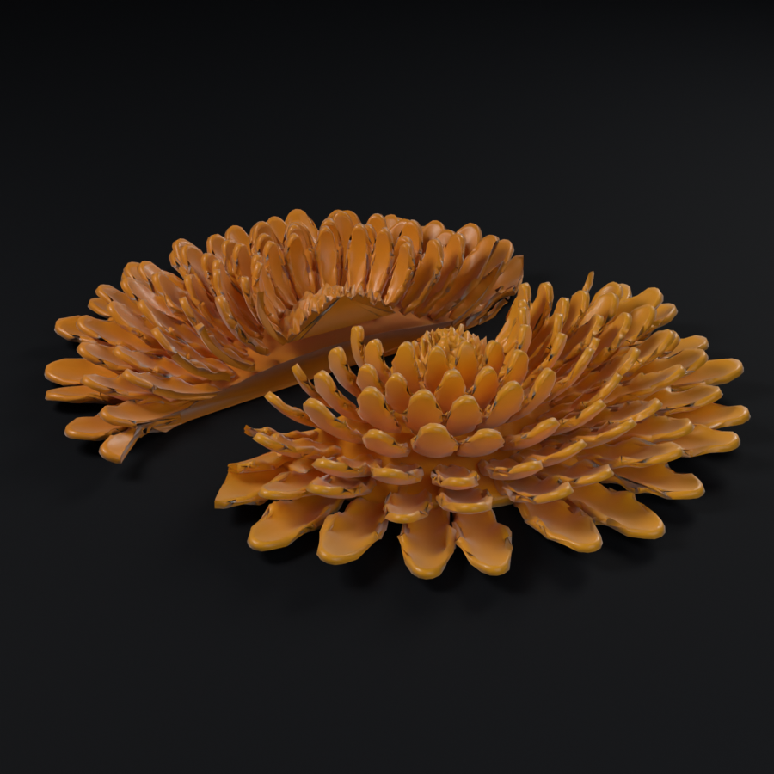
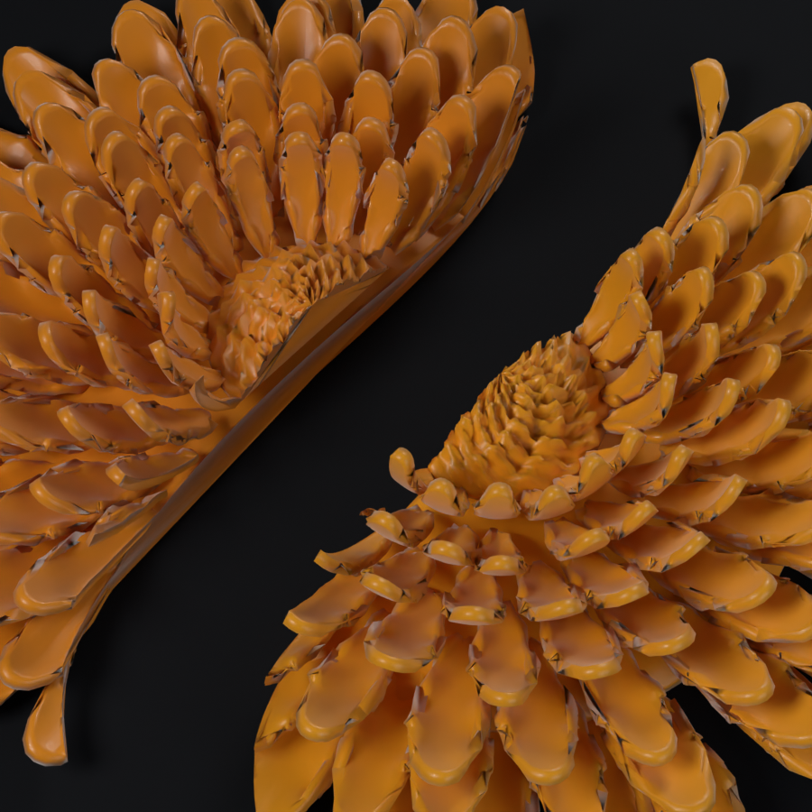
Concept B S River Split
The client's priority concept: a flowing S-shaped, river-inspired separation with an editable curve.
Assembled flower
The two components, separated
Detail of the division

Slide 4
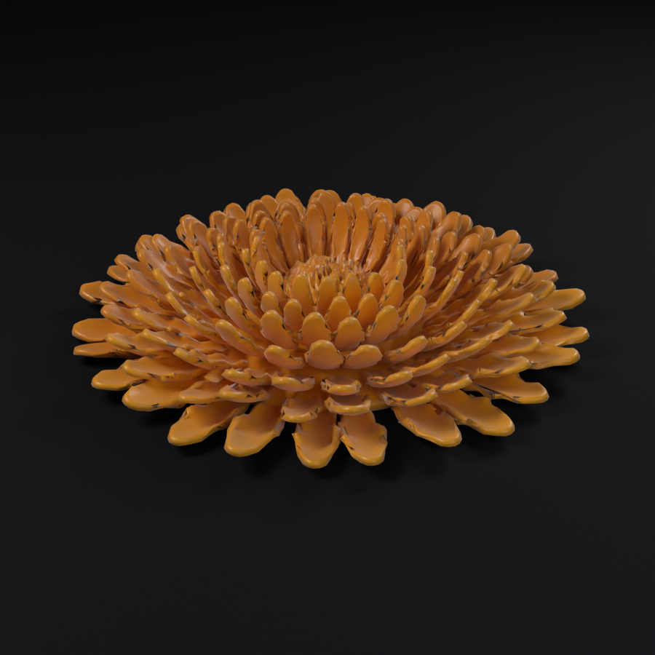
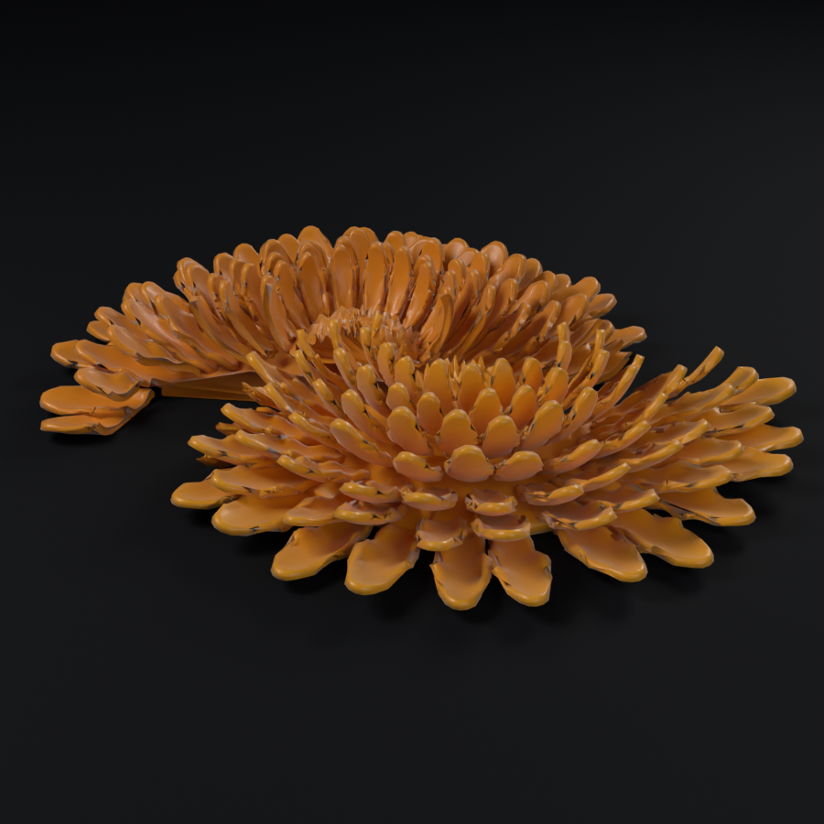
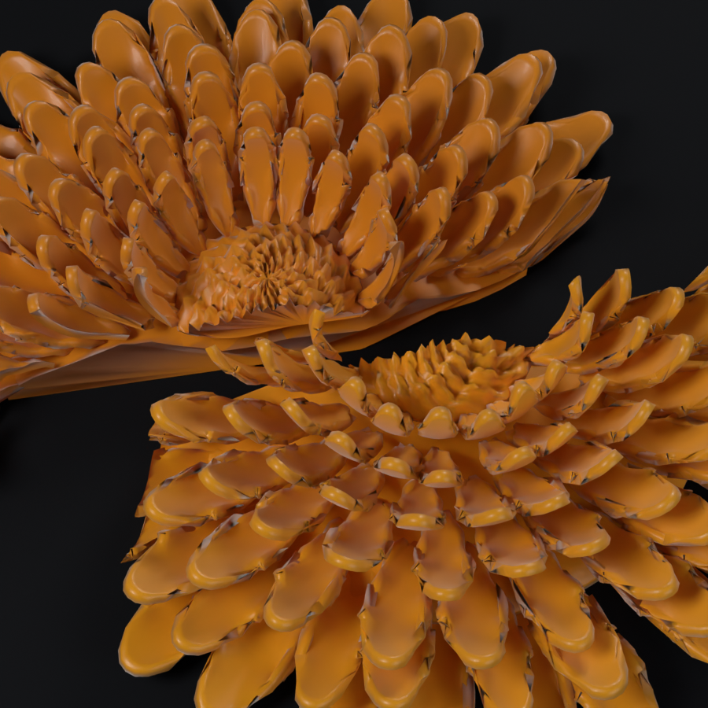
Concept C Organic Asymmetric
An expressive, irregular division that wanders with the petal arrangement. The two pieces are deliberately unequal.
Assembled flower
The two components, separated
Detail of the division

Slide 5
The three concepts side by side
Concept A Balanced Split
Concept B S River Split
Concept C Organic Asymmetric

Slide 6
Next steps
1. Select a preferred concept, or a combination.
2. Share AFRi reference material so the provisional assumptions can be replaced.
3. Confirm the intended finished size and material.
4. Authorise the hat stage: placing the approved flower on the brim and designing the attachment.
The hat is not modelled and no attachment has been designed. Manufacturing feasibility has not been assessed.

