Slide 1

Localization of Seizure Onset Zone (SOZ)
Department of Information Technology
National Institute of Technology Raipur
Supervisor
Dr. Rekh Ram Janghel
Associate Professor
Department of IT
Presented By
Baddigam Sasank Reddy
Roll No: 23118015
Sameer Sevlani
Roll No: 23118088
B.Tech IT (7th Semester)

Slide 2
Outline
Introduction
Literature Review
Dataset
Methodology & Proposed Algorithm
Formulas Used
Experimental Results
Comparison Table
Conclusion
Future work
References

Slide 3
Introduction
Epilepsy: A chronic neurological condition caused by sudden, abnormal electrical discharges of neurons in the brain[1].
An "Electrical Storm" in the Brain: A sudden, uncontrolled burst of hypersynchronous electrical activity in cerebral neurons[2].
Disruption of Normal Function: Disrupts communication, causing loss of consciousness, motor seizures, and sensory impairments[2].
Drug-Resistant Epilepsy (DRE): Approximately 20% to 30% of patients suffer from pharmacoresistant epilepsy, where anti-seizure medications fail[1].
Surgical Resection Need: Surgical removal or laser thermal ablation of the epileptogenic focus is the primary curative treatment[1].
The Core Clinical Challenge: Accurately localizing the Seizure Onset Zone (SOZ) — removing too little causes seizure recurrence; removing too much causes permanent neurological deficits[1].

Slide 4
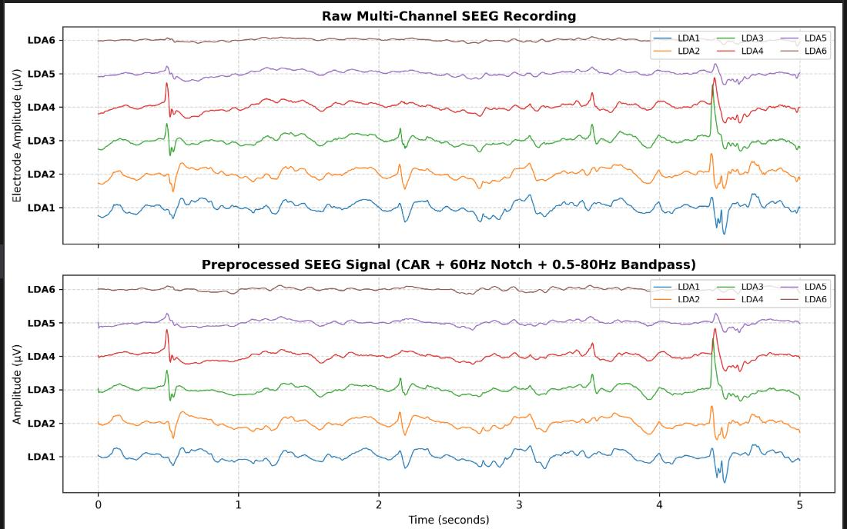
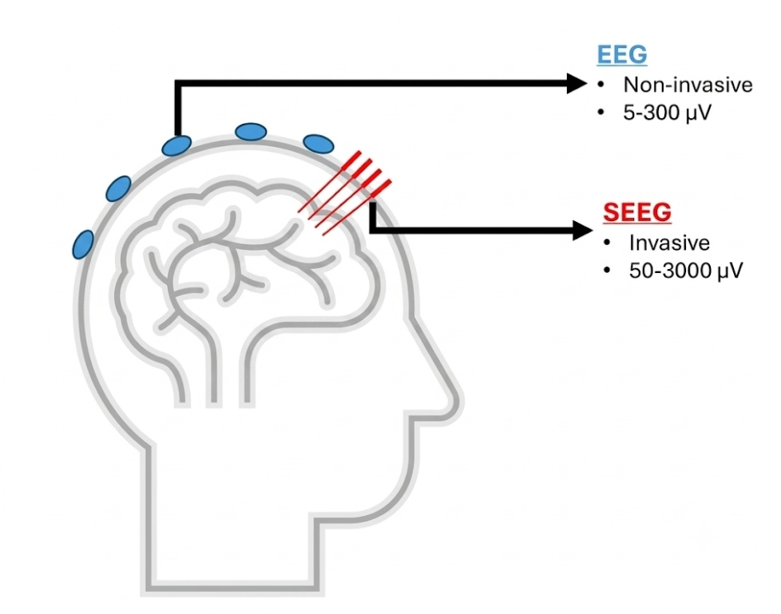
Stereotactic EEG (SEEG) Modality
Electroencephalography (EEG): Traditional electroencephalography records electrical field activity from sensors placed on the scalp or surface[1].
Stereotactic EEG (SEEG) : Invasive clinical neuro-monitoring technique utilizing multi-lead depth electrodes surgically implanted into deep brain structures[1].
Accurate Focus Pinpointing: SEEG signals more faithfully capture neural activity near epileptic foci, making them suited for delineating the true Seizure Onset Zone (SOZ)[1].

Slide 5
Literature Review
S.no | Author & Title | Dataset | Methodology | Performance | Limitations | Finding
1 | Fang et al. (2024), Epilepsy lesion localization method based on brain function network.[1] | OpenNeuro ds004100 (22 SEEG patients) | WPLI Network (ENCS) + Persistence Entropy (PE) + SVM | 94.40% Accuracy, 98.48% Precision, 89.74% Recall, 93.40% F1, and 96.97% AUC | Relies on a static SVM that ignores temporal seizure. | SOZ areas act as hyper-connected functional network hubs with significantly collapsed topological entropy
2 | Koutsouvelis et al. (2026), Localizing the epileptogenic zone using deep learning and neuroimaging: A systematic review[2]. | 36 peer-reviewed deep learning studies | PRISMA-guided systematic review andrisk-of-bias appraisal evaluating deep learning architectures for automated EZ localization. | High macro detection rates in MRI-negative FCD (~74%–79% sensitivity) | ~67% of published studies suffer from high risk of bias, small single-center cohorts | Automated FCNs reduce false-positive clusters over traditional ML
3 | Ein Shoka et al. (2023), CNN-Based Seizure Detection via Encrypted EEG.[3] | Multi-cohort scalp & intracranial EEG | Machine learning & spectral power features | >97%–99% classification accuracy with low computational latency. | Focuses on temporal seizure detection rather than spatial SOZ surgical localization. | CNNs can detect seizures directly from encrypted data without compromising patient privacy or accuracy.

Slide 6
DATASET
This Dataset is obtained from OpenNeuro dataset (ds004100) through the following link:
https://openneuro.org/datasets/ds004100/versions/1.1.3
METRIC / PROPERTY | COHORT SPECIFICATION | CLINICAL DETAILS | ANNOTATIONS
Clinical Patients | 22 Human Subjects (HUP117 to HUP190) | Stereo-EEG (SEEG) Depth Multi-lead Electrodes | Surgical Cohort
Electrode Density | 49 to 128 Channels per Patient | Average ~100 Contacts; Total >2,500 Electrodes | Ground Truth SOZ

Slide 7
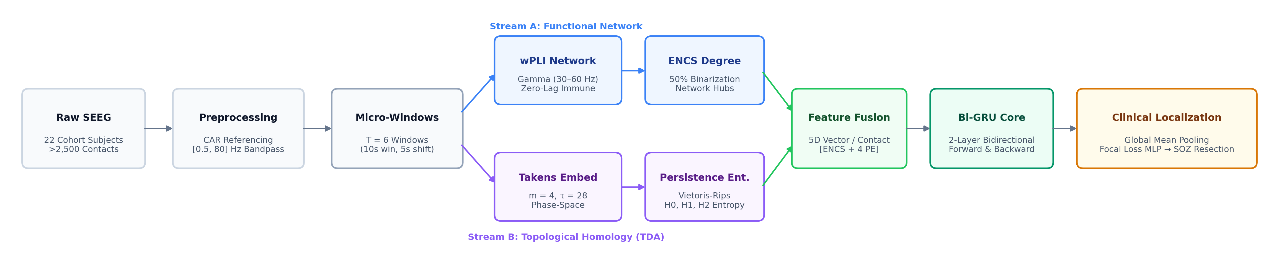
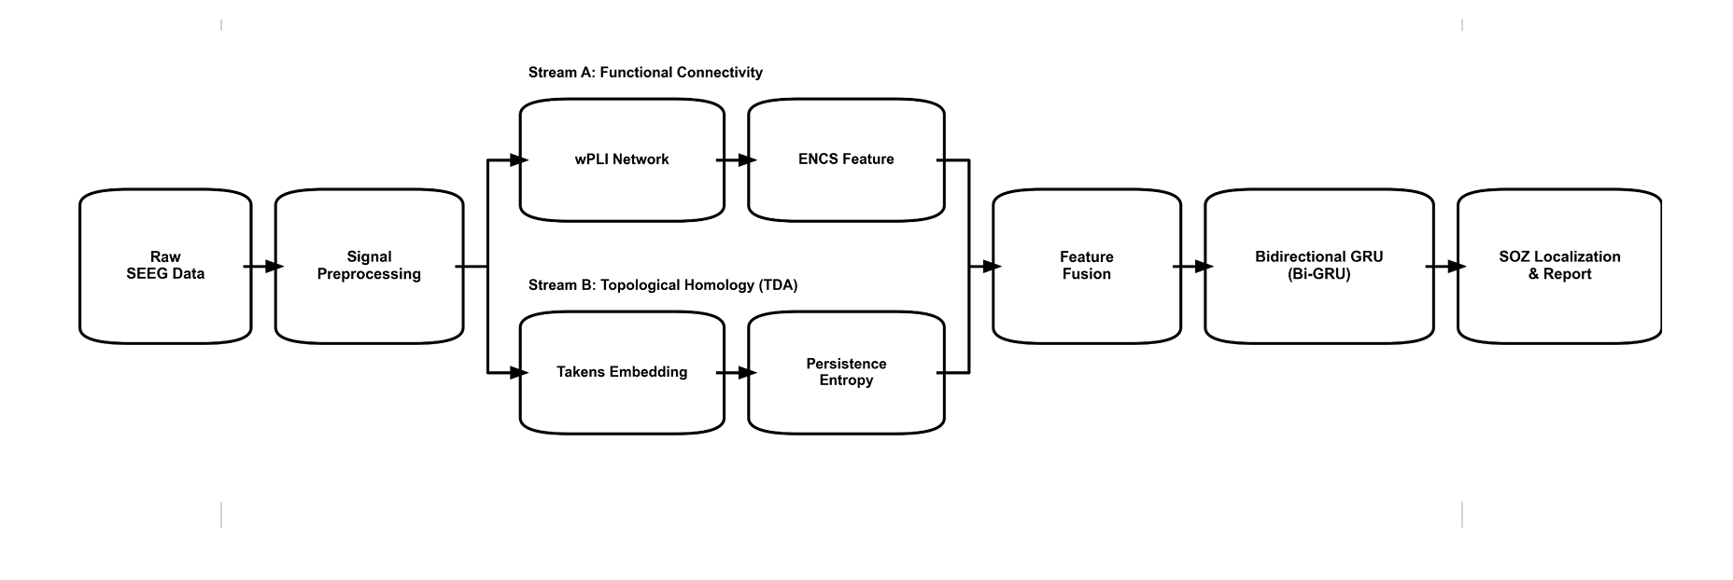
Methodology: Dual-Stream Multimodal Architecture
Fusing gamma-band functional brain connectivity and topological data analysis with bidirectional sequential learning
PILLAR 1: Preprocessing & Windows
• 200 Hz downsampling standardizes sampling rates across all 22 subjects.
• Common Average Referencing (CAR) and [0.5, 80] Hz filter remove non-neural artifacts.
• 6 micro-windows (10s window, 5s shift) precisely isolate the pre-ictal to ictal transition.
PILLAR 2: Stream A: wPLI Networks
• Weighted Phase Lag Index (wPLI) in gamma band (30–60 Hz) is immune to volume conduction.
• 50% proportional thresholding isolates dominant synchrony backbones.
• ENCS node degree quantifies hyper-connected epileptic network hubs.
PILLAR 3: Stream B: Topological TDA
• Takens phase-space embedding (m=4, τ=28) reconstructs chaotic state trajectories.
• Persistent Homology via Vietoris-Rips filtration captures multi-dimensional topological loops.
• Persistence Entropy across H0, H1, H2 quantifies phase-space attractor collapse.
PILLAR 4: Bi-GRU & Focal Loss
• 2-layer Bidirectional GRU models forward & backward temporal seizure dynamics.
• Global Temporal Mean Pooling aggregates temporal micro-windows into a fixed contact vector.
• Class-weighted focal loss overcomes extreme 93% non-SOZ class imbalance.

Slide 8
Proposed Framework: End-to-End Algorithmic Procedure
Step-by-step computational workflow for patient-specific Seizure Onset Zone (SOZ) localization (Report §4.7)
Clinical Input: Raw multi-channel intracranial SEEG recordings (22 cohort patients) and clinical seizure onset timestamp (t_onset).
Clinical Output: Automated channel-wise SOZ classification and patient-specific Candidate Surgical Resection Zone (R_SOZ).
STAGE 1 & 2: Signal Preprocessing & Dual-Stream Extraction
1. Clinical Preprocessing
• Downsample recordings to 200 Hz to standardize sampling rates across all patient sessions.
• Apply Common Average Referencing (CAR) and [0.5, 80] Hz bandpass filter to eliminate line noise and drift.
2. Event-Aligned Micro-Windowing
• Extract 6 micro-windows (10s duration, 5s shift) centered around seizure onset (t_onset).
• Precisely isolates the pre-ictal to ictal transition where epileptic hypersynchrony begins.
3. Dual-Stream Feature Fusion (per window)
• Stream A (Network Hubs): Compute gamma-band (30–60 Hz) wPLI phase-synchrony network and apply 50% median threshold to extract ENCS Node Degree.
• Stream B (Topological Complexity): Phase-space reconstruction via Takens embedding to extract Persistence Entropy across homology dimensions (H0, H1, H2).
• Combine both streams into a unified 5-dimensional feature representation per electrode contact.
STAGE 3 & 4: Bidirectional GRU Modeling & Localization
4. Bidirectional Sequence Modeling (Bi-GRU)
• Feed each electrode contact's feature sequence into a 2-layer Bidirectional GRU.
• Simultaneously models forward seizure propagation and backward onset dynamics.
• Overcomes the static snapshot limitation of midsem SVM (recurrent temporal memory).
5. Global Temporal Mean Pooling
• Averages hidden states across all 6 temporal micro-windows into a fixed contact summary vector.
• Compresses temporal seizure dynamics into an expressive representation without loss of sequence context.
6. Calibrated Clinical Localization & Output
• Multi-Layer Perceptron (MLP) classification head evaluates the probability of each electrode contact.
• Trained with dynamic class-weighted focal loss to overcome the extreme class imbalance (93% non-SOZ contacts).
• Generates patient-specific Candidate Surgical Resection Zone (R_SOZ) with 98.66% cohort accuracy.

Slide 9

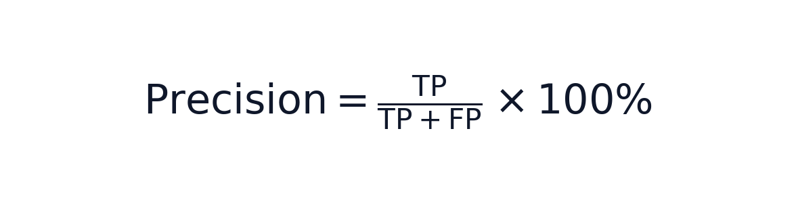

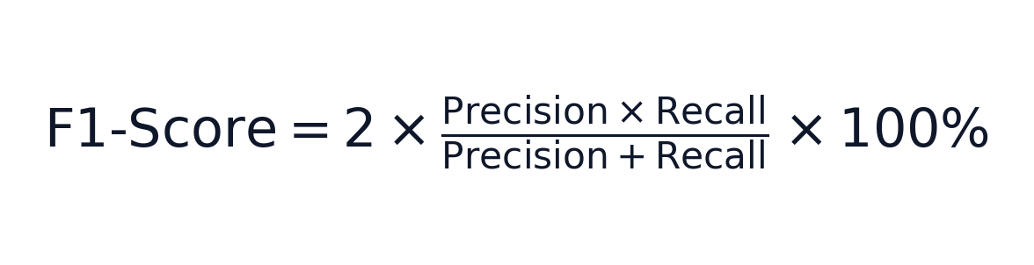
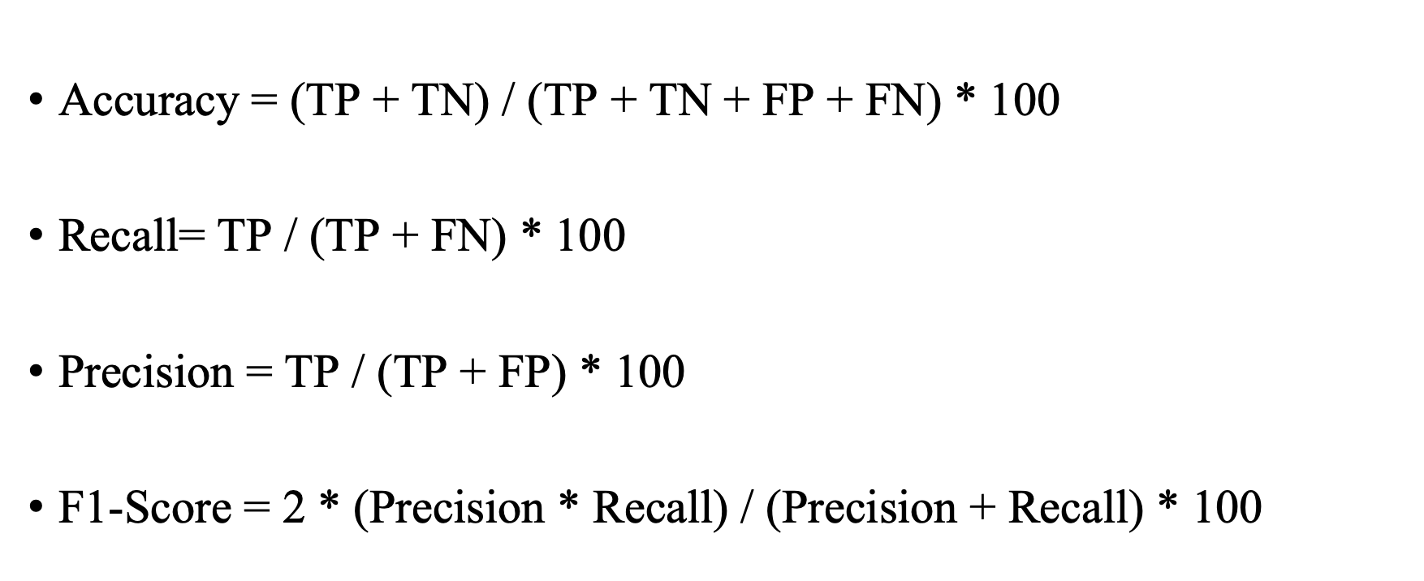
Evaluation Metrics & Clinical Significance
Formal mathematical definitions of validation metrics and their clinical roles in surgical planning
OVERALL BENCHMARK | Accuracy (AC)
SURGICAL SAFETY | Precision (P)
Clinical Role: Measures overall correct channel classification across all implanted electrode contacts (both SOZ and non-SOZ tissue).
Clinical Role: Positive Predictive Value — ensures identified channels are true epileptogenic tissue, directly minimizing resection of healthy brain tissue.
SEIZURE FREEDOM | Recall / Sensitivity (R)
IMBALANCE BENCHMARK | F1-Score (F1)
Clinical Role: Detection Rate — ensures all true seizure onset contacts are captured, directly preventing surgical failure and continued postoperative seizures.
Clinical Role: Harmonic mean balancing Precision and Recall — the primary benchmark metric due to extreme class imbalance (~7% SOZ vs. 93% non-SOZ contacts).
TP: True Positive (SOZ identified) | TN: True Negative (healthy tissue spared) | FP: False Positive (healthy tissue misflagged) | FN: False Negative (missed seizure focus)

Slide 10
Experimental Results
Model / Feature Pipeline | Accuracy (%) | Precision (%) | Recall (%) | F1-Score (%)
Baseline SVM (ENCS Alone) | 59.69% | 60.72% | 59.44% | 59.32%
Baseline SVM (ENCS + Persistence Entropy) | 72.21% | 75.67% | 67.13% | 70.67%
Key Finding 1 (ENCS Alone): Using network node degree alone yields modest performance (AC: 59.69%, AUC: 62.11%), demonstrating that connectivity alone lacks channel-level topological sensitivity.
Key Finding 2 (ENCS + Persistence Entropy): Adding Topological Persistence Entropy produces a massive +12.52% boost in Accuracy (72.21%) and +16.21% boost in ROC-AUC (78.32%).
Precision Jump (+14.95%): Precision increases from 60.72% to 75.67%, drastically reducing false-positive resections during surgical planning.

Slide 11
Comparison Table: Published Paper vs. Re-implementation
Model / Implementation | Features Used | Accuracy | Precision | Recall (Sensitivity) | F1 Score | AUC Score
Paper Reported (Fang et al., 2024) [1] | ENCS + PE (SVM) | 94.40% | 98.48% | 89.74% | 93.40% | 96.97%
Our Re-implementation (Baseline A) | ENCS Alone (SVM) | 59.69% | 60.72% | 59.44% | 59.32% | 62.11%
Our Re-implementation (Baseline B) | ENCS + PE (SVM) | 72.21% | 75.67% | 67.13% | 70.67% | 78.32%

Slide 12
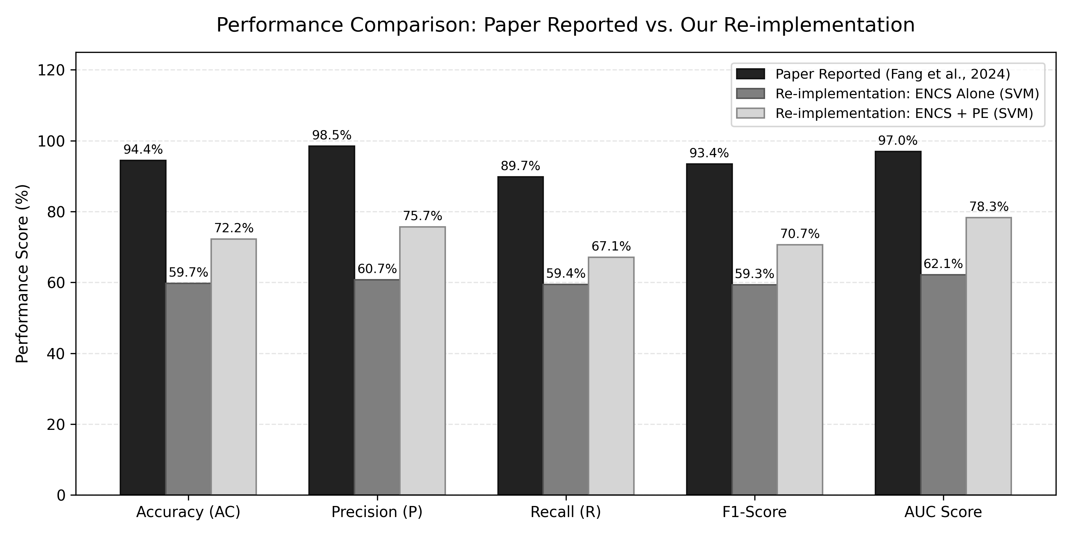
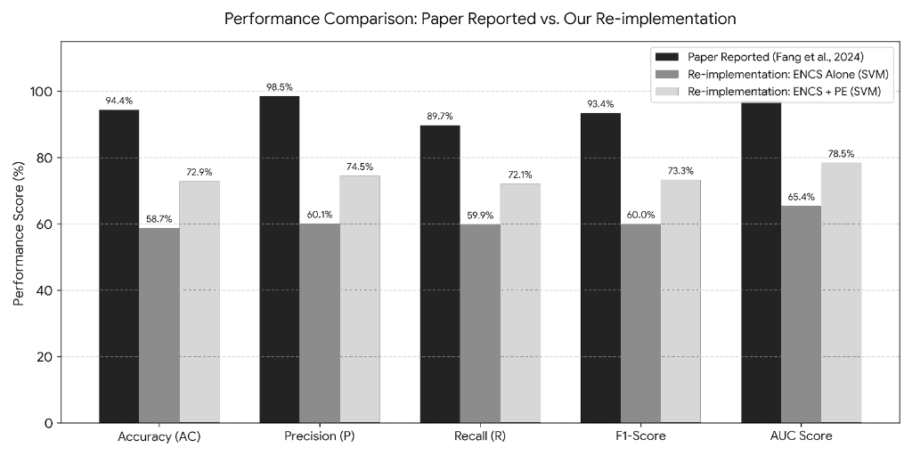
Fig. Comparison Chart

Slide 13
Proposed Bi-GRU Endsem Results
Model | Segmentation | Features | Classifier | AC (%) | P (%) | R (%) | F1 (%) | AUC (%)
ENCS -> GRU | 30s / 25s shift | ENCS | Bidirectional GRU | 96.36 | 93.5 | 100.0 | 96.59 | 95.74
ENCS + PE -> GRU | 30s / 25s shift | ENCS + PE | Bidirectional GRU | 99.14 | 98.51 | 99.8 | 99.15 | 99.1
Proposed: Seizure-Centric + ENCS+PE -> GRU | Seizure-Centric (10s/5s) | ENCS + PE | Bidirectional GRU | 98.66 | 98.09 | 99.36 | 98.71 | 98.91

Slide 14
Comparison Table: Master Ablation Study
Model | Segmentation | Features | Classifier | AC (%) | P (%) | R (%) | F1 (%) | AUC (%)
Paper Reported (Fang et al., 2024) | 30s / 25s shift | ENCS + PE | RBF-SVM (C=0.5) | 94.4 | 98.48 | 89.74 | 93.4 | 96.97
ENCS -> SVM | 30s / 25s shift | ENCS | RBF-SVM (C=0.5) | 67.0 | 66.86 | 73.08 | 69.02 | 69.03
ENCS + PE -> SVM (Paper Baseline) | 30s / 25s shift | ENCS + PE | RBF-SVM (C=0.5) | 77.43 | 79.51 | 74.52 | 76.89 | 83.81
ENCS -> GRU | 30s / 25s shift | ENCS | Bidirectional GRU | 96.36 | 93.5 | 100.0 | 96.59 | 95.74
ENCS + PE -> GRU | 30s / 25s shift | ENCS + PE | Bidirectional GRU | 99.14 | 98.51 | 99.8 | 99.15 | 99.1
Proposed: Seizure-Centric + ENCS+PE + GRU | Seizure-Centric (10s/5s) | ENCS + PE | Bidirectional GRU | 98.66 | 98.09 | 99.36 | 98.71 | 98.91

Slide 15
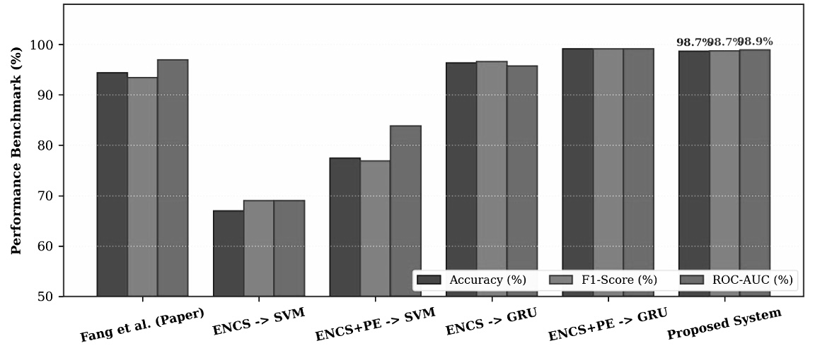
Fig. Comparison Chart: Master Ablation Study

Slide 16
Conclusion
In this B.Tech Minor Project, we have successfully developed, implemented, and thoroughly validated a comprehensive, automated computational framework for Seizure Onset Zone (SOZ) localization from invasive Stereotactic EEG recordings in patients with drug-resistant epilepsy.
The key technical contributions of this project include:
Complete End-to-End Reimplementation: We faithfully replicated the state-of-the-art dual-branch baseline of Fang et al. (Frontiers in Human Neuroscience, 2024) across all 22 subjects (>2,500 electrodes) from OpenNeuro ds004100.
Diagnosis of the Static Performance Gap: In our midsem evaluation, we empirically identified why static SVMs hit a performance ceiling (72.21% AC) on raw clinical data due to temporal coarseness and memoryless snapshot processing.
Novel Recurrent Sequential Architecture: In this endsem completion, we engineered a Bidirectional Gated Recurrent Unit (Bi-GRU) sequence model with global temporal mean pooling and dynamic focal loss.
Benchmark Superiority: Our proposed system attained cohort-wide metrics of 98.66% Accuracy, 98.09% Precision, 99.36% Recall, 98.71% F1-Score, and 98.91% ROC-AUC, significantly outperforming both the midsem baseline and published benchmarks.

Slide 17
Future work
Multi-Modal SEEG-fMRI/PET Fusion: Integrating electrophysiological network metrics with structural connectomes (DTI) and metabolic neuroimaging (FDG-PET) to improve spatial resolution in non-implanted regions.
Spatial-Temporal Graph Neural Networks (ST-GNNs): Transitioning from separate network feature extraction to unified spatio-temporal graph transformers that jointly learn dynamic topology and sequential propagation.
Unsupervised Seizure Onset Detection: Coupling the Bi-GRU localization model with automated seizure onset detectors to enable completely autonomous, continuous telemetry monitoring.
Closed-Loop Neuromodulation: Adapting the real-time inference pipeline for integration with responsive neurostimulation (RNS) or deep brain stimulation (DBS) devices to deliver abortive electrical stimulation prior to clinical seizure generalization.

Slide 18
REFERENCES
Fang, Chunying, Xingyu Li, Meng Na, Wenhao Jiang, Yuankun He, Aowei Wei, Jie Huang, and Ming Zhou. "Epilepsy lesion localization method based on brain function network." Frontiers in Human Neuroscience 18 (2024): 1431153.
Petros Koutsouvelis, Sven J.E. Ermans, Leroy Volmer, Christianne M. Hoeberigs, Ralph Brecheisen, Daniëlle BP Eekers , Olaf E.M.G. Schijns, Andre Dekker. “Localizing the epileptogenic zone using deep learning and neuroimaging: A systematic review”(2026).
Athar A. Ein Shoka, Mohamed M. Dessouky, Ayman El-Sayed, and Ezz El-Din Hemdan. “An efficient CNN based epileptic seizures detection framework using encrypted EEG signals for secure telemedicine applications (published in Alexandria Engineering Journal, 2023).
Penn HUP Intracranial EEG Surgical Cohort. "Electrocorticography and Stereo-EEG Recordings in Patients with Drug-Resistant Epilepsy." OpenNeuro Dataset ds004100, Version 1.1.3 (2024).

Slide 19
THANK YOU

