Slide 1
AIRVIEW AI
Hackathon focus
Urban air-quality intelligence for smart city intervention
Problem Statement 5 asks for forecasting, source attribution, enforcement intelligence and citizen health risk advisories for Indian smart cities. AirView AI converts multiple public data sources into one operational command centre.
Live-provider forecast path + validated replay fallback | Source screening | Enforcement priorities | Citizen advisories
Five validated cities
24-72h forecasting
Map-based action queue
Demo mode: live feeds when available, replay fallback when providers are unreachable.
AirView AI | ET AI Hackathon 2.0 | PS5
01

Slide 2
Why this matters
DATA EXISTS; INTERVENTION INTELLIGENCE DOES NOT
Monitoring is not enough
PS5 target
AirView AI answer
CAAQMS readings show pollution after it happens. Administrators still need source context, forecast lead time and actionable inspection queues.
Fuse monitoring, satellite, mobility/land-use, weather and geospatial layers to shift from reactive dashboards to proactive source intervention.
A city command centre that forecasts the next 24-72 hours, ranks source-influence evidence and recommends inspection/advisory actions.
AirView AI | ET AI Hackathon 2.0 | PS5
02

Slide 3
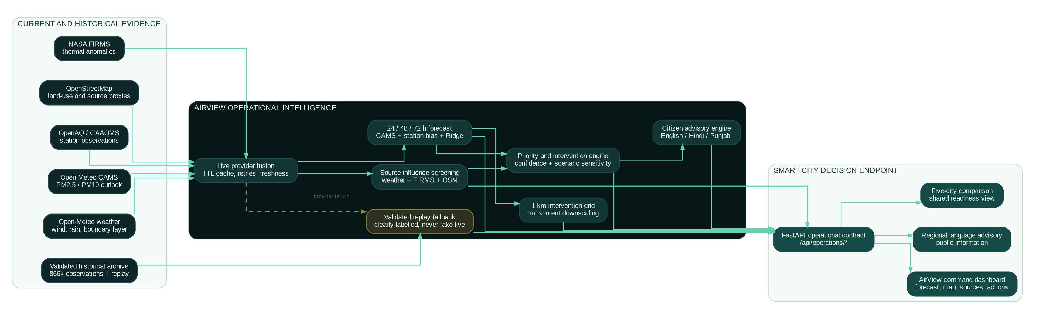
System architecture
SOURCE FUSION TO CITY DECISION ENDPOINT
• Public sources: OpenAQ/CAAQMS history and latest path, Open-Meteo AQ/weather forecasts, NASA FIRMS thermal anomalies, OpenStreetMap source proxies. • Operational engine fuses provider forecast, station bias correction, trained replay models, wind/stagnation cues and intervention grid scoring. • Frontend exposes only the polished decision workflow - no raw logs, dev panels or validation-only screens in the demo.
AirView AI | ET AI Hackathon 2.0 | PS5
03

Slide 4
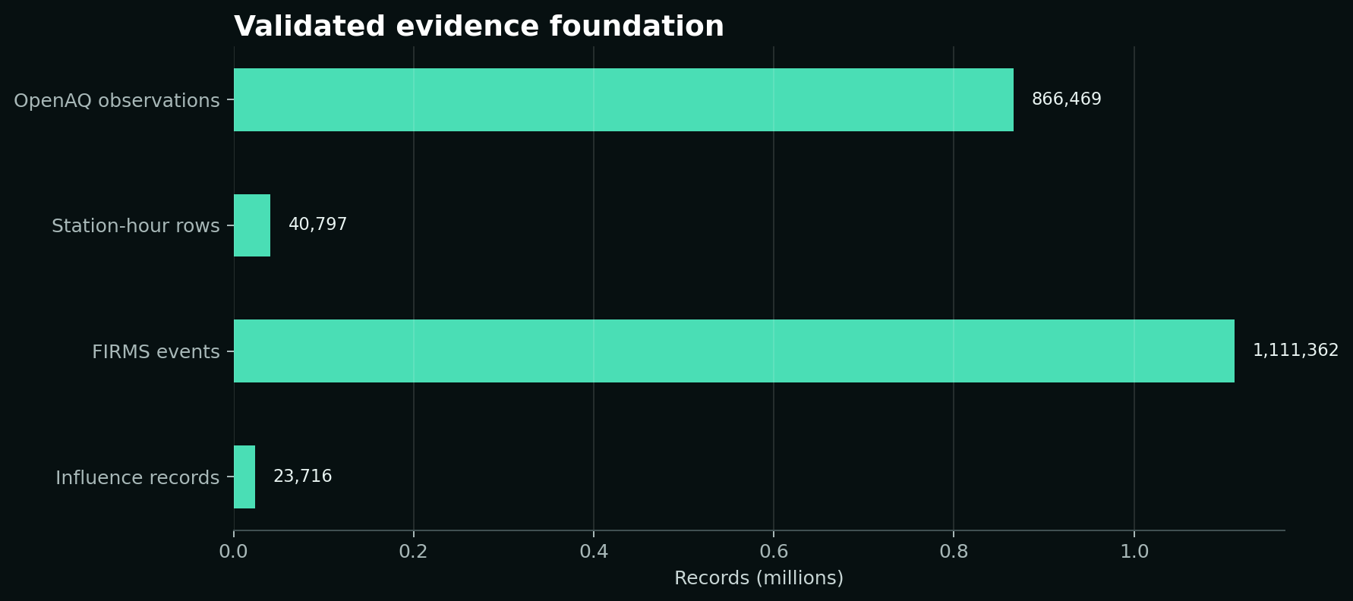
Evidence foundation
REAL DATA WHERE AVAILABLE, HONEST FALLBACKS WHERE NOT
866k
40.8k
1.11M
5
OpenAQ historical observations
station-hour feature rows
NASA FIRMS thermal-anomaly events
validated pilot cities
Source-status discipline
Sentinel-5P returned zero valid pixels and GHSL was unavailable, so AirView AI does not fabricate satellite columns or population exposure. Agra and Amritsar OSM gaps are shown as missing evidence, not zeros.
AirView AI | ET AI Hackathon 2.0 | PS5
04

Slide 5
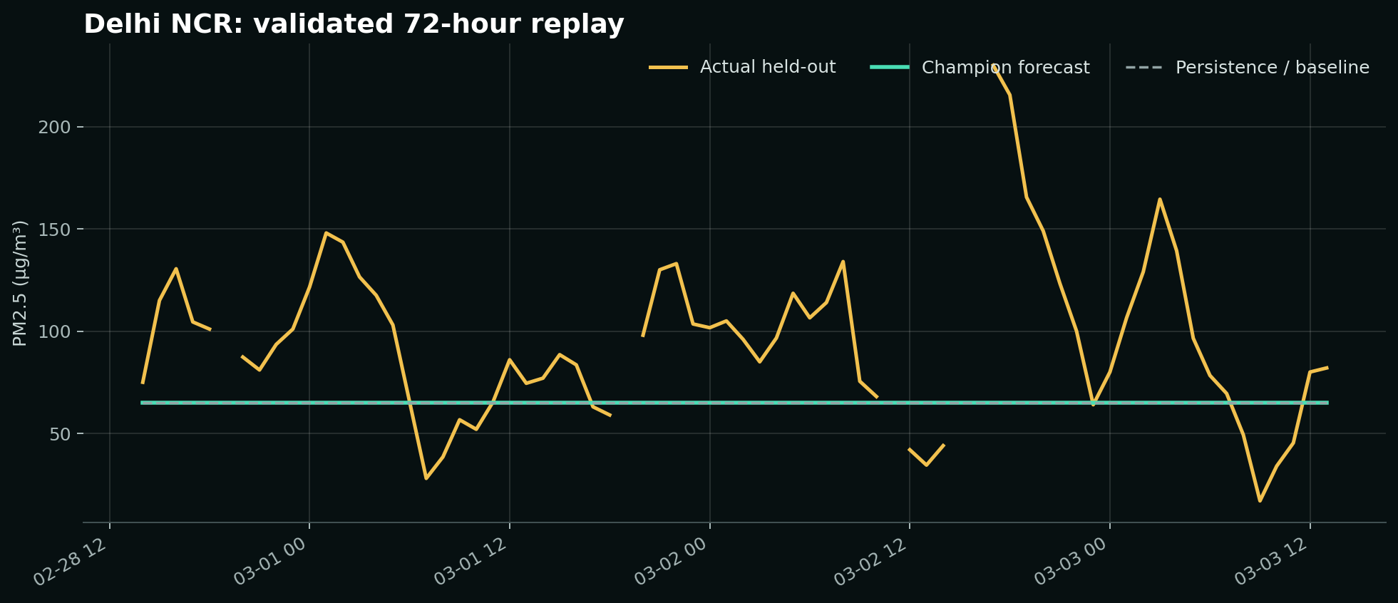
Forecasting intelligence
LIVE PATH + REPLAY VALIDATION
How prediction works
Live mode attempts OpenAQ recent observations, Open-Meteo AQ and weather forecasts, then fuses station bias, CAMS baseline and trained replay corrections. If online providers fail, a validated replay with actual held-out observations loads automatically.
• 24, 48 and 72 hour horizons • PM2.5 and PM10 • Actual vs forecast vs persistence • Uncertainty interval and AQI-style severity
AirView AI | ET AI Hackathon 2.0 | PS5
05

Slide 6
Geospatial source intelligence
SCREENING SIGNALS, NOT SOURCE APPORTIONMENT
Source indicators
Atmospheric context
Map safety
Traffic and transport
Industrial activity
Construction and road dust
Regional thermal anomalies
Meteorological accumulation
Background / unresolved
Wind direction and speed
Stagnation index
Humidity and rainfall
Distance-decay weighting
FIRMS event age
Upwind influence
Station marker
1 km planning grid
Bounded FIRMS markers
OSM evidence when available
No fake plume or heatmap
Missing evidence disclosed
AirView AI | ET AI Hackathon 2.0 | PS5
06

Slide 7
From signal to action
PRIORITY, INTERVENTION AND ADVISORY IN ONE FLOW
Forecast peak
Source context
Priority tier
Intervention
Citizen advisory
For officials
For citizens
Prioritised inspections, source-specific recommended actions, controllability, response window, caveats and scenario-sensitivity estimates.
Short, standard and detailed advisories in English, Hindi and Punjabi; replay/live status and public-information disclaimer included.
AirView AI | ET AI Hackathon 2.0 | PS5
07

Slide 8
Final demo product
ONE PROFESSIONAL COMMAND-CENTRE ENDPOINT
Frontend
Backend
Demo scripts
/dashboard as main route
City/pollutant/window controls
Forecast chart
Map with OSM attribution
Action queue
No dev logs on demo surface
/api/operations/status
/api/operations/cities
/api/operations/dashboard
/api/operations/network
Live provider retries
Replay fallback
scripts/run_demo.ps1
scripts/verify_demo.ps1
scripts/stop_demo.ps1
Validation reports
README workflow
Submission docs and deck
AirView AI | ET AI Hackathon 2.0 | PS5
08

Slide 9
What is honest today, what scales next
PRESENTABLE NOW; EXPANDABLE NEXT
Current validated scope
Next scaling step
Five-city operational prototype. Live path uses accessible online providers; demo remains robust through validated replay fallback. No GHSL population, no Sentinel valid pixels, no regulatory source apportionment claim.
Add more Indian cities through the same versioned pipeline: discover stations, rank readiness, selectively download archive partitions, enrich weather/FIRMS/OSM, train/evaluate, and auto-register in the existing command centre.
AirView AI | ET AI Hackathon 2.0 | PS5
09

