Slide 1
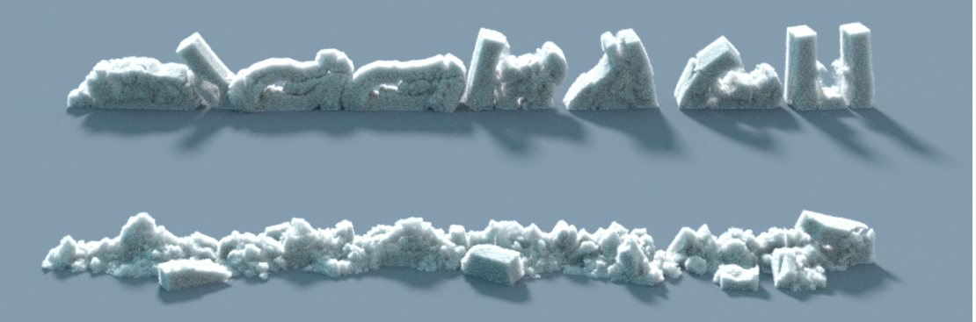
A material point method for snow simulation
Alexey Stomakhin^{1,2} Craig Schroeder¹ Lawrence Chai² Joseph Teran ^{1,2} Andrew Selle ²
¹University of California Los Angeles ²Walt Disney Animation Studios

Slide 2
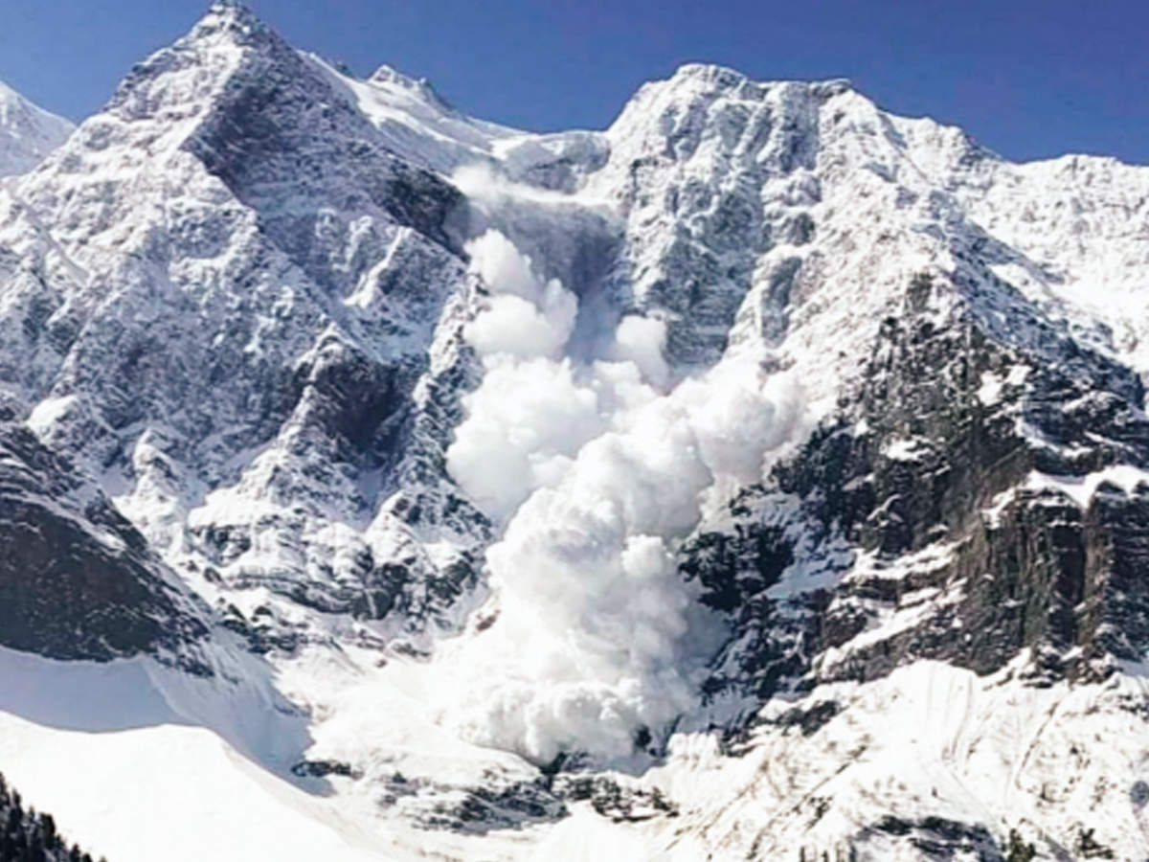
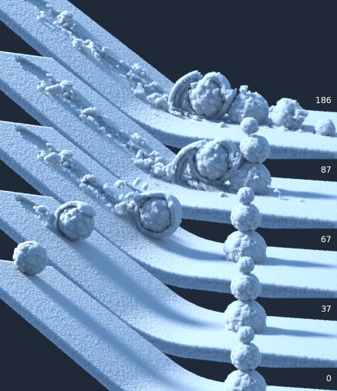
Snow material

Slide 3
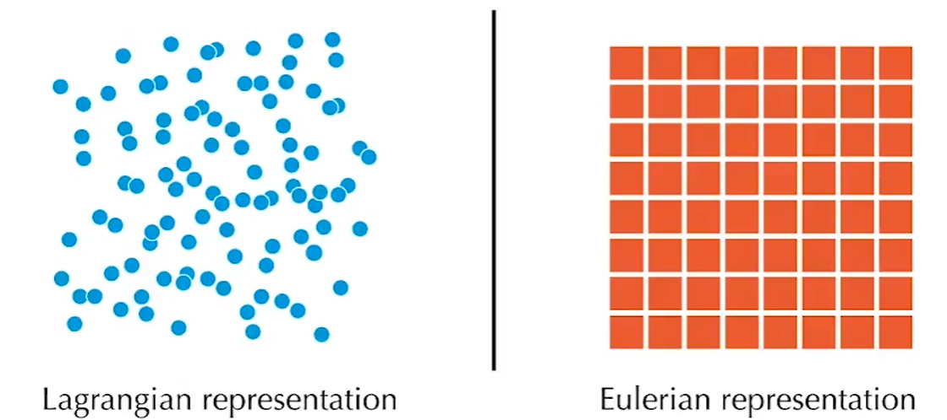
Eulerian View&Lagrangian View

Slide 4
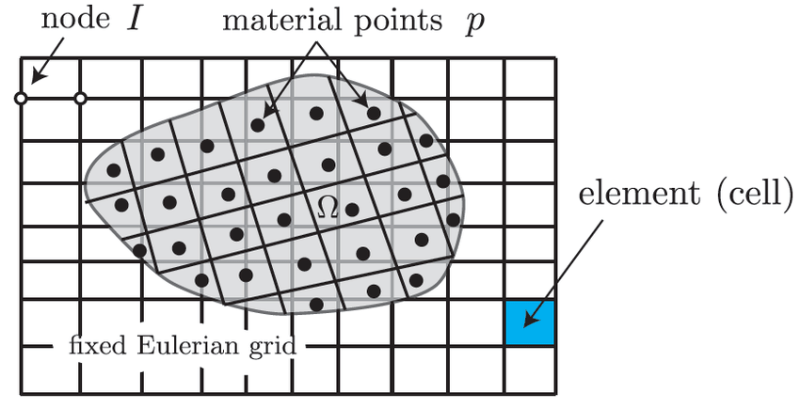
Hybrid Eulerian/Lagrangian View
Particle to Grid transfer
(P2G)
Grid Operation
Particle Operation
Grid to Particle transfer
(G2P)

Slide 5
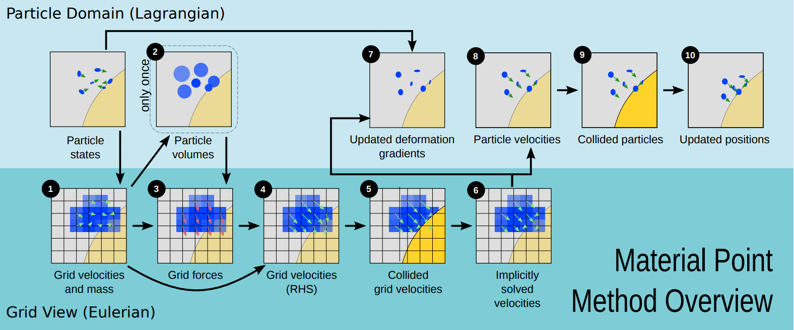
Material point method

Slide 6
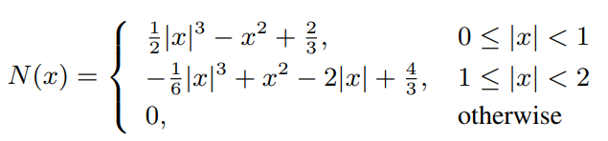
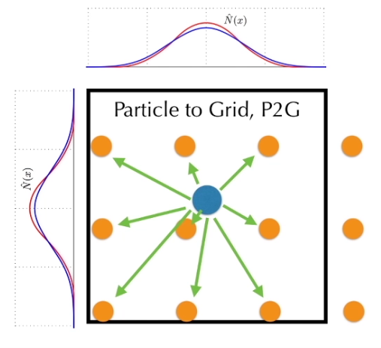
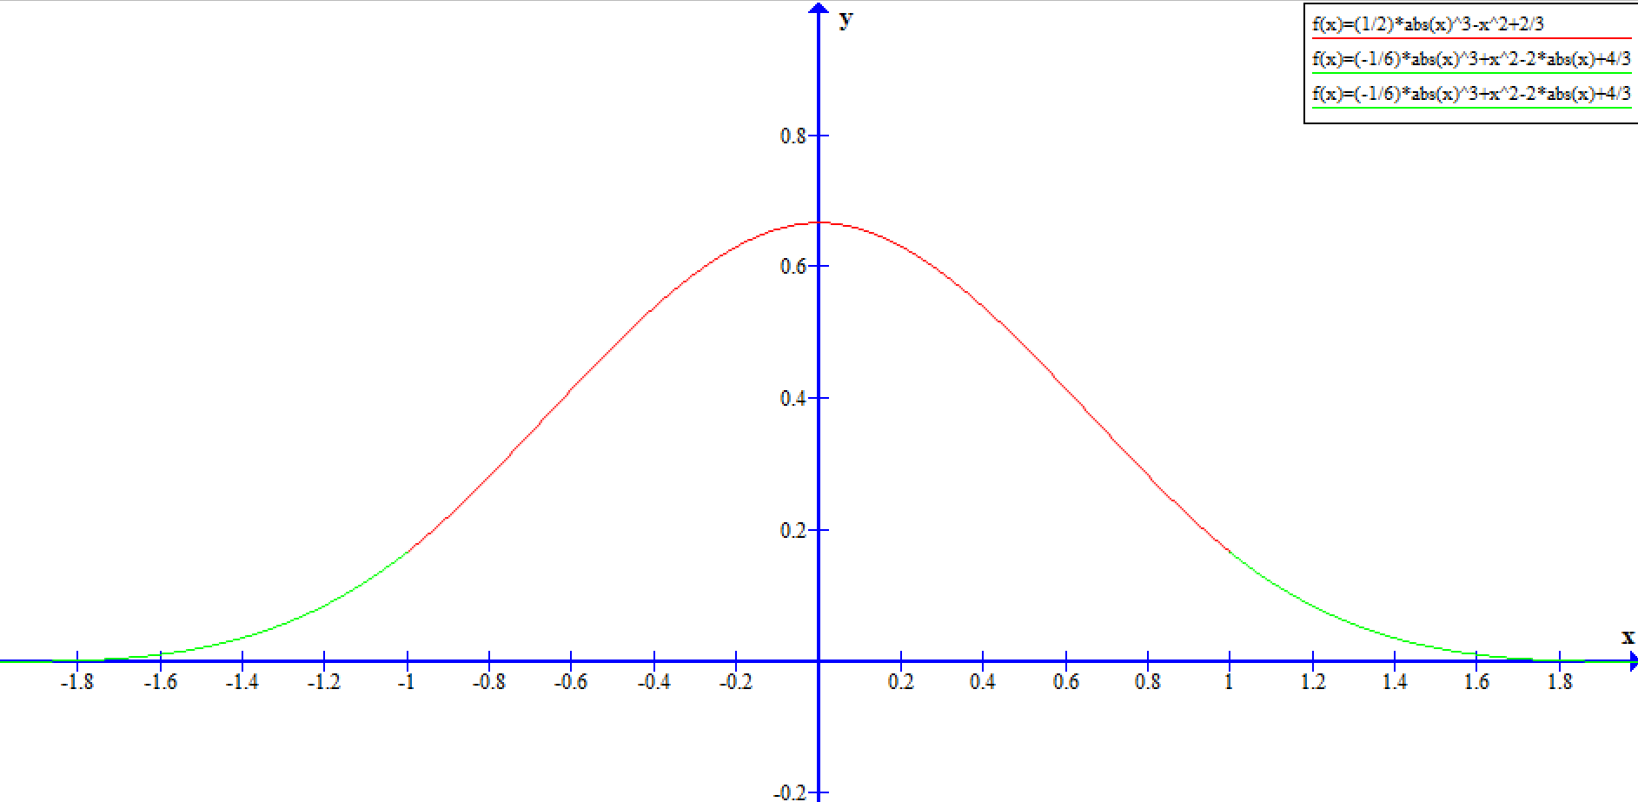
Kernel function

Slide 7
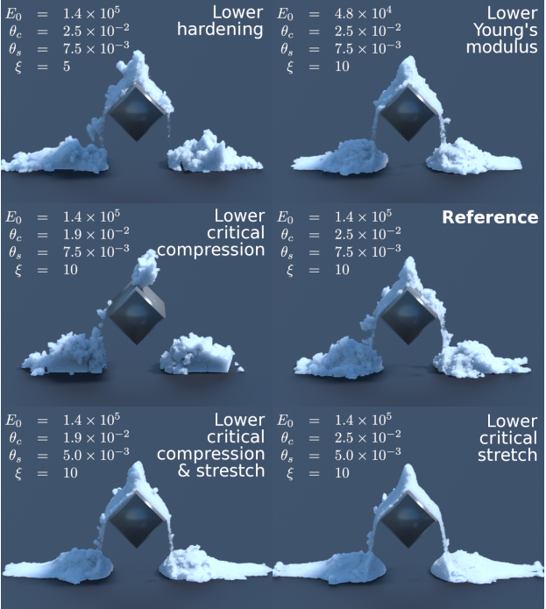

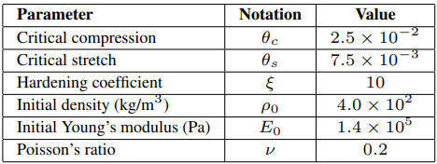
Constitutive Models

Slide 8
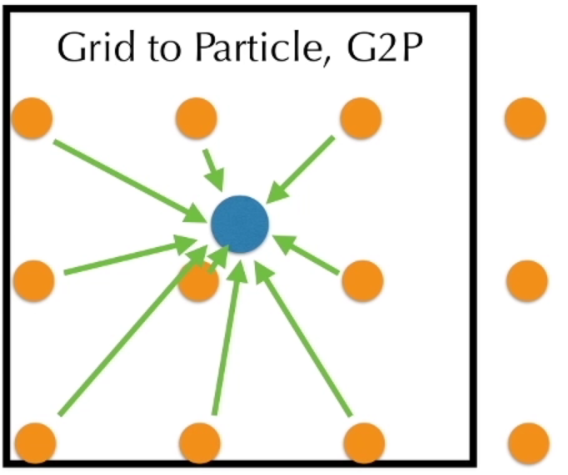





Update particle velocities
PIC method:
FLIP method:
FLIP0.95 method:

Slide 9
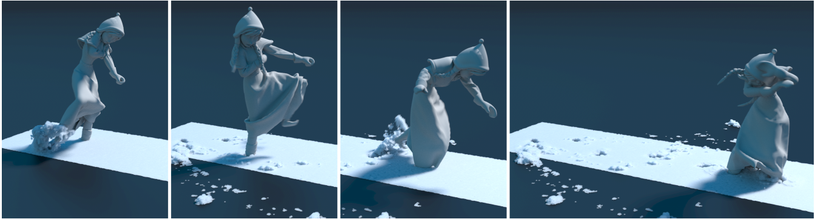
Evaluate
Better outreach work: MLS-MPM[1]
[1] Hu, Yuanming, et al. "A moving least squares material point method with displacement discontinuity and two-way rigid body coupling." ACM Transactions on Graphics (TOG) 37.4 (2018): 1-14.

Slide 10
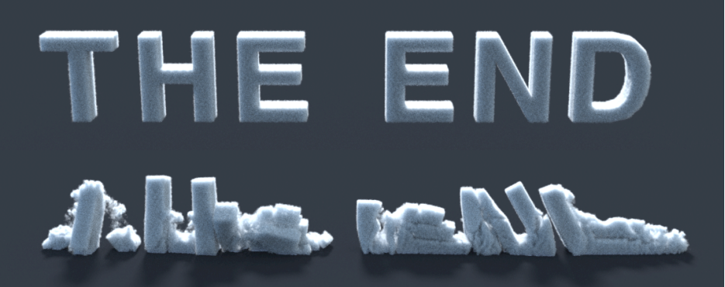
Thanks

