Slide 1


Bank of Baroda Hackathon - 2022
Technology Partner
Team Name : Brain Stormer
Team bio : To give an efficient solution is the main motive.
Date : 25.08.2022

Slide 2
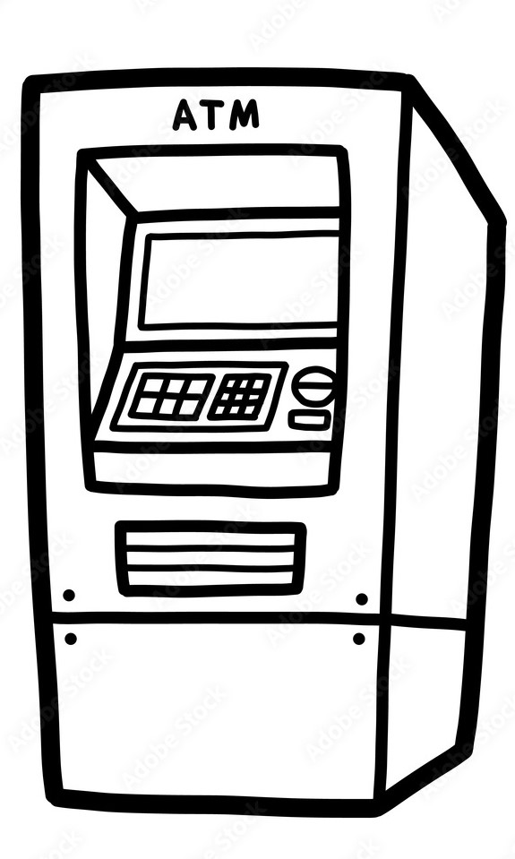
Problem Statement
As ATM is a very essential part of our daily lives.
We can easily withdraw our money after went
to the ATM just entering some key.
But, there are some fraudster or we can say thieves
who do scam with the process of ATM and
sometimes they broke the ATM and stole the
money of users, banks.

Slide 3


User Segment & Pain Points
To stop this I have come up with a solution to analysis the live video. Where we can easily track the sentiments of every person whoever is entering in the ATM. Not sentiments also we can track some other behaviors - :
Time taking by the person.
Have the person any tools to modifying the ATM.
Numbers of people entering in the ATM
Tempering with the cameras
Some activities that needs attention

Slide 4

Pre-Requisite
To implement the idea we need a cloud space to store the analysis of the live video data.
- Azure is the best platform for doing that.
A well defined Machine Learning algorithm which will be running in the backend as to doing all the work as well as it will learn automatically time to time.
To written the Machine Learning algorithm we need a system which can run efficiently that which will be programmed using Python Language.

Slide 5
Azure tools or resources
Azure Key Vault :- Which helps to easily maintain control of keys that are used by cloud applications and services to encrypt data. Azure Disk Encryption enables to encrypt VMs. Azure Firewall :- Which is a cloud-native and intelligent network firewall security service that provides threat protection for cloud workloads running in Azure. Azure Blob storage :- It is Microsoft's object storage solution for the cloud. Blob storage is optimized for storing massive amounts of unstructured data. Unstructured data is data that doesn't adhere to a particular data model or definition, such as text or binary data

Slide 6
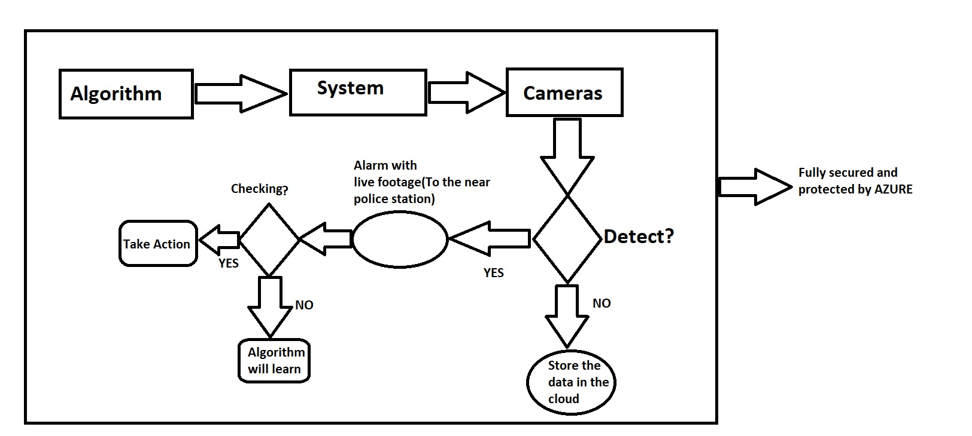
Methodology
A well written machine learning algorithm which can detect users sentiments, count faces along with some other functions which are already mentioned.
The brief methodoldy is:-

Slide 7
Key Differentiators & Adoption Plan
Some key points of the methodology are:-
It is very straight forward.
It takes action immediately.
If it fails then it will learn and it will be more better.
As it stores the data in the cloud so in the future we can access and get the information.
Its fully secure as Azure Firewall will be running with it.

Slide 8

Demo
GitHub Repository :-
https://github.com/CoderAvijit/AtmVideoAnalysis
Demo Video:-
Touch the video to play

Slide 9
Thank You
Team Members :-
Avijit Rana (Leader)

