Slide 1
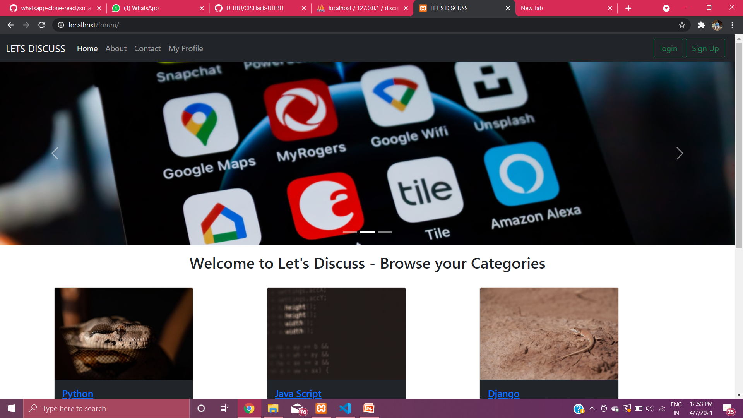
LET’S DISCUSS FORUM
THE CODING FORUM FOR DEVELOPERS

Slide 2
Presented to You by
Name:- Debabrata Basak
Email : debabratabasak061@gmail.com
Department : Computer Science and Technology
Phone : 8348708604
University Institute of Technology
University of Burdwan

Slide 3
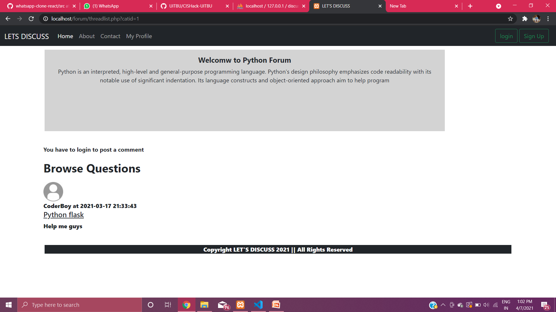
FEATURES OF THE FORUM
DYNAMICALLY PAGE RENDERING
RENDERING ALL THE DATA FROM MY-SQL DATABASE
USER LOGIN/SIGNUP FACILITY
SEARCH FACILITY
DEVELOPER CONTACT FACILITY
POSTING COMMENTS AND QUESTIONS FACILITY

Slide 4
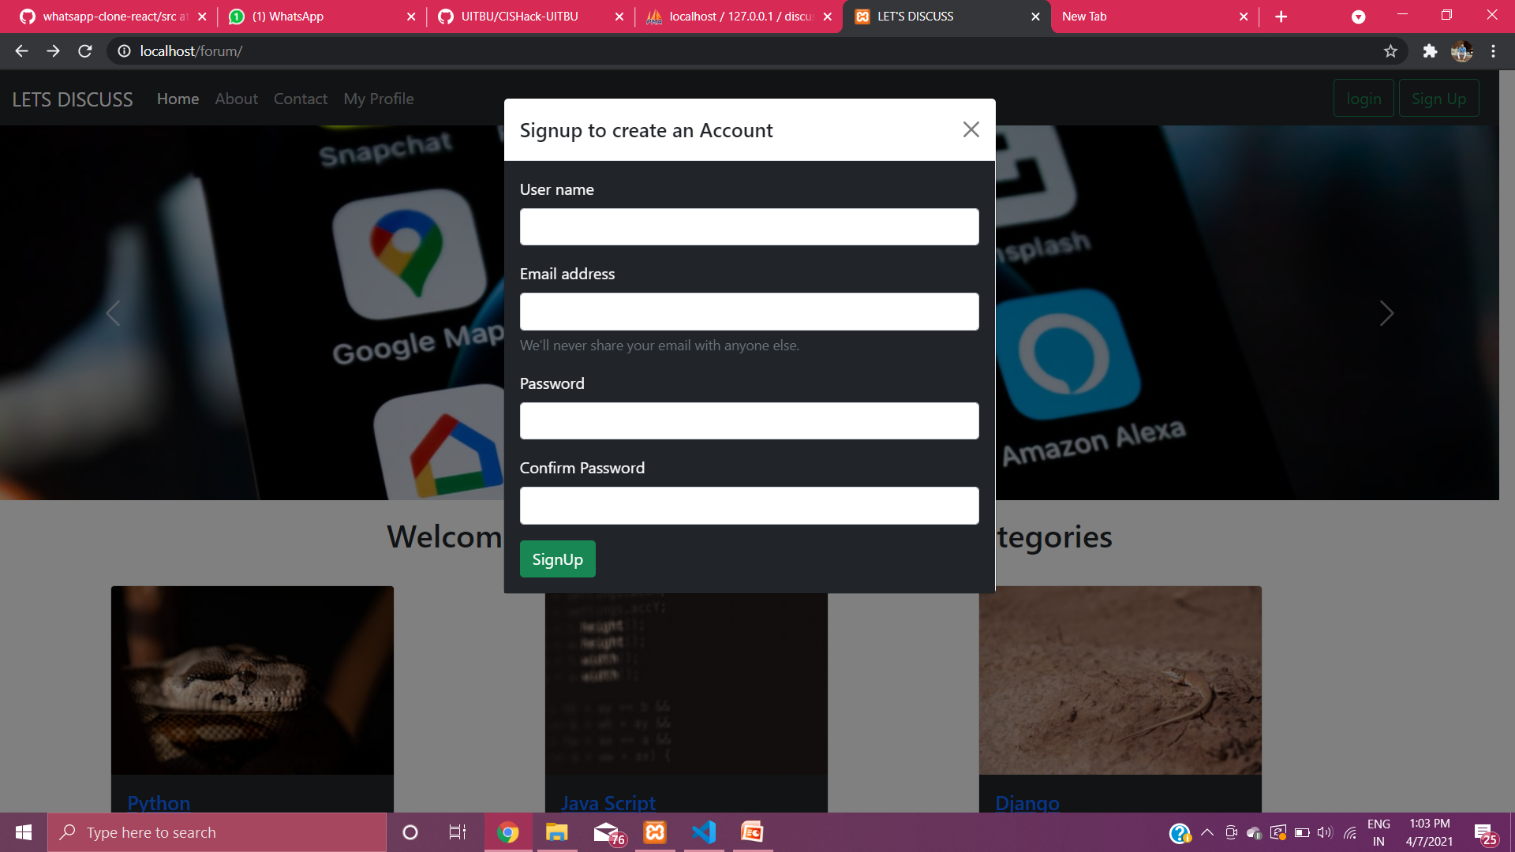
SignUp page created using Modal
User can SignUp through Email address , and Username
Without login , anyone cannot post any comments and answers in thread page

Slide 5
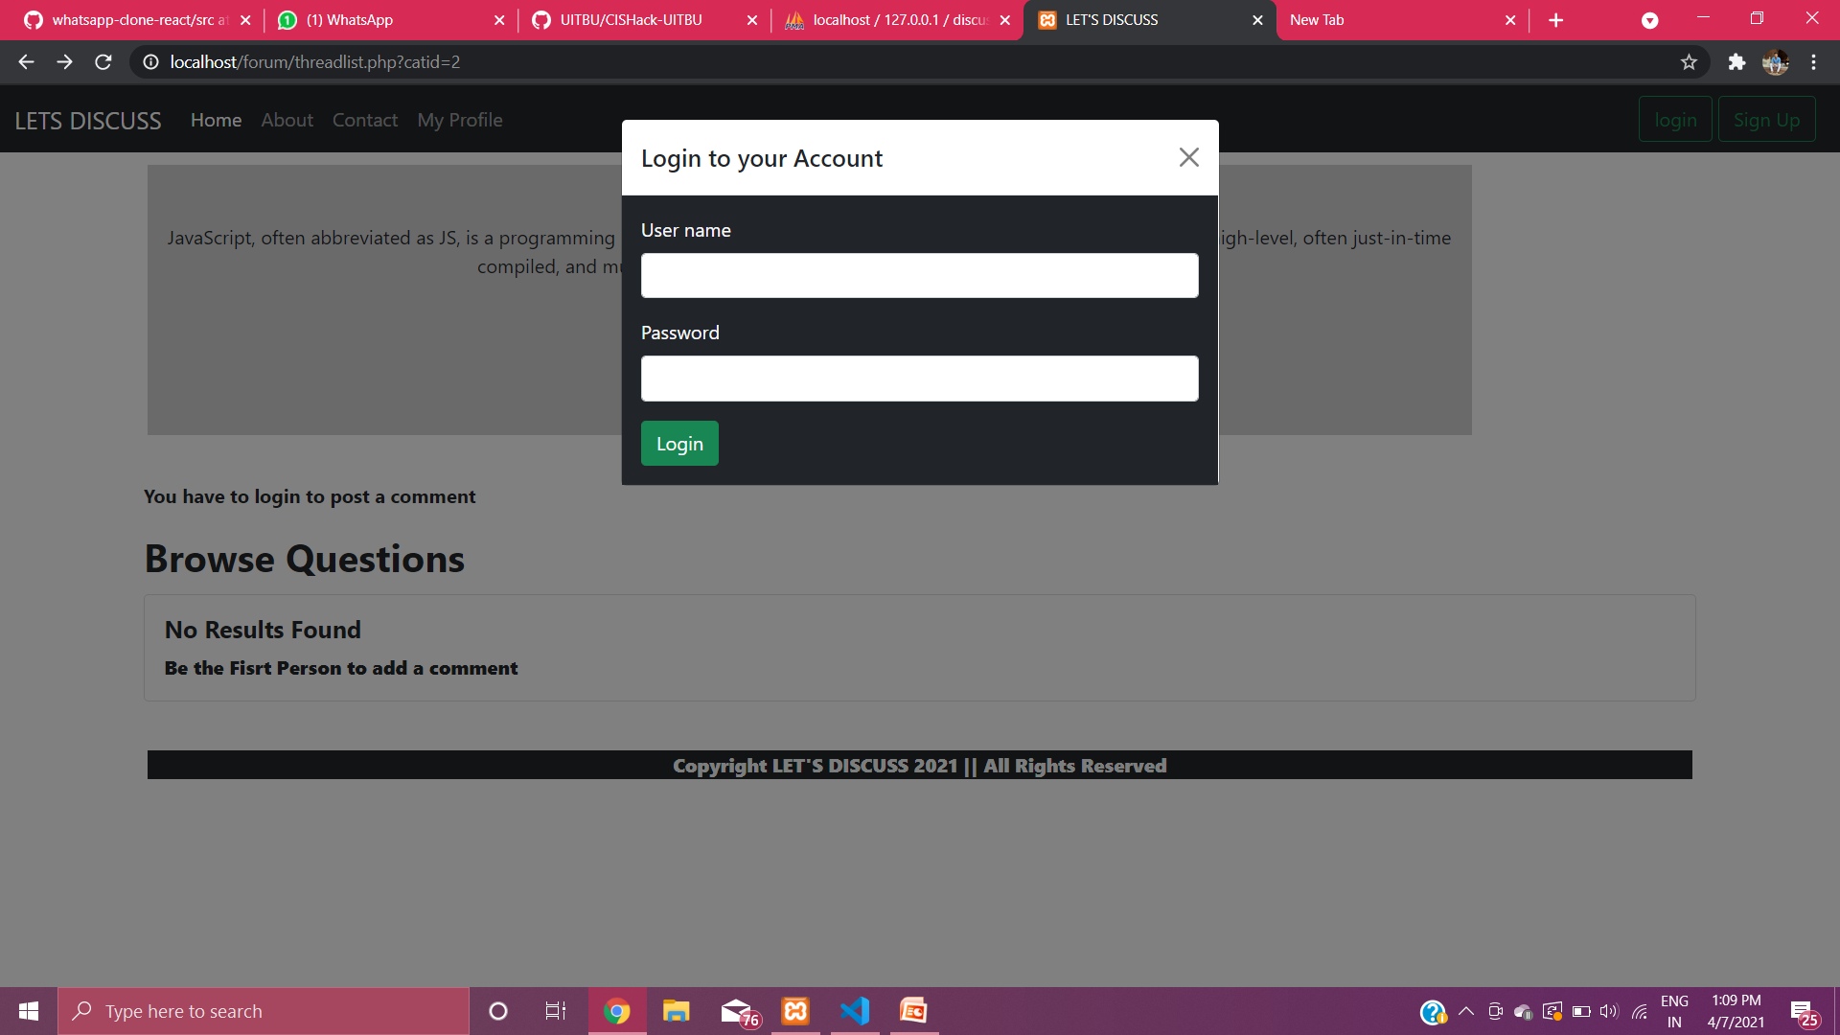
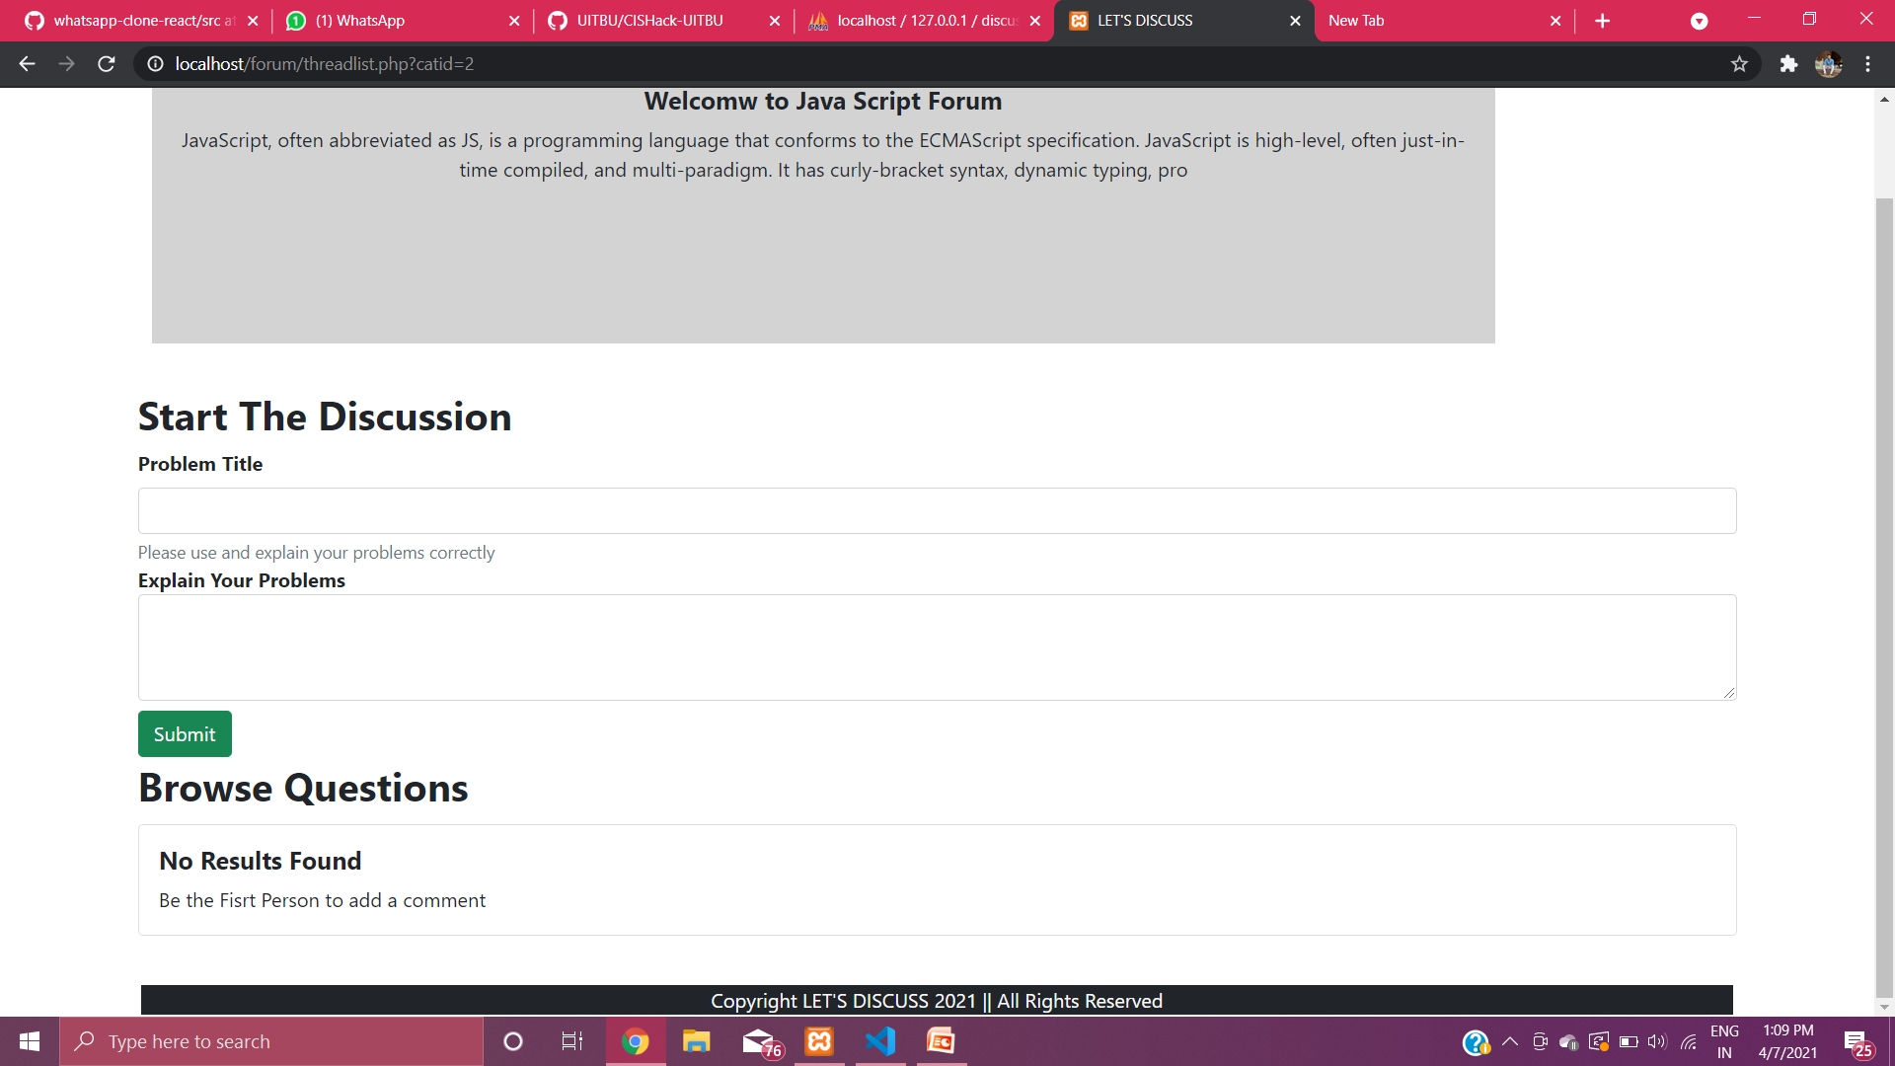
LOGIN FACILITY
LOGIN PAGE
After successfully login, now you can post any comments and start the discussion in thread page

Slide 6
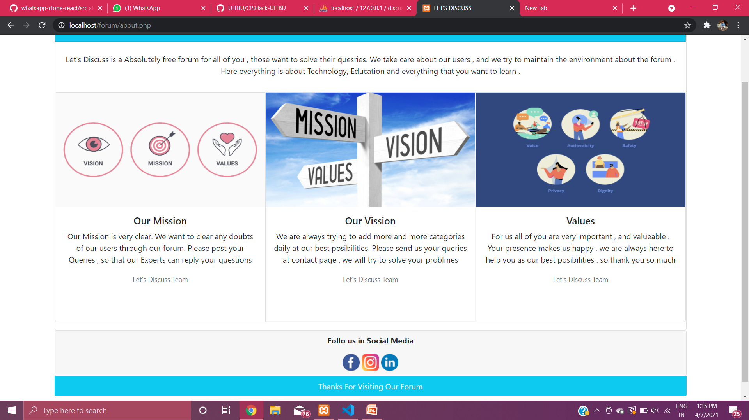
This is the About Page of the Forum. Where you will get the Social Media Icons , which redirect you respective social media page

Slide 7
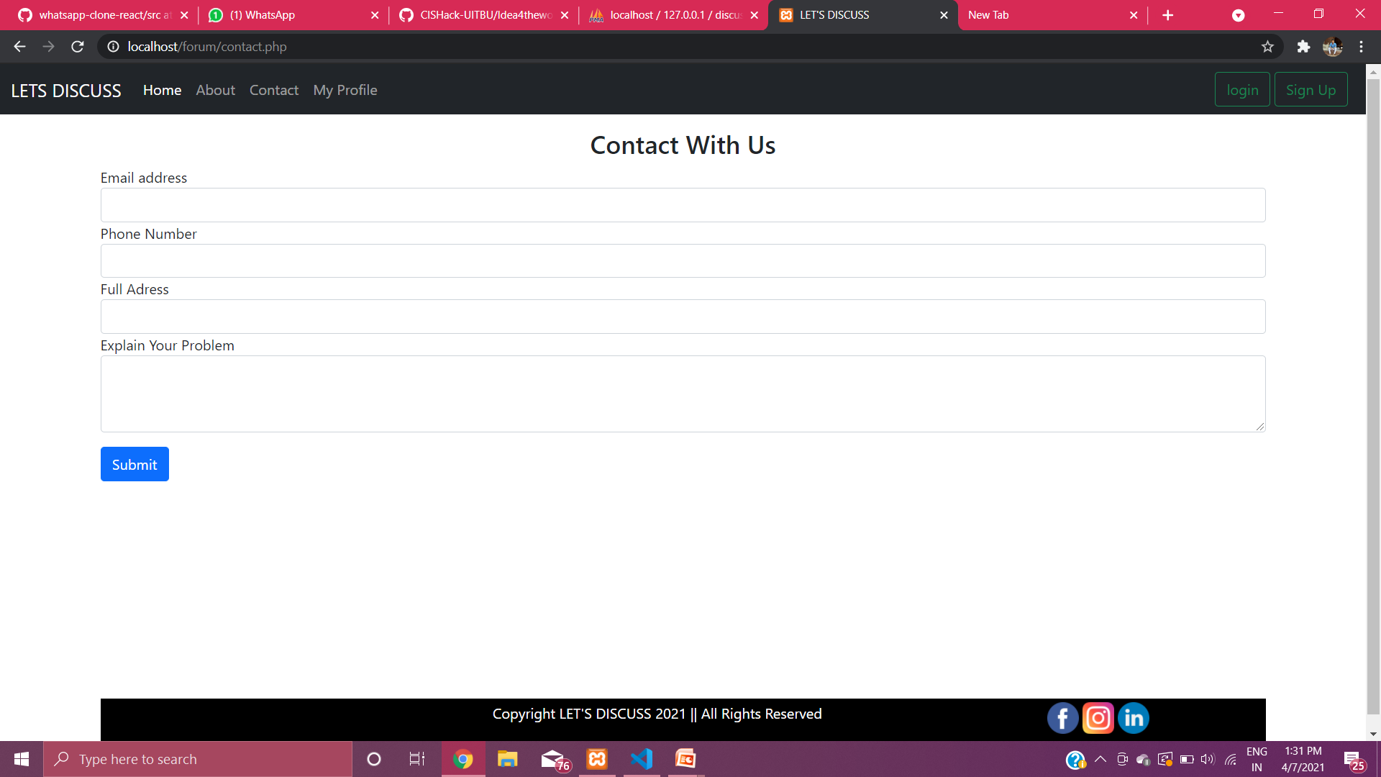
This is Contact page of the Forum , Where user can contact with the developers

