Slide 1
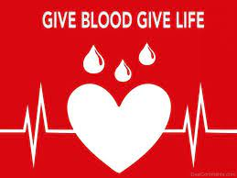
A PROJECT PRESENTATION
ON
BLOOD TRACKING APPLICATION

Slide 2
Presented to You
By
Name --> Avishek Chatterjee
Dept. --> Computer Science & Engg (B.E)
Contact Details :
Email ID --> cavishek39@gmail.com
Phone --> 6296130757
Name --> Priyam Koner
Dept. --> Computer Science & Engg (B.E)
Contact Details :
Email ID --> konerpriyam8@gmail.com
Phone --> 9064154679
Student of,
University Institute of Technology, Burdwan

Slide 3
Introduction
This project is designed for successful completion on Blood Tracking Application.Blood is essential element of life, we need to donate blood to help peoples. Here presenting the Blood Tracking Application Project. This project idealised the blood bank database. The database of Blood Tracking Application Project will store the information of people who are willing to donate their blood.

Slide 4
Key Elements
The main aim of this project is to save the lives of people by providing blood.
Our project Online Blood Tracking Application using React Native is developed so that users can view the information of nearby hospitals, blood banks, and volunteer donors.
This project is developed by four perspectives i.e. hospital, blood bank, volunteer donors and patient.
This application we are developing helps to select the nearby hospitals, blood banks, donors online instantly by tracing its location.
This application reduces the time to a greater extent that is searching for the required blood through blood banks and hospitals.
Thus this application provides the required information in less time and also helps in quicker decision making.

Slide 5
Abstract
The objective of this application is to developing an online Blood Donation Information.
The Blood Donation Agent is to create an e-formation about the donor and organization that are related to donating the blood.
This System is used for maintain whole information about donors,receivers,camps.

Slide 6
Problems
The major problem in old Blood Tracking Application was that, they don’t follow the actual needs of users.
Traditional blood banking systems were developed by 1 or 2 perspective.
Tracking the database was complicated when the details are maintained manually.
There was shortage and sometimes unavailability of rare blood groups due to less modules i.e. patient and donors.
It is having lots of manual work.
It wastes a lot of time in visiting blood bank center if needed blood is not available.

Slide 7
Solution
A better idea is to use the application which Mobile device is very popular with people too.
This application is providing each entity the facility to approach nearby blood donors so that it will become much easier to search rare blood groups in the hour of need.

Slide 8
Aims & Objectives
To bridge the gap between blood banks, hospitals, volunteer donors and needy people, through this system.
To facilitate the search process for needy people and make it easier than before.
To reduce the data entry process.
Some blood types are rare so the system can find the required donors with the required blood type easily from the huge database by using the search feature in the react app.
To provide a dynamic database that is storing donors Information and can communicate with them easily.

Slide 9
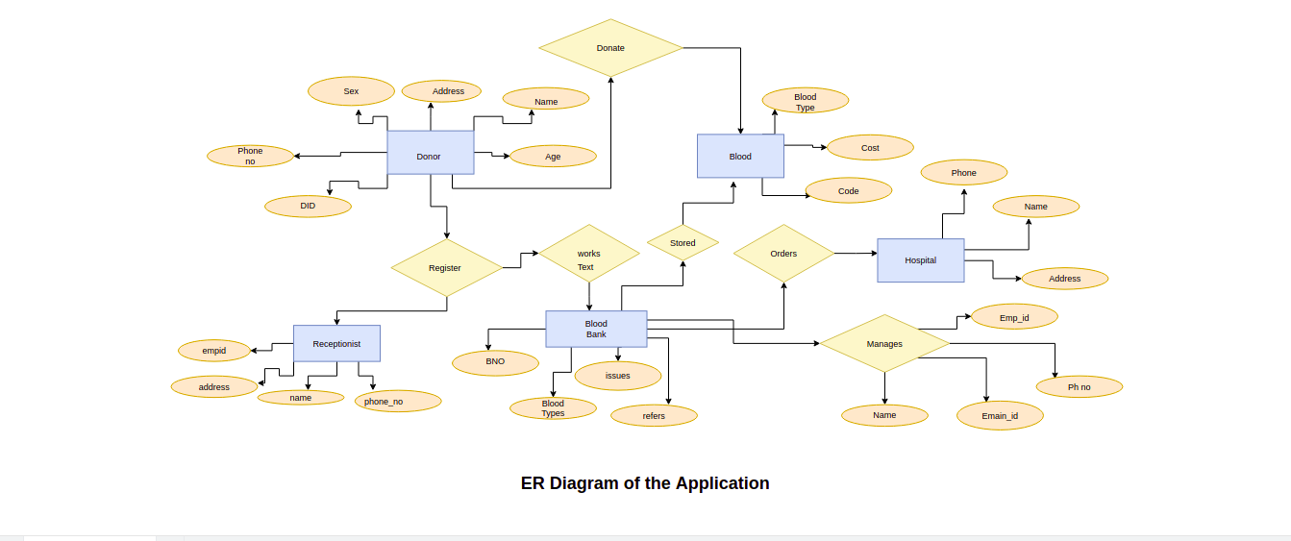

Slide 10
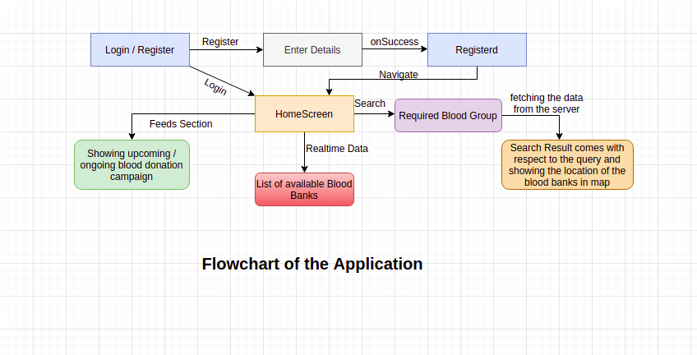

Slide 11
Advantages of Proposed Application
Easy way to find the donors.
Less time.
No need to search blood centers and no need to wait in queue.
User can find their specific blood group.
User can find donors contact details.
User can communicate with donor by making call or messaging directly.

Slide 12
Scope
Our project covers Blood Tracking Application where the management of donors, blood,donor’s current address, hospital records and blood stock records according to their groups are done manually. Usage of our software will increase efficiency in almost all areas of Blood Bank.

Slide 13
Proposed System
Blood Tracking Application is mobile based project.
By using of this application people who want to donate their blood can register in this application by providing their details.
And Persons who needs blood can search and find the blood which group they need.
After searching,a list of donors will be displayed.
Then user can communicate with them easily.
System makes the overall project management much easier and flexible.
Upload the latest updates, allows user to see the alerts by clicking the URL.
It provides high level of security with different level of authentication.
User friendliness I provided in the application with various controls.

Slide 14
Conclusion
Today the world is become a global village where everything is online.
There are so many web based solutions provided in the market for the comfort of the people.
But without blood human being is non living, just by providing the web solution of Blood Tracking Application information system is just one more step in order to serve the mankind.
By using this application we can overcome the problem which we are facing in current scenario and we can introduce a new way to find blood donors.
Aim to quickly make connection between user and donar.
Most efficient in Emergency Situation.
Know the current donor details and Blood Group, if shortage.
We can maintain Blood stock in advance.
Can be used by both donor and non-donor.

