Slide 1

GhostRes Edge
Local AI video restoration with a verified Snapdragon model path
Short Pitch Presentation
Kartikey Bhardwaj | B.Tech CSE, DIT University
Notes:
Cover visual is a generated conceptual illustration. It is not presented as project output or a real video frame.

Slide 2
THE USER PROBLEM
Low-resolution footage needs more than pixel stretching
Traditional interpolation increases size, but it loses edge definition and texture.
Video quality
Privacy
Control
480p and compressed recordings become soft or blocky when enlarged.
Cloud workflows can require creators to upload personal footage before enhancement.
Creators need a visible speed-versus-quality choice instead of an opaque process.
GhostRes Edge uses Real-ESRGAN super-resolution locally and reports the resulting processing tradeoffs.
GhostRes Edge | Snapdragon AI Lab Build and Present Challenge | 2
Notes:
Problem statement based on the current GhostRes Edge product scope. No external market-size claims are used.

Slide 3
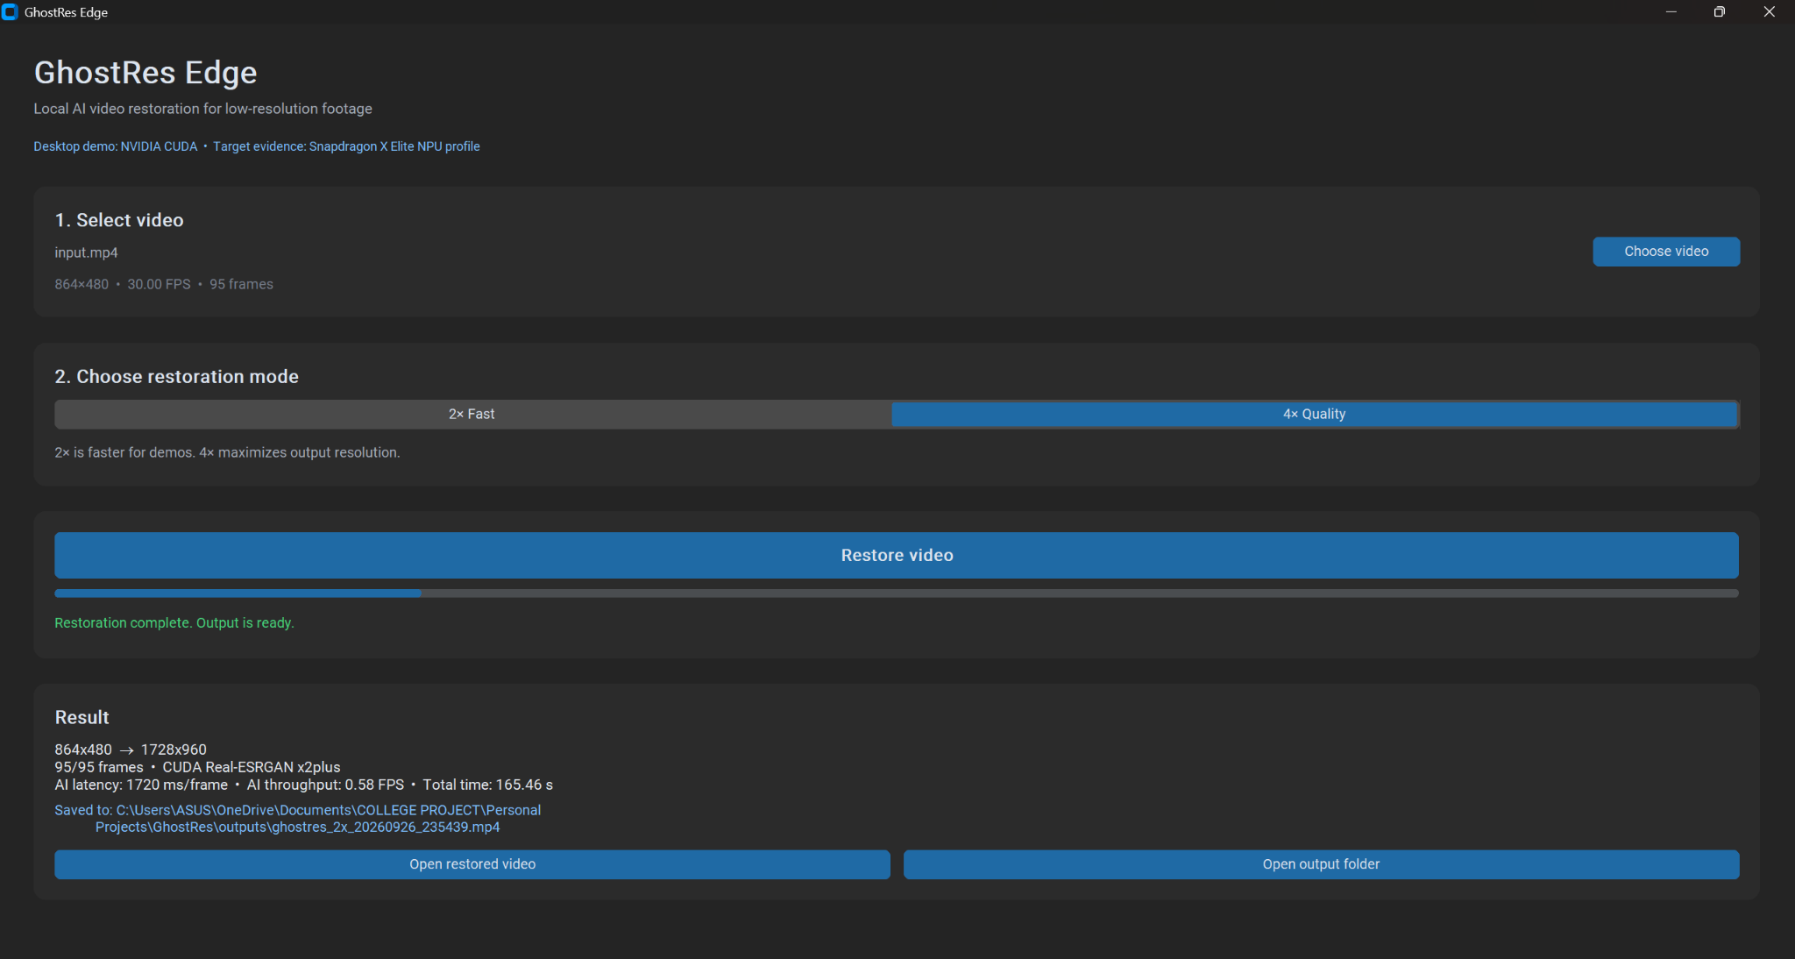
WORKING PRODUCT
A local desktop workflow that exposes the tradeoff
The user selects a video, chooses an enhancement mode, runs restoration, and reviews measured output.
Fast 2x
Lower output resolution with quicker restoration.
Quality 4x
Higher output resolution with greater compute cost.
The UI reports output resolution, frames processed, AI latency, AI FPS, and total time.
GhostRes Edge | Snapdragon AI Lab Build and Present Challenge | 3
Notes:
Product screenshot supplied by the project author. It shows a completed Fast 2x restoration from 864x480 to 1728x960.

Slide 4
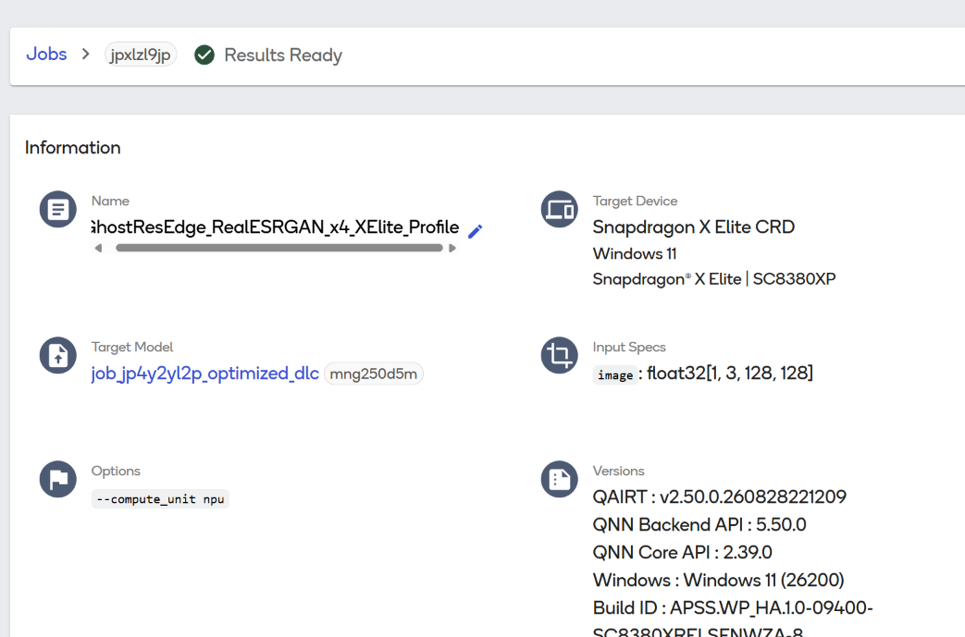
MEASURED EVIDENCE
Desktop video result and Snapdragon model profile
The two measurements answer different questions and use different workloads.
Environment | Workload | Measured result
RTX 3060 desktop app | 95 frames at 864x480 Fast 2x | 1728x960 output 165.46 seconds 1720 ms per frame 0.58 AI FPS
Snapdragon X Elite CRD | Real-ESRGAN x4 ONNX tile float32 [1, 3, 128, 128] QNN NPU | 65.4 ms inference 0.2 MB peak memory
Qualcomm AI Hub profile result summary
The desktop result measures an entire video. The Snapdragon result measures one 128x128 x4 model tile.
GhostRes Edge | Snapdragon AI Lab Build and Present Challenge | 4
Notes:
Desktop result: author supplied GhostRes Edge app screenshot. Snapdragon result: author supplied Qualcomm AI Hub profile screenshot. The profile ran on Snapdragon X Elite CRD, Windows 11, using QNN NPU.

Slide 5
ENGINEERING APPROACH
Modular inference architecture
A reusable interface keeps model code separate from the video workflow.
Desktop workflow
Current engine
CustomTkinter UI
OpenCV video processing
Resolution checks and performance telemetry
CudaRealESRGANEngine
x2plus and x4plus models
128 pixel tiled inference
EnhancementEngine
Single interface for frame enhancement
Snapdragon path
ONNX export
QNN NPU profile on X Elite CRD
Future OnnxQnnEngine
The future QNN backend can retain the existing UI and video pipeline rather than requiring a product rewrite.
GhostRes Edge | Snapdragon AI Lab Build and Present Challenge | 5
Notes:
Architecture drawn from the GhostRes Edge source structure: app.py, ghostres_edge/video.py, EnhancementEngine, and CudaRealESRGANEngine.

Slide 6
SUBMISSION POSITION
What GhostRes Edge demonstrates today
A working local restoration application with measured video output and verified Snapdragon model profiling.
Available now
Next engineering milestone
Working desktop app
Fast 2x and Quality 4x modes
Full 95-frame local restoration result
ONNX model validated with onnx.checker
Snapdragon X Elite CRD QNN profile
Implement the QNN inference engine inside the same application
Benchmark the full video pipeline on a physical Snapdragon PC
Preserve source audio during output creation
GhostRes Edge
Local AI video restoration built with a clear route from CUDA development to Snapdragon QNN deployment.
GhostRes Edge | Snapdragon AI Lab Build and Present Challenge | 6
Notes:
Closing slide. Keep the distinction between current CUDA desktop execution and future native Snapdragon application deployment clear during the pitch.

