Slide 1

UE20CS343 -Topics in Deep Learning
Dr Bharathi R
Professor, Dept. Of Computer Science and Engg

Slide 2
Topics in deep learning
Visualizing Graphs using TensorBoard
Dr Bharathi R

Slide 3
UE20CS343 -TDL
What is TensorBoard?
TensorBoard is a visualization web app to get a better understanding of various parameters of the neural network model and its training metrics.
Such visualizations are quite useful when you are doing experiments with neural network models and want to keep a close watch on the related metrics.
It is open-source and is a part of the Tensorflow group.

Slide 4
UE20CS343 -TDL
TensorBoard
Some of the useful things you can do with TensorBoard includes
Tracking and visualizing metrics such as loss and accuracy
Visualizing the model graph (ops and layers)
Viewing histograms of weights, biases, or other tensors as they change over time
Projecting embeddings to a lower dimensional space
Displaying images, text, and audio data
Profiling TensorFlow programs

Slide 5
UE20CS343 -TDL
TensorBoard Tutorial (Keras)
A small project to create a neural network in Keras for Tensorboard Tutorial. For this, we are going to use the famous MNIST handwritten digit recognition dataset.
i) Install TensorBoard
ii) Starting TensorBoard
iii) Loading Libraries
iv) Loading MNIST Dataset
v) Preprocessing
vi) Create and Compile the Model
vii) Creating Callback Object
viii) Training Model
ix) Visualization Model in Tensorboard
Scalars
Graph
Distribution
Histograms
x) Comparing Different Models in TensorBoard

Slide 6
UE20CS343 -TDL
TensorBoard Tutorial (Keras)
A small project to create a neural network in Keras for Tensorboard Tutorial. For this, we are going to use the famous MNIST handwritten digit recognition dataset.
i) Install TensorBoard
ii) Starting TensorBoard
iii) Loading Libraries
iv) Loading MNIST Dataset
v) Preprocessing
vi) Create and Compile the Model
vii) Creating Callback Object
viii) Training Model
ix) Visualization Model in Tensorboard
Scalars
Graph
Distribution
Histograms
x) Comparing Different Models in TensorBoard

Slide 7
UE20CS343 -TDL
i) Install TensorBoard
Install TensorBoard by using pip as shown below –
pip install tensorboard

Slide 8
UE20CS343 -TDL
ii) Starting TensorBoard
Start the TensorBoard service.
To do this you need to run below in the command prompt.
–logdir parameter signifies the directory where data will be saved to visualize TensorBoard.
Here we have given the directory name as ‘logs’.
tensorboard --logdir logs
This will start the TensorBoard service at the default port 6066 as shown below.
The TensorBoard dashboard can be accessed as http://localhost:6006/
Output:
Serving TensorBoard on localhost; to expose to the network, use a proxy or pass --bind_all TensorBoard 2.5.0 at http://localhost:6006/ (Press CTRL+C to quit)
In Jupyer notebook, you can issue the following command in the cell
%tensorboard --logdir logs

Slide 9
UE20CS343 -TDL
iii) Loading Libraries
Do note these libraries have nothing to do with TensorBoard( except the last one) but are needed for building the neural network of our example.
import tensorflow as tf
from tensorflow import keras
import matplotlib.pyplot as plt
%matplotlib inline
import numpy as np
from tensorflow.python.keras.callbacks import TensorBoard

Slide 10
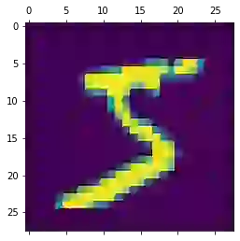
UE20CS343 -TDL
iv) Loading MNIST Dataset
Now we will load the MNIST dataset that comes as part of the Keras package.
(X_train, y_train) , (X_test, y_test) = keras.datasets.mnist.load_data()
plt.matshow(X_train[0])
Output :

Slide 11
UE20CS343 -TDL
v) Preprocessing
Preprocess the data by normalizing it between 0 to 1 and then flattening it.
X_train = X_train / 255
X_test = X_test / 255
X_train_flattened = X_train.reshape(len(X_train), 28*28)
X_test_flattened = X_test.reshape(len(X_test), 28*28)

Slide 12
UE20CS343 -TDL
vi) Create and Compile the Model
Create and compile a simple neural network model consisting of just one input layer, one hidden layer of 100 neurons, and one output layer. All other configurations are standard.
model = keras.Sequential([
keras.layers.Flatten(input_shape=(28, 28)),
keras.layers.Dense(100, activation='relu'),
keras.layers.Dense(10, activation='sigmoid')
])
model.compile(optimizer='adam',
loss='sparse_categorical_crossentropy',
metrics=['accuracy'])

Slide 13
UE20CS343 -TDL
vii) Creating Callback Object
This is where we need to draw our attention while working with TensorBoard. We have to create a Keras callback object for TensorBoard which will help to write logs for TensorBoard during the training process.
Please do note that the parent path for log_dir below should be the same as the logdir value we gave while starting the TensorBoard service in the second step.
tb_callback = tf.keras.callbacks.TensorBoard(log_dir="logs/", histogram_freq=1)

Slide 14
UE20CS343 -TDL
viii) Training Model
Finally, we start the training of the model by using fit() function. We train it for 5 epochs and do notice that we have also passed the callback object that we created in the previous step.
model.fit(X_train, y_train, epochs=5,callbacks=[tb_callback])
Output
Epoch 1/5 1875/1875 [==============================] - 11s 5ms/step - loss: 0.2709 - accuracy: 0.9230 Epoch 2/5 1875/1875 [==============================] - 6s 3ms/step - loss: 0.1244 - accuracy: 0.9634 Epoch 3/5 1875/1875 [==============================] - 6s 3ms/step - loss: 0.0852 - accuracy: 0.9745 Epoch 4/5 1875/1875 [==============================] - 7s 4ms/step - loss: 0.0662 - accuracy: 0.9794 Epoch 5/5 1875/1875 [==============================] - 6s 3ms/step - loss: 0.0524 - accuracy: 0.9839
<keras.callbacks.History at 0x7f2398f1e520>

Slide 15
UE20CS343 -TDL
ix) Visualization Model in Tensorboard
We can now go to the TensorBoard dashboard that we started in the first step and see what all visualizations it has to offer. The visualizations mostly depend on what data you have logged for TensorBoard.
Scalars
Graph

Slide 16
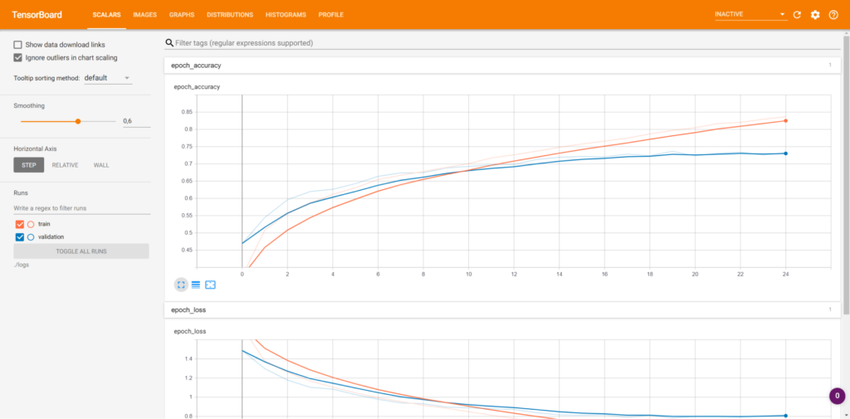
UE20CS343 -TDL
ix) Visualization Model in Tensorboard- Scalar
Scalar provides how the training process happened over time by showing you the loss value (for training and validation data)
It shows visualizations for accuracy and loss in each epoch during the training process. And when you hover the graph it shows more information like value, step, time.

Slide 17
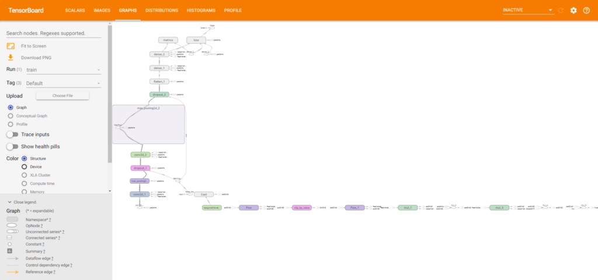
UE20CS343 -TDL
ix) Visualization Model in Tensorboard- Graph
The Graphs tab shows you the network graph created by Keras when training your model:

Slide 18
UE20CS343 -TDL
x) Comparing Different Models in TensorBoard
In the first run, we create the Keras callback object of TensorBoard whose logs are going to be saved in the ‘run1’ folder inside the main logs folder.
tb_callback = tf.keras.callbacks.TensorBoard(log_dir="logs/run1", histogram_freq=1) model.fit(X_train, y_train, epochs=5, callbacks=[tb_callback])
In the second run, we give the log path as run2 as shown below.
tb_callbak = tf.keras.callbacks.TensorBoard(log_dir="logs/run2", histogram_freq=1) model.fit(X_train, y_train, epochs=5, callbacks=[tb_callback])
Creating a good Neural Network is not a straightforward job and requires multiple runs to experiment with various parameters.
With TensorBoard, you can visualize the performance of all the model runs in the dashboard and compare them easily.
For this, we will create the logs of training in different subfolders inside the main folder. The below example will help you understand better.
In the first run, we create the Keras callback object of TensorBoard whose logs are going to be saved in the ‘run1’ folder inside the main logs folder.

Slide 19
UE20CS343 -TDL
x) Comparing Different Models in TensorBoard
In the first run, we create the Keras callback object of TensorBoard whose logs are going to be saved in the ‘run1’ folder inside the main logs folder.
tb_callback = tf.keras.callbacks.TensorBoard(log_dir="logs/run1", histogram_freq=1) model.fit(X_train, y_train, epochs=5, callbacks=[tb_callback])
In the second run, we give the log path as run2 as shown below.
tb_callback = tf.keras.callbacks.TensorBoard(log_dir="logs/run2", histogram_freq=1) model.fit(X_train, y_train, epochs=5, callbacks=[tb_callback])

Slide 20
Topics in deep learning
References
https://www.tensorflow.org/tensorboard
https://keras.io/api/callbacks/
https://machinelearningknowledge.ai/tensorboard-tutorial-in-keras-for-beginner/

Slide 21
Topics in deep learning
Thank You
Dr. Bharathi R

