Slide 1




Game Development with Python

Slide 2

Have you got these installed/downloaded?
  Python 3.x.x
  Pygames (not required this week)
  “Invent Your Own…” eBook
Do you know where these are?
  IDLE (Python GUI)
  Python Folder
  The eBook
  Hint: Put shortcuts on your Desktop or Taskbar!

Slide 3

Play with Python
Look ahead to Projects
Learn about some of the boring stuff….
Learn about some of the fun stuff!

Slide 4

Some “Teaching” but mainly…
Self Learning
Working together & Peer Mentoring
“Ask three before me”
Pythonning between Dojos

Slide 5

Start thinking/planning/dreaming…
coolestprojects.org
Coolest Project Presentation
Project Planning Template

Slide 6

“Proper” programming language
Readable
Elegant
Open Source
“Batteries Included”

Slide 7

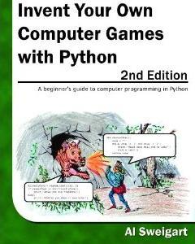

Slide 8

General info about the Dojo
coderdojobray.com
@CoderDojoBray
bray@coderdojo.com

Slide 9

http://python.coderdojobray.com/
  Still under development
Websites
  http://inventwithpython.com
  Search for “Python Tutorials” or similar
  Beware of “Easy…” and earlier versions of Python
  Some URLs are included in Shared Folder
Between Dojos
  We hope to have the Forum open soon
  Shared Folder http://bit.ly/DojoPython

Slide 10

Review what we’ve done on the book and, if you wish, look ahead at further topics
Dream about your Project
Look at other resources online
Keep watching the email for further info

