Slide 1




Week 5
Game Development with Python

Slide 2

Boring Stuff
  Down with that sort of thing!
Fun Stuff (depending on time…)
  Share YOUR code
  Quick Review to date
  Look at dragon.py code (Ch.6)
  Look at the Debugger (Ch.7)
  Play with Python
Week 5

Slide 3

Any code you have that you think may be interesting
  Challenges, mods to code from the book etc.
  Doesn’t have to be a full program – code snippets are fun too
  Doesn’t have to be completed
  Doesn’t even have to be working!
If you need help finalising, ask your fellow Coders plus Mentors
Week 5

Slide 4

If you are happy with last weeks coding, carry on at your own pace. Otherwise…
Chapter4 (guess.py) – whitespace, while, if, Boolean, break & ‘What is programming?’
Chapter 5 (jokes.py) – escape characters, end keyword argument
Questions? Ask your neighbour or a Mentor
Week 5

Slide 5

Chapter 6 – dragon.py (last trivial programme)
If you are happy with all of the concepts, carry on at your own pace. Otherwise...
We’ll do a sample run on screen
Look at key concepts/functions
Then (with neighbour or group if you wish)
  Input code yourself
  Run the Game
  Play with some of the code
Get help from neighbour, team, mentors
Week 5
Notes:
Key concepts/functions -

Slide 6

Defining your own functions – def
Boolean operators – and, or & not
Return keyword
Global & Local variables
Parameters & Arguments
Designing programmes – Flowchart (see next)
Now – enter the code, modify it & play with functions & Boolean operators etc.
Week 5
Notes:
Key concepts/functions -

Slide 7
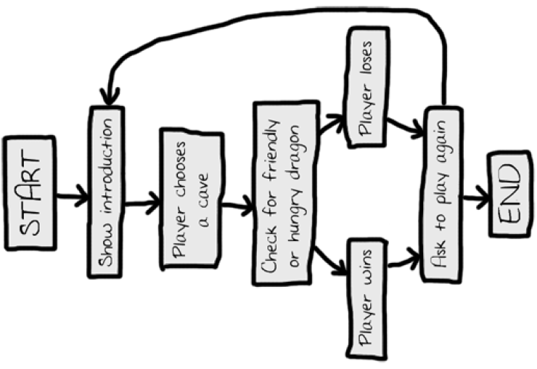

Week 5

Slide 8


Week 5
Notes:
I thoink we just show it on-screen. Showing much easier than telling….

Slide 9
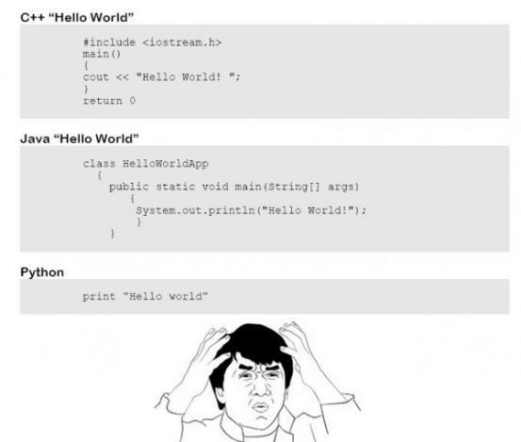
Week 5

Slide 10

  Use the Shared Folder http://bit.ly/DojoPython
  .doc files with useful links for each week
  .doc files for the “Ninja Challenges”
  .pdfs of the presentations
  Project template & example
Keep an eye on
  coderdojobray.com
  @CoderDojoBray
  bray@coderdojo.com
Week 5
Notes:
Point specifically at Wk4 – Websites & Other Resources doc

Slide 11

Fun! – If we’re not enjoying it, we’re not doing it right
A coding club where YOU learn coding by coding. With assistance from
  Your neighbours
  The Python Team around you (#crowdsourcing)
  The InterWeb - “Google is your friend” (#googleit)
  The Mentors
How?
  Play with Python, you won’t break it!
  Learn the “hard” way – by using it
  Follow the tutorials in the book
  Mentor explanations
  Sharing with those around you (your code & your ideas)
  Accepting the Ninja Challenges!
Week 5
Notes:
Want to get across the ideas that – this is NOT school; Mentors are not all-knowing; Mentors are not 1st point of call; Internet & those around you are great resources (used wisely)

