Slide 1

CoderDojo Bray
Introduction to Programming
Session #1 : Hello Scratch. Or Javascript for that matter.

Slide 2
WiFi Network
Join wireless network: coderdojo<x> where <x> is your table number
Have you got: - Google Chrome - Komodo Edit - Scratch (if you want to work with Scratch)
Installed on your laptop?

Slide 3
What do you need?
An editor
To write your HTML/Javascript code
Komodo Edit
Or Notepad++, or TextWrangler
Scratch if you plan to work with Scratch
A web browser
Google Chrome, Firefox, Safari, Internet Explorer
A wireless network connection
To see the internet, Google for help, get images …
… if you need help setting up, call a mentor …
Notes:
Mentors should check that all laptops are up and running, are on the wireless network, can see the internet (google.ie, maps.google.com https://thimble.webmaker.org, dojo.hallamor.org)
On a school network (like Pres Bray) various sites are blocked. Youtube for example does not work)
We would also like to have a decent editor (komodo edit is good: is saves on errors) and ideally Chrome as the browser installed.
Having the same browser everywhere makes it much easier for mentors to help out in later sessions.
So now we need to go around and make sure everyone is setup.
USB keys should have the installs for our tools, although sometimes these have been seen not to work and a download from the internet was required.

Slide 4
Session #1 What will you do today?
Write your first computer program
Well, maybe not your first
We will use two programming languages, and you can pick which one to work with
Scratch
Javascript

Slide 5
Wait, no HTML?
If you want to do HTML, no problem!
We have material from the first 5 sessions
All HTML first-timers can work through these with mentors
HTML improvers can continue to work on their HTML/CSS

Slide 6
Programming is …
Designing and writing down a set of instructions that tell a computer how to do something
Computers are majorly dumb and need to be given step-by-step instructions about every single little thing
Programming is giving these instructions to the computer

Slide 7
Programming Languages
A “Programming Language” is an artificial language used to describe instructions to a computer
There are hundreds of programming languages
But only about 20 are widely used
Some of the most common C, Java, C++, C#, PHP, Javascript, Python, Ruby, Perl, SQL, Objective-C
Programming languages are different, but share a lot of the same ideas
Like human languages

Slide 8
What is Scratch?
Scratch is an interactive programming language from MIT (scratch.mit.edu)
Scratch makes it easy to make your own interactive games, animations, stories and art
You don’t need to know anything about HTML or other programming stuff to start Scratch
It’s a really good way to learn about programming ideas without having to write lots of text
Some examples to give you some ideas coming up …

Slide 9
What is Javascript?
Javascript is a scripting language,
One of the most widely used programming languages
It’s often used in web pages and web sites to allow you web page to change when the user does something
To make games
To make “live” pages which have animation
To learn Javascript you should know HTML
Otherwise it will be too confusing to start with

Slide 10
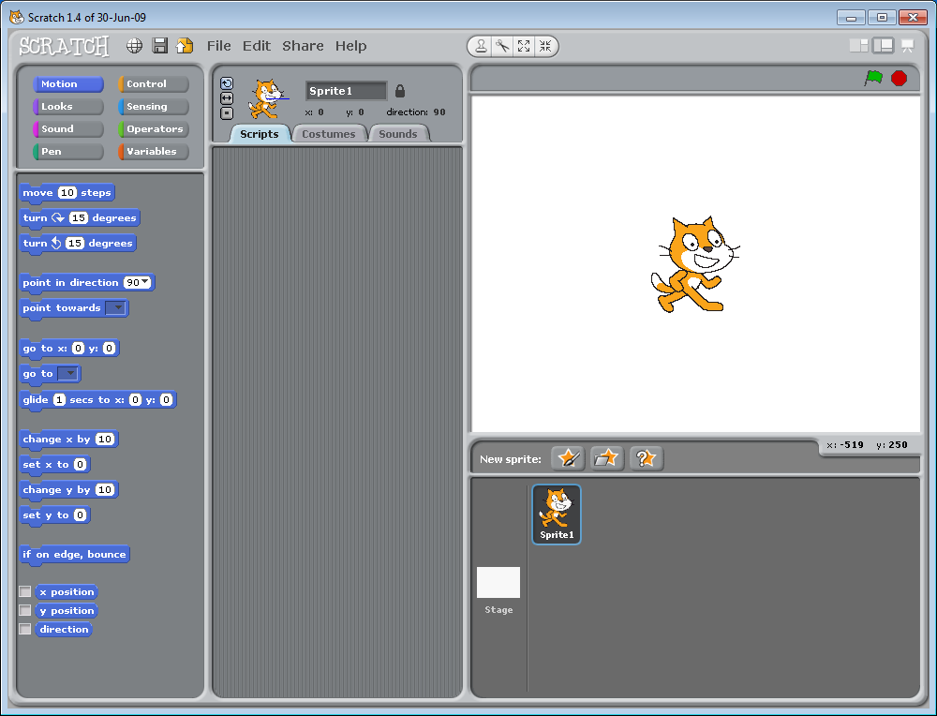
Scratch …

Slide 11
Javascript …
window.onload = setup;
var logo;
function setup() {
logo = document.getElementById('logo');
logo.style.left = '0px';
animate();
}
function animate() {
logo.style.left = parseInt(logo.style.left) + 2 +'px';
animator = setTimeout(animate,20);
}

Slide 12
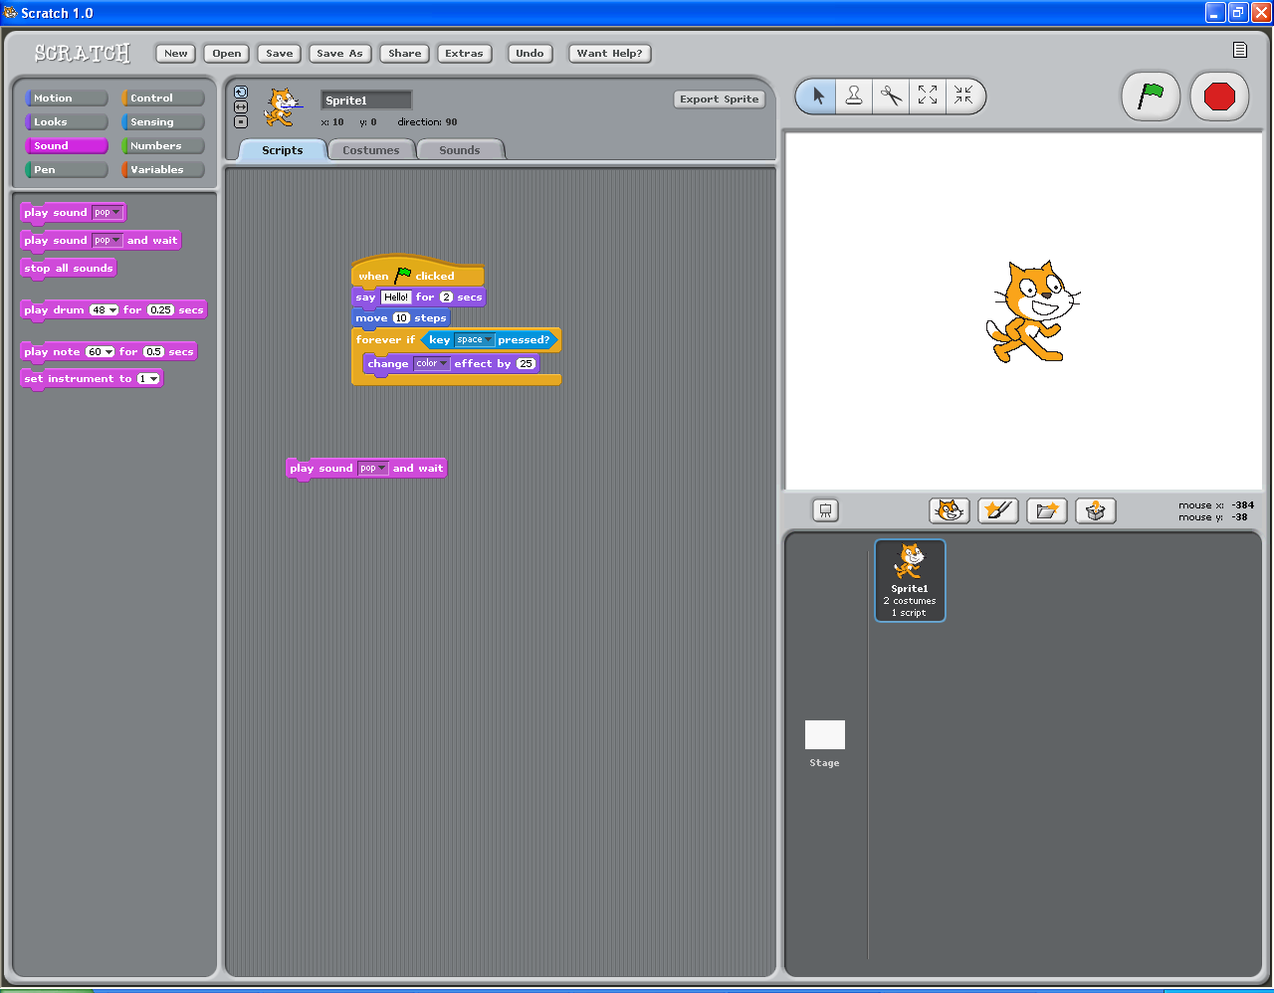
The Scratch Control and Design Screen
Tabs
Project Notes
Palate
Green Flag
Stage
(White Space)
Blocks
New Sprite Buttons
Script Area
Sprite List

Slide 13
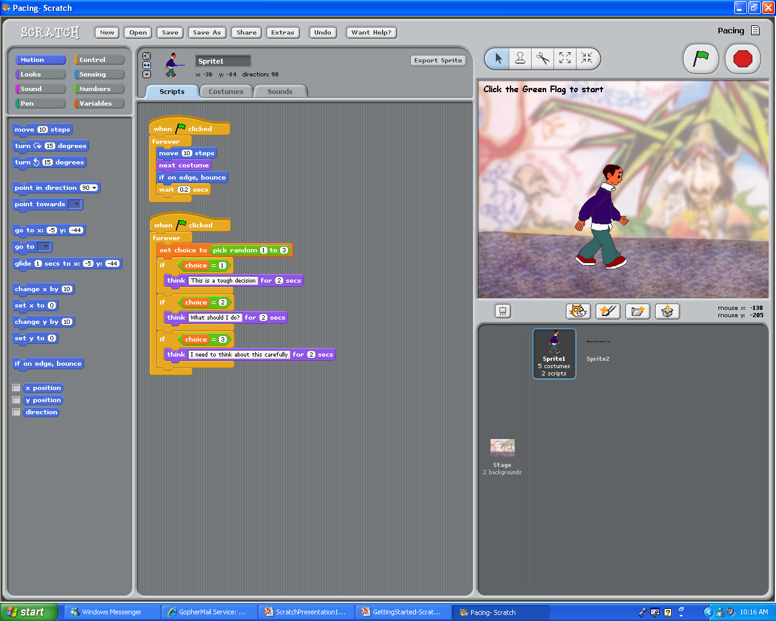
The Basic Buttons
New Sprite Buttons
The Scratch objects and characters are called Sprites
Get a new cat Sprite (Default)
Paint your own Sprite
Choose an image for a new Sprite
Get a surprise Sprite

Slide 14
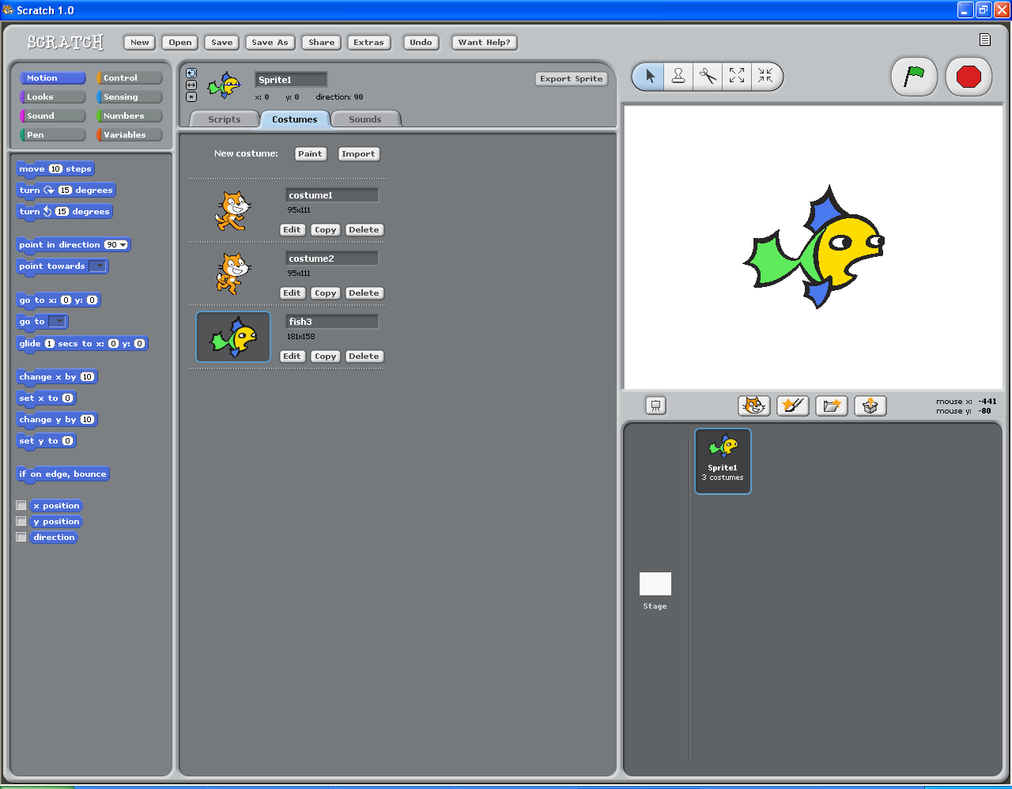
The Basic Buttons
Sprite Costumes
Change your Sprite’s Look with a costume change
Click on the Costumes tab. To add a costume click Import
To modify your Sprite using the paint function, click Edit
Any image can be used

Slide 15
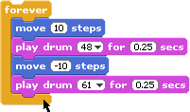

The Basic Buttons
Scratch Blocks
By snapping these blocks together you create a script
When you double click on a script, your program will run
The Scratch blocks are in 8 color-coded categories based on function

Slide 16
Here’s some I made earlier
A card game
Shooting some parrots
Pong*
Drawing a Rosette*
* OK I didn’t actually make those

Slide 17
Scratch Activities …
Invent your own game!
… or …
Start with “Pong”
Change it so that you move the paddle with keys
Change it so that there are bricks which you destroy by hitting them with the ball
Change it so that you can have two players

Slide 18
Javascript Activities …
We have three samples : let’s look at these now
These show simple animation of an image
You can download the code from https://www.dropbox.com/sh/frqal12wb7888u1/HSND24nQuR/javascript
http://goo.gl/yFkKI
There are “activity cards” in that folder too, suggestions for changing the JS code
And there is also http://www.crunchzilla.com/code-monster which is a step-by-step tutorial

Slide 19
Next Week …
Next week:
Improve your Scratch games or
More Javascript Animation

