Slide 1

CoderDojo Bray
Introduction to Programming
Session #2 : Scratch and Javascript

Slide 2
WiFi Network
Join wireless network: coderdojo<x> where <x> is your table number
Have you got: - Google Chrome - Komodo Edit - Scratch (if you want to work with Scratch)
Installed on your laptop?

Slide 3
Session #2 What will you do today?
Work ahead on your Scratch and Javascript
For Scratch, we’ll show you a few ideas you can put into your own games
For Javascript, we’ll be working through the animation and code maven examples

Slide 4
Reminder: Website Hosting
Digiweb offers a free website hosting package to every Dojo member in Ireland/UK
Pick a name (.com or .net only for the moment)
Use whois.net to make sure it is free
Email liam.friel@coderdojo.com with the details

Slide 5
Javascript Activities …
Still looking at the same examples from last week
It will take a few weeks to really understand all of that
You can download the code from https://www.dropbox.com/sh/frqal12wb7888u1/HSND24nQuR/javascript
http://goo.gl/yFkKI
There are “activity cards” in that folder too, suggestions for changing the JS code
And there is also http://www.crunchzilla.com/code-maven which is a step-by-step tutorial

Slide 6
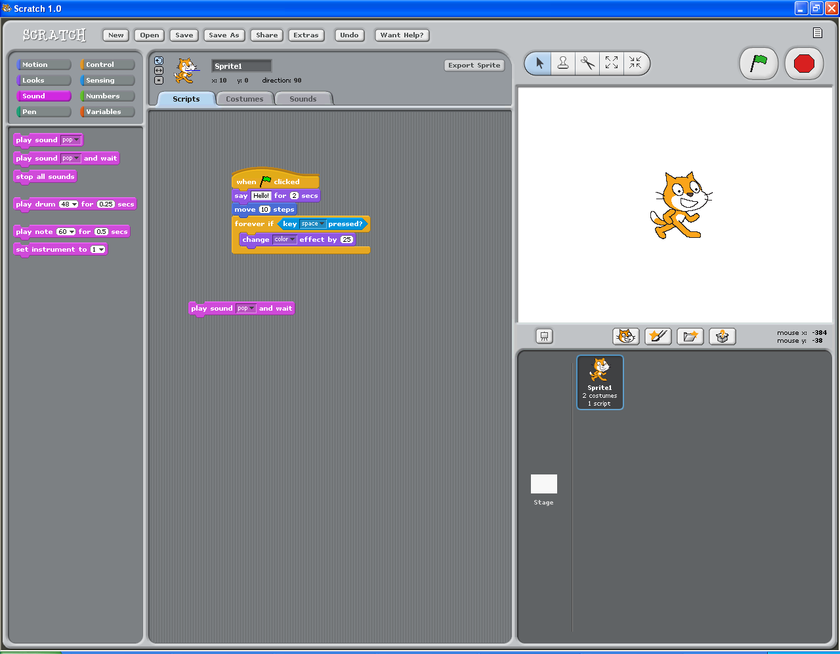
The Scratch Control and Design Screen
Tabs
Project Notes
Palate
Green Flag
Stage
(White Space)
Blocks
New Sprite Buttons
Script Area
Sprite List

Slide 7
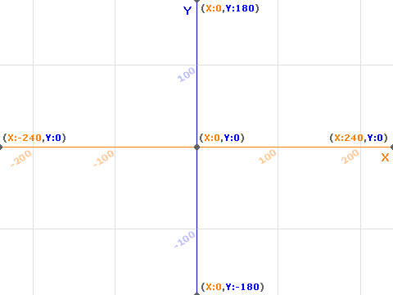
Scratch Stage: Moving Around

Slide 8
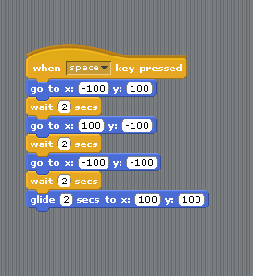
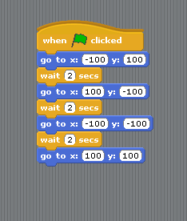
Moving & Gliding

Slide 9
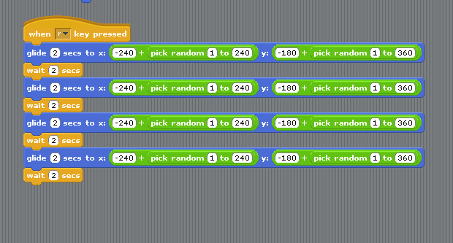
Moving to a Random Place

Slide 10
Hiding and Showing
You use the “hide” block to make a sprite disappear
You often do this in different games
If you hit a brick with a ball
Or a parrot with a cannonball
Remember to “show” the sprite again when you need to
Two different examples now …

Slide 11
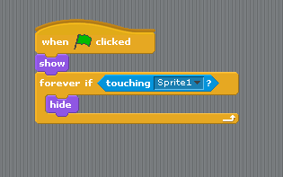
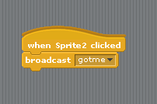

Hiding sprites in your game
check if you are
touching
use a message

Slide 12
Next Week …
Next week:
Improve your Scratch games or
More Javascript Animation

