Slide 1

CoderDojo Bray
Introduction to Programming
Session #3 : Scratch and Javascript

Slide 2
WiFi Network
Join wireless network: coderdojo<x> where <x> is your table number
Have you got: - Google Chrome - Komodo Edit - Scratch (if you want to work with Scratch)
Installed on your laptop?

Slide 3
Session #4 What will you do today?
Work ahead on your Scratch and Javascript
For Scratch, we’ll show you a few ideas you can put into your own games
For Javascript, we’ll be working through the animation and code maven examples

Slide 4
Reminder: Website Hosting
Digiweb offers a free website hosting package to every Dojo member in Ireland/UK
Pick a name (.com or .net only for the moment)
Use whois.net to make sure it is free
Email liam.friel@coderdojo.com with the details

Slide 5
Javascript Activities …
Still looking at the same examples from last week
It will take a few weeks to really understand all of that
You can download the code from https://www.dropbox.com/sh/frqal12wb7888u1/HSND24nQuR/javascript
http://goo.gl/yFkKI
There are “activity cards” in that folder too, suggestions for changing the JS code
And there is also http://www.crunchzilla.com/code-maven which is a step-by-step tutorial

Slide 6
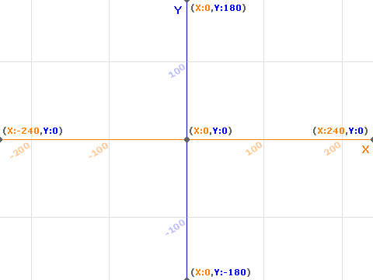
Reminder: Scratch Stage

Slide 7
Moving by Scrolling
Often in Scratch your Sprite moves
or
You can make it look like a sprite is moving by moving a “background” sprite instead

Slide 8


Backgrounds …
Make a few sprites which line up
They should be the same height and the width of the whole stage (480 pixels)
(We’ll just use two … )

Slide 9


Now make our character
We’ll use a little stick man
First let’s watch what it looks like …

Slide 10
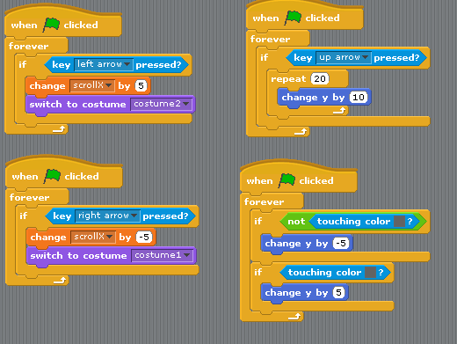
Scrolling: stick man

Slide 11
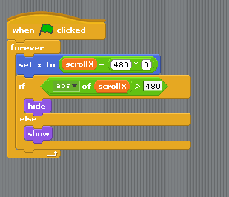
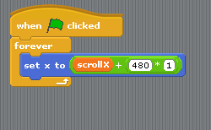
Scrolling: “backgrounds”
Sprite1: Sprite2:

Slide 12
Code…
You can download this scratch project from http://goo.gl/knaUL
You can use this to experiment with your own scrolling game
Hint: probably easier to draw the whole background in a drawing program (e.g. Paint.NET) and chop it up afterwards

Slide 13
Next Week …
Next week:
Improve your Scratch games or
More Javascript Animation

