Slide 1

CoderDojo Bray
Introduction to Programming
Session #4 : Scratch and Javascript

Slide 2
WiFi Network
Join wireless network: coderdojo<x> where <x> is your table number
Have you got: - Google Chrome - Komodo Edit - Scratch (if you want to work with Scratch)
Installed on your laptop?
Get these slides at http://goo.gl/umBg3

Slide 3
Session #4 What will you do today?
Work ahead on your Scratch and Javascript
For Scratch, we’ll show you:
How to make things fall like gravity
How to trigger the next level in a game
For Javascript, you can
Continue through the animation and code maven examples
Publish your work to the web (optional)
Make things fall under gravity (optional)

Slide 4
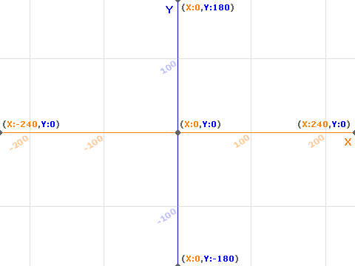
Reminder: Scratch Stage

Slide 5

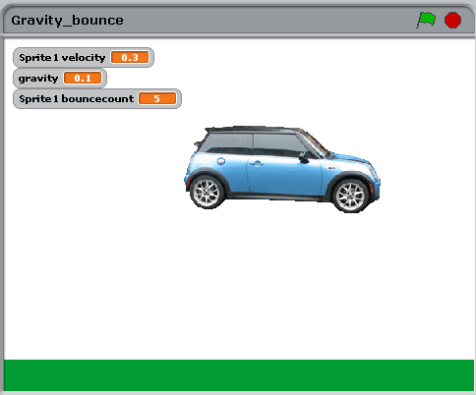

Gravity in Scratch
To make things fall like gravity
To make them bounce back

Slide 6
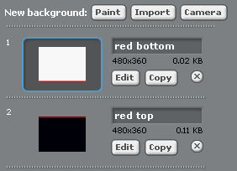
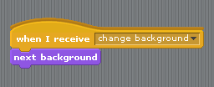

One way to reach next game level in Scratch
Set up several stage backgrounds
In your sprite

Slide 7
Get the Scratch files (and these slides)
You can download these scratch projects from http://goo.gl/umBg3
You can use these ideas to experiment with your own games

Slide 8
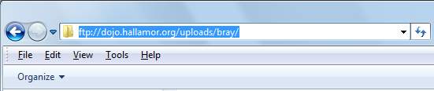
JavaScript: Website Publishing
Upload your work to ftp://dojo.hallamor.org/uploads/bray/
View it at http://dojo.hallamor.org/eden/bray/
Send us the URLs of your websites to look at, to bray@coderdojo.com

Slide 9
JavaScript: Website Hosting
Digiweb offers a free website hosting package to every Dojo member in Ireland/UK
Pick a name (.com or .net only for the moment)
Use whois.net to make sure it is free
Email liam.friel@coderdojo.com with the details

Slide 10
Javascript Activities …
Still looking at the same examples from last week
It will take a few weeks to really understand all of that
You can download the code from
http://goo.gl/yFkKI
There are “activity cards” in that folder too, suggestions for changing the JS code
And there is also http://www.crunchzilla.com/code-maven which is a step-by-step tutorial

Slide 11
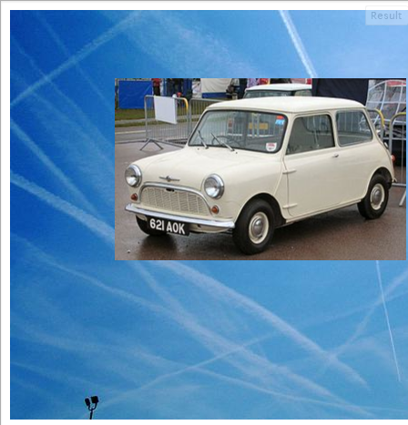
Gravity in JS
Gravity and more physics in Code Maven
http://www.crunchzilla.com/code-maven#Circles, Arcs, and Balls
See also http://goo.gl/x6nxF (Physics and code)
And http://goo.gl/9pO4C (More about HTML canvas)
Make a Mini fall:
See jsfiddle http://jsfiddle.net/SLuxd/
Add gravity, improve on this

Slide 12
Get the slides
For all the links
Get these slides at http://goo.gl/umBg3

Slide 13
Next Week …
Next week:
Scratch and JS
Improve your games
Publish them on the web so others can play (optional)

