Slide 1

CoderDojo Bray
Introduction to Programming
Session #5 : Scratch and Javascript

Slide 2
WiFi Network
Join wireless network: coderdojo<x> where <x> is your table number
Work ahead on your code while you’re waiting for us to get our act together

Slide 3
Session #5 What will you do today?
Work ahead on your Scratch and Javascript
For Scratch, you’ll learn about Parallax Scrolling
Some ideas for the New Year

Slide 4
Reminder: Website Hosting
Digiweb offers a free website hosting package to every Dojo member in Ireland/UK
Pick a name (.com or .net only for the moment)
Use whois.net to make sure it is free
Email liam.friel@coderdojo.com with the details

Slide 5
Javascript Activities …
Still looking at the same examples from last week
It will take a few weeks to really understand all of that
You can download the code from http://goo.gl/yFkKI
There are “activity cards” in that folder too, suggestions for changing the JS code
And there is also http://www.crunchzilla.com/code-maven which is a step-by-step tutorial

Slide 6
Continual Scrolling
A few weeks ago we showed scrolling on keypress
Today we’ll see a different way of scrolling: Continual scrolling and Parallax Scrolling

Slide 7

A wall…
Again we have two sprites which line up
I am using exactly the same picture for each sprite
We just scroll this in a loop, like this …

Slide 8
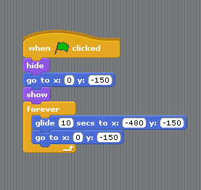
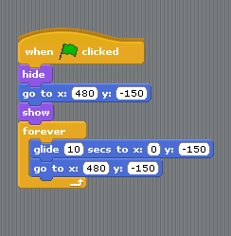
Continual scrolling …
We use “glide” to scroll the wall sprites
First line them up, them set them moving

Slide 9
Parallax Scrolling
“Parallax” means the way things appear to you to be moving, when you move
Closer objects appear to move more
Next time you’re in a car, watch the wall at the side of the road and the houses behind the wall
The wall seems to move faster
You can use this to trick you brain into thinking your Scratch game is 3D

Slide 10

Mountains…
Again we have two sprites which line up, same picture in each (mountains)
We put these “behind” the wall and scroll them slower …

Slide 11
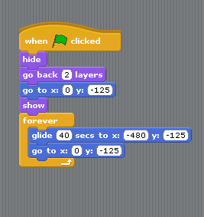
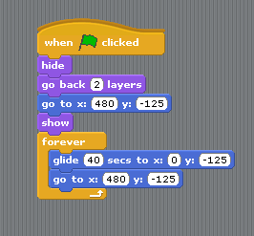
Mountains scrolling …
We use “glide” to scroll the mountain sprites
Line up and move slower than the wall

Slide 12
Code…
You can download this scratch project and the images from http://goo.gl/Pfzoj
You can use this to experiment with your own scrolling backgrounds

Slide 13
JavaScript
You can also use parallax scrolling in Javascript to make fancy webpage backgrounds
Here’s a nice example: http://prinzhorn.github.com/skrollr/

Slide 14
Christmas Break…
This is our last session before Christmas
We plan to start again in January ’13
You’ll get an email inviting you to sign up for tickets for those sessions
Next sessions we’ll add Raspberry Pi and (maybe) some Electronics if there’s interest

