Slide 1

Verified Volunteers Overview
2015

Slide 2
Agenda
INTRODUCTION
CODERDOJO PARTNERSHIP
WHO WE ARE
BACKGROUND SCREENING CHALLENGES
PRODUCT AND SERVICE OFFERINGS
ACCOUNT SET UP OPTIONS
OUR VOLUNTEER COMMUNITY
A WALK THROUGH THE SYSTEM
COMMUNITIES ACROSS THE COUNTRY

Slide 3


TRUE PARTNERSHIP
Preferred Partnership
New Standard In Screening For Volunteer Programs
Resource For New & Existing Dojos
Best Practice Education
Purchasing Benefits
Benefit From Our Growing Communities
.

Slide 4












Who We Are
Verified Volunteers is the only background screening platform tailored to the specific needs of the service sector and the first online community to mobilize repeat, vetted volunteers.
Invests capital and technology behind Verified Volunteers
One of the largest background screening companies in the world
40 years of experience in screening and risk mitigation
Strategic partnership with Verified Volunteers
World's largest organization dedicated to volunteer service
Affiliate network of more than 200 U.S. volunteer centers

Slide 5

Screening Volunteers Can Be Painful
The volunteer screening process is not ideal….
It’s painful for the volunteer manager.
It’s frustrating for the volunteer.
We’ve changed the game.
Low-quality, incomplete searches
Poor customer service
Time consuming process
Searching and administration
Spreadsheets & paper work
Turn around slow
Multiple screenings for the same volunteer
Expensive

Slide 6

The Complete Criminal Locator
Federal OFAC/OIG Watchlist
Federal Sex Offender (NSOPW)
Where you live & have lived
Unlimited counties/states
Where you have worked & played
Validated Nationwide Criminal Search
Validated Arrest Direct Search
Alias and Maiden Name Searches
Monthly Nationwide Updating
Criminal background checks run comprehensively as outlined above reveal on average ~8.1% hit rates for at least one misdemeanor or felony. That compares to between 1-5% when only running some of the items above.

Slide 7
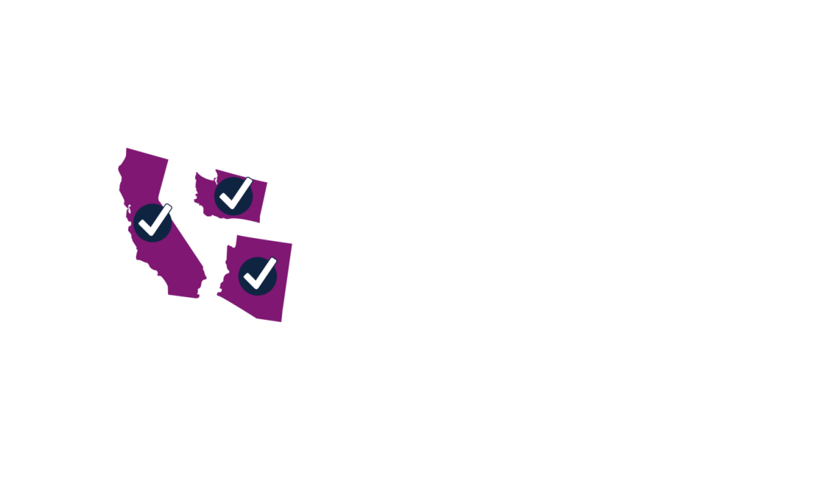
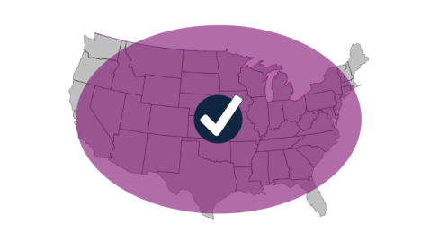

Get The Complete Volunteer Picture
1
2
The volunteer had lived in 4 counties within 3 states (CA/WA/AZ) which all came back Clear at the county/state level.
We searched our Nationwide database, OFAC Watchlist, and NSOPW Sex Offender. All came back Clear.
Then, using our proprietary technology, Arrest Direct, we located an arrest record in DuPage County, IL confirmed at the county courthouse as felony burglary.
4
We located a child
abuse conviction in
Colorado at the state level
under a maiden name.
3
RESULT: Only Arrest Direct could find the record in DuPage County because DuPage does not submit data to any Nationwide database.
RESULT: Only searching the maiden name at the local level could reveal the child abuse conviction because the crime was not recorded under the primary name.

Slide 8


ACCOUNT SET UP OPTIONS
1. Requires own 501c3
If less than a year in business, additional proof of business is required
A Dojo can now add their program as a sub
account to the CoderDojo Foundation account
No 501c3 or additional proof necessary
Each Dojo is responsible for their own billing
Account can be moved from Foundation account at anytime with 501c3 and other requirements.

Slide 9


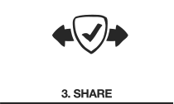

We’re Not Only Screening, We’re…
…Promoting a Culture of Volunteerism: The Fast-Pass
An organization asks a volunteer to be screened via email invitation or personalized link on their website.
Volunteers create their account and order their background check.
You get a copy and they do too.
Once the check is complete, volunteers can share their up-to-date check with other organizations on the platform.
When a check is shared, both the volunteer and the original organization can earn credits to use towards future checks.

Slide 10
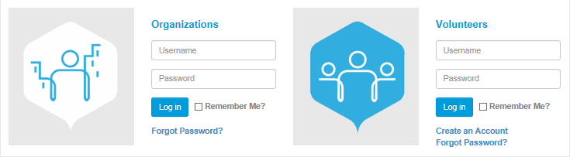
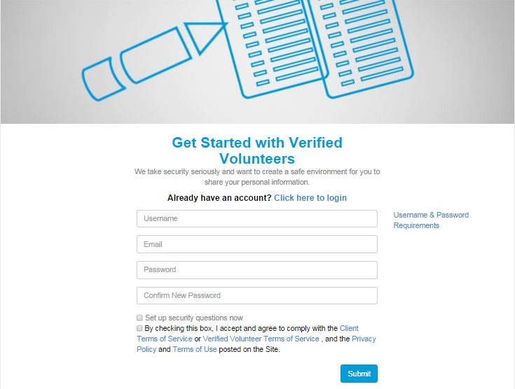

Creating a Community Dedicated to Serving Others
Our screening platform is 2-sided.

Slide 11
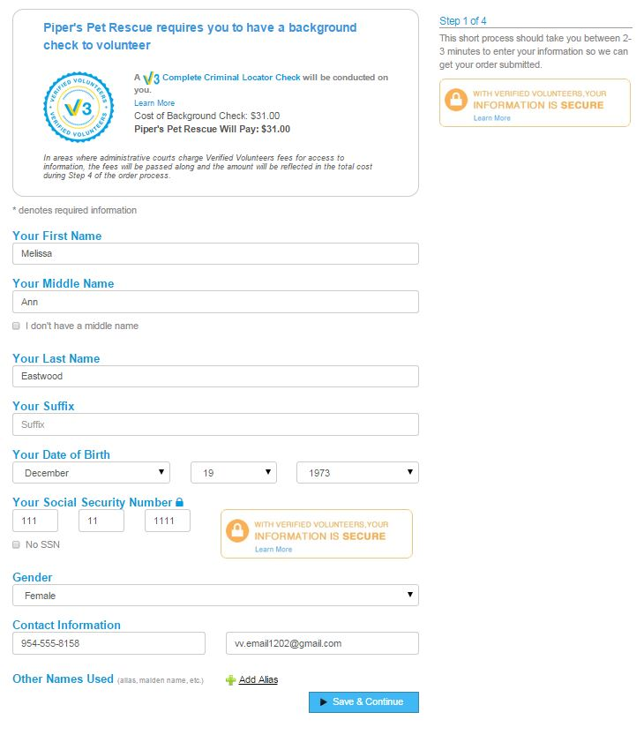
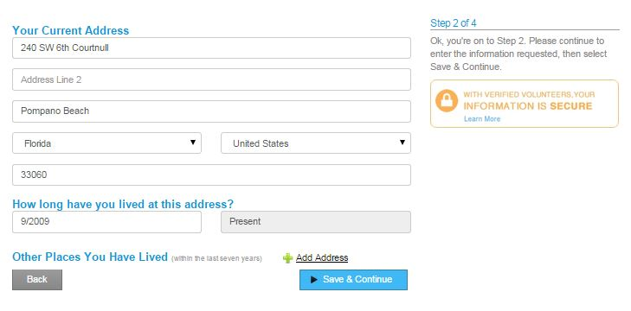
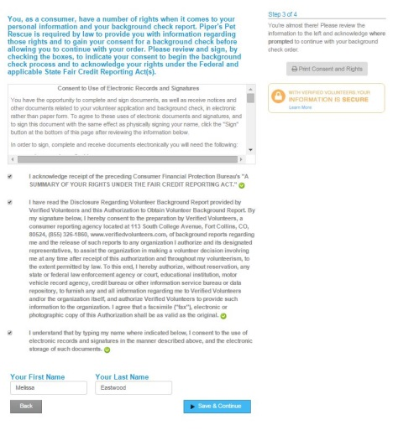

And It’s All Simple! With Our 4-Step Order Process
is all it takes!

Slide 12
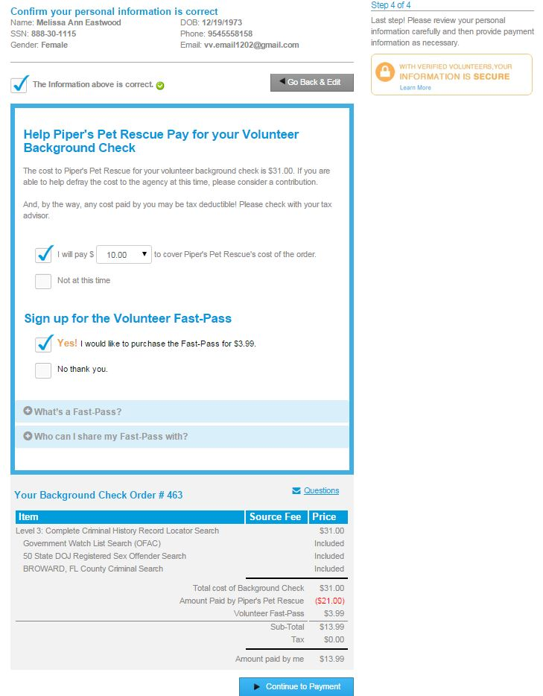




And It’s All Simple! With Our 4-Step Order Process
The final step…
Confirmation
Payment (optional)
Fast-Pass (optional)
Order Summary

Slide 13
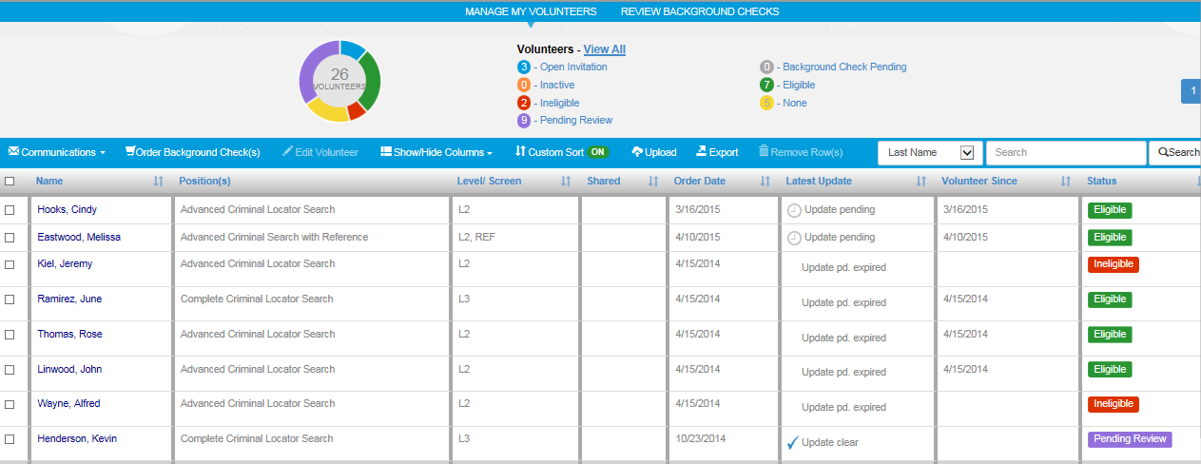
Intuitive Organization Dashboard
Screening and volunteer management made simple…

Slide 14
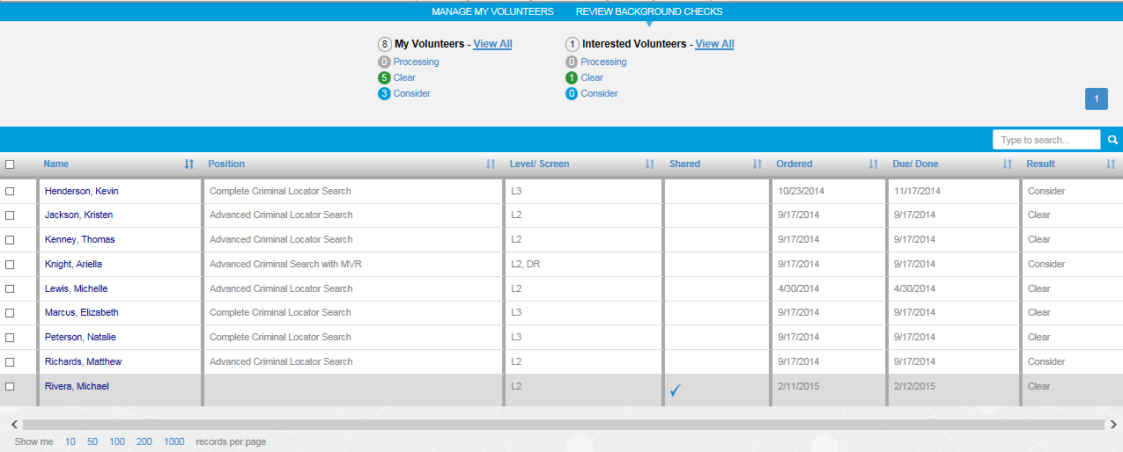
Intuitive Organization Dashboard
Organize, Filter, & Review Background Checks

Slide 15
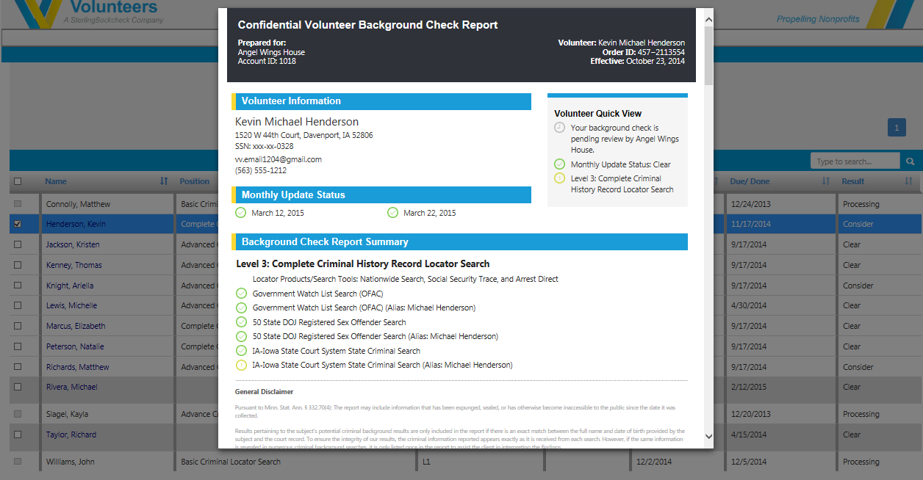
Easy-to-Read Background Check Reports

Slide 16
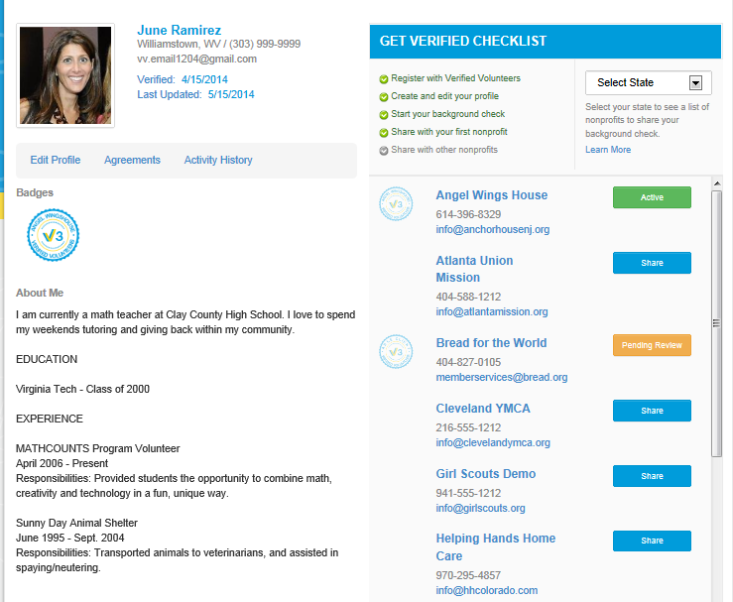

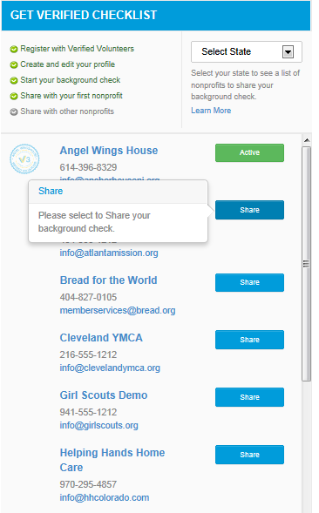

Screening Can Be Collaborative
From the volunteer profile…
Track progress
View organizations
Share check

Slide 17



































Communities Across the Country
Key community anchors
Major local volunteer programs
Religious institutions
Hospitals
School districts
City governments
Food banks
Youth sports
…and more

Slide 18

Braden Beisse
Regional Director
Verified Volunteers
503-349-2503
braden@verifiedvolunteers.com

