Slide 1
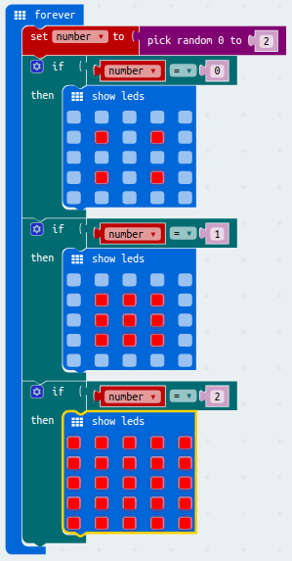
Micro:bit Pumpkin Candle
Use a Micro:bit instead of a candle to light up a pumpkin
Challenges:
Design your own light patterns to make the lights flicker like a real candle.
Add extra light patterns.

