Slide 1

Micro-bit counter
Getting started with BBC Micro-bit

Slide 2
What’s our goal?
1. Press button “A” , counter number minus 1
2. Press button “B” , counter number plus 1
3. Press button “A”、“B” together, counter number become 0

Slide 3
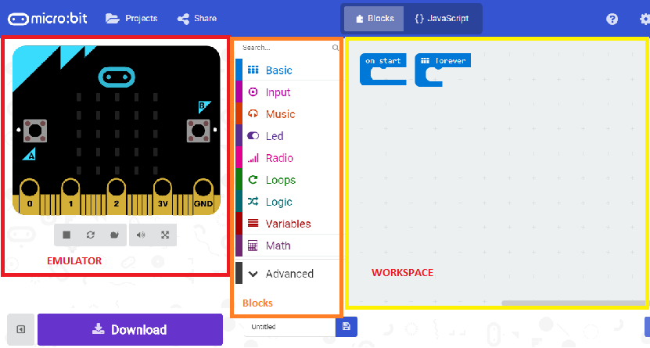
https://makecode.microbit.org/#

Slide 4
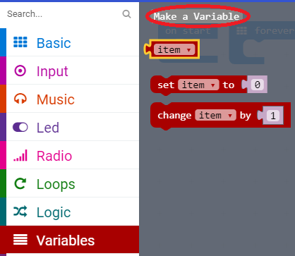

Set our counter to ZERO

Slide 5
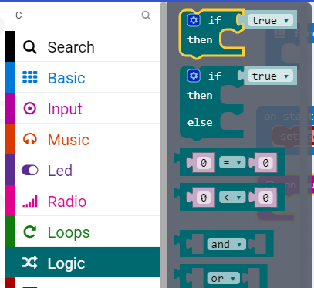
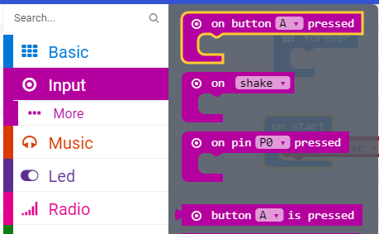
Input and decisions

Slide 6
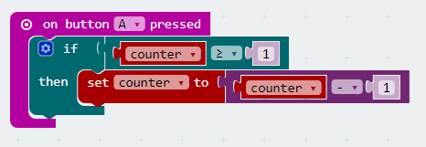
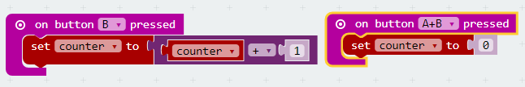
Click to count

Slide 7
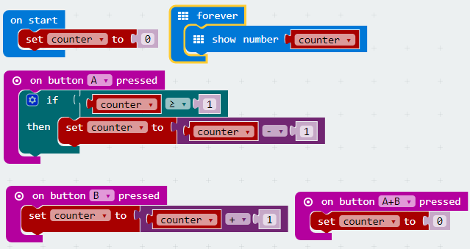
Counting forever

Slide 8
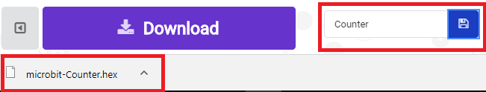
Name it and save it

Slide 9
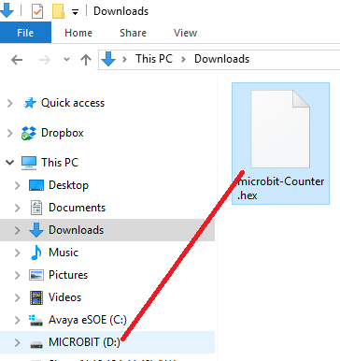
Drag it and drop it

