Slide 1

Coal Paper Scissors
Christmas fun

Slide 2
What we’ll learn
How to take user input
Make decisions
Use broadcasts

Slide 3
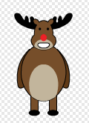
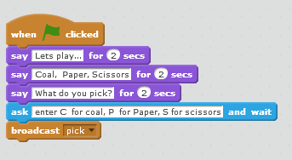
Explain the game
SAVE and TEST

Slide 4

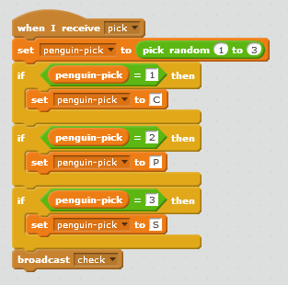
Pick up a penguin

Slide 5
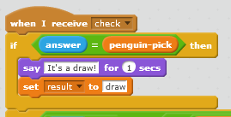
It’s a draw
SAVE and TEST

Slide 6
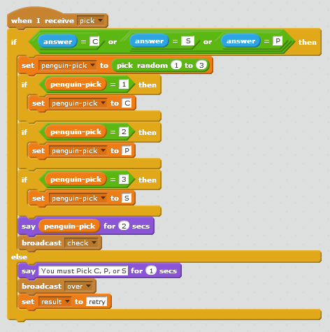
Be defensive
SAVE and TEST

Slide 7
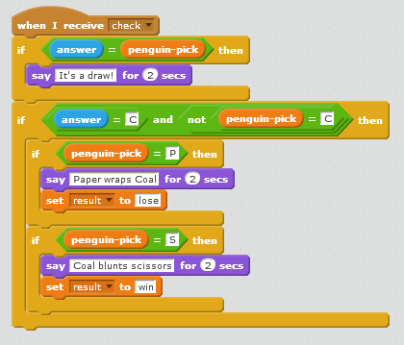
Pick coal

Slide 8
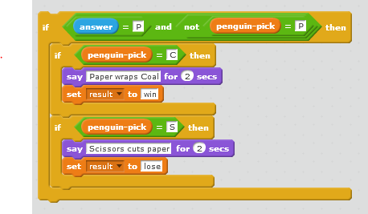
Pick rock

Slide 9
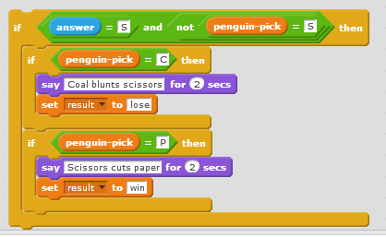
Pick scissors
SAVE and TEST

Slide 10

Call an end to it
SAVE and TEST

Slide 11
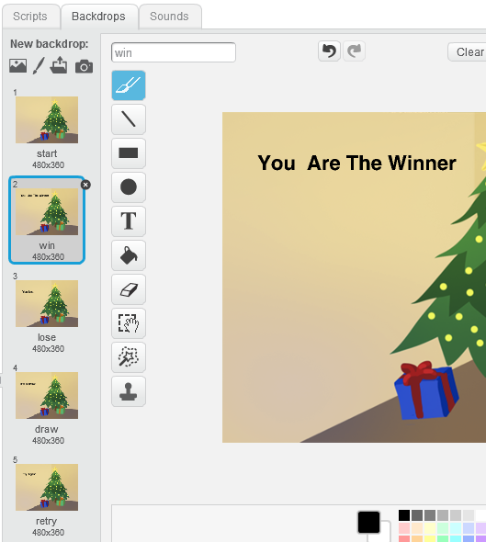
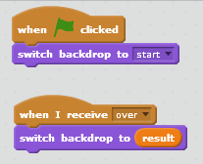
Give it the right ending
SAVE and TEST

