Slide 1

Zombie showdown
Don’t let the zombies take over

Slide 2
What’s our goal?
Create a shooter that can walk around
Create bullets our shooter can fire
Create zombies that have health

Slide 3

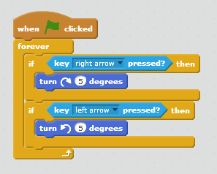
Create turning shooter
SAVE and TEST

Slide 4
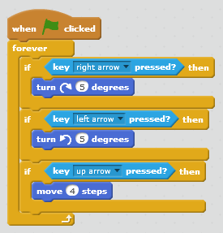
Create walking shooter
SAVE and TEST

Slide 5
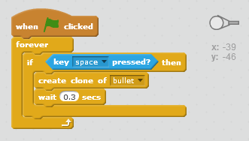

Create a bullet and clone it
Code goes on shooter
Bullet sprite

Slide 6
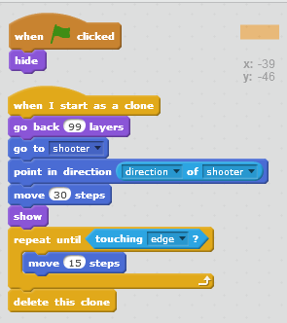
Shoot some bullets
SAVE and TEST

Slide 7

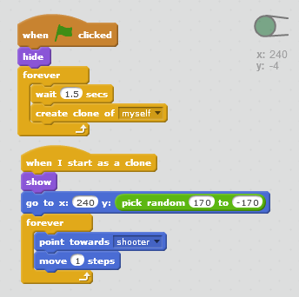
Clone some zombies
SAVE and TEST

Slide 8
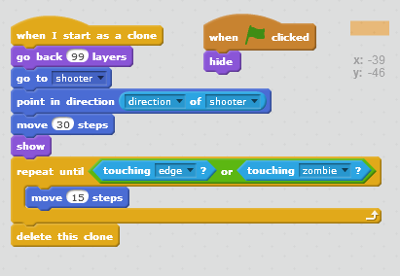
Give a hit

Slide 9
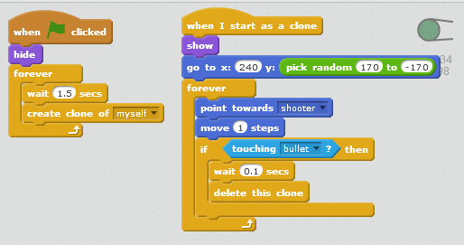
Take a hit
SAVE and TEST

Slide 10
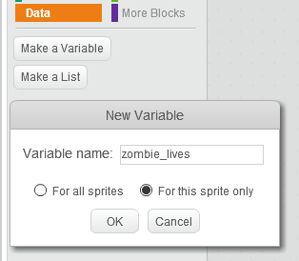
Tougher zombies

Slide 11
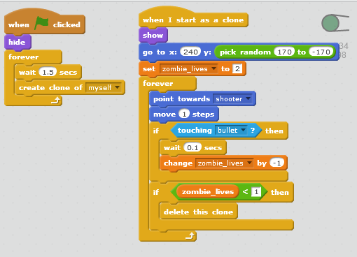
Hit’em hard
SAVE and TEST

Slide 12
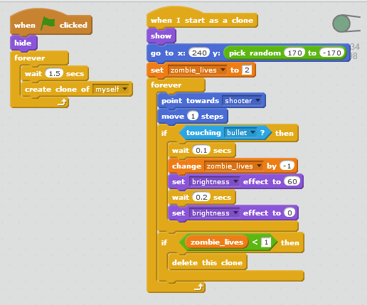
Light’em up
SAVE and TEST

Slide 13
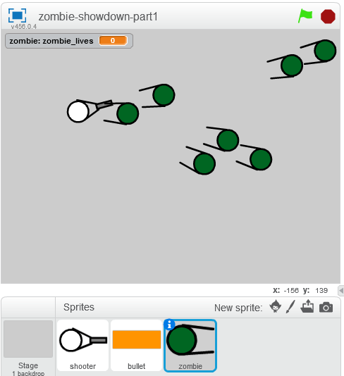
Enjoy!!!

