Slide 1
Drawing from Scratch
It’s not all about gaming

Slide 2
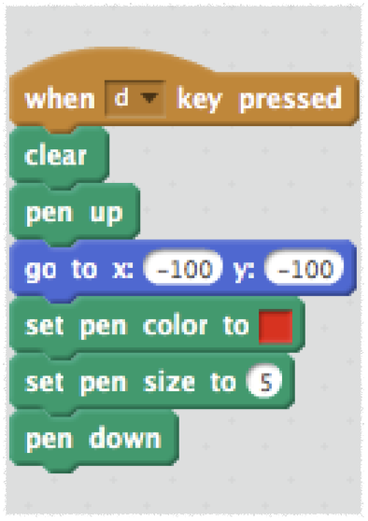
Get the set up right
Clean the board
Get in position
Get your pen ready
Go!

Slide 3
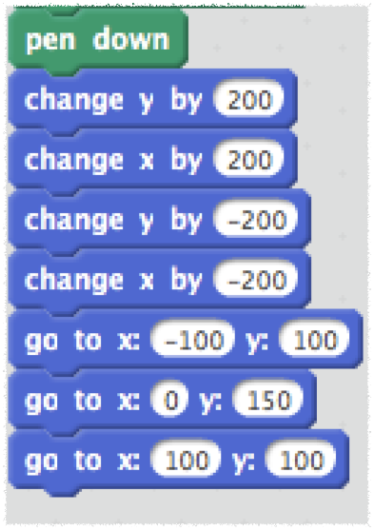
Move around
Let’s figure out what this will draw…

Slide 4
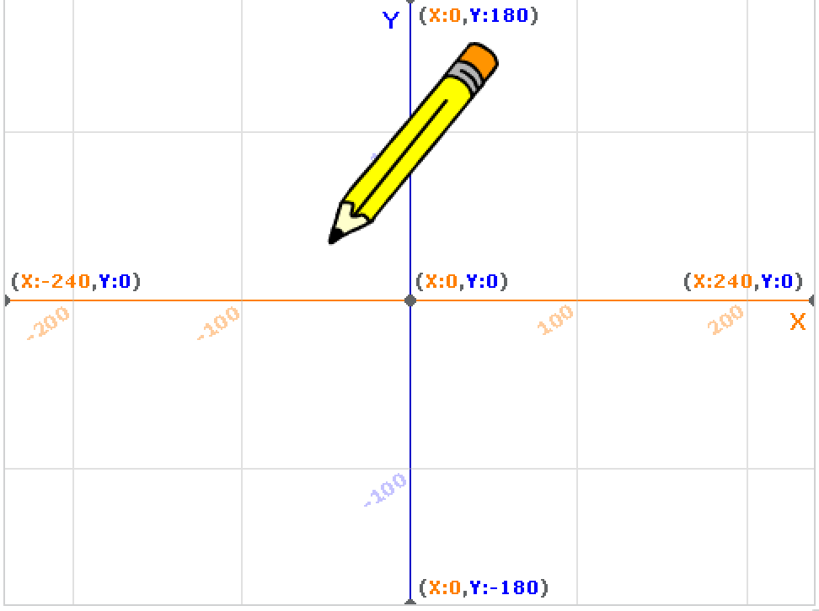

Slide 5
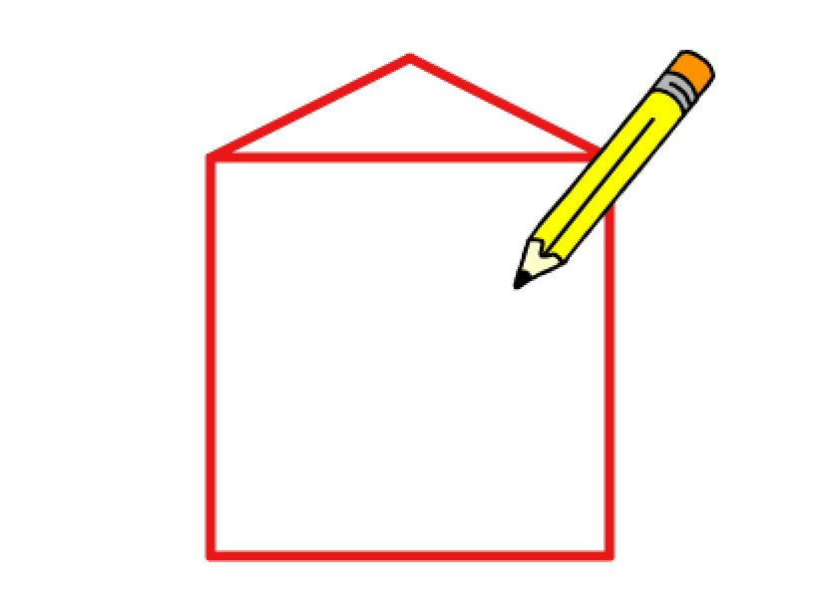

Slide 6
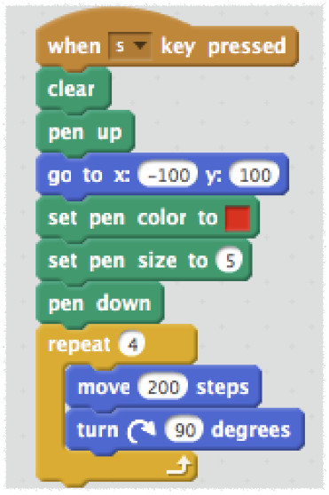
Iteration
Stop repeating yourself!
What will this draw?

Slide 7
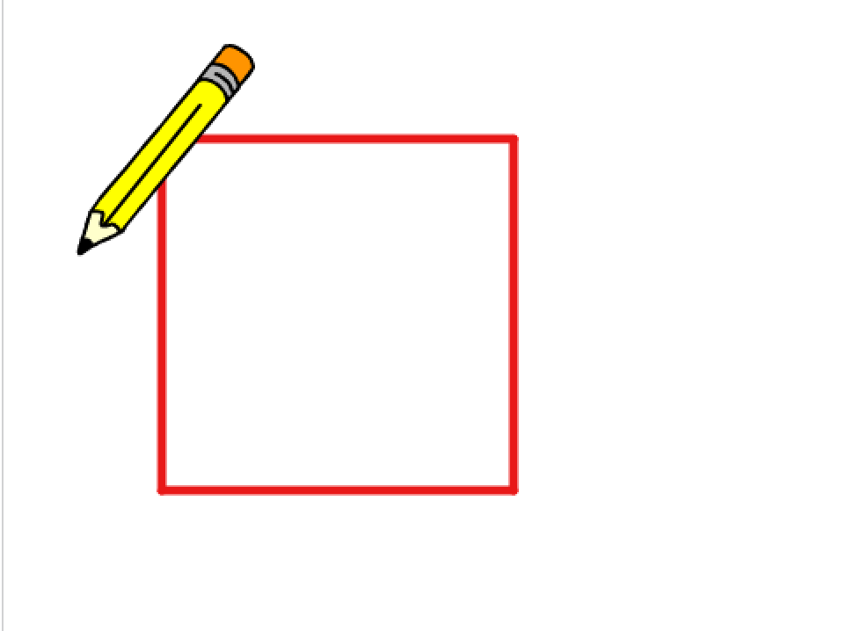

Slide 8
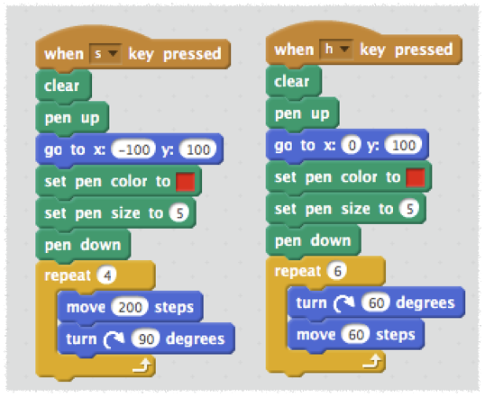
Spot the difference
Re-usable patterns

Slide 9
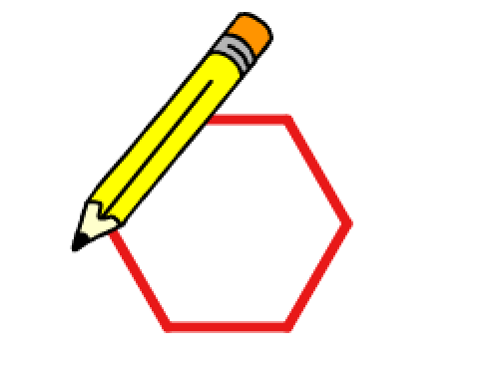

Slide 10
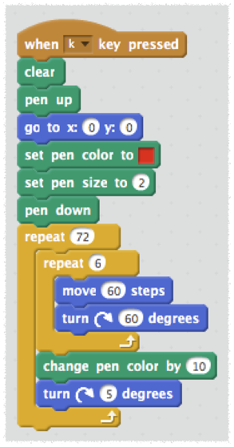
Get loopy
Loop within a loop

Slide 11
