Slide 1

Zombie showdown
Don’t let the zombies take over

Slide 2
What’s our goal?
Create a shooter that can walk around
Create bullets our shooter can fire
Create zombies that have health

Slide 3

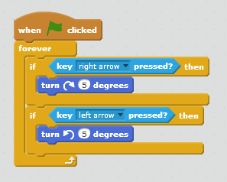
Create turning shooter
SAVE and TEST

Slide 4
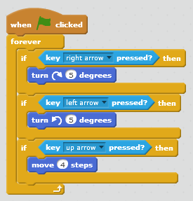
Create walking shooter
SAVE and TEST

Slide 5
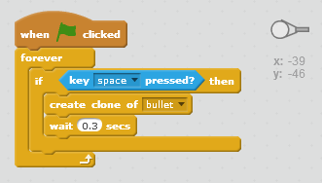

Create a bullet and clone it
Code goes on shooter
Bullet sprite

Slide 6
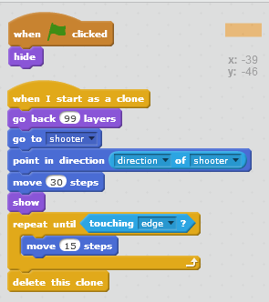
Shoot some bullets
SAVE and TEST

Slide 7
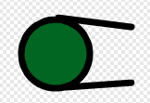
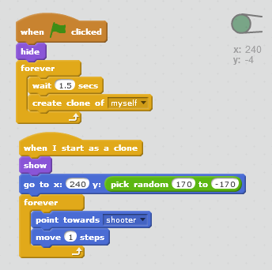
Clone some zombies
SAVE and TEST

Slide 8
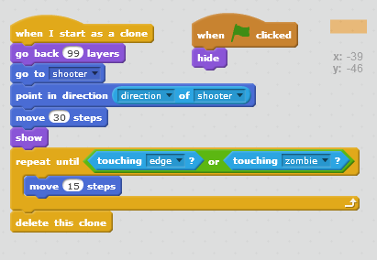
Give a hit

Slide 9
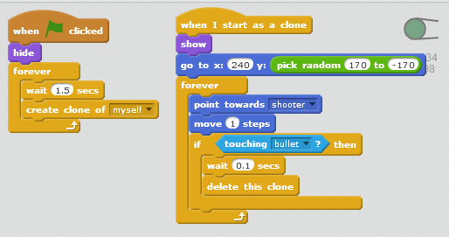
Take a hit
SAVE and TEST

Slide 10
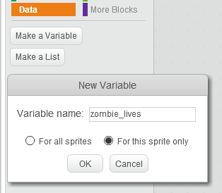
Tougher zombies

Slide 11
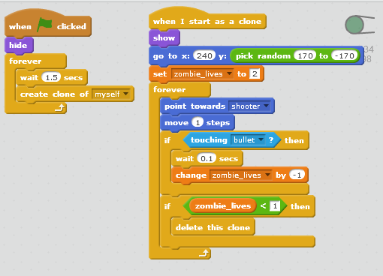
Hit’em hard
SAVE and TEST

Slide 12
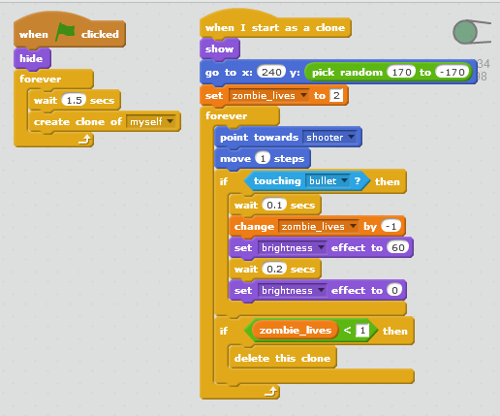
Light’em up
SAVE and TEST

Slide 13
Zombie showdown
Part 2 It’s getting serious

Slide 14

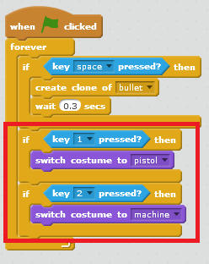
Bigger Guns

Slide 15
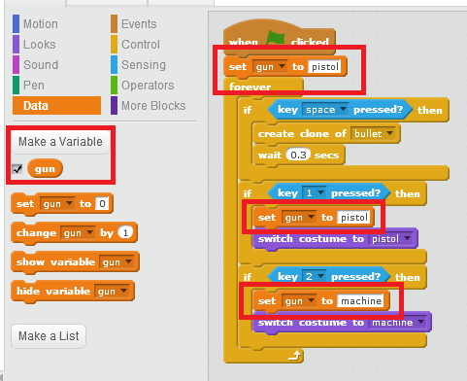
Pick a gun

Slide 16
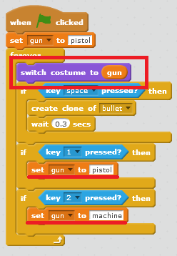
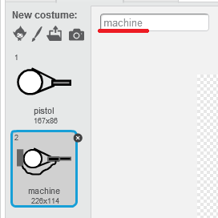
Switch gun
SAVE and TEST

Slide 17
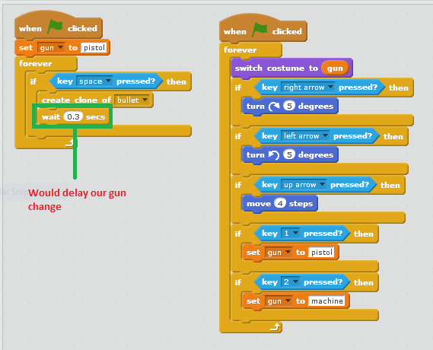
Refactor time
SAVE and TEST

Slide 18
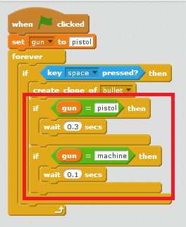
Did we say “better” gun?

Slide 19
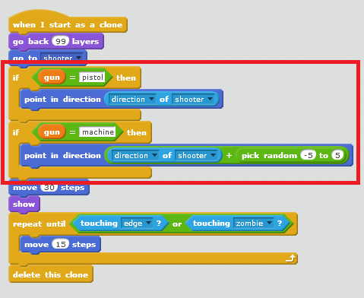
Machine gun spray
SAVE and TEST

Slide 20
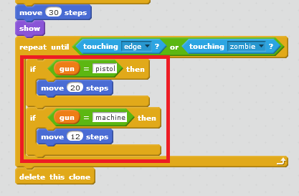
More but slower
SAVE and TEST

Slide 21
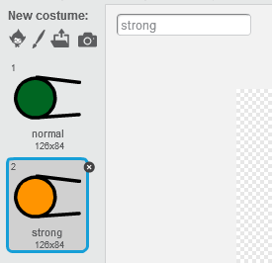
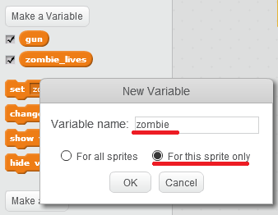
Different Zombies

Slide 22

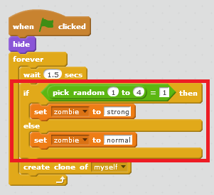
Not too many strong uns
SAVE and TEST

Slide 23
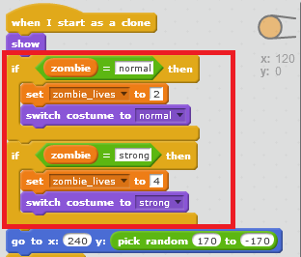
Hard to kill

Slide 24
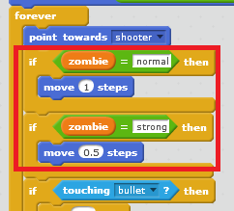
But slow to move
SAVE and TEST

Slide 25
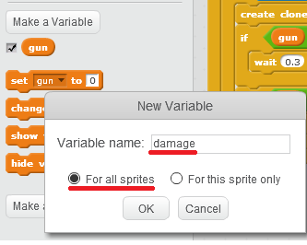
Make some damage

Slide 26
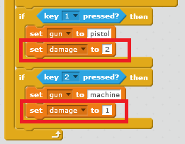
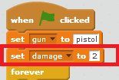
Damage that counts

Slide 27

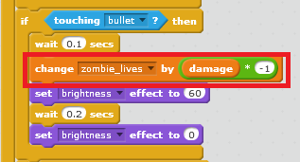
Different lives
SAVE and TEST

Slide 28
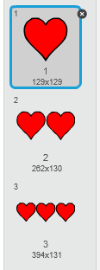
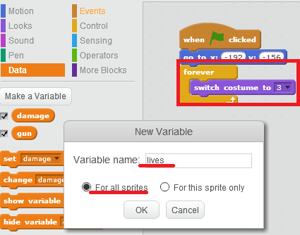
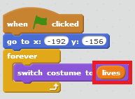
Healthy hearts

Slide 29
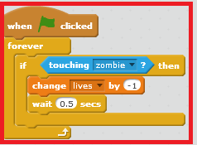
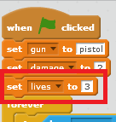
Healthy hearts
SAVE and TEST

Slide 30

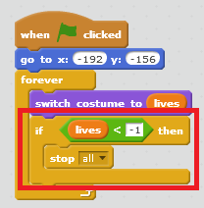
When your heart stops!
SAVE and TEST

