Slide 1
Anthony’s
Drawing Machine

Slide 2


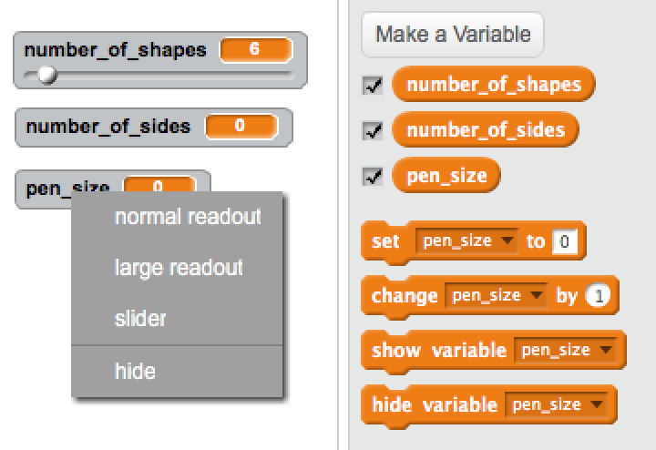


Data to draw with
Create your
variables
Right click
On a variable
And pick slider

Slide 3

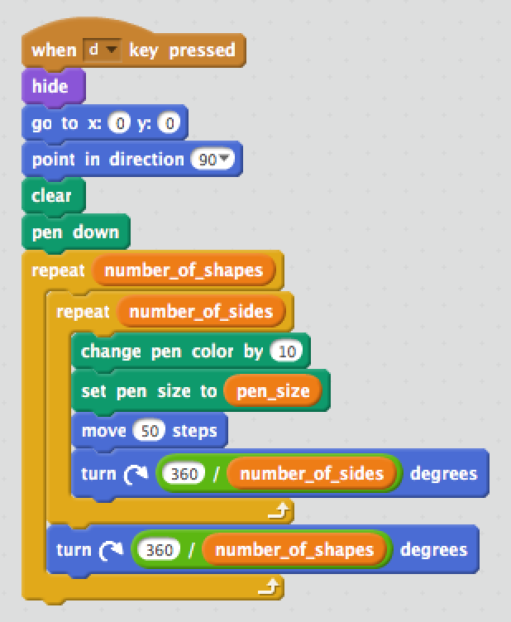





Starting position
Clear the canvas
Repeat for the number of shapes you want to draw
Repeat for the number of sides you want on your shape
Divide the a full circle (360 degrees) by the number of sides
Divide the a full circle (360 degrees) by the number of shapes

Slide 4
Special thanks to Anthony for sharing his code!

Slide 5
