Slide 1
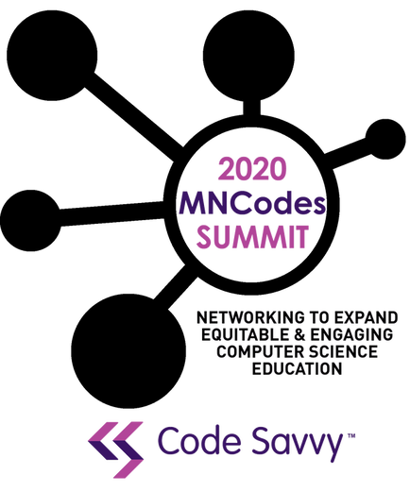

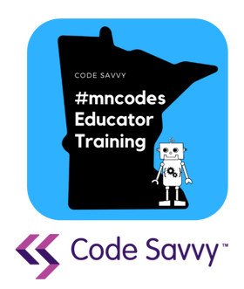
Teaching AI and Using AI to Teach
2020 MNCodes Summit
Dan McCreary November 14th, 2020

Slide 2
Summary
The AI Racing League is a new project that is attempting to introduce AI concept into students as young as 5th grade. The centerpiece of our curriculum revolves around strapping a Raspberry Pi and camera on a remote-control car body. Because they are not graceful, these cars are called “Donkey Cars.” Students learn how to “train” a neural network by driving around a racetrack. After learning to associate images with turning car the students build a program that allows a car to drive itself around a track.
AI
LET’S BUILD A NETWORK
OF PEOPLE INTERESTED
IN AI IN EDUCATION

Slide 3
Four Parts
AI in 2020: Natural Language Processing
Progress is non-linear
Discriminative vs. Generative AI
Alexnet
BERT
GPT-3
Teaching Your Students about AI
AI and Computational Thinking
Bias and Explainability
Fun interactive activities for students from 5th to 12th grade
Teachable Machine Labs
Using AI to Help You Teach
Grammarly
Intelligent Autocomplete
Lesson Plan Generation
AI Teaching Assistants
Recommending learning content
Predicting student success

Slide 4
AI and Computational Thinking
decomposition - breaking down a complex problem or system into smaller, more manageable parts
pattern recognition – looking for similarities among and within problems
abstraction – focusing on the important information only, ignoring irrelevant detail
algorithms - developing a step-by-step solution to the problem, or the rules to follow to solve the problem
explainability - can a computer explain why it took a specific action or made a specific recommendation?
bias - is the result of the suggestion made by a computer skewed in a direction that makes it unfair to a group of people?
Code
AI
https://www.coderdojotc.org/CoderDojoTC/beginning-concepts/

Slide 5
AI, Machine Learning and Data Literacy
AI
Machine Learning
Classical
”Programming”
Data Literacy
Learning to Code
Understanding the machine learning branch of AI is build not just on programming, but also on data literacy

Slide 6
Four AI Stories
The AI Winter
Alexnet
BERT
GPT-3

Slide 7
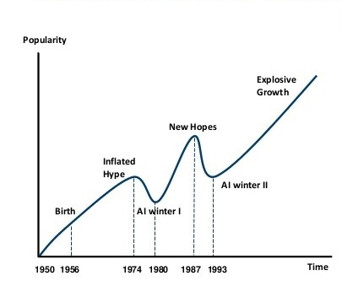
AI Progress in Not Linear
Progress in AI is not linear
Not a straight line
Frequent large “jumps” in capabilities
In 2020 we have seen a huge jump in Natural Language Processing

Slide 8
Discriminative vs. Generative
Discriminative – discriminates between classes of items
Example: Photos of Cats vs. Dogs
Only needs to understand the “borders” between items
Generative – can generate examples
Given a short description of a lesson plan, generate the details of the lesson plan

Slide 9

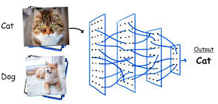

Alexnet 2012
Alexander Krizhevsky
Image classification using neural networks
Innovation: Using GPUs to train a deep neural network
Geoffrey Hinton
https://en.wikipedia.org/wiki/AlexNet

Slide 10
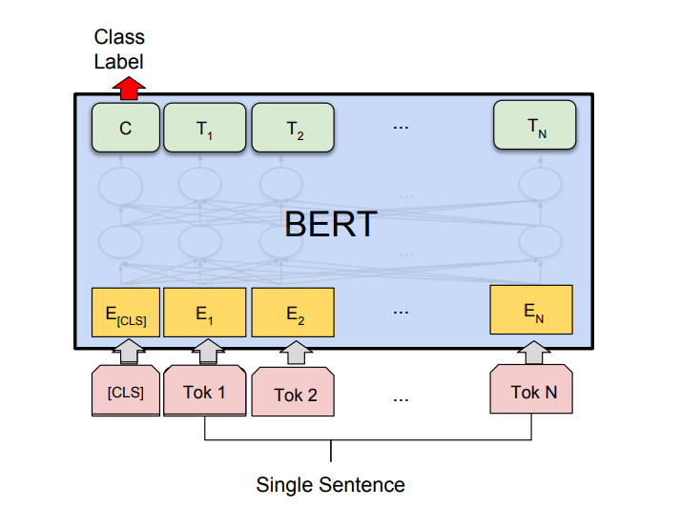
BERT 2018
Bidirectional Encoder Representations from Transformers
Builds large neural networks that are trained on massive amounts of text (Wikipedia, novels, fan fiction)
Predicts the next word given the prior context
Intelligent autocomplete
Key innovation: Vector Space Model
https://en.wikipedia.org/wiki/BERT_(language_model)
https://en.wikipedia.org/wiki/Vector_space_model

Slide 11
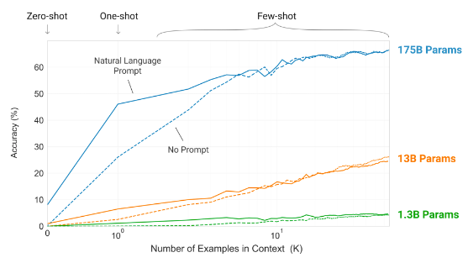
GPT-3 (2020)
Generative Pre-trained Transformer
Large leap in generative programming
First strong example of general AI
Generates stories, answers complex questions about text, generates code
Key innovation: scale
$10M to build the model
But can it generate detailed lesson plans?

Slide 12
Teaching AI
No Coding examples that focus on visual learning
Google’s Teachable Machine
Neural Network Flashcards
TensorFlow Playground
Object recognition (part of AI Racing League)
Coding Examples
Requires basic python
Jupyter notebooks
Open Computer Vision
Image classification MNIST
AI Racing League
Virtual activities possible
Post COVID: Requires hardware ($300/car + classroom GPU)
Fun activities for teachers, mentors and students
5th Grade to 12th Grade
9th Grade to 12th Grade
https://teachablemachine.withgoogle.com/

Slide 13
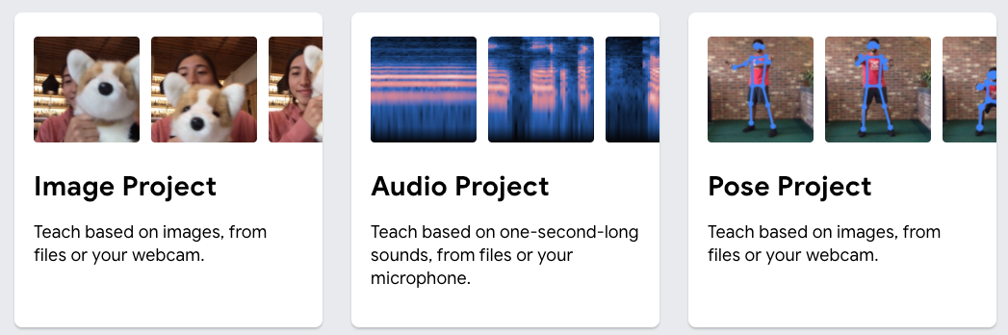
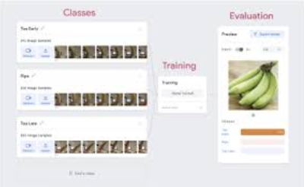
Teachable Machine
No-code way to learn how AI classifies images, sound or dance poses
Requires a camera for image classification
Excellent way to learn many AI concepts
Classification
Training
Bias
https://teachablemachine.withgoogle.com/

Slide 14
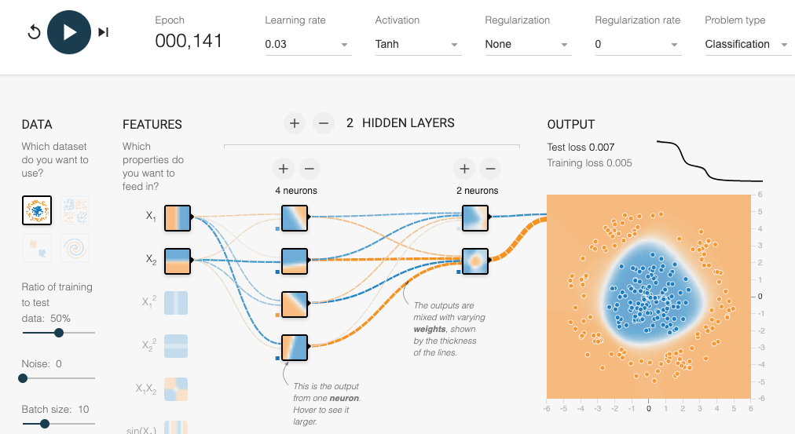
TensorFlow Playground
Fun way to visualize neural networks
https://playground.tensorflow.org/

Slide 15
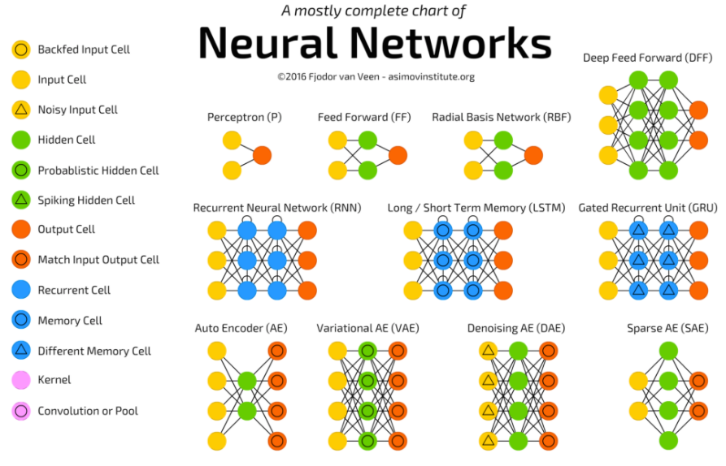
Neural Network Flashcards
Students learn about the different components of a neural network
Colorful cards for various network types
Parameter counting exercises
https://towardsdatascience.com/the-mostly-complete-chart-of-neural-networks-explained-3fb6f2367464

Slide 16
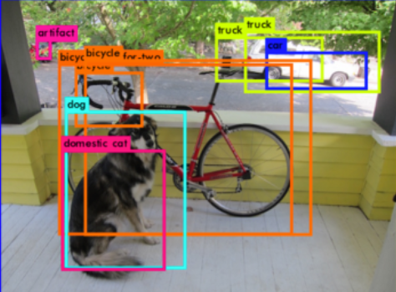
Object Detection
Requires a current Raspberry Pi or NVIDIA Nano ($60) and camera ($20)
Objects can be classified in real time from any video source
Fun to see what items can be recognized and if the students can “fool” the algorithm

Slide 17
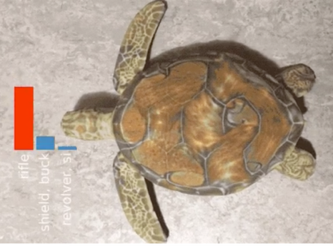
The Adversarial Turtle
Use a 3D printer to print a turtle
Place different “textures” on the shell
Most image recognition algorithms fail
On CNNs: “On a very fundamental level, our work highlights how far current CNNs are from learning the 'true' structure of the world”
rifle
99% of modern image recognition is just simple (but precise) texture matching
https://www.theverge.com/2017/11/2/16597276/google-ai-image-attacks-adversarial-turtle-rifle-3d-printed

Slide 18
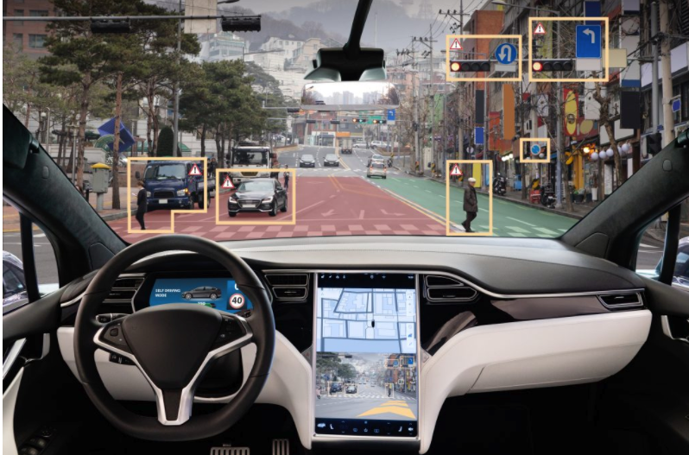
Six Levels of Self-Driving Cars
Level 0: The automated system issues warnings and may momentarily intervene but has no sustained vehicle control.
Level 1 ("hands on"): The driver and the automated system share control of the vehicle
Level 2 ("hands off"): The automated system takes full control of the vehicle: accelerating, braking, and steering
Level 3 ("eyes off"): The driver can safely turn their attention away from the driving tasks
Level 4 ("mind off"): As level 3, but no driver attention is ever required for safety, e.g. the driver may safely go to sleep or leave the driver's seat
Level 5 ("steering wheel optional"): No human intervention is required at all on all roads all over the world, all year around, in all weather conditions
https://en.wikipedia.org/wiki/Self-driving_car#Classification

Slide 19
Our Brains are Graphs
100B neurons
10K Connections per neuron (degree)

Slide 20
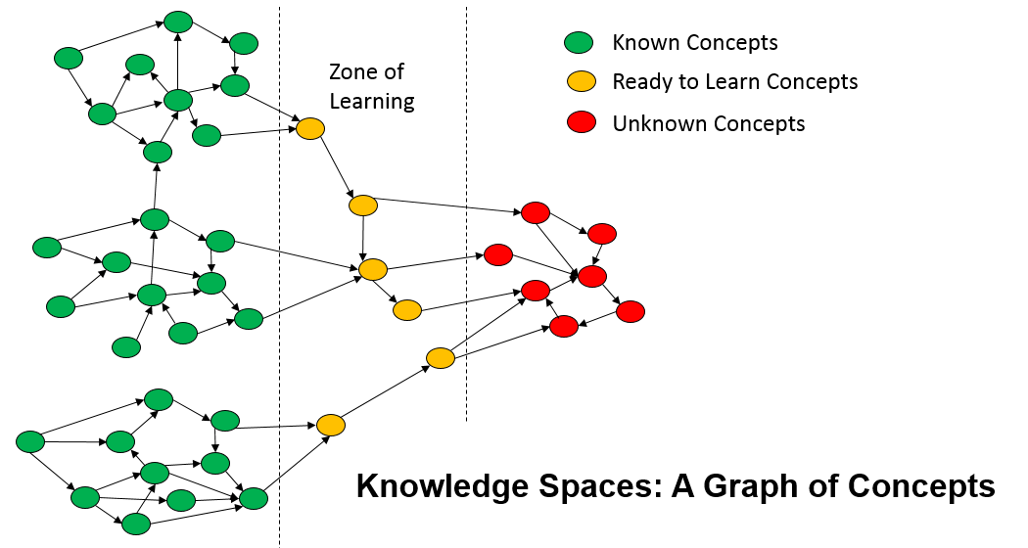
Can we Recommend Learning Content?
More than a search engines
Understands the context of the student
What to they already know
What are their goals
What resources have similar student liked in the past?
In many countries, privacy concern block many options
https://dmccreary.medium.com/lost-in-knowledge-space-14be123ea083

Slide 21
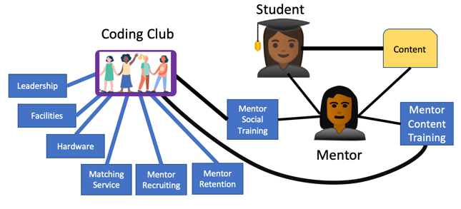
Can we Predict Student Success?
Student success data model:
Predictive function:
Predicting student success depends on having a graph of prior data of online coding experiences

Slide 22
Evolution of Online Learning
Autonomous
AI-Learning
Optimized
AI-Agent
Predictable
Recommendation-Driven
Defined
Concept-Driven
Managed
Coordinated
Initial
Formative
A capability-maturity model for online mentoring
https://medium.com/@dmccreary/how-online-coding-clubs-will-transform-education-550faccff1f
Notes:
https://medium.com/@dmccreary/how-online-coding-clubs-will-transform-education-550faccff1f

Slide 23
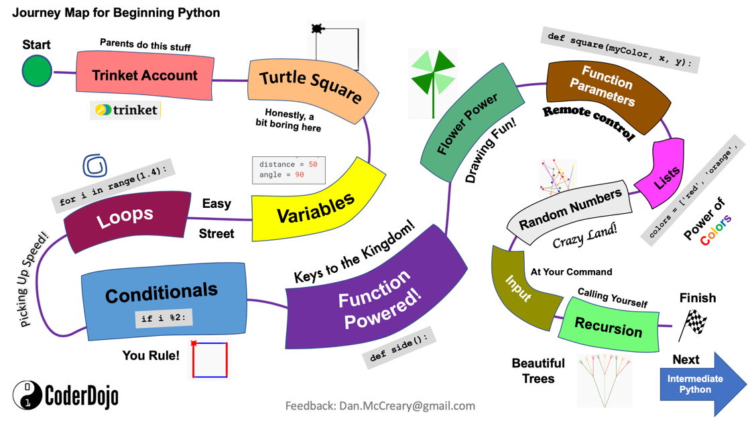

Slide 24
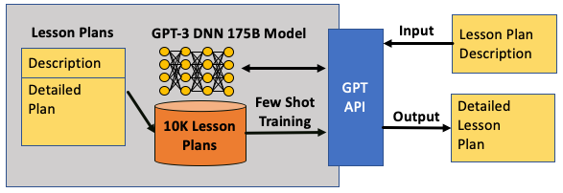
Can GPT-3 Generate a Lesson Plan?
Answer – probably yes, if we had enough training data
Ideally, we would have 10,000 lesson plans to train our model
https://dmccreary.medium.com/using-al-to-generate-detailed-lesson-plans-29a5af200a6a

Slide 25

Three Eras of Computing
1) Procedural Era
Data
Programs
Answers
Procedural Code (Rules)
Explanations (Why)
2) Machine Learning Era
Data
Machine
Learning
Rules (10M weights)
Answers
3) Knowledge Graph Era
Data
Knowledge
Answers
Machine
Learning
Explanations (Why)

Slide 26
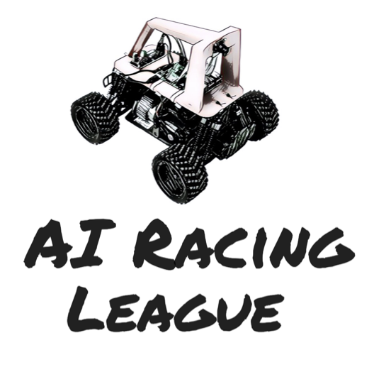
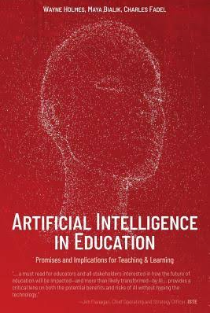
Resources
AI Racing League Web Site
https://www.coderdojotc.org/ai-racing-league
Artificial Intelligence in Education: Promises and Implications for Teaching by Charles Fadel, Maya Bialik, and Wayne Holmes

