Slide 1
The Evolution of Online Learning
How AI Will Drive Online Experiences
Jumpstart – August 29th, 2020
Dan McCreary
Distinguished Engineer

Slide 2
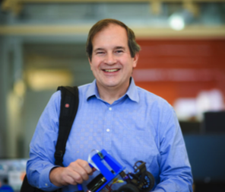
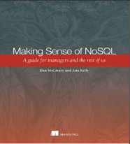
Hello, my name is
Dan
Distinguished Engineer in AI and Graph Technologies at Optum’s Advanced Technology Collaborative
Optum is part of United Health Group (Fortune 5)
300K+ employees (48,000 IT employees)
Co-founder (with Tony Shaw) of the NoSQL Now! conference (now part of Dataversity’s Database Now! conferences)
Co-author of "Making Sense of NoSQL" (with Ann Kelly)
Background in Solution Architecture
Interest in cognitive bias in database selection
Cofounder: AI Racing League
Active participant in CoderDojo Twin Cities
Disclaimer: All opinions are my own and may not reflect the views of my employer
Notes:
My background is a solution architect. I have spent most of the last 20 years understanding how to objectively match business problems to the appropriate technologies. My focus has been on the fast-evolving area of NoSQL databases. I have also had a strong interest in AI, semantics, natural language process and search.

Slide 3
Key Questions
What are the key stages of online learning?
What data and AI skills do I need to help schools move online?
What are the challenges of learning today?
What are knowledge spaces?
How can technology make learning easier?
What is adaptive learning?
How can recommendation engines help?
How will NLP and intelligent agents transform education?

Slide 4
Six Levels of Self-Driving Cars
Level 0: The automated system issues warnings and may momentarily intervene but has no sustained vehicle control.
Level 1 ("hands on"): The driver and the automated system share control of the vehicle
Level 2 ("hands off"): The automated system takes full control of the vehicle: accelerating, braking, and steering
Level 3 ("eyes off"): The driver can safely turn their attention away from the driving tasks
Level 4 ("mind off"): As level 3, but no driver attention is ever required for safety, e.g. the driver may safely go to sleep or leave the driver's seat
Level 5 ("steering wheel optional"): No human intervention is required at all on all roads all over the world, all year around, in all weather conditions
https://en.wikipedia.org/wiki/Self-driving_car#Classification

Slide 5
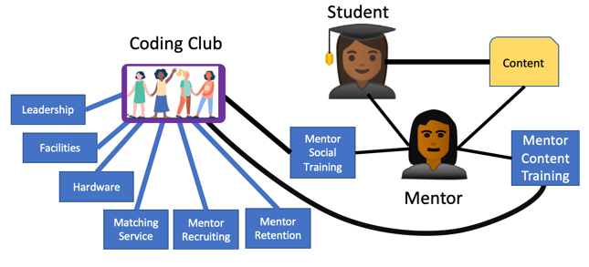
Can we predict student success?
Student success data model:
Predictive function:
Predicting student success

Slide 6
Evolution of Online Learning
Autonomous
AI-Learning
Optimized
AI-Agent
Predictable
Recommendation-Driven
Defined
Concept-Driven
Managed
Coordinated
Initial
Formative
A capability-maturity model for online mentoring
https://medium.com/@dmccreary/how-online-coding-clubs-will-transform-education-550faccff1f
Notes:
https://medium.com/@dmccreary/how-online-coding-clubs-will-transform-education-550faccff1f

Slide 7
Skills Necessary
Python and Computational Thinking
Data Literacy – how to find and analyze large datasets for training AI models
Data Science – probability and statistics, linear algebra
Data Structures – graph!
Databases – transactions, analytics, reporting
Knowledge representation – Labeled Property Graph
Web and user experience – changes every 18 months
React and Google Material components
Machine Learning – PyTorch
Distributed Graph - TigerGraph

Slide 8
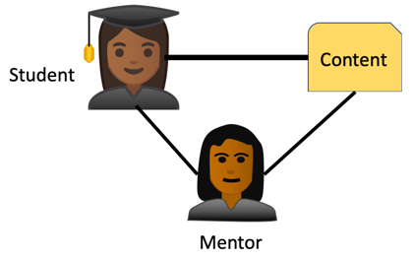
Level 1: Initial Formative Online Coding Club
Autonomous
AI-Learning
Learning Goals:
Scratch
Python
Robots
Optimized
AI-Agent
Predictable
Recommendation
Driven
Mentoring Experience:
Java
Python
Web
Defined
Concept-Driven
Online training with mentors
Use zoom to work with students
Manual matching of a student’s preferences with a mentor’s background
Assignments given and reviewed by mentors
Managed
Coordinated
Initial
Formative

Slide 9
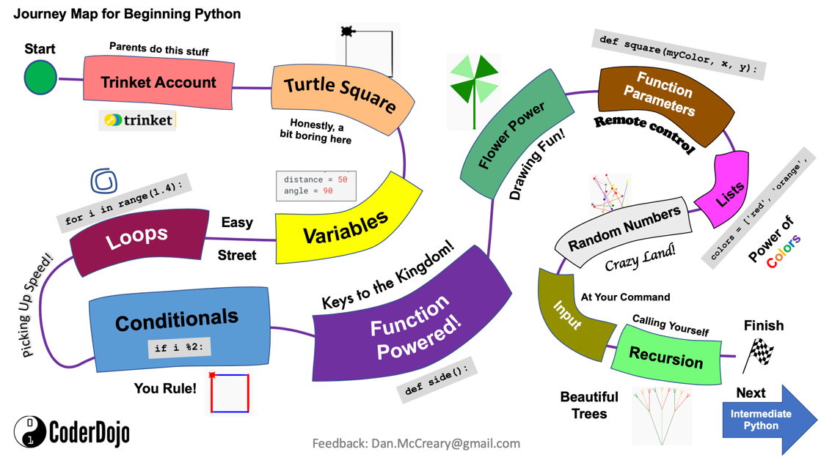

Slide 10
Level 2: Managed Coordinated
Autonomous
AI-Learning
We recommend that Alice has a mentoring session with Lisa on Robots.
S
M
S
M
Optimized
AI-Agent
S
M
Predictable
Recommendation
Driven
Students
Mentors
T
T
Defined
Concept-Driven
T
Topics
Managed
Coordinated
Many student interests, many mentors, many topics
Sophisticated matching process based on constraint optimization algorithm
Successful outcomes tracked and used for future student-mentor matching
Initial
Formative

Slide 11

Level 3: Defined Concept Driven Learning
Ready to Learn Concepts
Student
Learning Goals
Autonomous
AI-Learning
Known Concepts Graph
Optimized
AI-Agent
Predictable
Recommendation
Driven
Learning
Content
Lesson
Defined
Concept-Driven
Mentor
Concept graphs created for both students and mentors
Students express their learning goal concepts - the concepts they want master, and we track what contents they need to learn to
Manual processes and simple deterministic rules match content with mentors
Managed
Coordinated
Initial
Formative

Slide 12

Level 4: Predictable Recommendation Driven
Autonomous
AI-Learning
Known Concepts
Ready to Learn
Goal Concepts
Optimized
AI-Agent
Predicted best matches
AI Agent
Predictable
Recommendation
Driven
Learning
Content
Lesson
Defined
Concept-Driven
Mentor
Managed
Coordinated
We have a large a stable graph database of our concept, their dependencies, our students, their goals, and their existing knowledge
We use machine learning to match content and mentors
Initial
Formative

Slide 13

Level 5: Optimized AI-Agent Driven
Autonomous
AI-Learning
I can’t figure out this problem!
Try using the debugger and look at the index value on line 25
I am here if you need me
Optimized
AI-Agent
Predictable
Recommendation
Driven
Defined
Concept-Driven
Student
Agent
Mentor
Managed
Coordinated
Introduction of AI-backed chatbots for narrow domain problems
Trained on learning management clickstream data and question/answer pairs of millions of learning sessions
Human mentors added when needed
See: Open AI’s GPT-3
Initial
Formative

Slide 14
Level 6: Fully Autonomous AI-Learning Agent Clubs
Autonomous
AI-Learning
Optimized
AI-Agent
Predictable
Recommendation
Driven
Defined
Concept-Driven
An extensive and well-connected knowledge graph that is used to train an online learning agent
Learning agent has access to all concept graphs, content, and access to billions of chats between students and mentors
Strong general AI capabilities
The agents will understand common sense and are responsive to the individual needs of students down to recommending specific slides in a presentation, particular fragments of code, and even suggest particular discussion topics with mentors or other students (with mutual consent)
Managed
Coordinated
Initial
Formative

Slide 15
Role of Teacher and Mentor
Weight on
Student
Success
Level 0
Level 1
Level 2
Level 3
Level 4
Level 5
The relevance of the teacher and mentor in predicting student success will drop as the automation increases

Slide 16
Challenges
Putting reusable online content online is hard
Access to private student information
Student records privacy and portability between computer systems
Who will rate online content?
Will learning content ratings be manipulated by pollical processes?

Slide 17
Positive Impact for Society
Wikipedia model: free to everyone
Lower cost of education
Learning should be offered free – just like public schools and public libraries
Everyone will have equal access to high-quality education

Slide 18
Thank You!
Dan.McCreary@gmail.com
https://www.linkedin.com/in/danmccreary/

